Slide 1
The Chris Tarrant problem
Colin beveridge
Mathsjam conference, november 2013

Slide 2
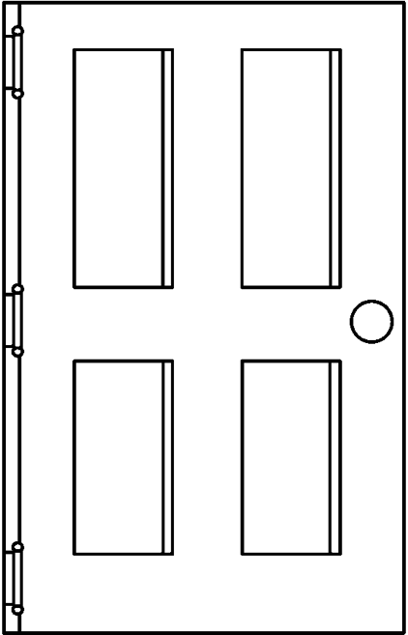
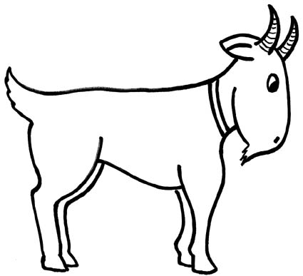
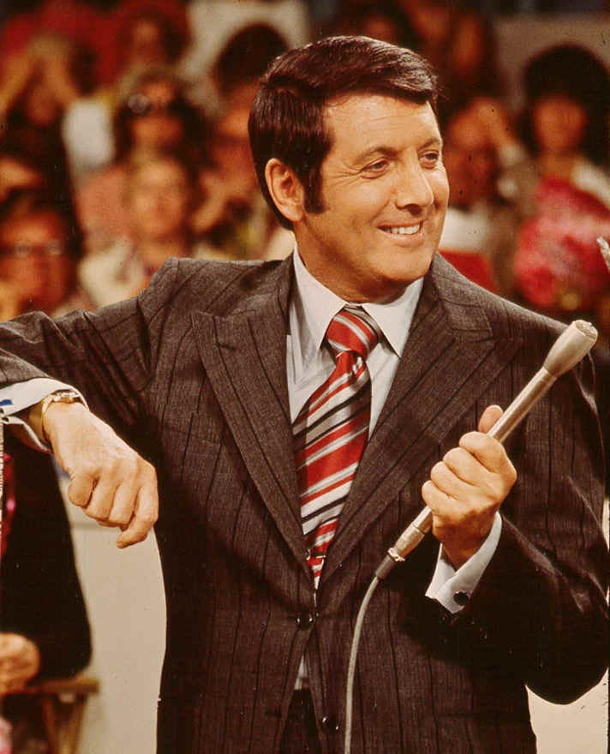
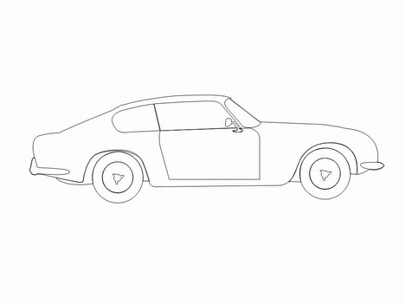
The monty Hall problem

Slide 3
Pick a door…

Slide 4
Pick a door…
Do you stick or do you switch?

Slide 5

Spoiler alert

Slide 6
Spoiler alert
If you were right (1/3), it’s correct to stick.
If you were wrong (2/3), it’s correct to switch.
You should switch.

Slide 7

The chris tarrant problem

Slide 8
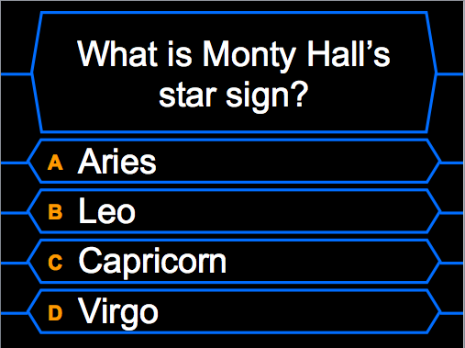
The £64,000 question

Slide 9
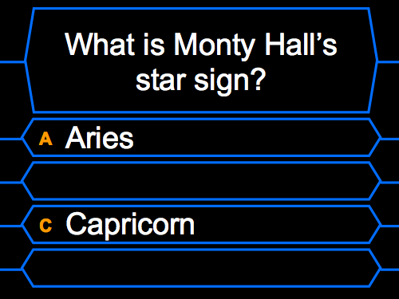
Use your lifelines!

Slide 10
Stick or switch?
Is this any different to the Monty Hall problem?

