Slide 1
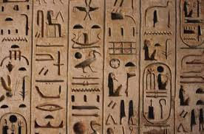
Excelling at Maths
Part 3 of the ancient Egypt trilogy

Slide 2
The mathematical requirements for even the most developed economic structures of antiquity can be satisfied with elementary household arithmetic that no mathematician would call mathematics
Otto Neugebauer
The Exact Sciences in Antiquity

Slide 3
Practiced scribes must have developed a degree of mathematical intuition, but the idea of pursuing this as an end in itself – to create the subject of mathematics – did not occur to them
Barry Kemp
Ancient Egypt – Anatomy of a Civilization

Slide 4
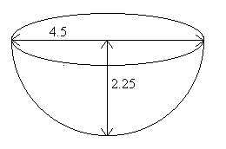

Slide 5
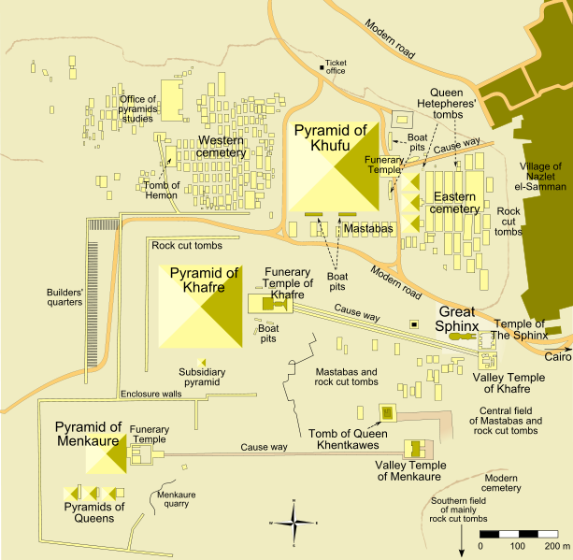
Notes:
The map of the Giza plateau shows how accurately the pyramids were built.
The sides of the pyramids are almost exactly aligned to the four cardinal points.
They are almost perfectly square.
The bedrock has also been flattened so that it is almost perfectly flat.
There are three pyramids at Giza, each of which shows the same level of accuracy.
Whatever method the Egyptians used they could replicate it.

Slide 6
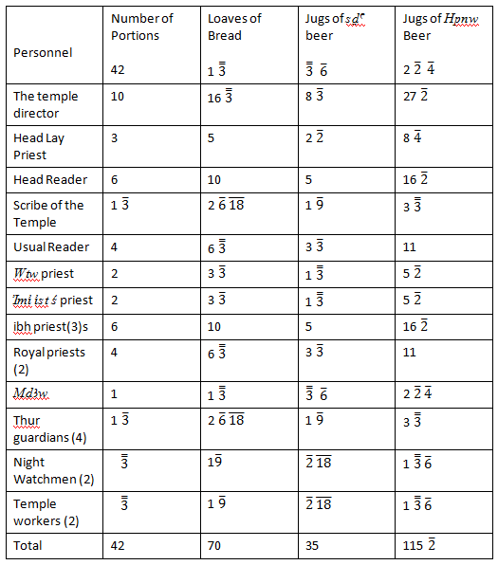

Slide 7
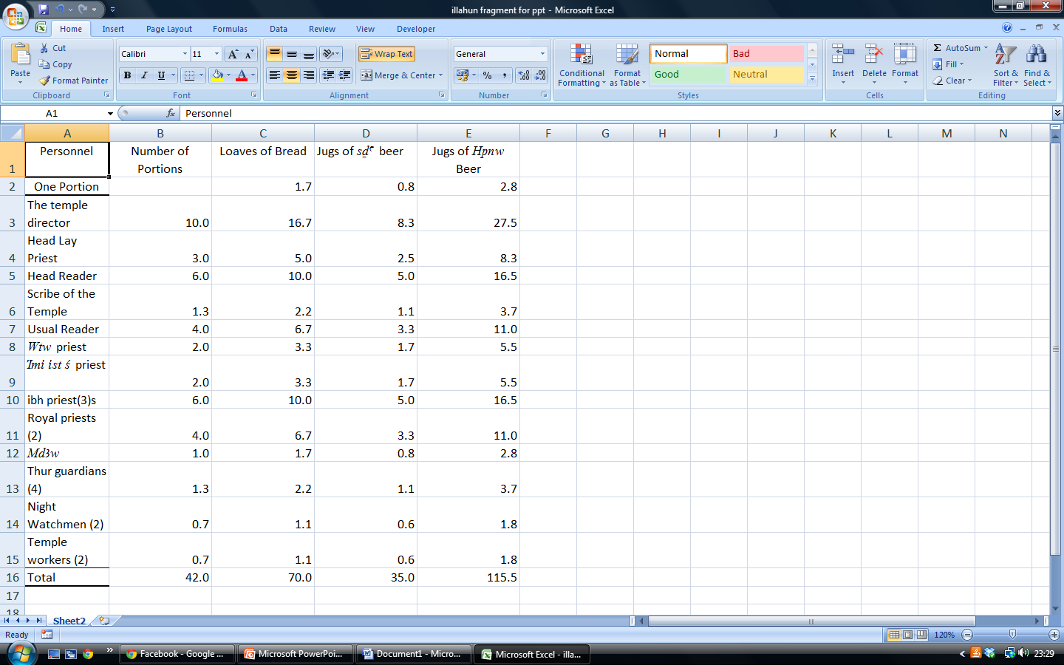

Slide 8
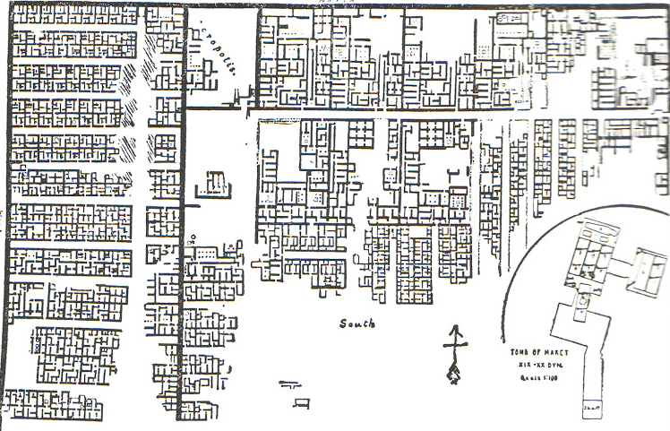

Slide 9
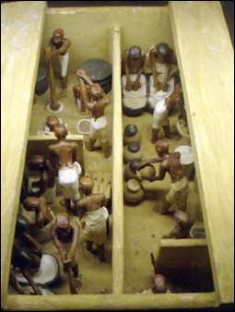
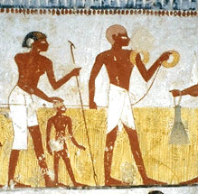

Slide 10
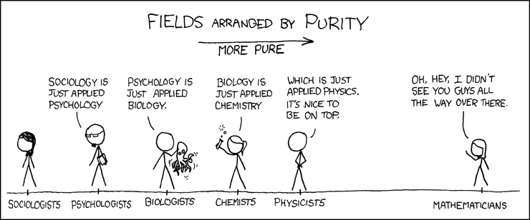

Slide 11
Maths
What is the minimum requirement
What are the 3 most desirable features

