Slide 1
Why John Buridan (c. 1300 – after 1358) should be remembered for more than cruelty to animals
Tony Mann

Slide 2
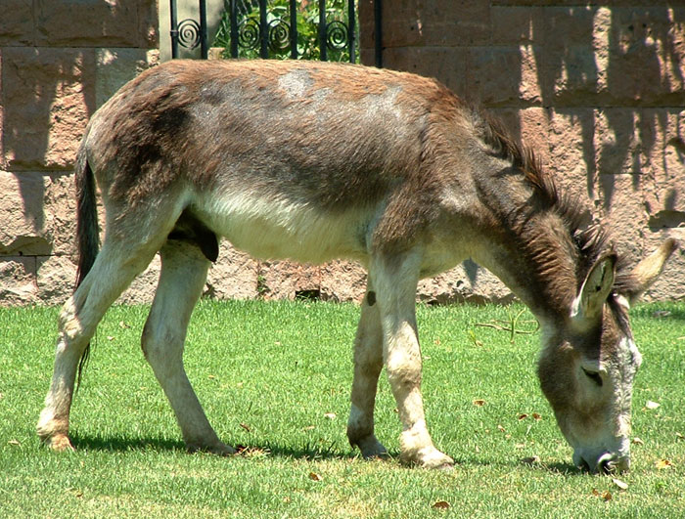
Buridan’s Ass
Cantus, Wikimedia Commons

Slide 3
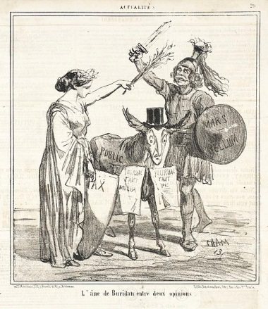
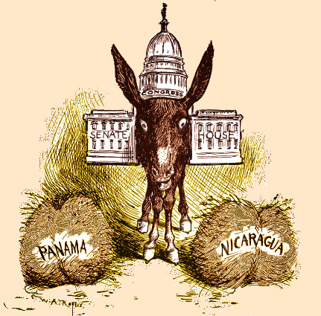
Buridan’s Ass
Cham, Le Charivari, 1859, Wikimedia Commons
W.A. Rogers, New York Herald, c.1900, Wikimedia Commons

Slide 4
Buridan on self-reference
I say that I am the best-looking man at MathsJam
Am I telling the truth?

Slide 5
Buridan on self-reference
Proposition:
Someone at this moment is unsure whether a proposition is true or false

Slide 6
Buridan on self-reference
Socrates wants to cross bridge Plato is guarding.
Plato will let Socrates cross if he makes a true statement but will throw him in the river if the statement is false.
Socrates:“You will throw me in the river”

Slide 7
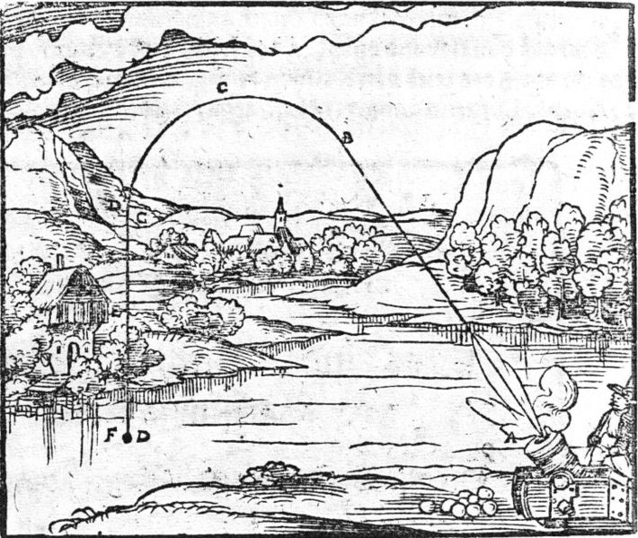
What else did Buridan do?
Theory of Impetus
(≈ Newton’s First Law)
“Created modern theory of money”
“somewhere found on internet”, Wikimedia Commons

Slide 8
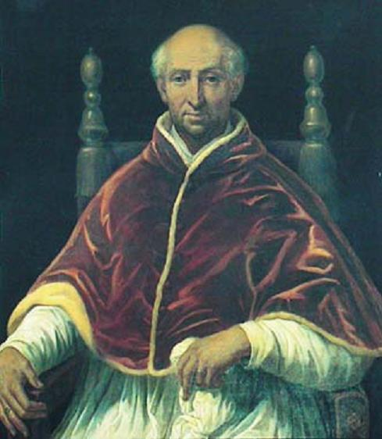
What else did Buridan do?
Hit future Pope Clement VI on head with shoe, giving him remarkable memory
Thrown into Seine in a sack by King of France because of his affair with the Queen
Pope Clement VI, Wikimedia Commons

Slide 9
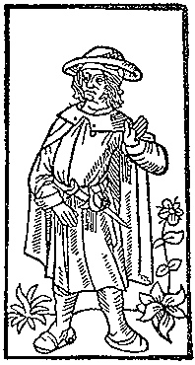
Name-checked in famous poem
Où est la très sage Heloïs,
Pour qui fut chastré et puis moyne
Pierre Esbaillart à Sainct-Denys?
Pour son amour eut cest essoyne.
Semblablement, où est la royne
Qui commanda que Buridan
Fust jetté en ung sac en Seine?
Mais où sont les neiges d'antan!
François Villon
Ballade des dames du temps jadis
“François Villon”, 1489,
Wikimedia Commons

Slide 10
Thank you for listening!

