Slide 1



Overhanging Bricks
Dr David Bedford

Slide 2
(
)
(
)
(
)

Slide 3
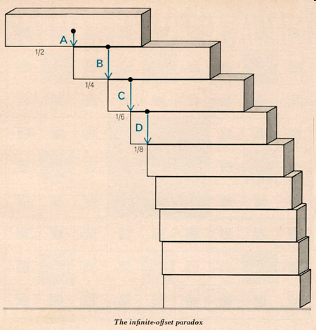
Overhanging Bricks

Slide 4
