Slide 1
Joining the dots
Can you teach graph theory with this game?
@NoelAnn @UniofGreenwich

Slide 2
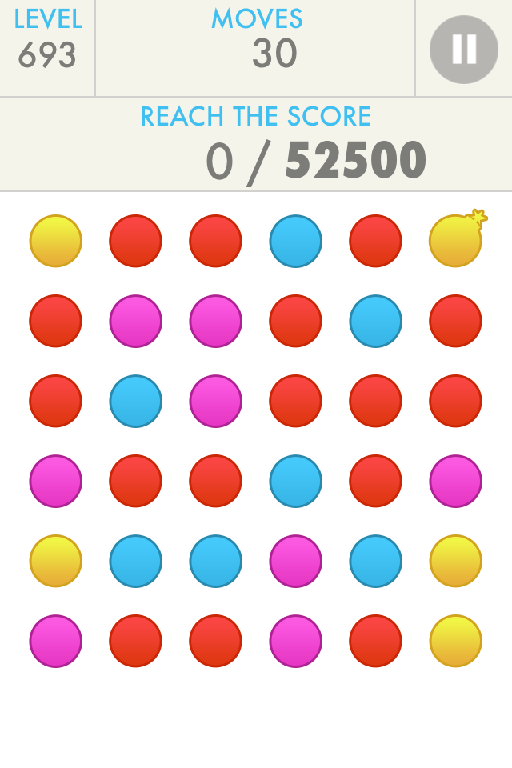
Match Dots
Find a Hamiltonian path.
You draw the edges to create the network.

Slide 3
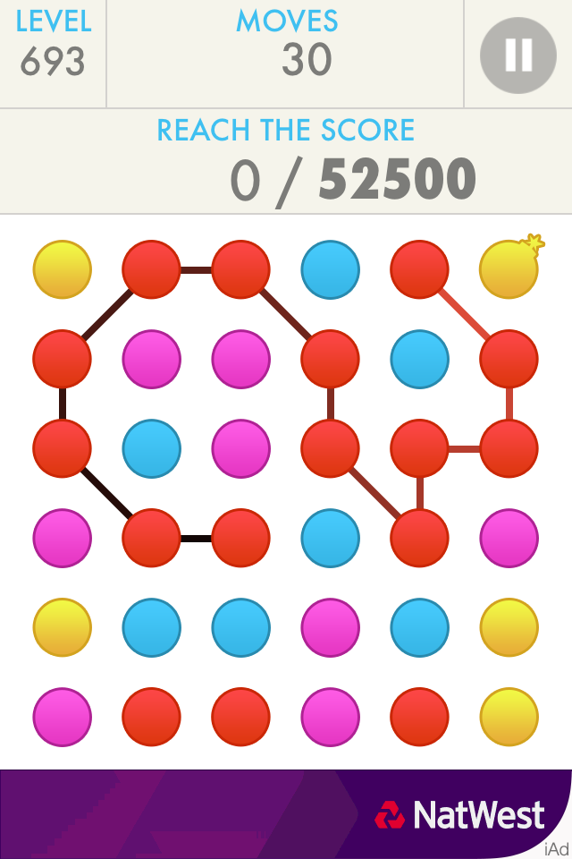
Match Dots
Find a Hamiltonian path.
You draw the edges to create the network.

Slide 4
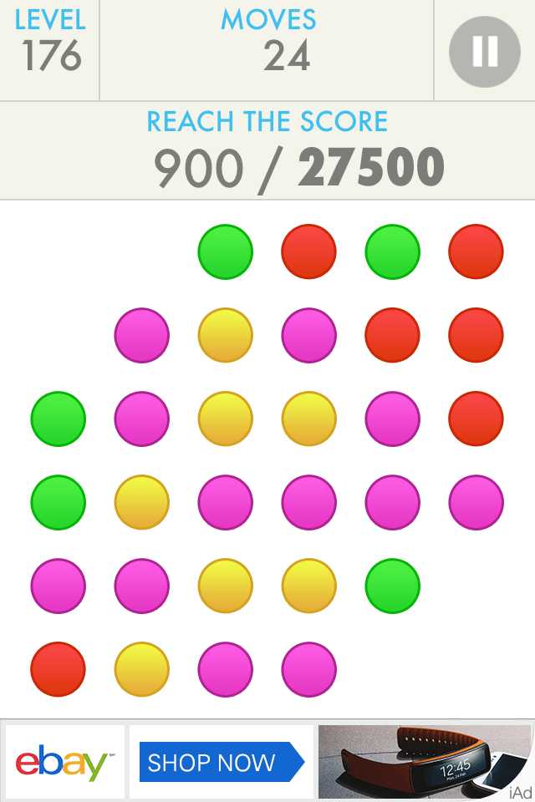
Trees
Look at Pink.
Which is the best part of the tree to get?

Slide 5
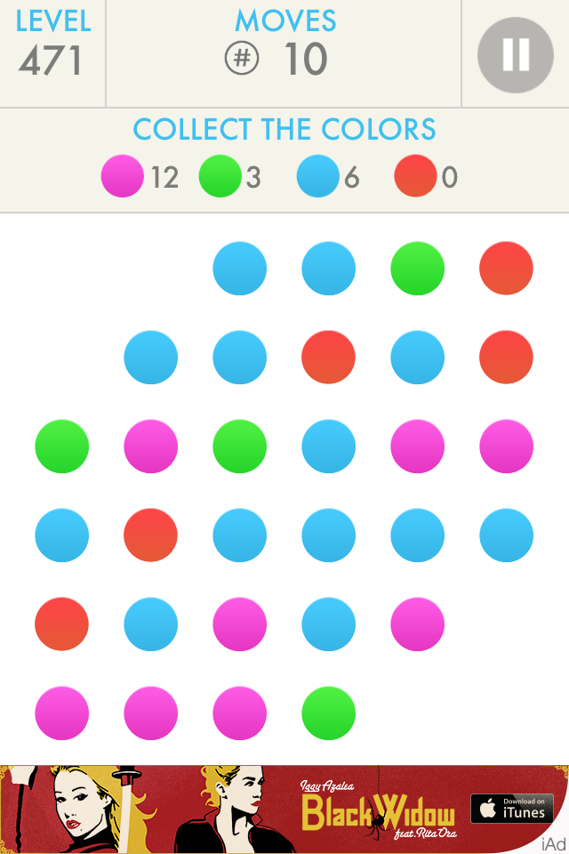
Where to start
Blues:
Which is the best one to start at and is there a way to tell this?

Slide 6
Where to start
Blues:
Which is the best one to start at and is there a way to tell this?

Slide 7
Where to start
Blues:
Which is the best one to start at and is there a way to tell this?

Slide 8
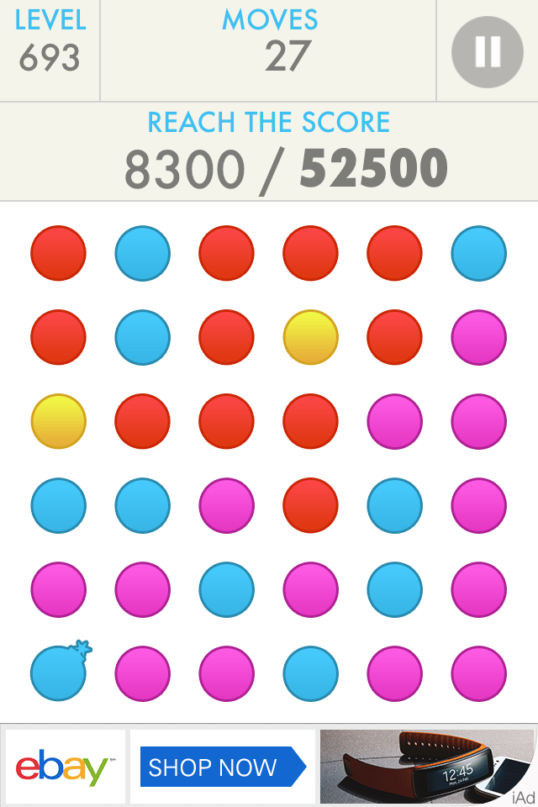
Where to start
Pink:
Which is the best route to take and is there a way to tell this?

Slide 9
Where to start
Pink:
Which is the best route to take and is there a way to tell this?

Slide 10
Where to start
Pink:
Which is the best route to take and is there a way to tell this?

Slide 11
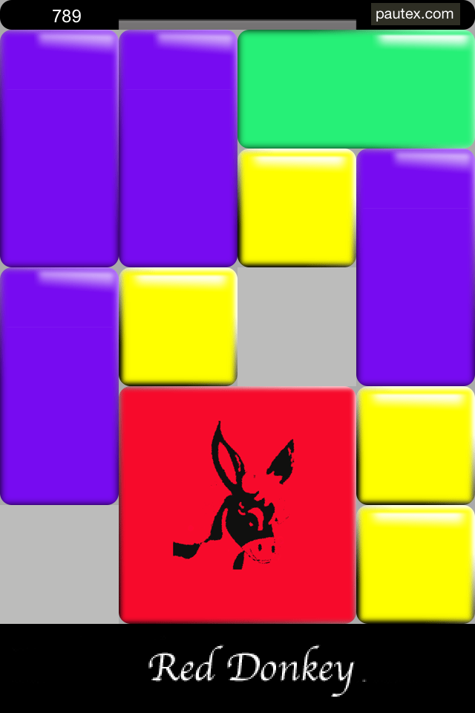
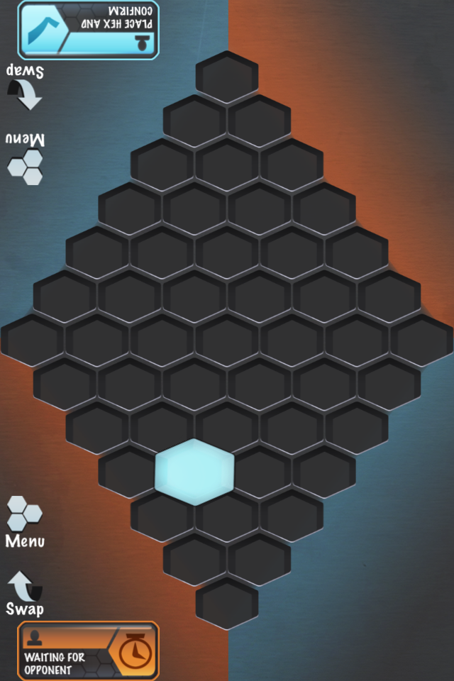
Other ‘mathematical’ games

Slide 12
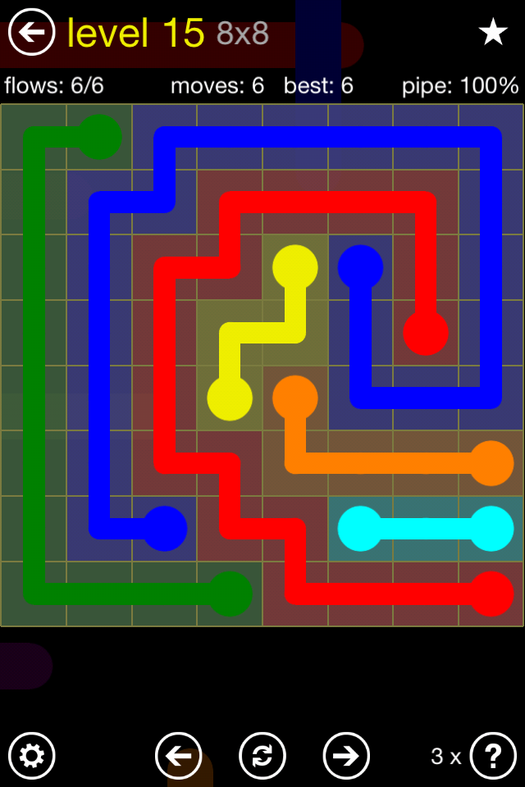
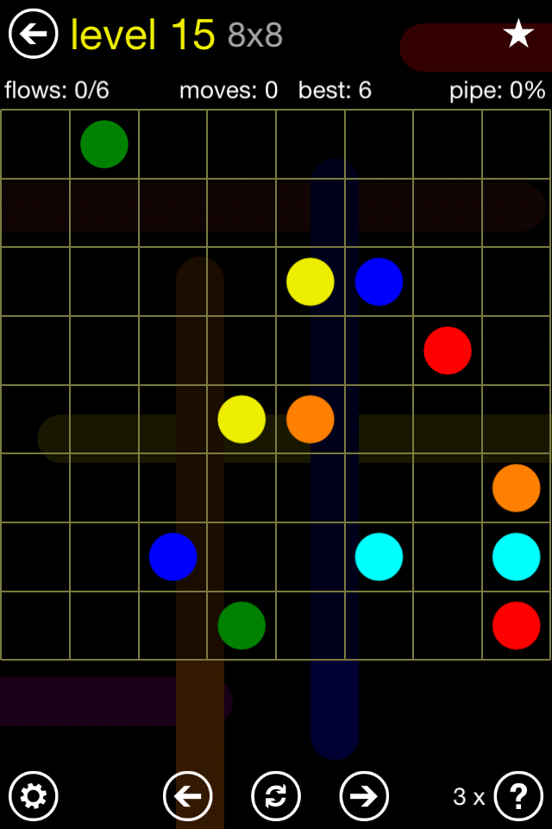
Flow

Slide 13
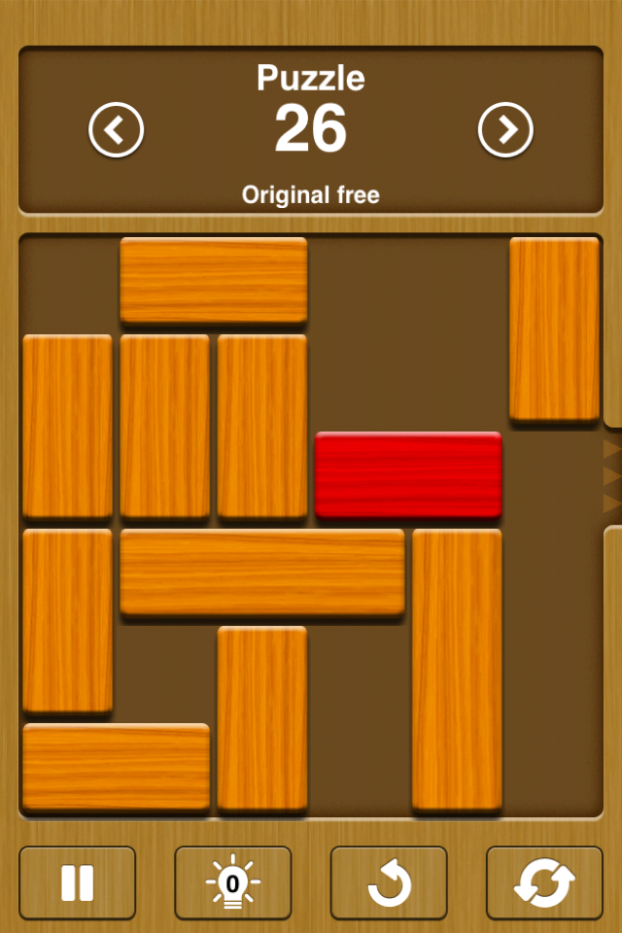
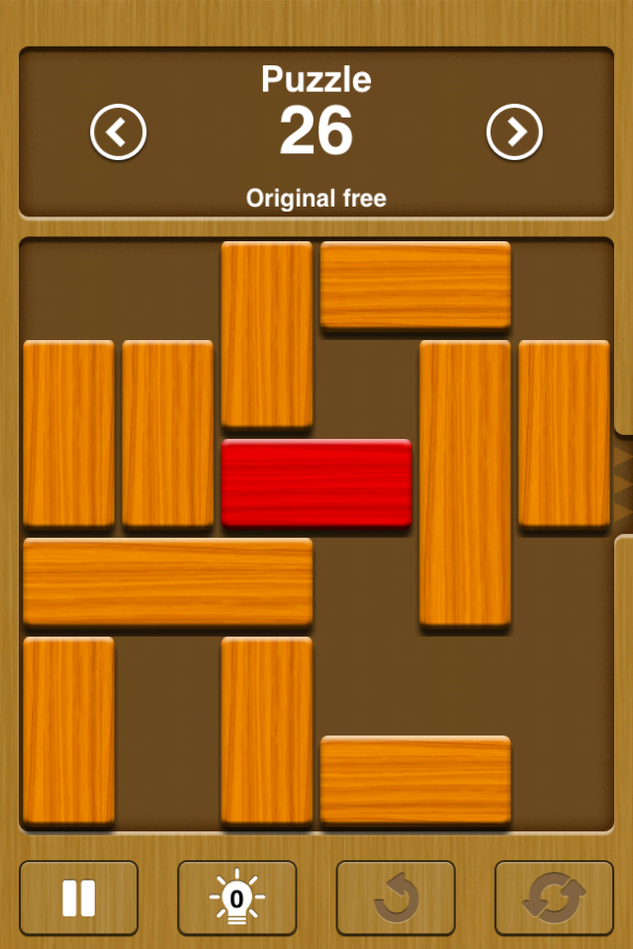
Unblock me

Slide 14
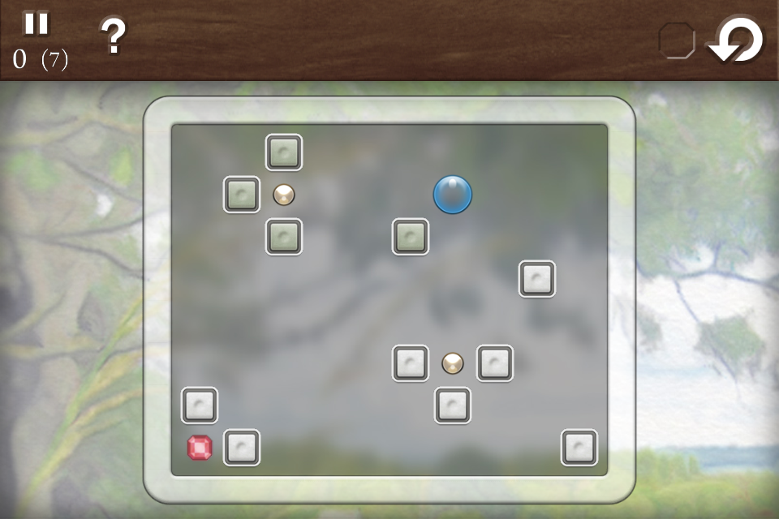
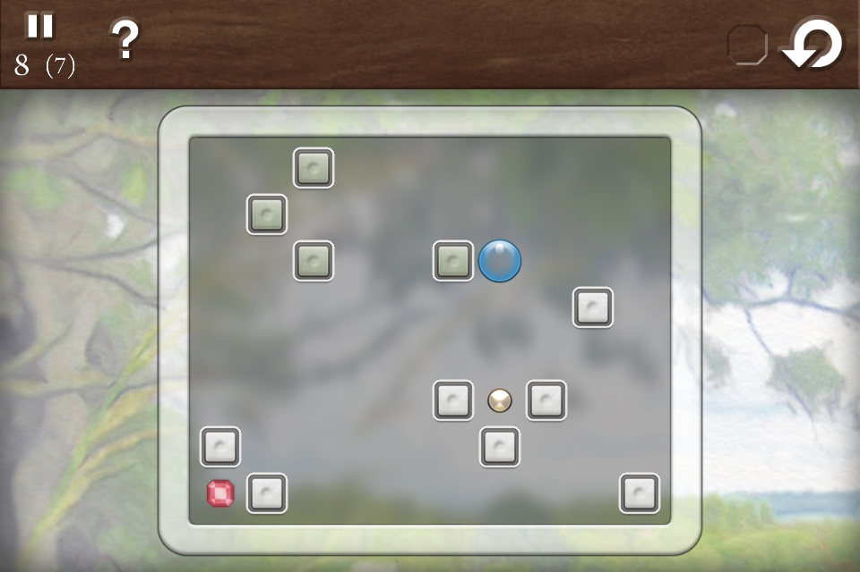
Quell

Slide 15
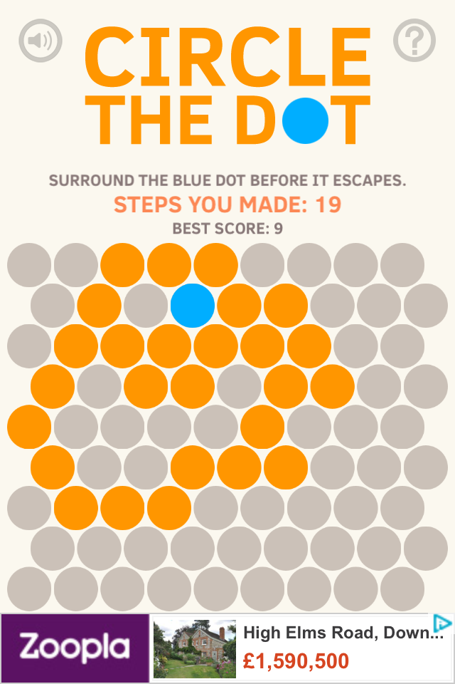
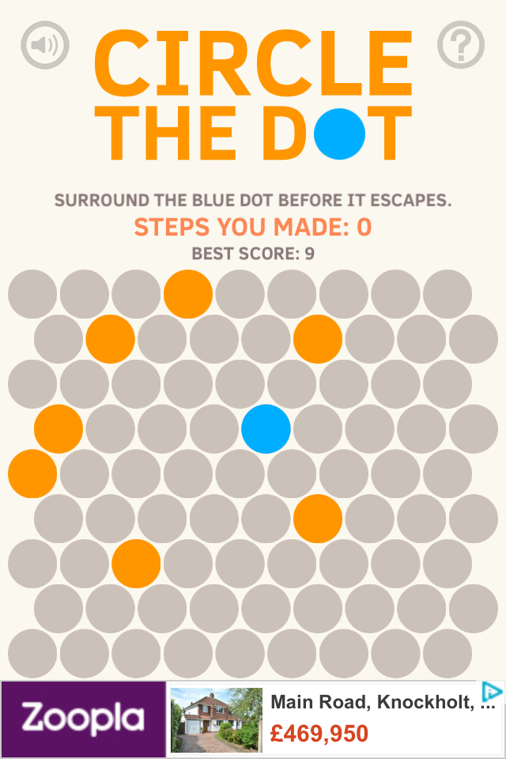
Dot

