Slide 1
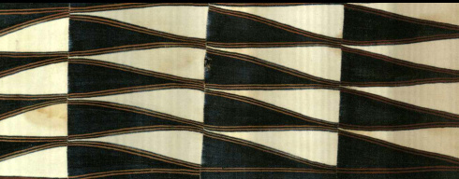
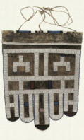
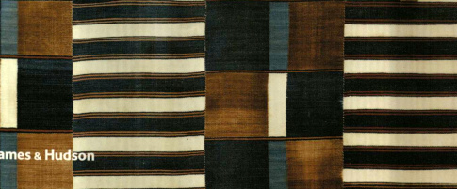
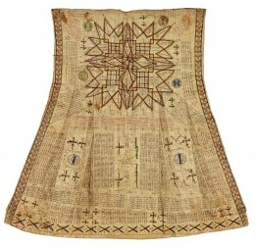
Maths & African Textiles
- Common Threads
John Bibby –
MathsJam, November 2015

Slide 2
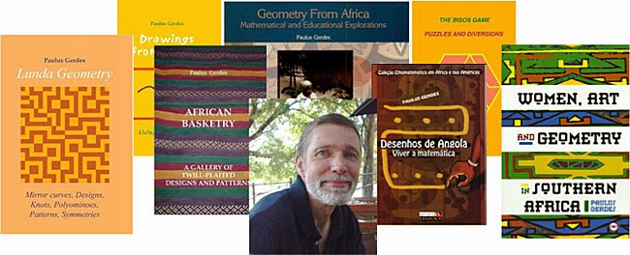
Paulus Gerdes
1952 - 2014
In Memoriam

Slide 3
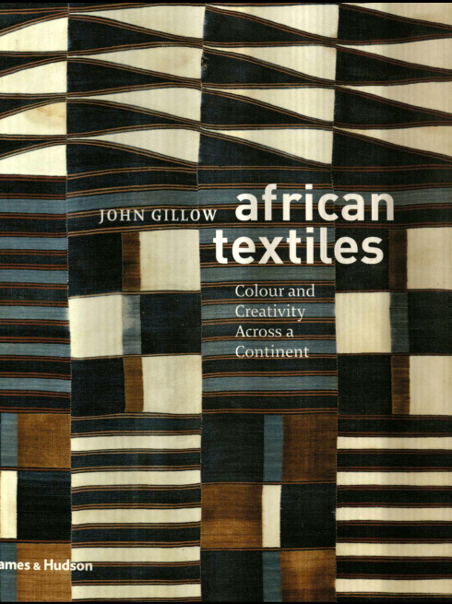
Triggered by a random purchase
Notes:
And by experience selling books to mathematicians – I knew that ethnographic patterns sell well

Slide 4
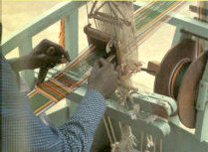
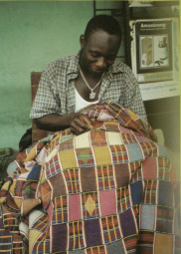
Lots of stunning images …….
Kenti loom & stitchwork
Notes:
Weaving kente strips; sewing strips to form cloth

Slide 5
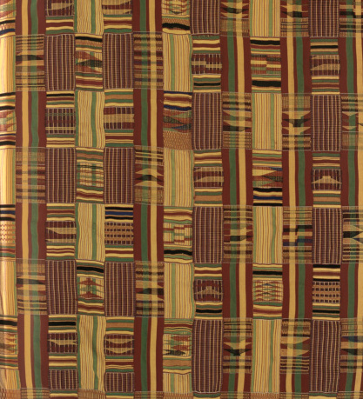
Lots of stunning patterns
…….

Slide 6
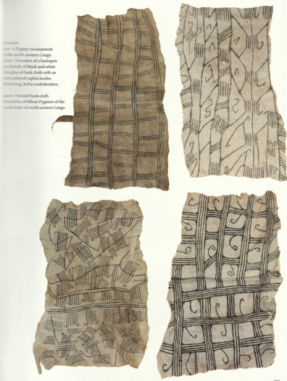
Mbuti bark-cloths
Ndebele apron
showing 2 “children”
Endless scope for
mathematical imaginings ….
Notes:
p.203 Mbuti bark-cloths

Slide 7
“….. (I)t has been calculated that the Shoowa use at least two-thirds of the known geometric (wallpaper?) patterns in their cut-pile embroidery”
(p.196)
Not much explicit maths ……

Slide 8
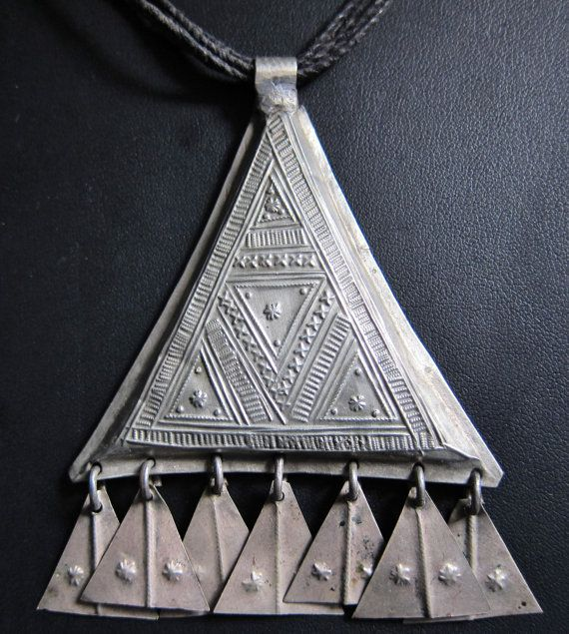
Shades of
Sierpinski ??

Slide 9
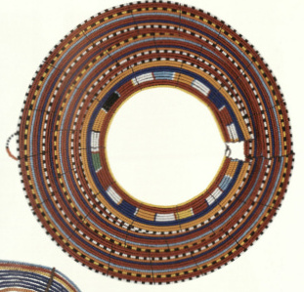
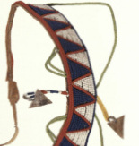

Slide 10
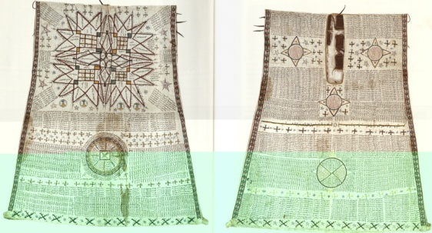
“Rigan yaki charm gown,
inscribed with Koranic verse, magical diagrams … with leather amulets”
Notes:
pp.98-99 “Rigan yaki charm gown, inscribed with Koranic verse, magical diagrams … with leather amulets”

Slide 11
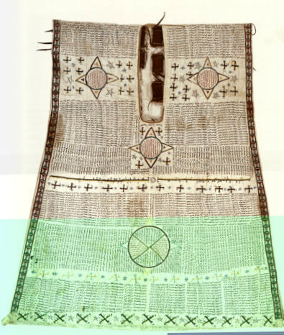
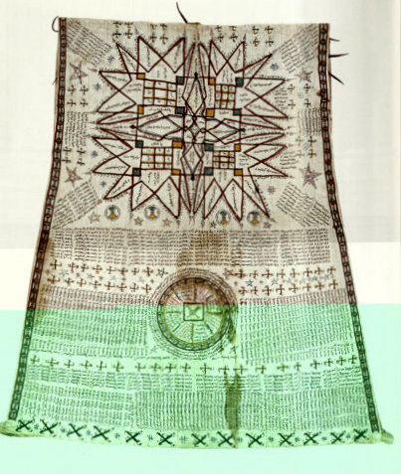

Slide 12
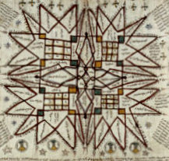
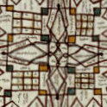

Images unclear – but there does seem to be a ‘gap’ in the central square

Slide 13
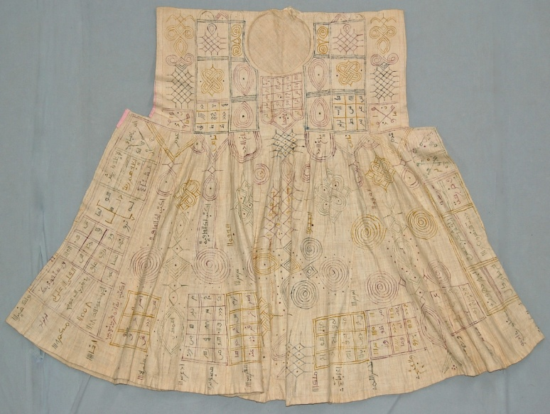
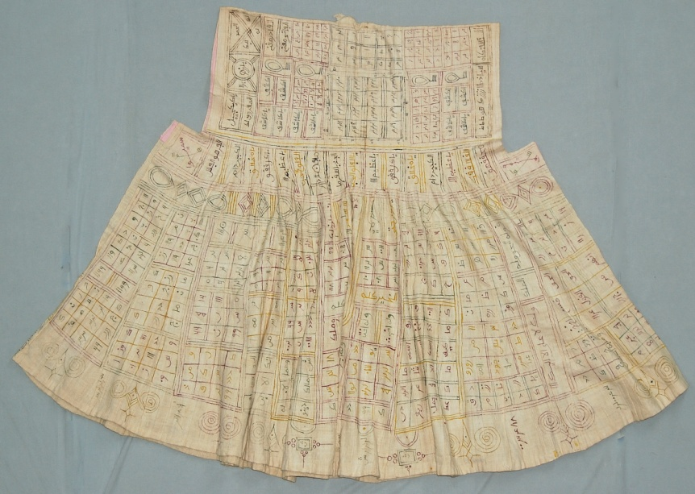
On another smock ….

Slide 14
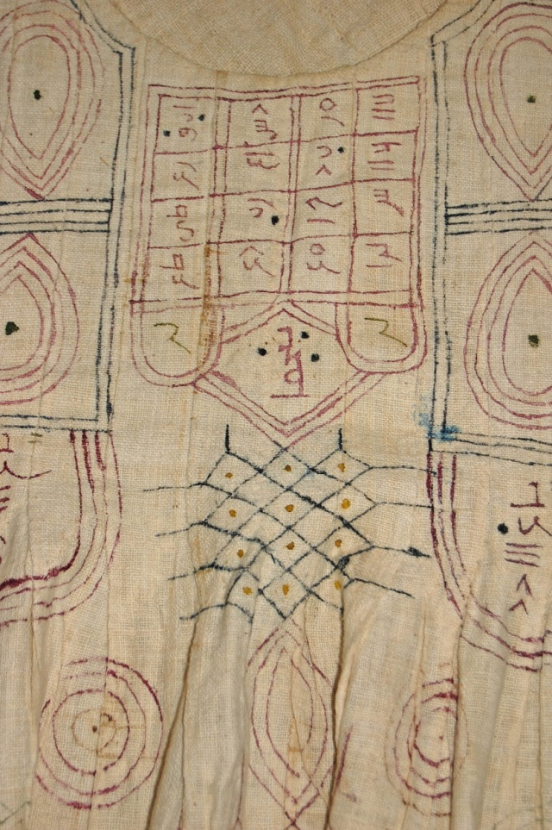
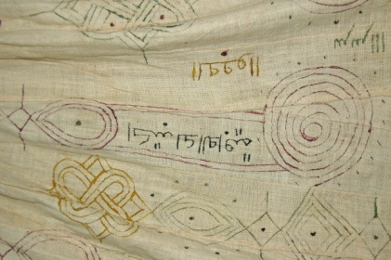
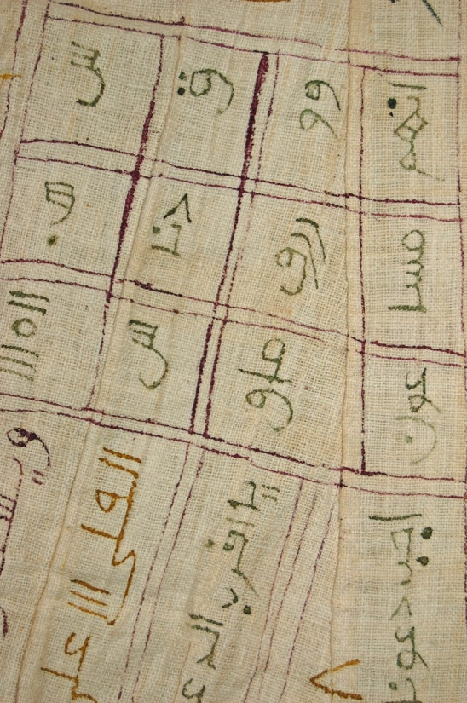
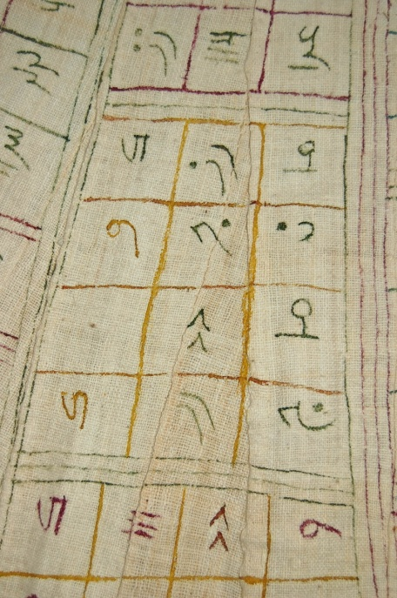
Similar patterns ….

Slide 15
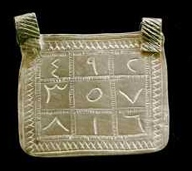
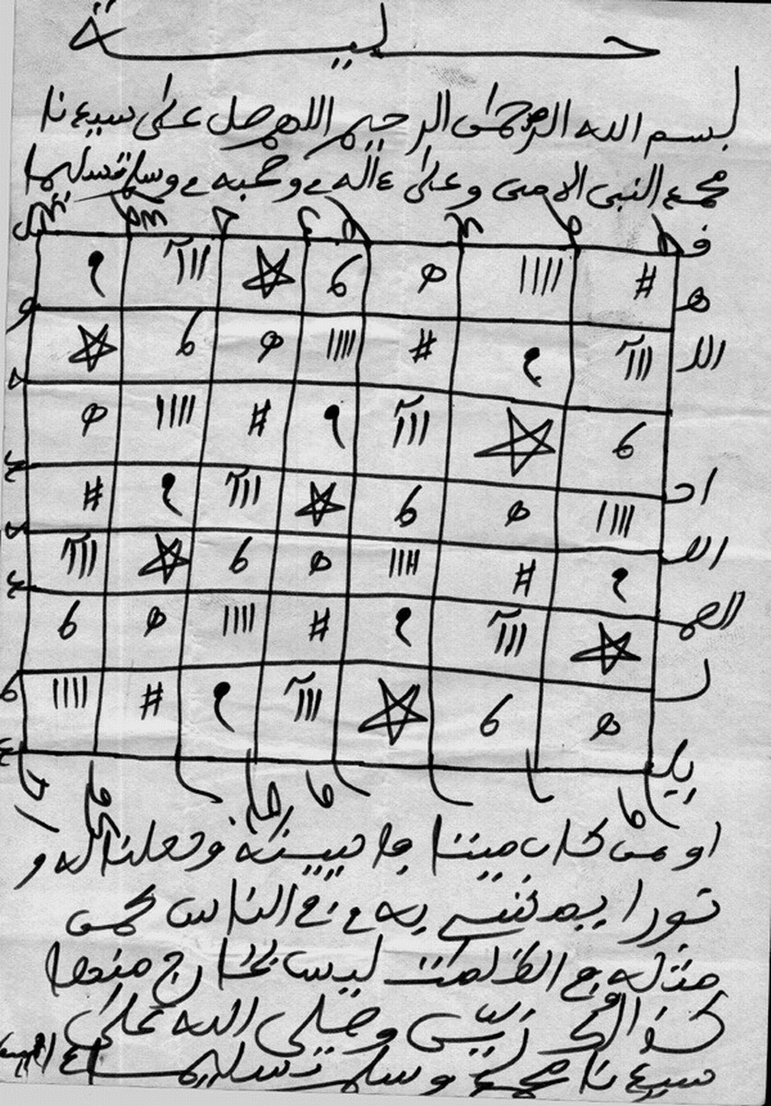
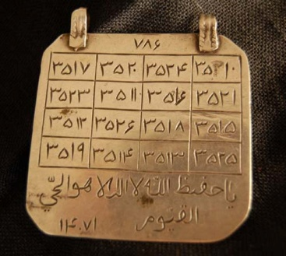
Magic(???) squares elsewhere
(‘Hatim’ in Arabic: pl. ‘hatimi’)

Slide 16
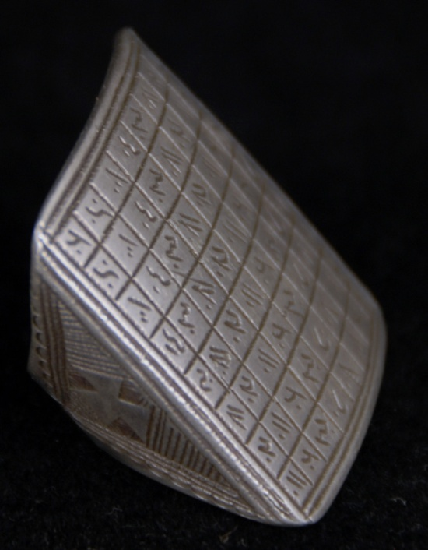
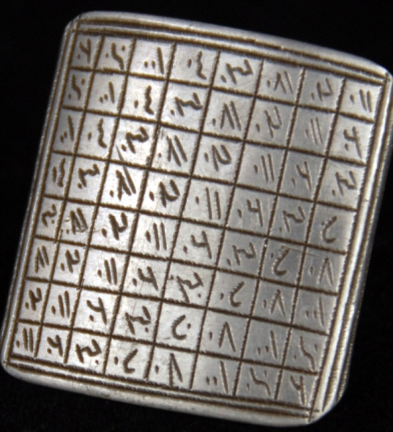

Slide 17
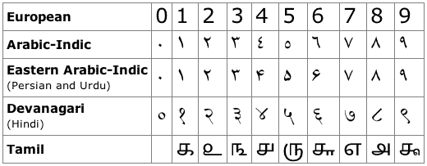
Note:
Good friends: 0, 1, 9 recognisable to us
False friend: Arabic ‘6’ looks like ‘7’
5 and 0 easily confused

Slide 18
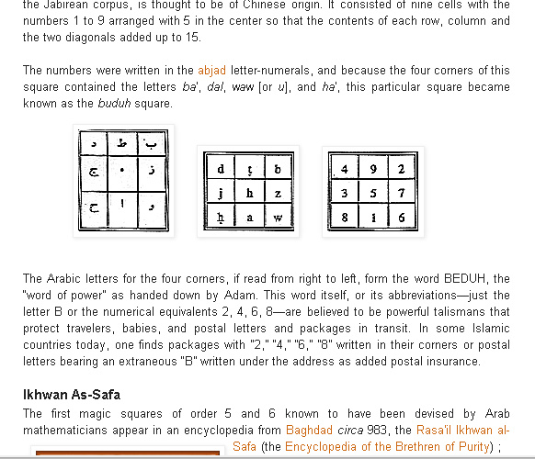

Slide 19
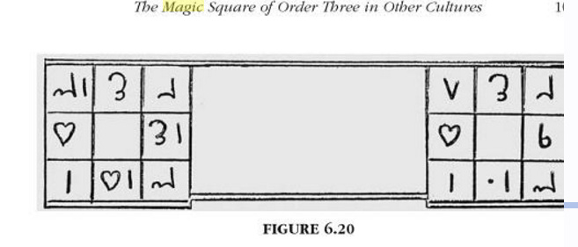
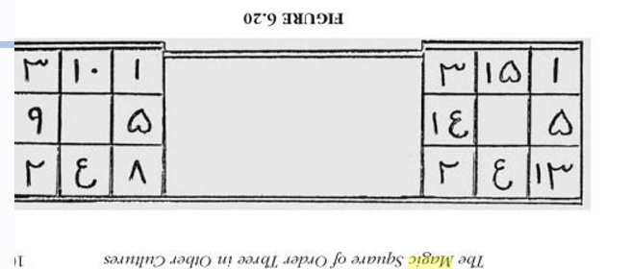
Swetz Luoshu , p. 103
- difficult to interpret!
15 1
14 5
2 4 13
10 1
9 5
2 4 8

Slide 20
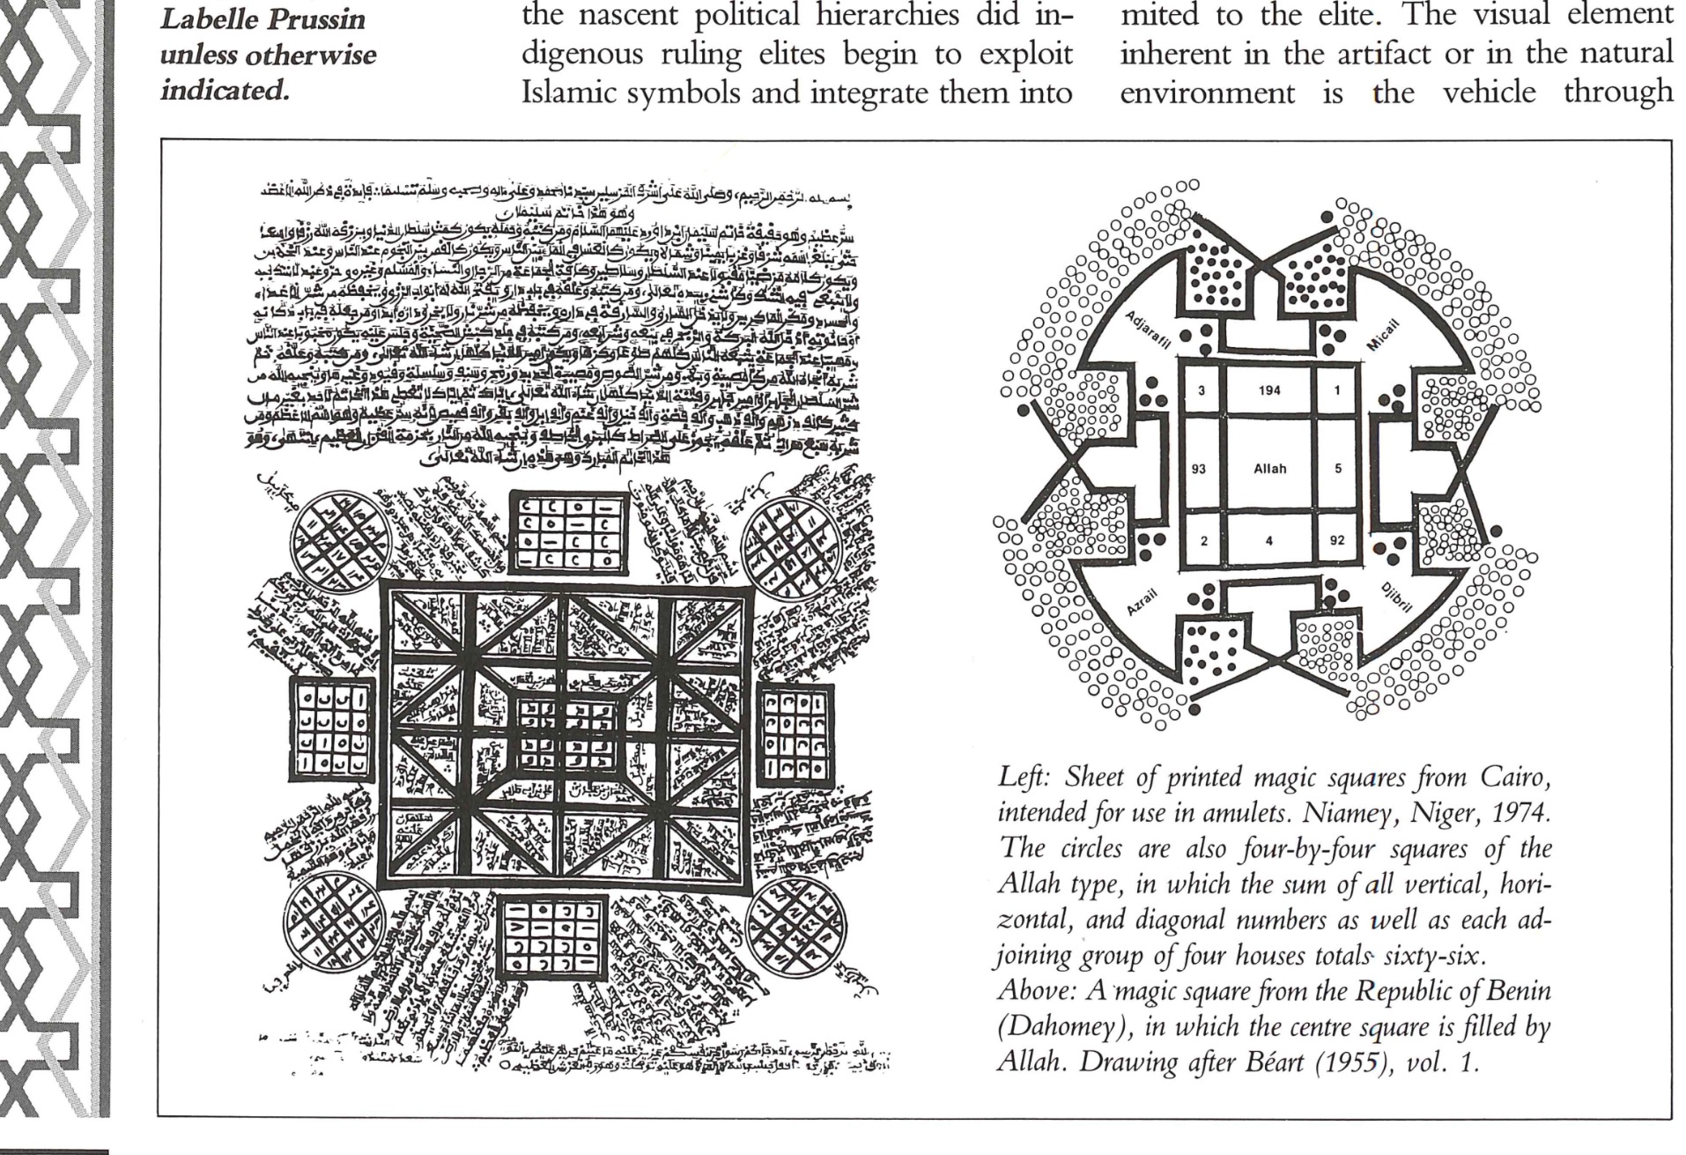

Slide 21
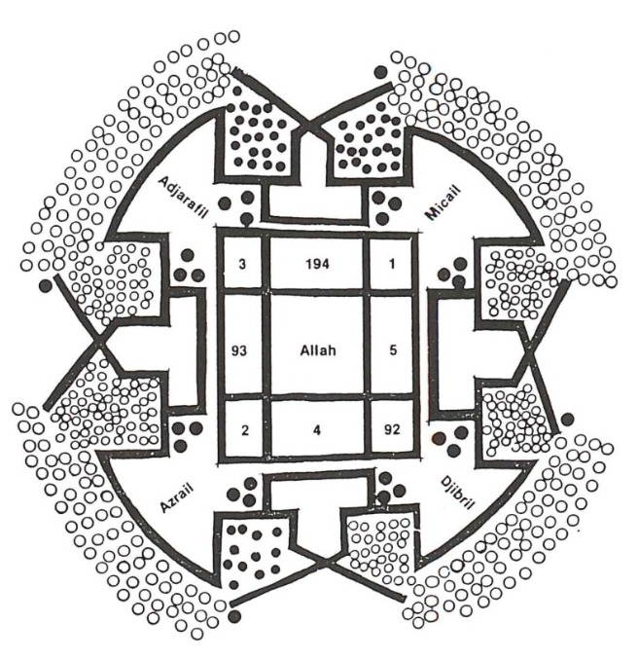
Map showing Islamic angels?
Adjarfil (3)
Micail (1)
Djibril (92)
Azrail (2)

Slide 22
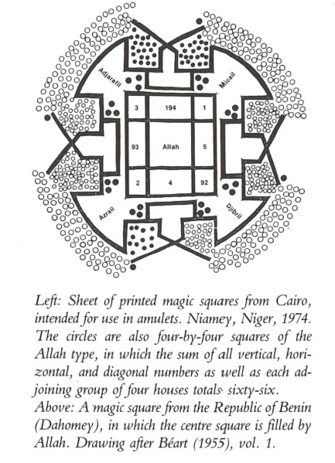
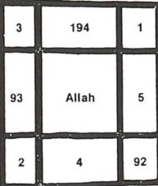
Changing 92, 93, 194
to 2, 3, 4
gives:
4 1
3 - 5
2 4 2
Is this
a magic square with total 8
A list all possible ways of summing numbers 1-5 to add to 8 ?
… or even
(c) a Duhrer-type square showing the date 1941 (cf. Melancholia)?
3+4+1 = 3+5 = 2+4+2 = 3+3+2 = 4+4 = 1+5+2

Slide 23
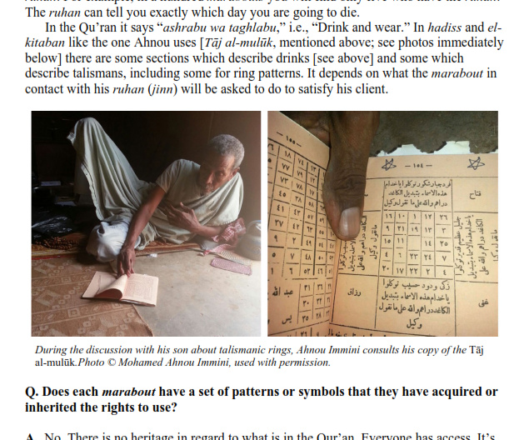

Slide 24
More questions than answers:
Is there any ‘real’ maths here, or are we just ‘playing’?
If so, does it matter?
How best to ‘learn through play’?
Problems of ‘orientalism’ in discussing folk-mathematics.

Slide 25
The End

