Slide 1
G & P Revisited
Eric Solomon's Hexagrams & More
John Read
John.read@outlook.com
@johndavidread

Slide 2
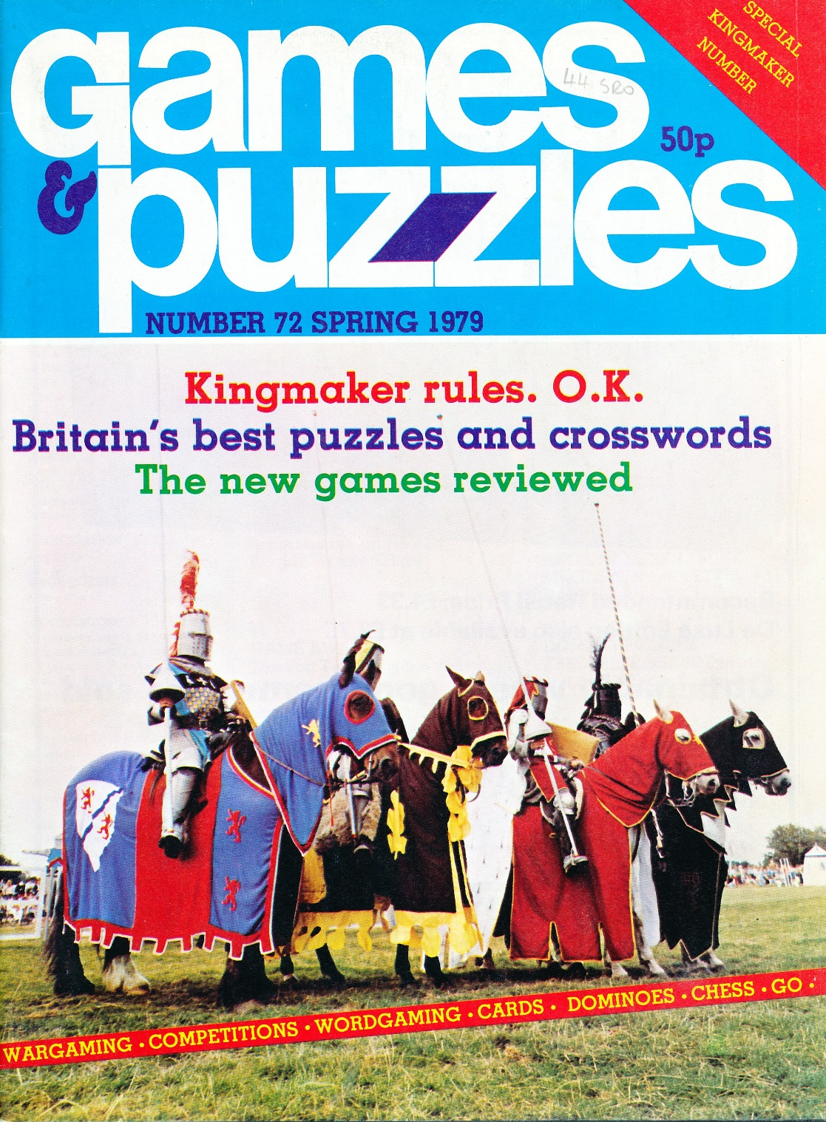

Slide 3
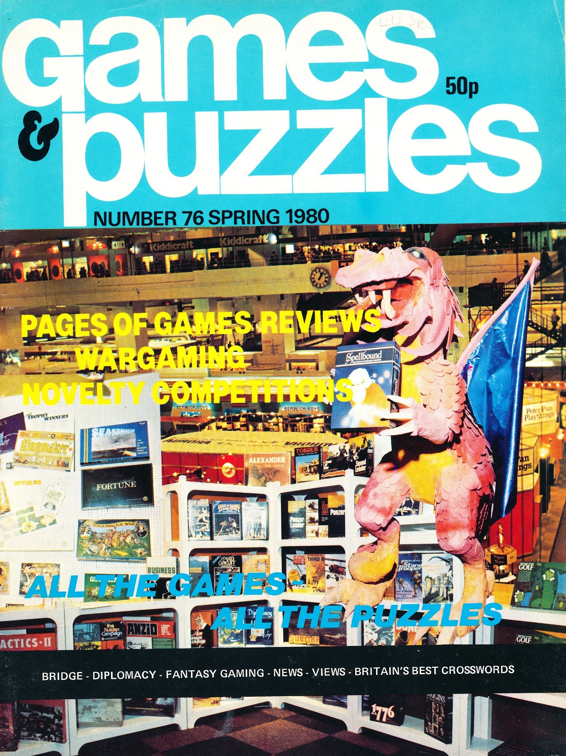

Slide 4
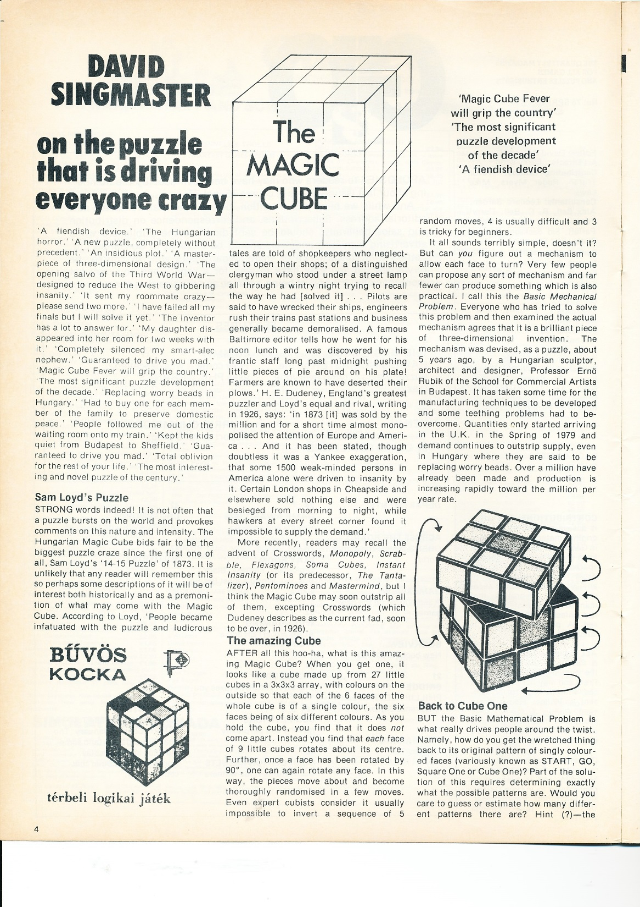

Slide 5
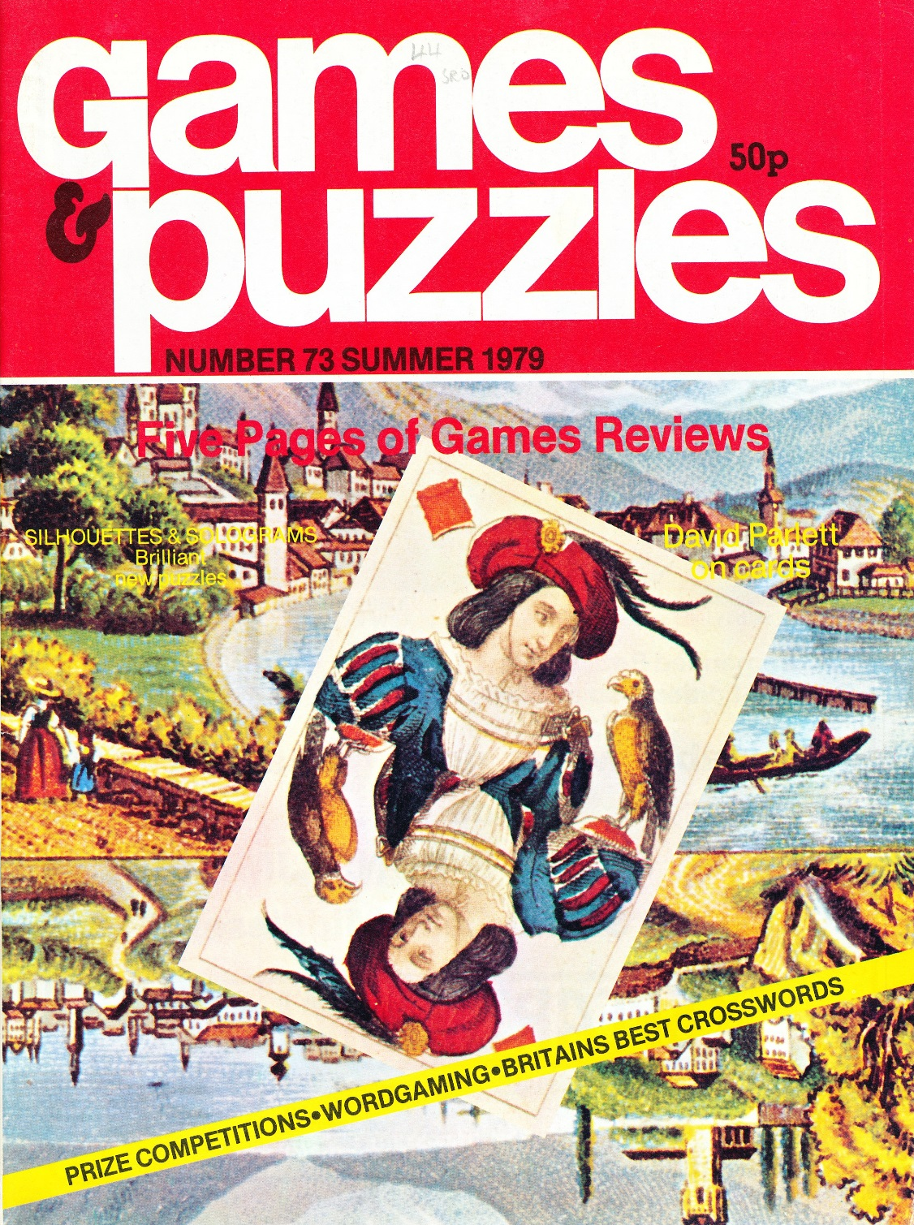

Slide 6
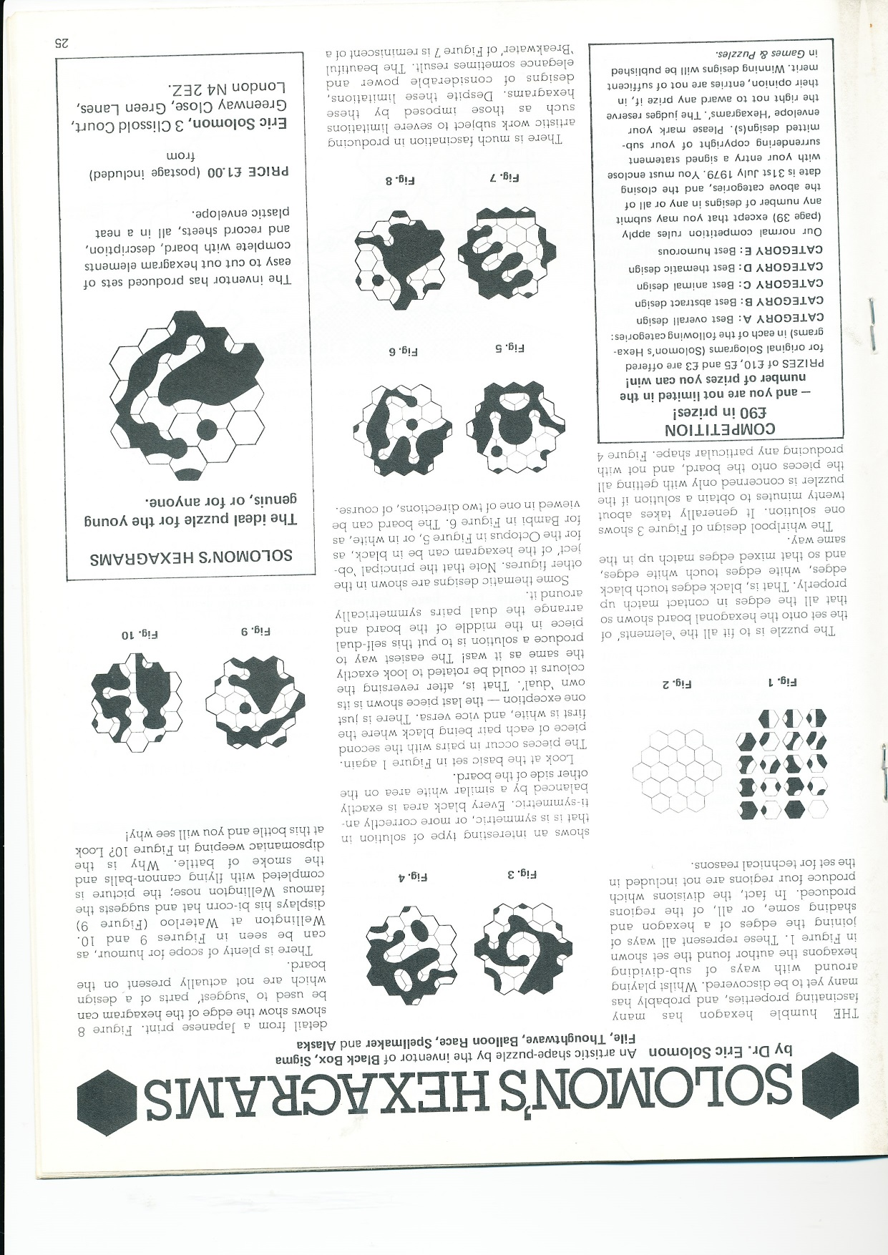

Slide 7
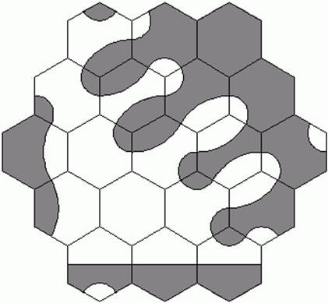
Set of 1, 2 or 3 regions gives
19 tiles
Large radii centred on adjacent hex diameter 1½
Small Radii centred on hex corners
diameter ½
http://www.ericsolomon.co.uk/

Slide 8
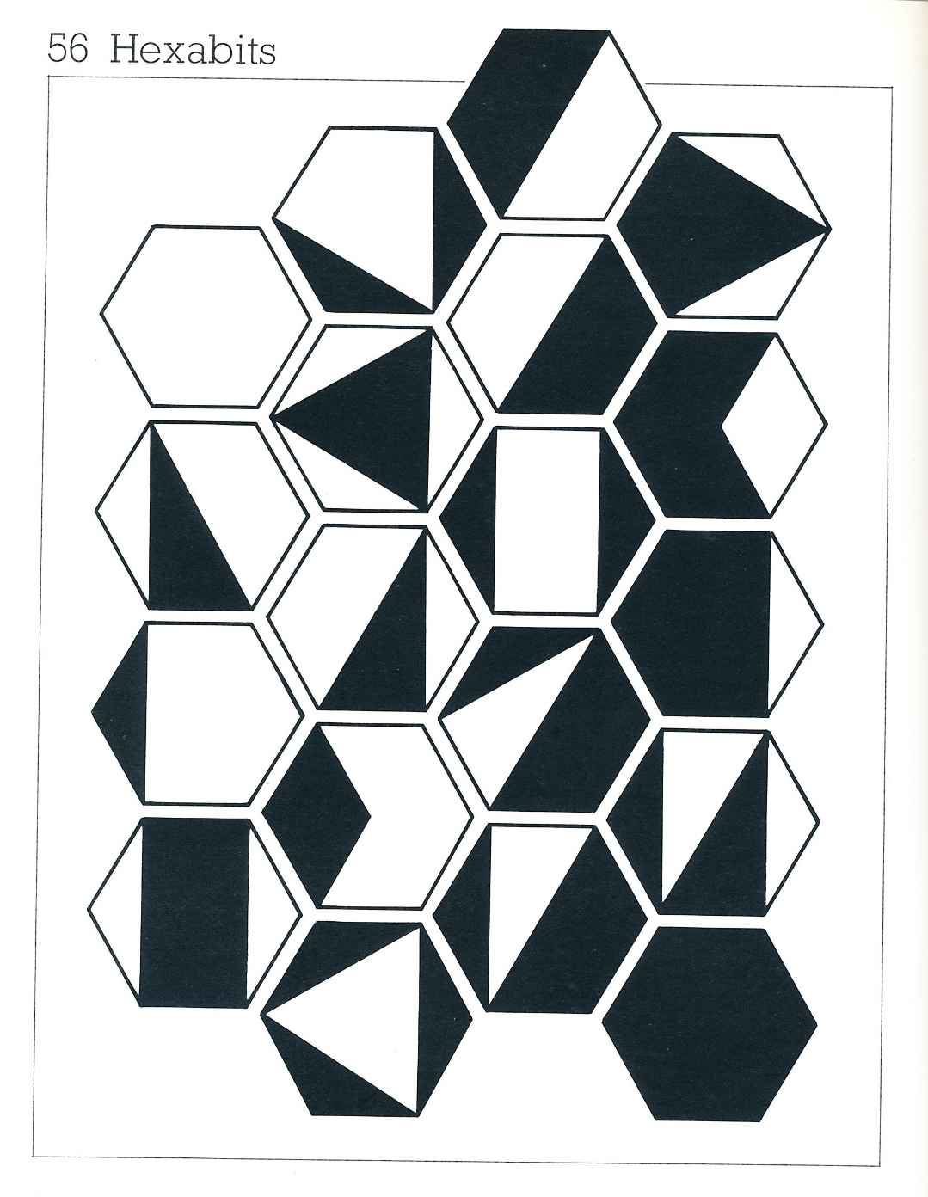
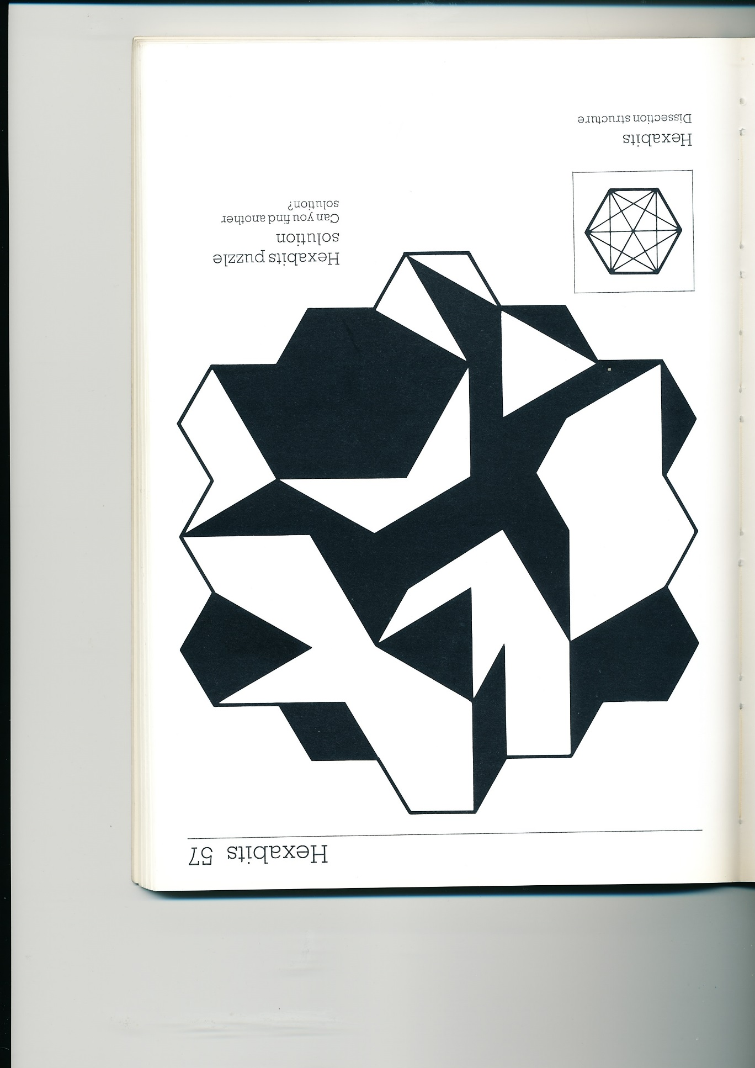
‘Hexabits’
from
Ian
Moscovich’s
Super-Games
(published 1984)

Slide 9
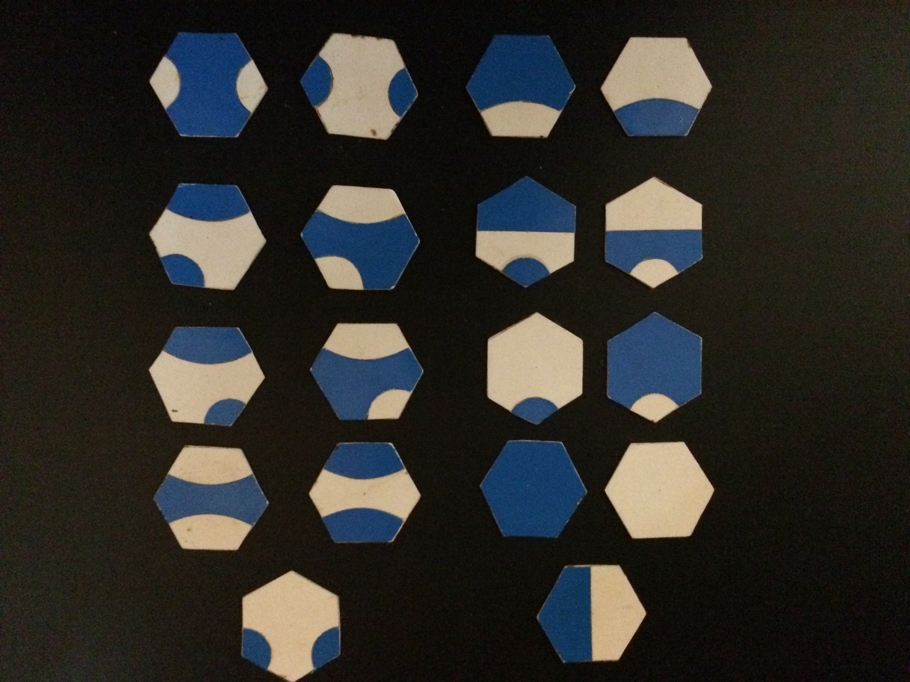

Slide 10
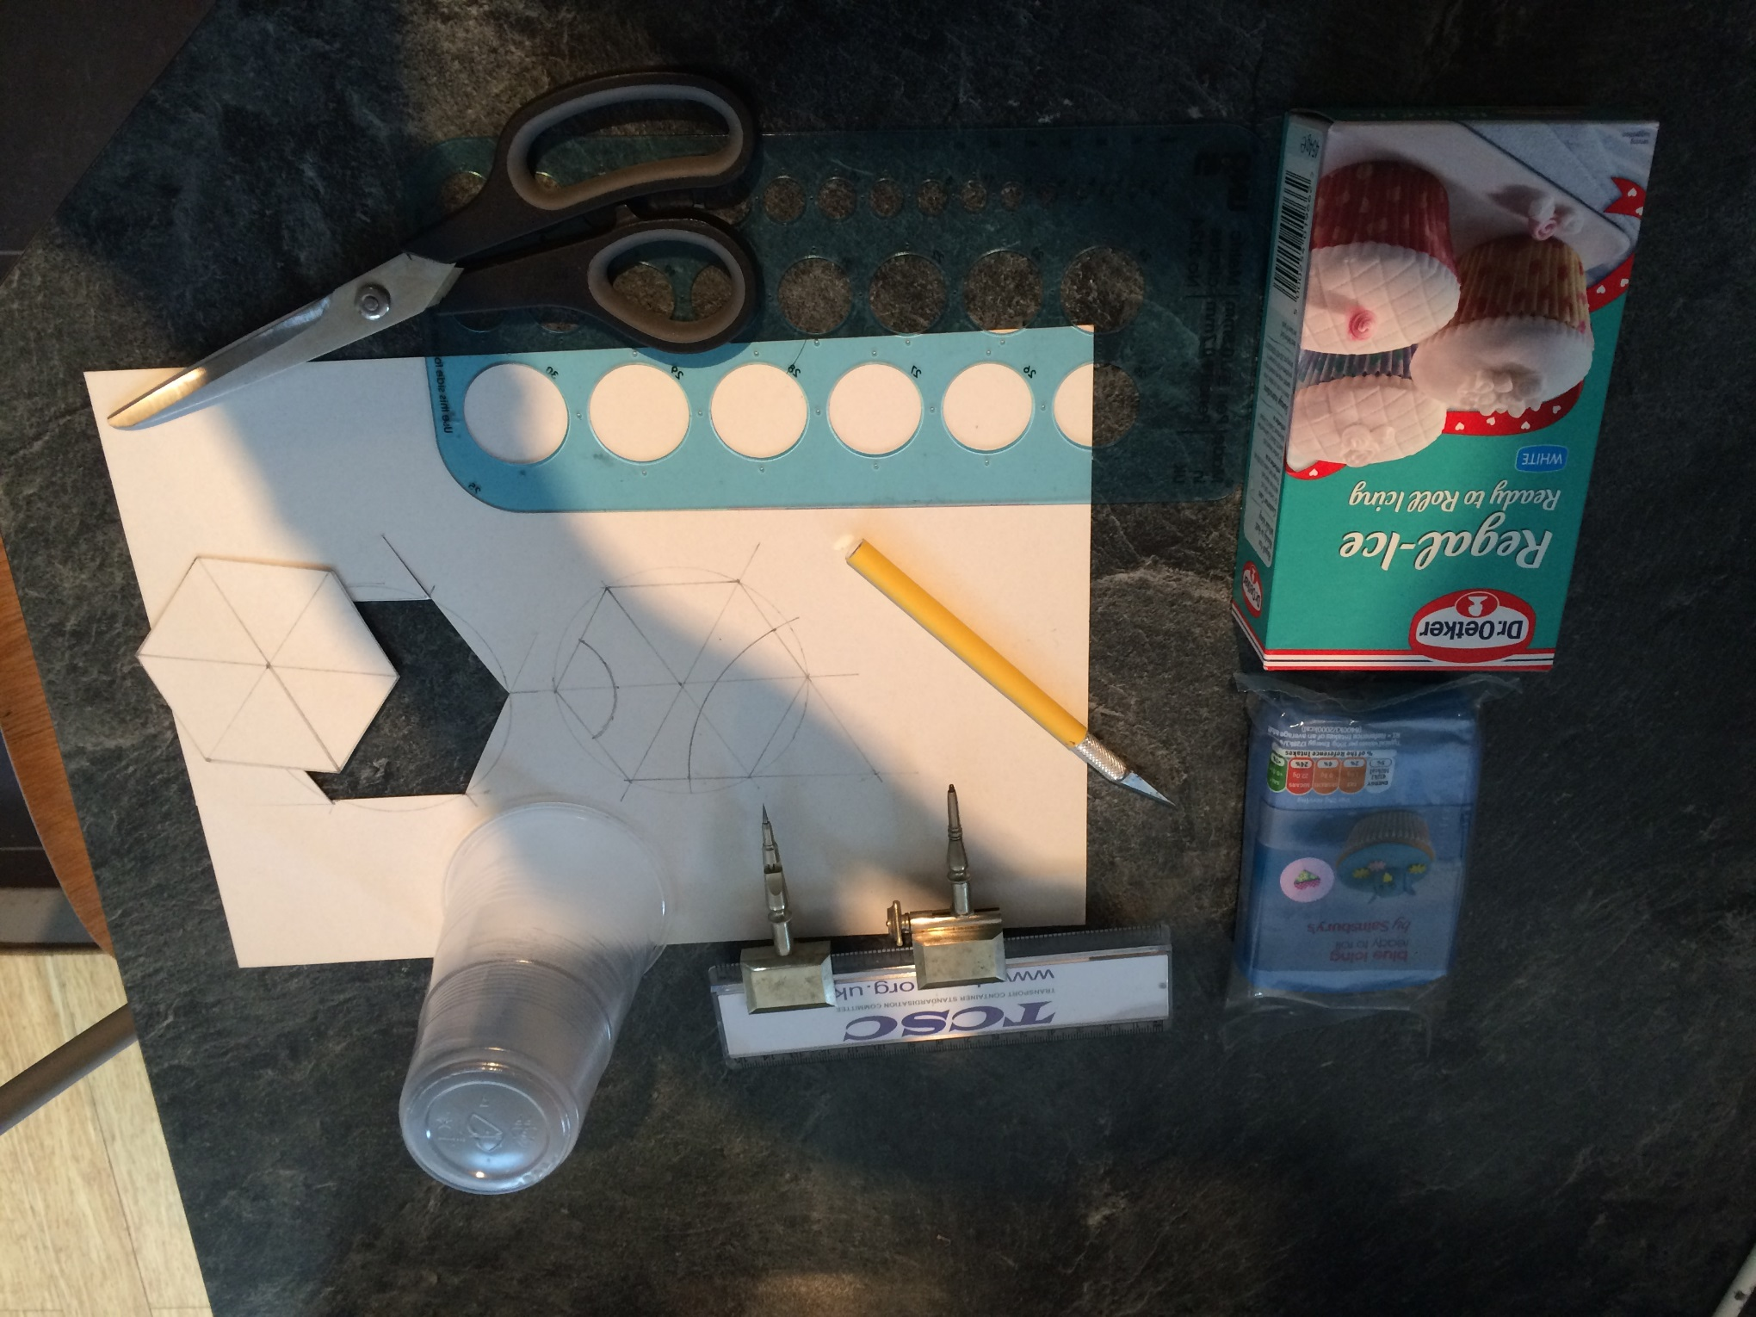

Slide 11
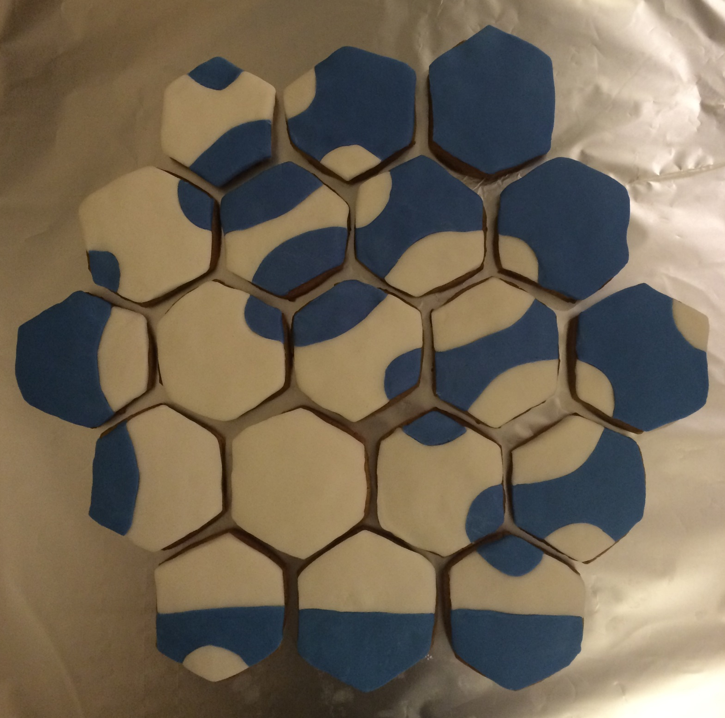

Slide 12








Octopus/
Bambi
Puppy
Elephant
Plane
Tiler
Only 2-2
Solution
Largest
Region
An 8-8
Solution

Slide 13
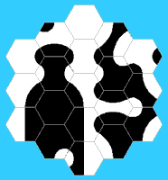







Weeping Wino/
ET Plays
Football
Where are
Grandma’s Teeth?
This Soap
Tastes Terrible
Tribal
Spear
Plumbers
Delight
Still Life
With Urn
Broken
Guitar

Slide 14
G & P Revisited
Eric Solomon's Hexagrams & More
John.read@outlook.com
@johndavidread
http://www.ericsolomon.co.uk/

