Slide 1
How to Win Football Prediction Leagues
By Michael Gibson
mikegibson2010@gmail.com

Slide 2
Background
I don’t know much about football.
I don’t have a huge interest in football.
This is just as well, given that I support Newcastle United.
I do know a little bit about Maths.
I do know a little bit about computers and programming.
This is just as well, given that I work as a teacher of Maths and Computing.

Slide 3
A Bit More Background
Between around 2010 and 2012 I had the opportunity to take part in a couple of “football prediction leagues”.
The first one was run by a colleague of mine.
Another was run by my wife’s friend’s dad’s former colleague.
Since I know very little about football, I decided to take a mathematical/computational approach to this challenge.
This proved to be very successful!

Slide 4
A Typical Prediction League
Participants pay £5 per month to take part.
Each week, participants submit their predictions for the scorelines for a selection of 10 matches.
Points are accumulated according to the following system:
Small prizes of around £40 are awarded each week.
A large prize of around £300 and second prize of around £100 are awarded at the end of the season.
Correct scoreline (draw) | 12 points
Correct scoreline (non-draw) | 10 points
Correct goal difference (draw) | 5 points
Correct goal difference (non-draw) | 3 points
Correct outcome | 1 point

Slide 5
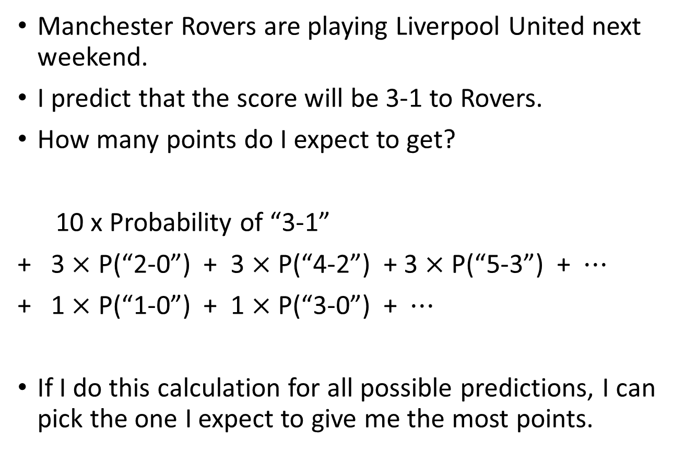
Expectation Values
Manchester Rovers are playing Liverpool United next weekend.
I predict that the score will be 3-1 to Rovers.
How many points do I expect to get?
10 x Probability of “3-1”
+ 3 $×$ P(“2-0”) + 3 $×$ P(“4-2”) + 3 $×$ P(“5-3”) + $⋯$
+ 1 $×$ P(“1-0”) + 1 $×$ P(“3-0”) + $⋯$
If I do this calculation for all possible predictions, I can pick the one I expect to give me the most points.

Slide 6
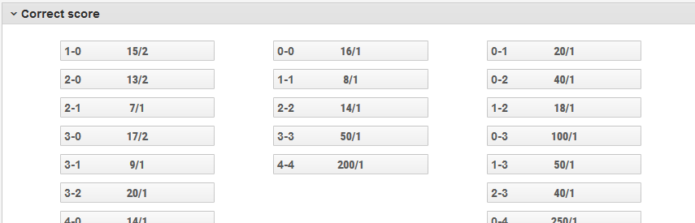
Probabilities
But what are the probabilities for each of the possible scorelines?
Surely this requires some knowledge football?
Not if you consult someone who really knows…

Slide 7
Probabilities
Bookmakers quote odds for individual scorelines.
These are probably the closest thing you can get to actual probabilities ahead of a sporting event.
Obviously bookmakers “tighten” their odds to make a profit.
I assumed that they would make an equal profit margin on all bets. This allowed me to infer working “probabilities”.

Slide 8
Practicalities
Doing all of this manually proved to be somewhat time-consuming! Here are some ways of speeding this up…
Microsoft Excel allows imports of data from web pages.
It also has a built-in programming language (VBA) that allows quite straightforward processing of the data after importing.
This speeds up the process and amounts to a “black box” – import the odd from the bookies, press “go”, output a list of recommended predictions.

Slide 9
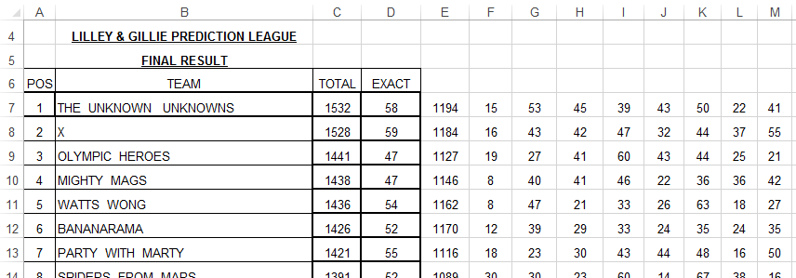
Outcomes
2nd place overall in the first season, prize ~£100.
1st place overall in the second season, prize ~£300
After that the company split in two and the league no longer operates.
Awkward moments at parties when my wife’s friend’s dad tries to engage me in intelligent conversation about football!

Slide 10
Some interesting maths…
Optimal predictions tend to be “low-scoring”
For examples, the total number of goals “predicted” across the 10 matches is usually somewhat less than the actual total.
In the league at my own workplace, my (non-mathematician) colleague thought that my system was simply to give my predictions in “binary”!
At the root of this is a very common statistical phenomenon…

Slide 11
Simple Demonstration…
Suppose I roll an ordinary dice until I get a 6.
You need to predict how many times I will roll the dice.
The mean number of times will be 6.
The median number of times will be 4.
The modal number of times will be…
1!
This is the most sensible prediction.

Slide 12
Back to Football
The situation with football predictions is a little more complicated but the underlying principle is the same.
My hunch is that people who know lots about football but less about probability will tend to make predictions that are more “plausible” as opposed to more “probable”.
In the 2010 World Cup the most likely scoreline, according to bookmakers, for Brazil vs North Korea was 3-0. Most people’s gut reaction was “Brazil will win by more goals than that!” – but of course “more than 3-0” is not a single option!
Does anyone remember what the actual scoreline was?
BRAZIL 2-1 NORTH KOREA
Well that’s football for you!

Slide 13
Finally: What troubles me…
Since doing this I have sometimes asked myself…
If I had simply looked up the scoreline with the shortest bookmaker odds and used that for all my predictions, would it have made a difference…
I know it would sometimes have given different predictions, but might I have still won?
After all the, expectation values for the top few options differed by very little.
I have all the data I need should I choose to find this out. I really would prefer not to know!
But my advice would be, if you’re in a football prediction league, unless you have a lot of time on your hands, just go for the scoreline with the shortest bookmaker odds – you’ll save a lot of time and maybe make a lot of money!

