Slide 1
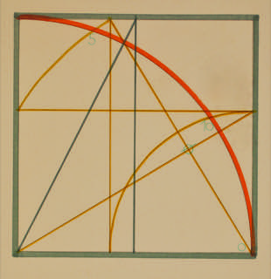
Almada Negreiros
Pedro J Freitas
Simao palmeirim costa
University of lisbon

Slide 2
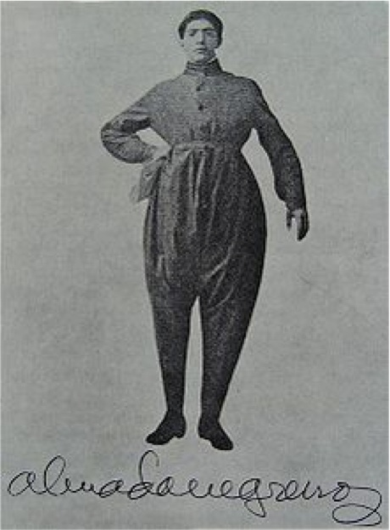
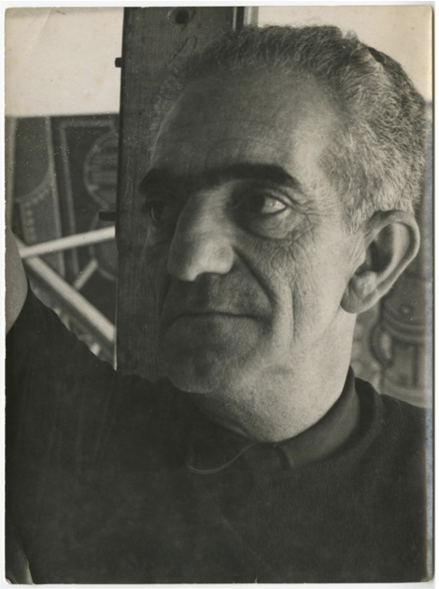
S Tomé e Príncipe, 1893 – Lisboa, 1970
Futurist Conference, 1917
In the 1940s

Slide 3
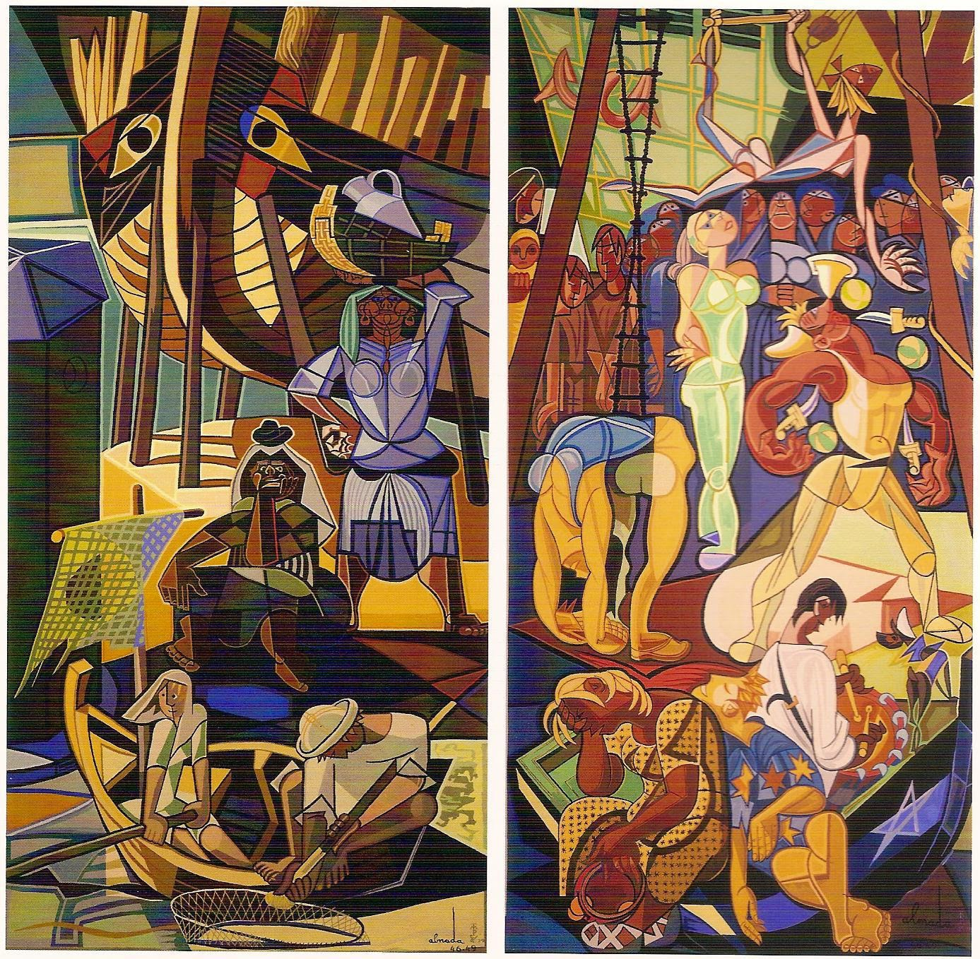

Famous works
Portrait of Fernando Pessoa, 1954
Mural at the Maritime Station of Rocha, 1948

Slide 4

A Geometric Canon

Slide 5

Language of the square

Slide 6
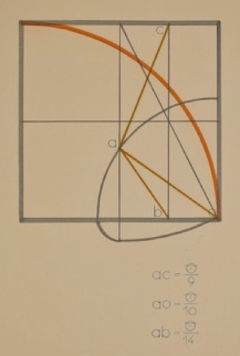
Language of the square
ac: error 0,001%
ao: exact
ab: error 1%
Almada Negreiros and the nonagon
Recreational Mathematics Magazine
Associação Ludus

Slide 7
Gauss-Wantzel’s Theorem
It is possible to divide the circle in n equal parts with straightedge and compass if and only if
n = 2^{k} p₁ … p_{t}
where p₁, …, p_{t} are distinct Fermat primes.
A Fermat prime is a prime of the form 2^{m}+1, where m is a power of 2.
Known Fermat primes: 3, 5, 17, 257 and 65537.
Regular polygons with 7, 9, 14 sides are nor constructible.

Slide 8
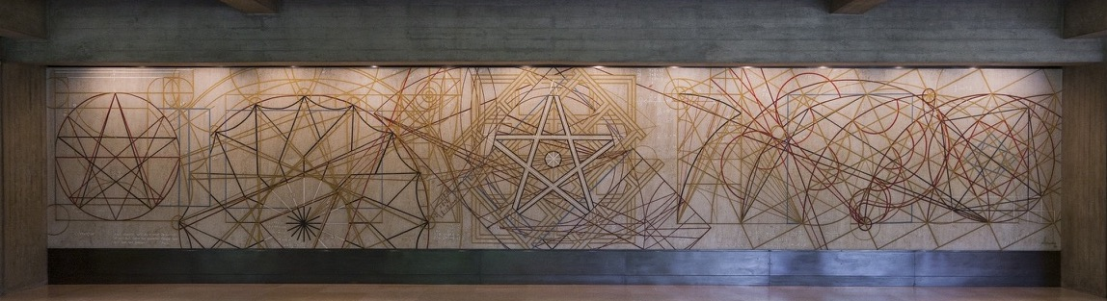
Começar
Mural, 1968/69. Fundação Calouste Gulbenkian, Lisboa

Slide 9
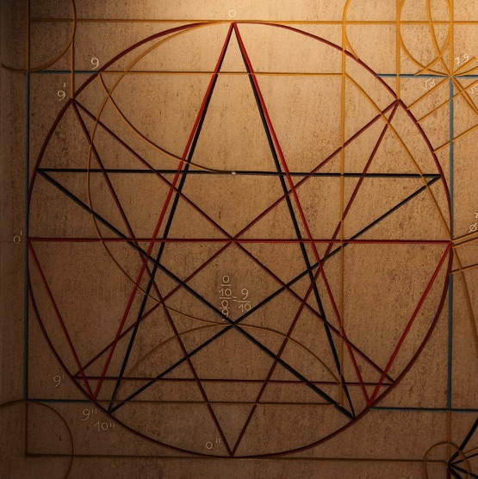
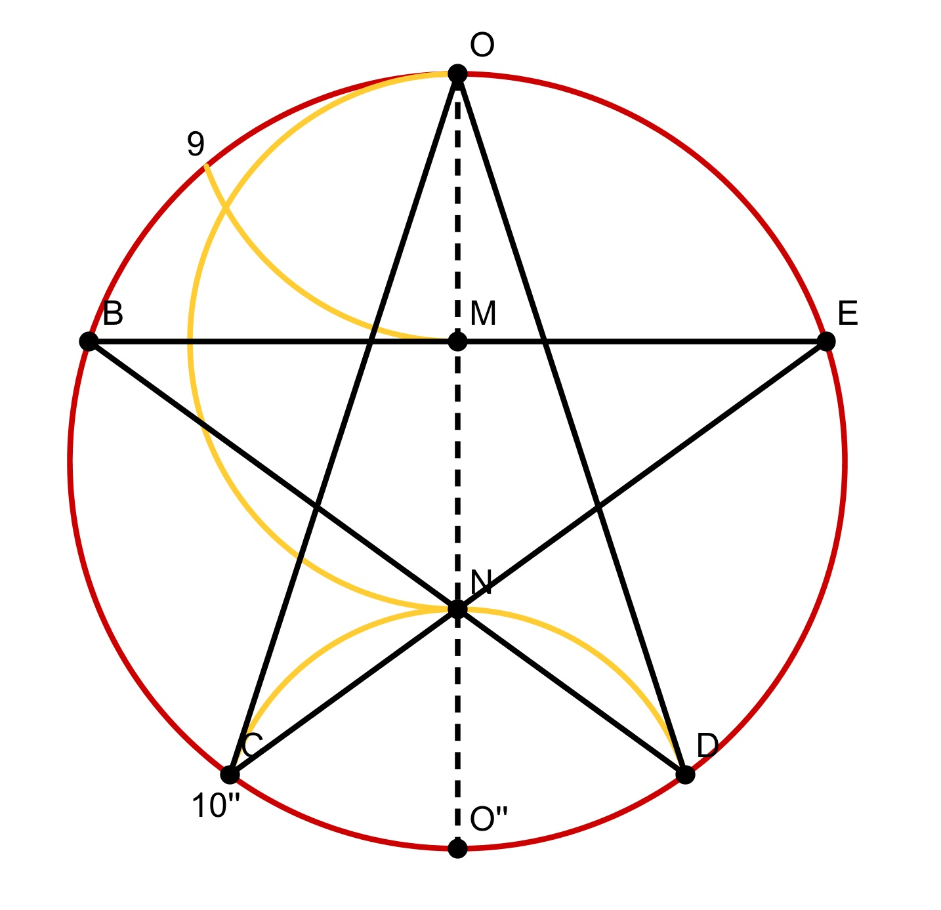
Pentalpha
Error in O/9: 1%
2r = 2 O/9 + O/10

Slide 10
More on this
• Almada and the Geometric Canon, Journal of Mathematics and the Arts (2015)
• Almada Negreiros and the nonagon, Recreational Mathematics Magazine (2015)

Slide 11
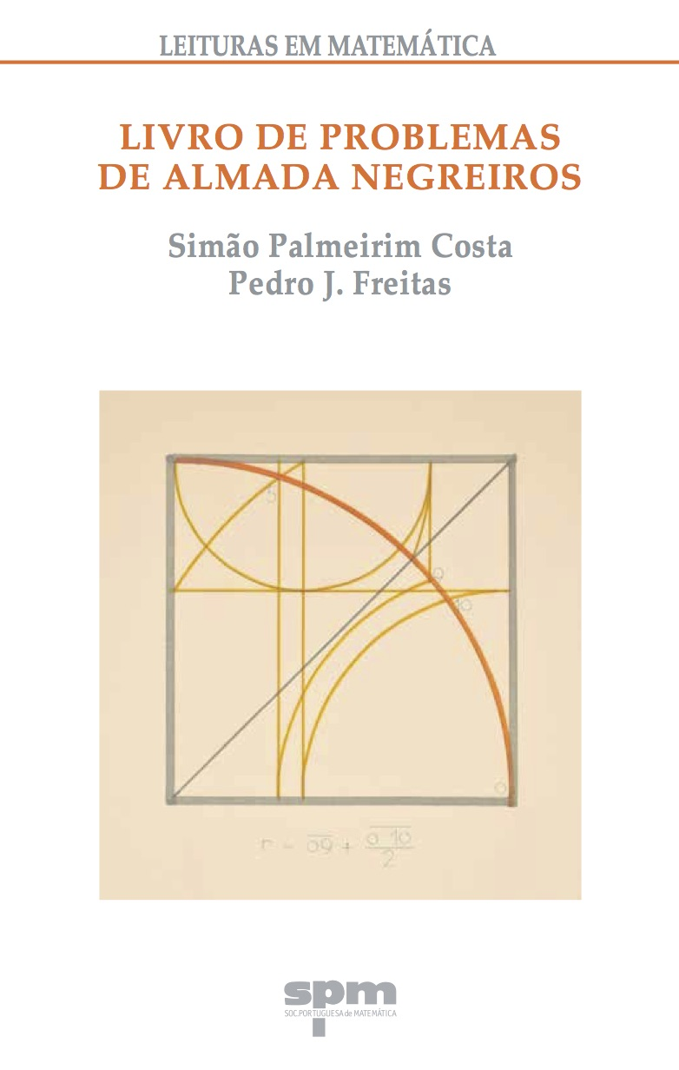
More on this

