Slide 1
Cardioids in Coffee Cups
Dominika Vasilkova (@dragon_dodo)

Slide 2
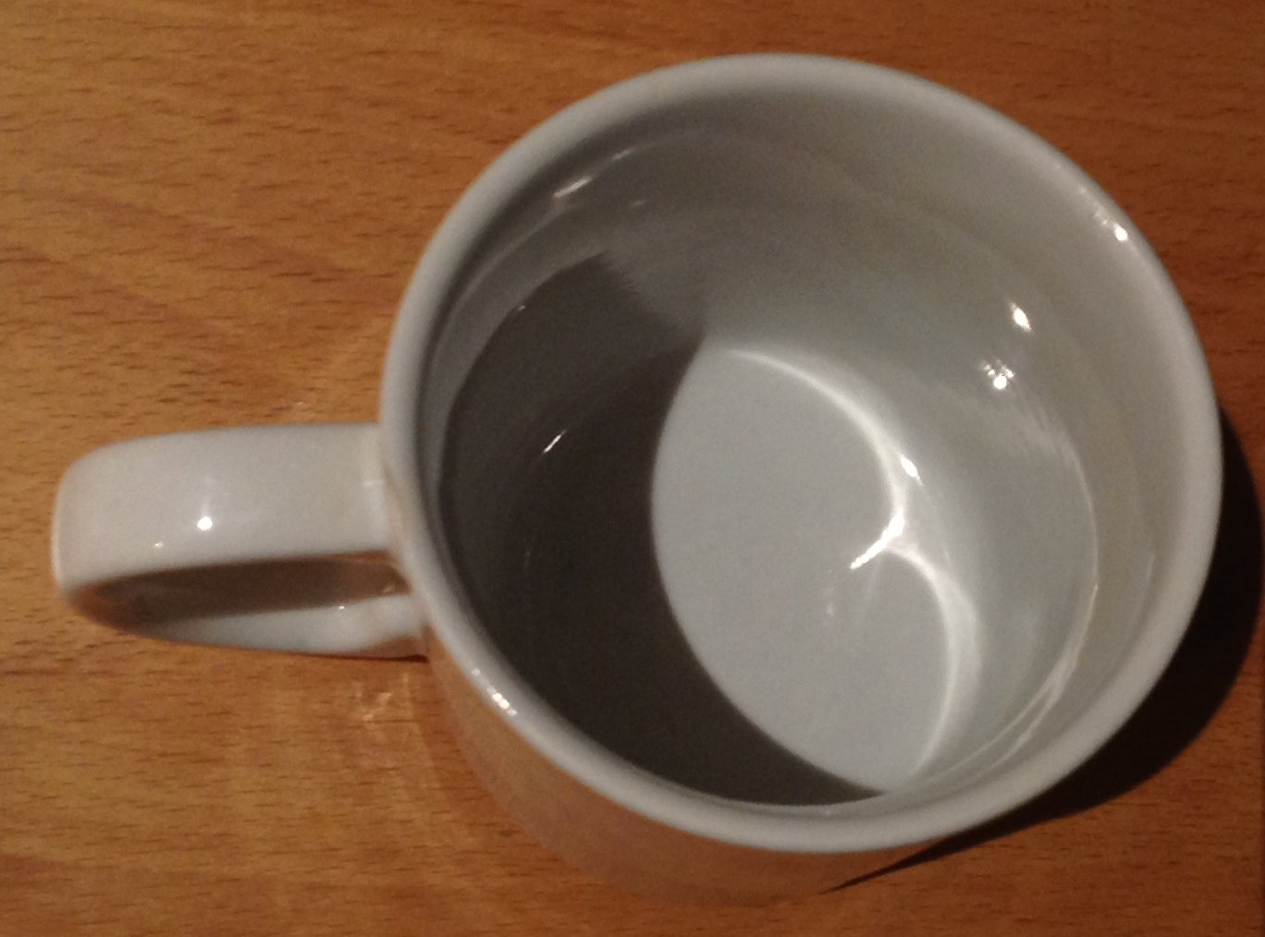
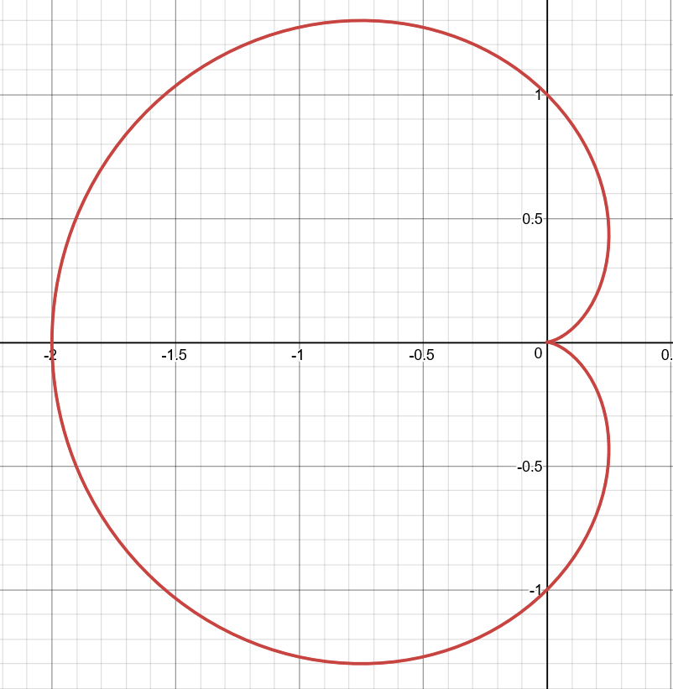

Slide 4
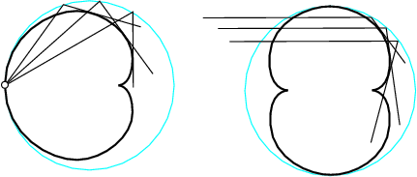
But according to maths, I’m wrong
With uniformly spaced light – actually a nephroid
Point source gives a cardioid, though.

Slide 5
But cups are 3D…oh no.
I didn’t realise this for an embarrassingly long time.

Slide 6
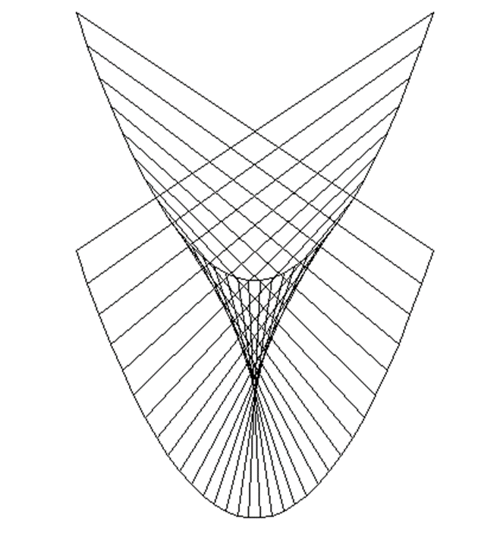

Slide 7
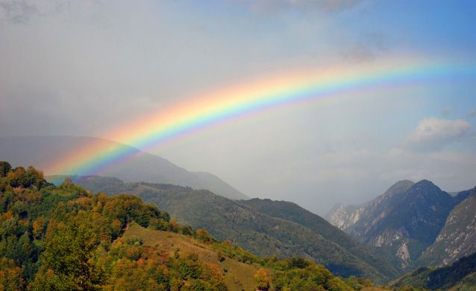
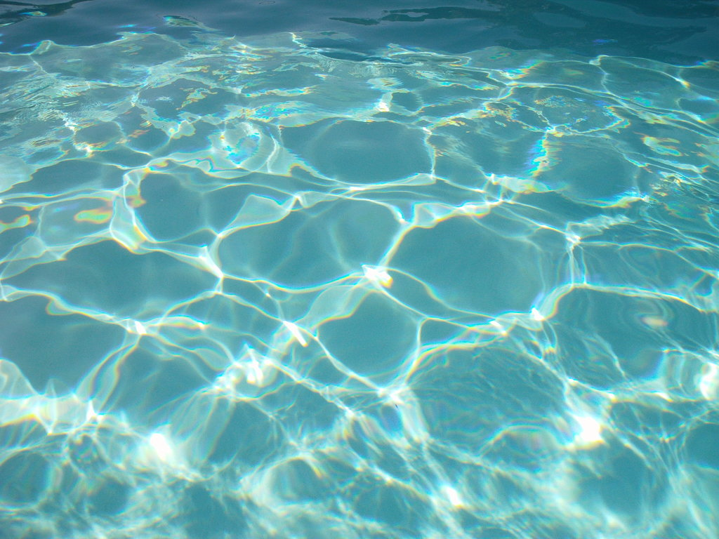
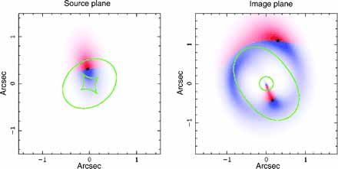
Other places to see caustics

Slide 8
Thanks for listening!
Image credits:
https://thatsmaths.com/2014/09/25/curves-with-singularities/
http://www.tankonyvtar.hu/hu/tartalom/tamop425/0038_matematika_Miklos_Hoffmann-Topology_and_differential_geometry/images/caustic_circle.png
http://www.singsurf.org/parade/caustics.php
http://www.mnn.com/earth-matters/climate-weather/photos/10-stunning-images-of-rainbows-and-their-less-famous-cousins/at
http://emerald-stock.deviantart.com/art/Blue-water-light-302043993
http://www.ams.org/news/math-in-the-media/mmarc-07-2003-media#caustics

