Slide 1
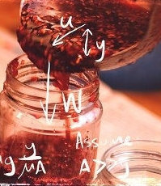
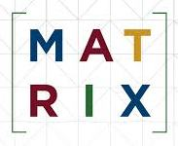

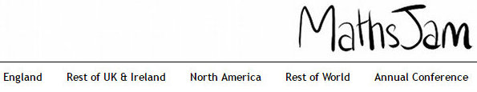

Will you join in?
World Maths Year 2020
Or maybe 2025? - a possible legacy for this conference
John Bibby: jb43@York.ac.uk
2

Slide 2
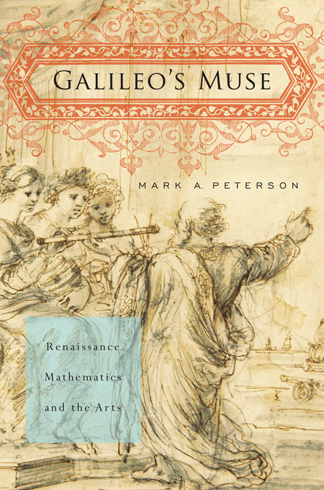
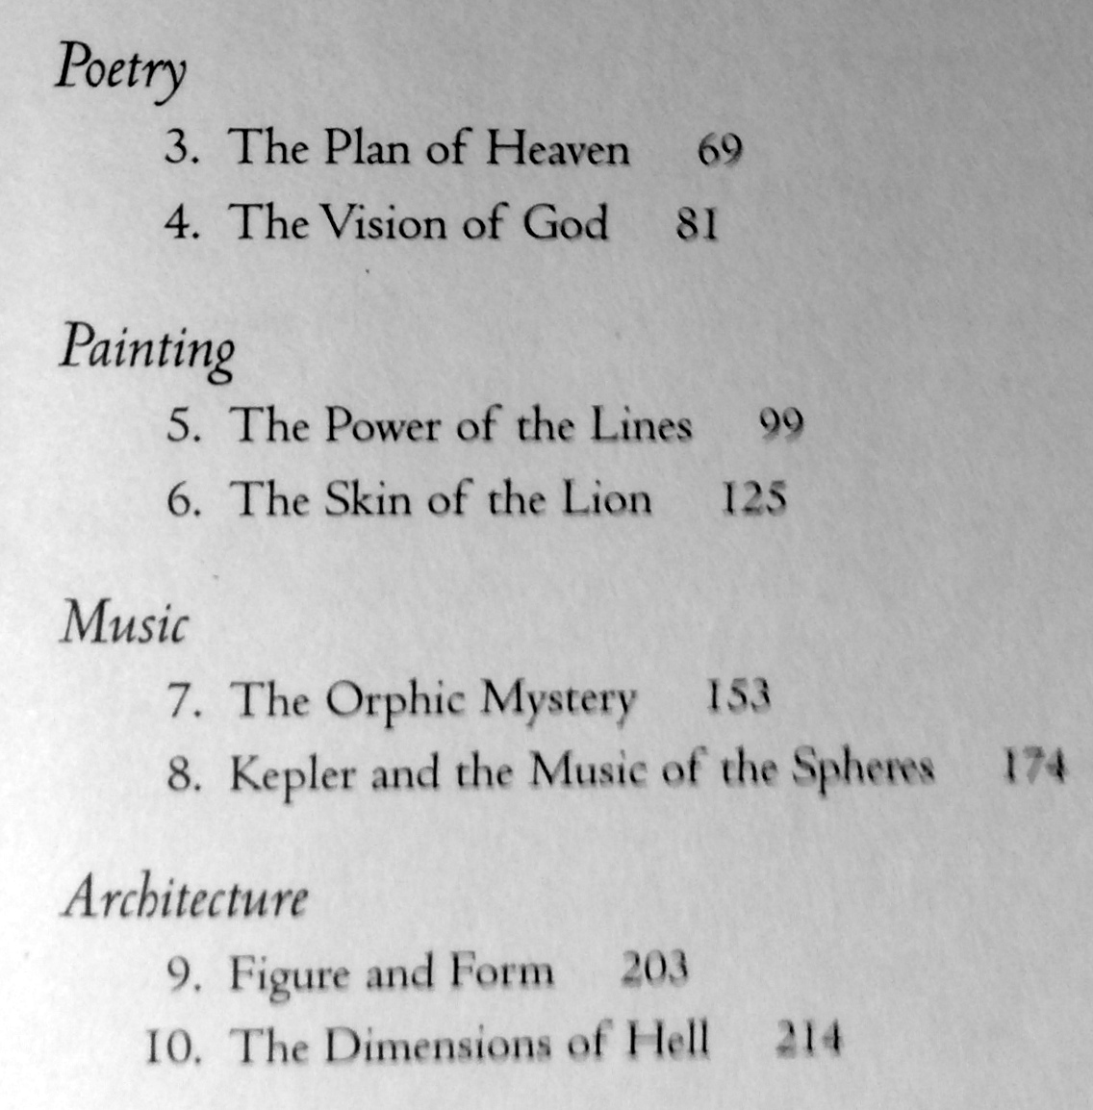
Contents:
Galileo’s Muses: Poetry, Painting, Music, Architecture (including Dante’s “Dimensions of Hell”!)
Mark Peterson (2011) Galileo’s Muse.
Harvard University Press.
Notes:
What are our Muses?
Get away from disciplinary silos.
It may seem ironic that mathematics is the most theoretical of subjects, but at the same time has unreasonable effectiveness in so many areas (Wigner 1960).
Mark Peterson (2011) traces modern mathematics back via Galileo to Dante’s vision of hell (! – chapter 10), and beyond that to poetry, painting, music and architecture – the renaissance arts, not the sciences. Perhaps it is here that we may find our mathematical muses. However, I want to look forward and explore more tongue-in-cheek potential muses for our mathematical future.
Mark Peterson (2011) Galileo’s Muse. Harvard University Press.
Eugene Wigner (1980) “The Unreasonable Effectiveness of Mathematics in the Natural Sciences.”
R.W. Hamming (1980) “The Unreasonable Effectiveness of Mathematics.” The American Mathematical Monthly 87(2):81–90.

Slide 3
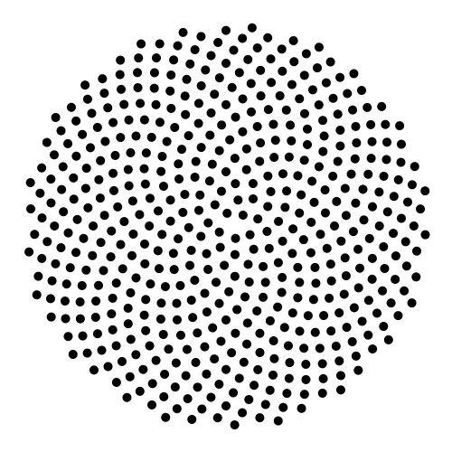
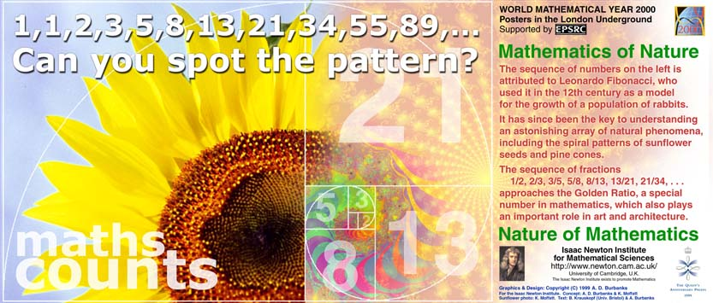
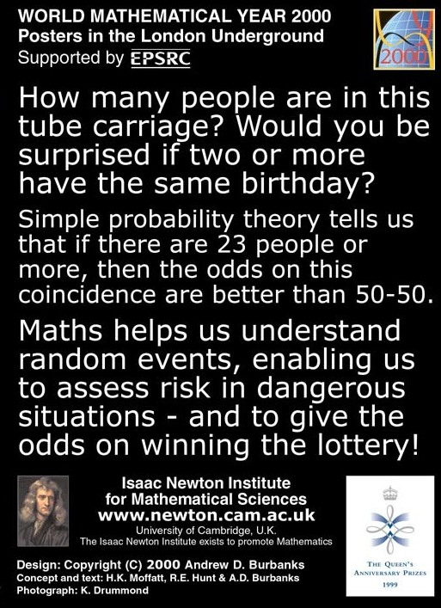
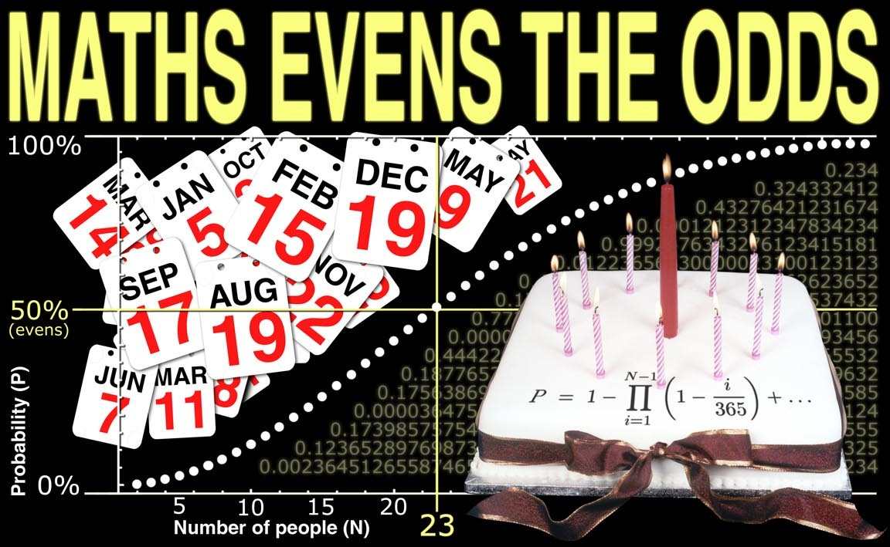
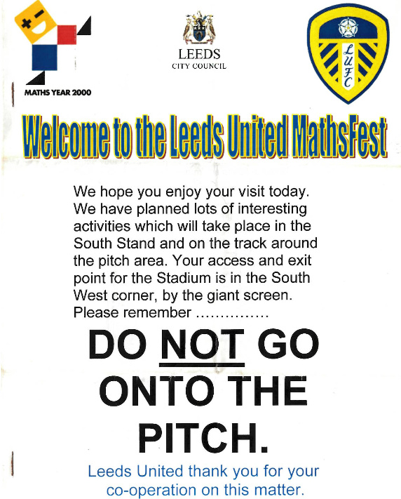
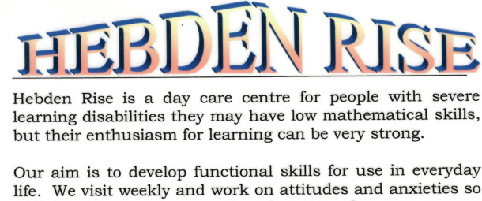
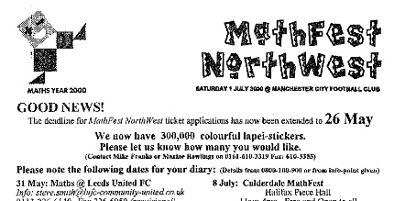
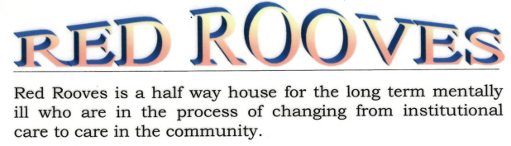
Out of the silo (1): Physical silos
(Get out of the building: build bridges to
“Non-standard learning environments”)
On the buses / On the train (and stations and stops)
In the home (care-homes, Arclight, Hebden Rise)
On the street (youngsters, offenders, homeless people)
Cafes & pubs: beermat(h)s, quizzes, napkins, tablecloths incl. origami
Sports arenas: MathFests at Leeds United & Manchester City
Shopping malls
Car boot sales
Informal learning “Out of the box”
Breaking barriers, Building bridges
Physical walls
Academic silos

Slide 4
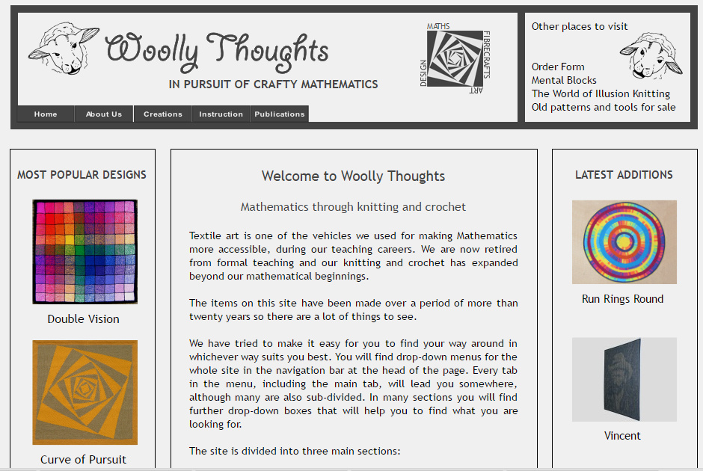
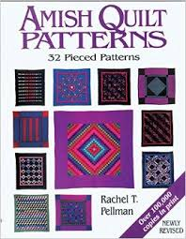
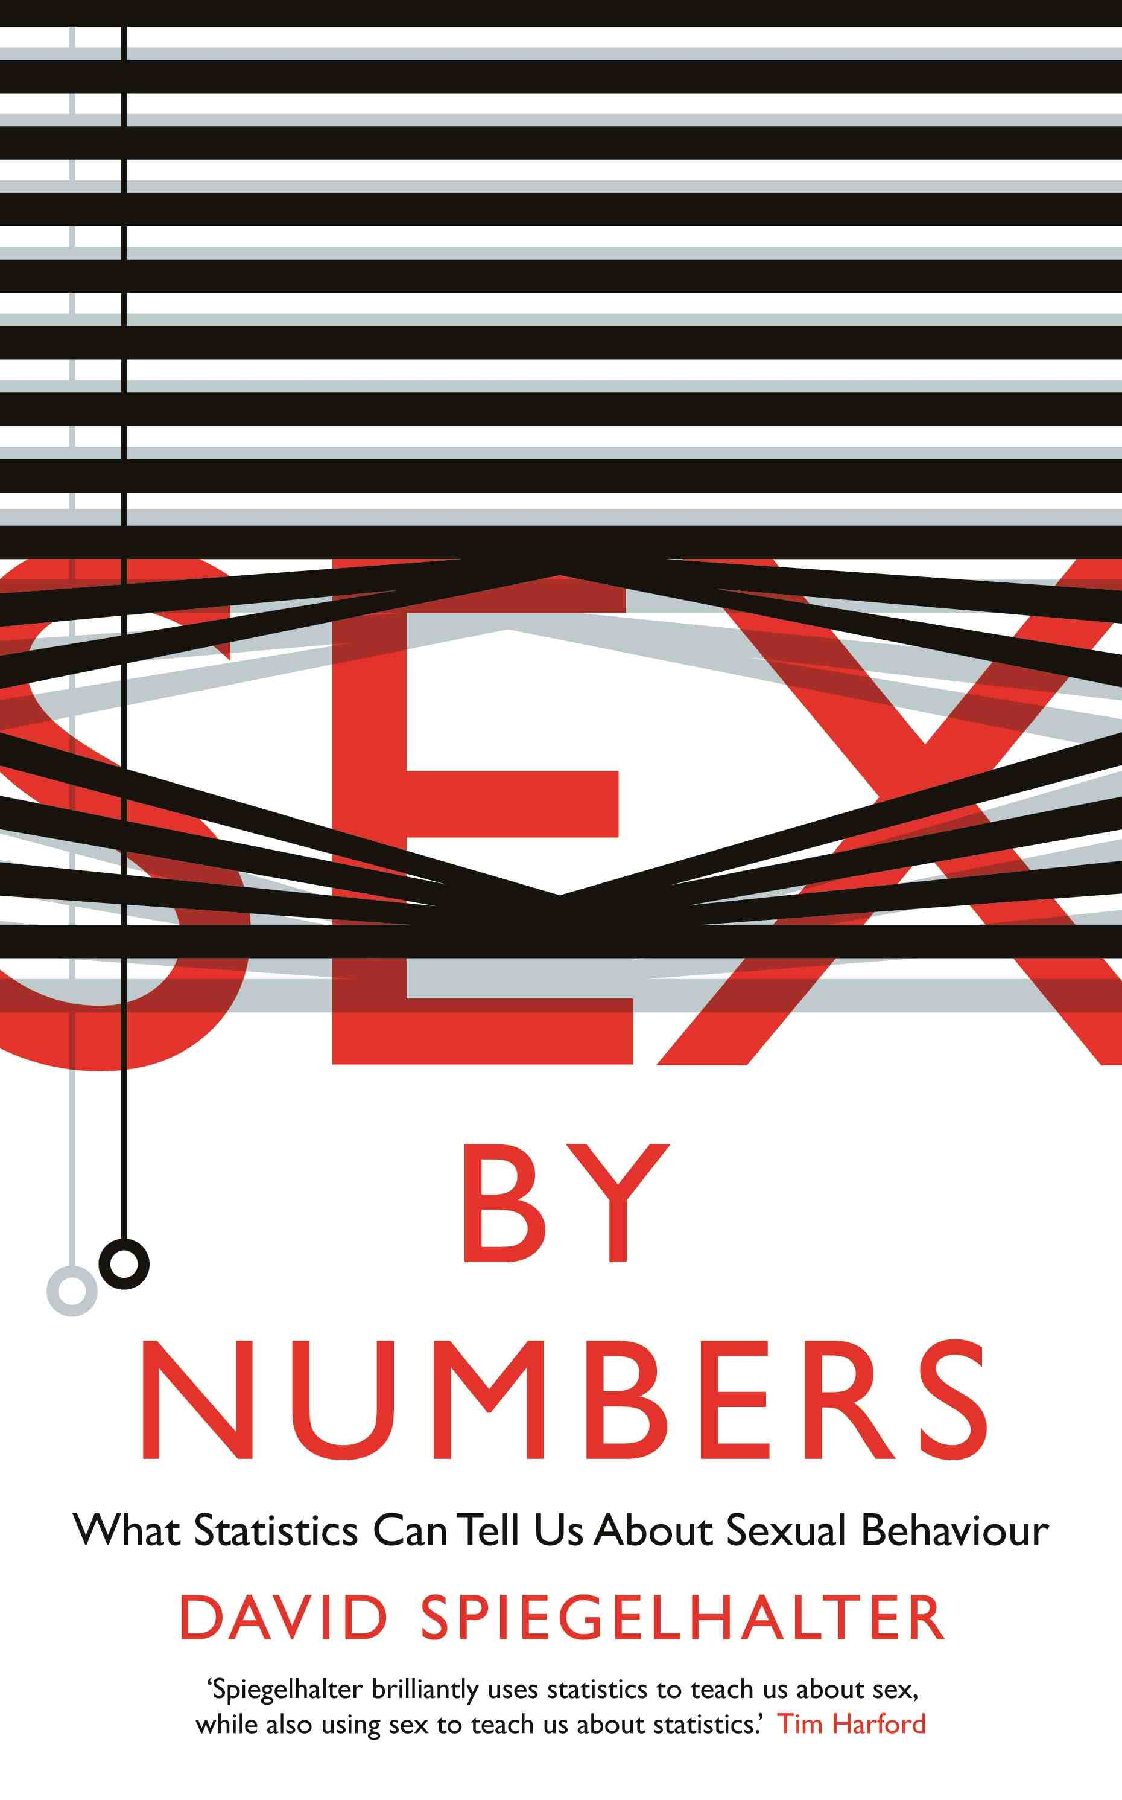
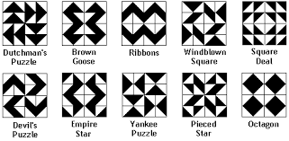
Out of the silo (2): Intellectual silos
(Get out of the box: build bridges to other disciplines & non-disciplines)
“Maths and X”: x member of {{accounting, acupuncture, archaeology, art, …. youth development, zoology, zymology, …}}
Hobbies & everyday activities too: (archery, beer, chess, drama, …gardening, … knitting, … quilts, … sport, … war, xylophones, youth, zebras)
Health & Risk
Joint activities e.g. suitable for both
numeracy and literacy curriculums
Notes:
Maths is hard like a diamond. And like a diamond it combines a host of industrial applications with exceptional beauty.

Slide 5
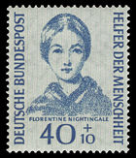
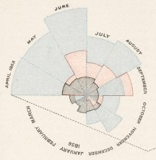
An ideal icon for 2020?
Florence Nightingale
(1820-1910)

Slide 6
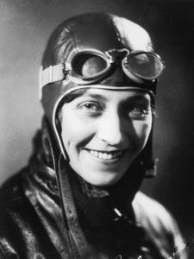

Amy Johnson – a better icon?
Less remote for today’s target groups – in time and in social class
More “mathematical” (engineer/navigation)
A better role-model? (Hull swimming baths – she stood up for ‘women’s rights’ against her headmaster who called swimming ‘unladylike’)

Slide 7
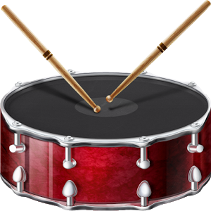
Gender equity or
Social class equity?
Beat the drum!
Beat the bigger drum !!!

Slide 8
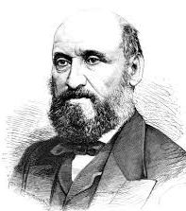
William Farr - part of the “bigger drum” !
Son of an agricultural labour
Contrast to Nightingale who was massively privileged
A greater statistician than Nightingale – and far more than her “statistical assistant”
He probably saved more lives too – via public health
William Farr
(1807-1883)

Slide 9


WMY2020 legacy - this is important!
Ideas from Radical Statistics, Full Fact, and MWUK
MathsJam + Radical Statistics = MathsJam World …. ???
MathsJam Centres - Data World
National network of local “Discovery Centres” (with outreach):
1. Hands-on data exploratory/museum: 'edutainment' from the worlds of science, technology, mathematics, art, music, colour, fun, history, philosophy, politics etc., etc. – all relating to data and information
2. Social venue and meeting-place for events with a science or technology flavour
3. Community resource centre for local community groups and others who use data in their activities.

Slide 10
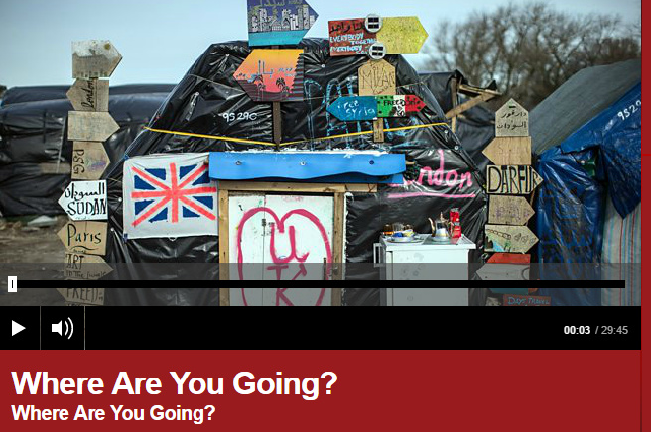
Lastly – on BBC World Service yesterday:
From ‘The Jungle’ migrant camp in Calais
Young maths teacher: “I want to go to UK so I can teach mathematics. It’s what I do. It’s beautiful.”
An impossible dream?
Catherine Carr: “Where are you going?” BBC World Service

Slide 11
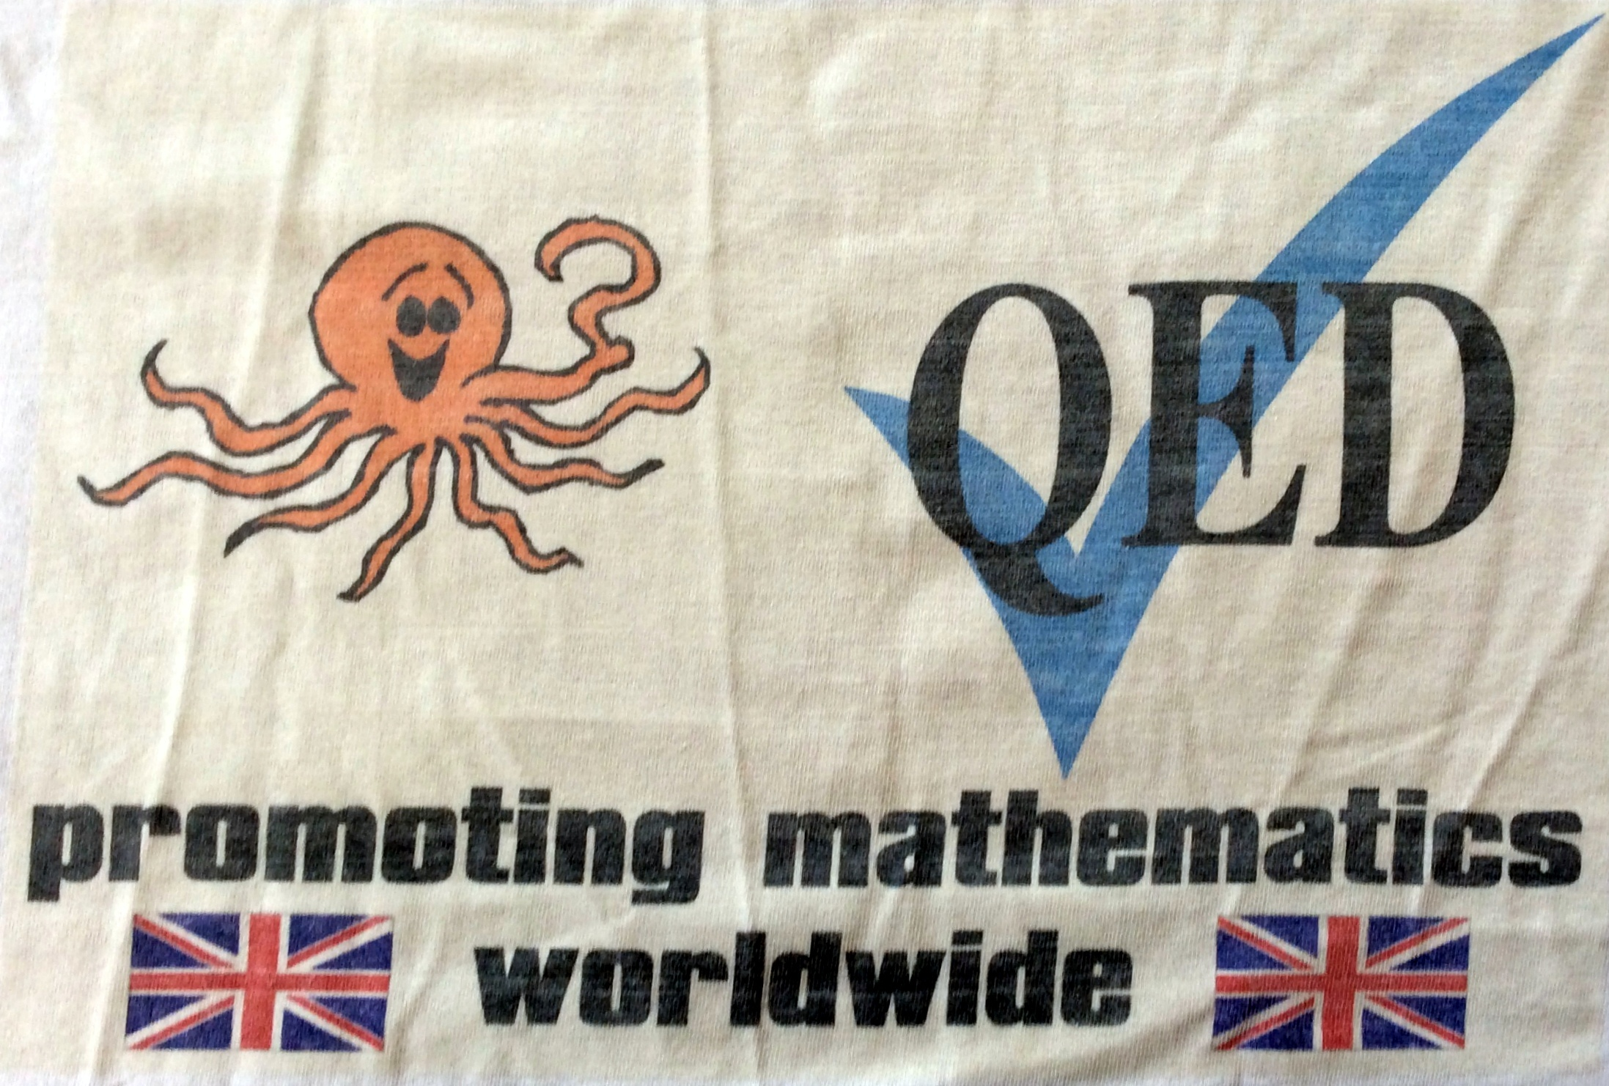

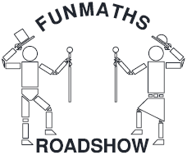
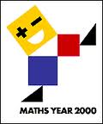
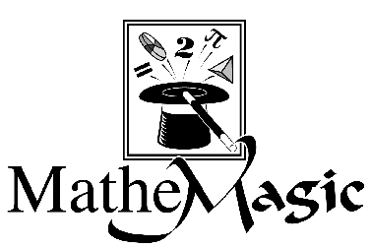
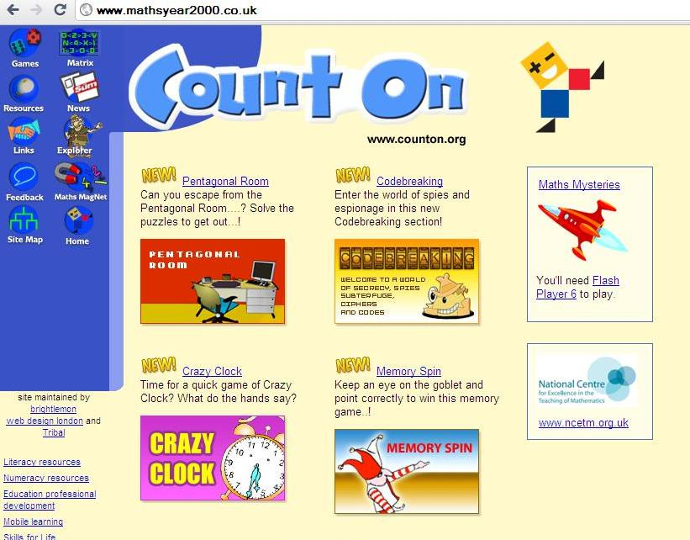
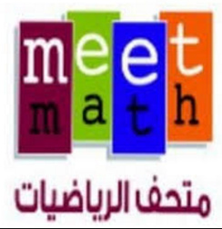
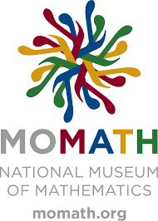
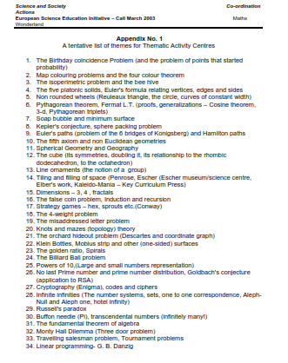





Do we have a critical mass here at MATRIX
along with partners
to turn an “impossible dream”
into WMY 2020 ??
2

Slide 12
Will you join in?
World Maths Year 2020
(and the need for lots more maths t-shirts)
John Bibby: jb43@York.ac.uk
2

