Slide 1












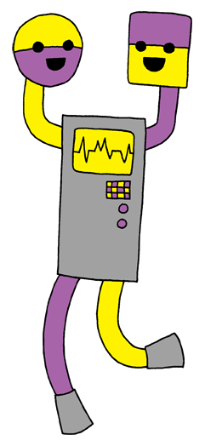
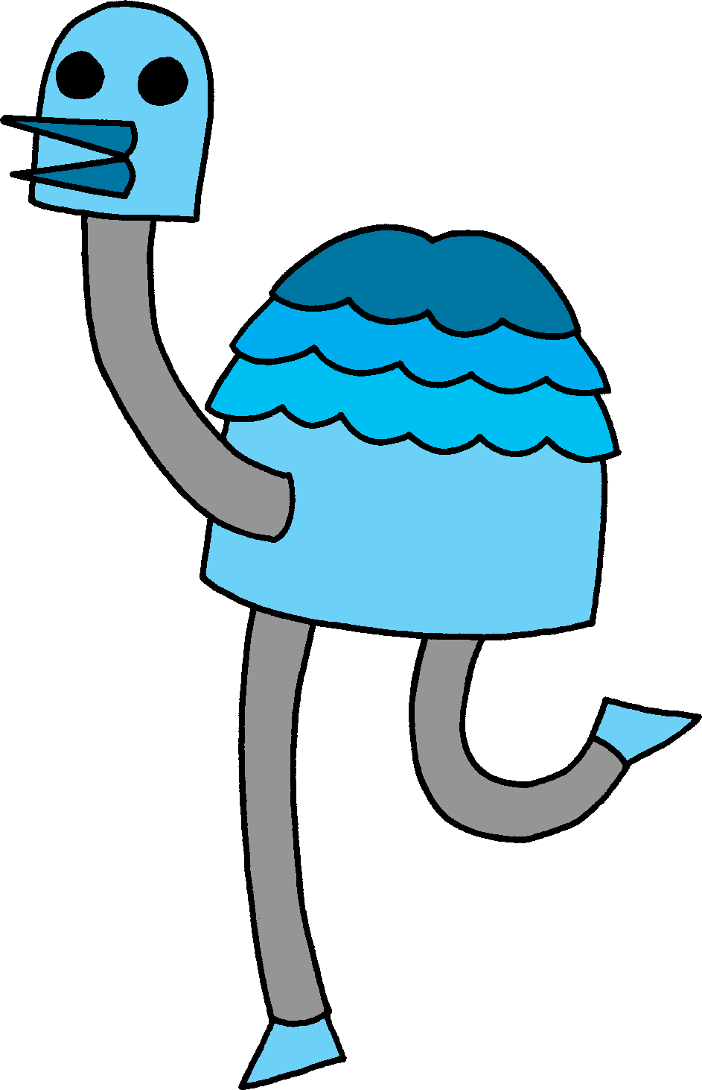

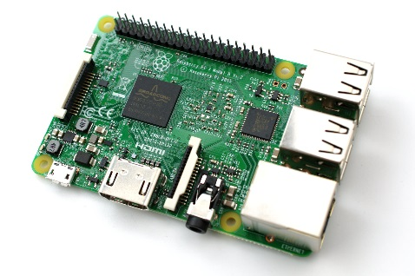
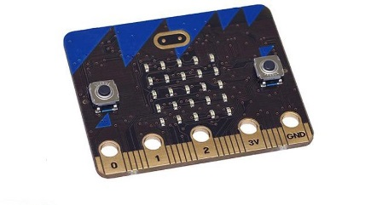
+
+
+
=
Venue
Projects
Children
Volunteer and teacher
Code Club - founded 2012
Joined forces with Raspberry Pi Foundation 2015
Code Club UK is a nationwide network of volunteers and educators
who run free coding clubs for children aged 9 - 11.

Slide 2
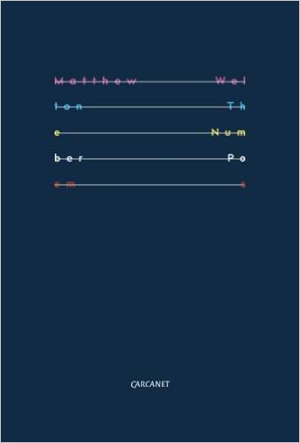

National Poetry Day 6th October – Matthew Welton – The Number Poems

Slide 3
Roosters Roost
Roosters Swallow
Roosters Warble
Roosters Grouse
Roosters Duck
Roosters Crow
Swallows Roost
Swallows Swallow
Swallows Warble
Swallows Grouse
Swallows Duck
Swallows Crow
Warblers Roost
Warblers Swallow
Warblers Warble
Warblers Grouse
Warblers Duck
Warblers Crow
Grouse Roost
Grouse Swallow
Grouse Warble
Grouse Grouse
Grouse Duck
Grouse Crow
Ducks Grouse
Ducks Swallow
Ducks Warble
Ducks Grouse
Ducks Duck
Ducks Crow
Crows Roost
Crows Swallow
Crows Warble
Crows Grouse
Crows Duck
Crows Crow
A Poem in 72 Words

Slide 4
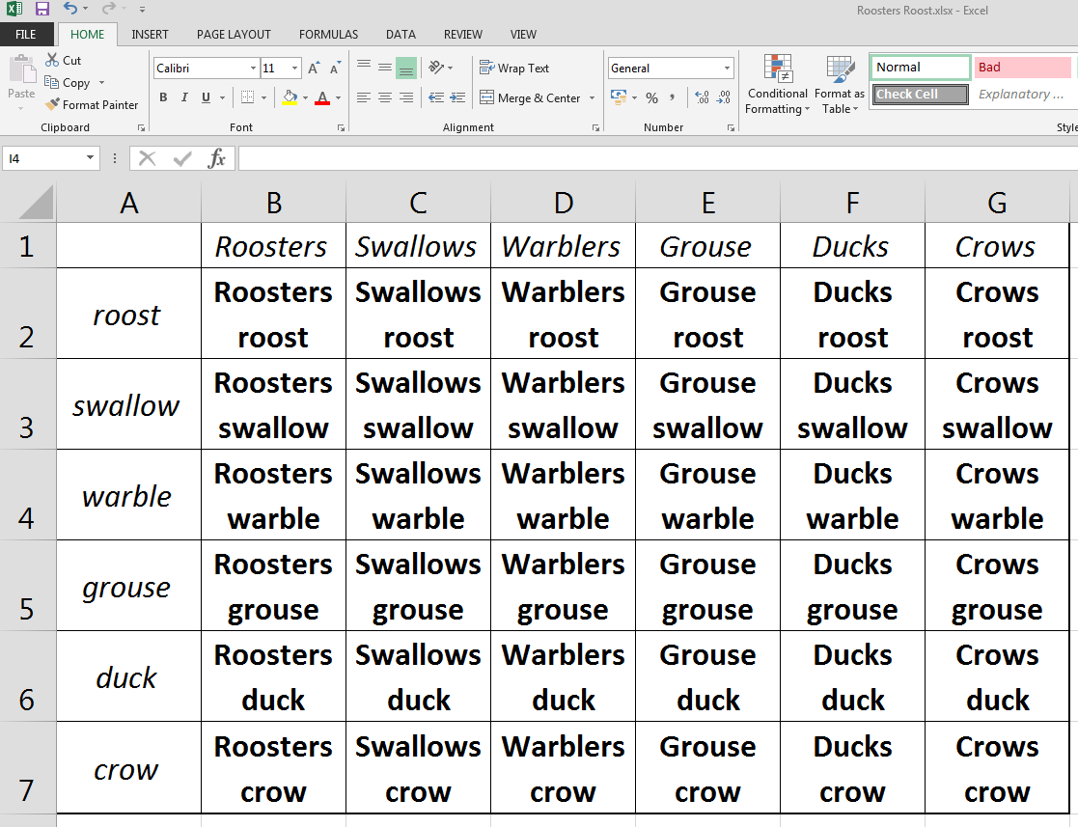

Slide 5
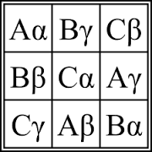
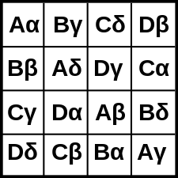


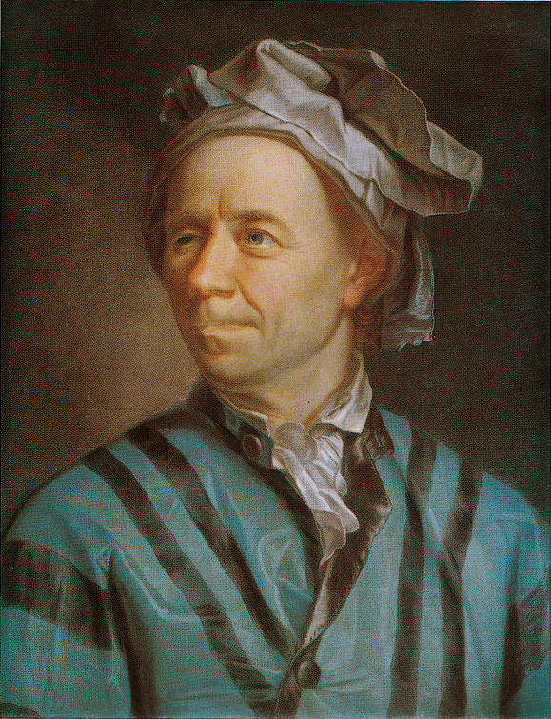
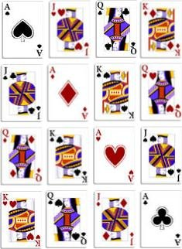
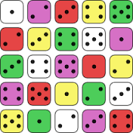
Proof for Order n=2 (k =0)
A α | B β
(A β) | (B α)
A α | B β
(B α) | (A β)
Euler conjectured that there do not exist
Graeco-Roman squares of order n=4k+2 for k=0, 1, 2 …

Slide 6

The non-existence of order-6 squares was confirmed in 1901 by Gaston Tarry through a proof by exhaustion
In April 1959, Parker, Bose, and Shrikhande presented their paper showing Euler's conjecture to be false for all n ≥ 10
… but Eulers conjecture was wrong

Slide 7
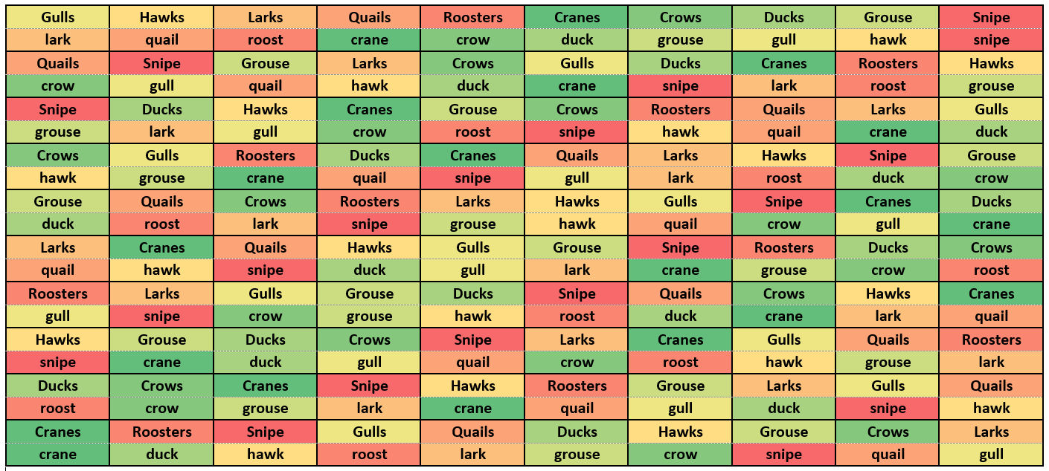
A Poem in 200 Words

Slide 8
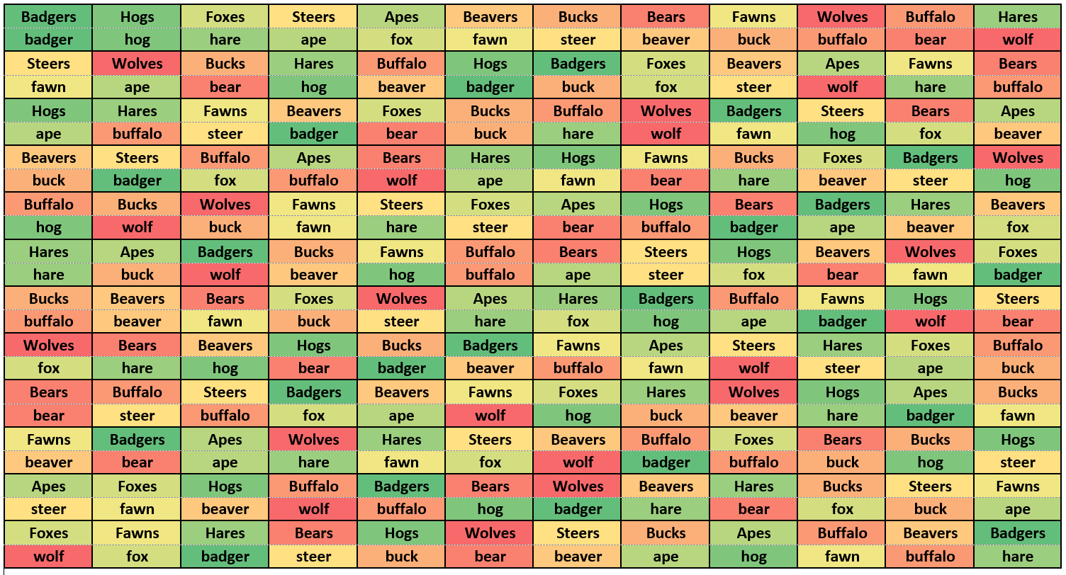
A Poem in 288 Words

Slide 9
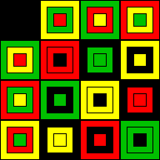
Mutually orthogonal Latin squares
A set of Latin squares is called mutually orthogonal if each Latin square in the set is pairwise orthogonal to all other Latin squares of the set.
Due to the Latin square property, each row and each column has all aspects of each element. Due to the mutually orthogonal property, there is exactly one instance somewhere in the table for any pair of elements.

Slide 10
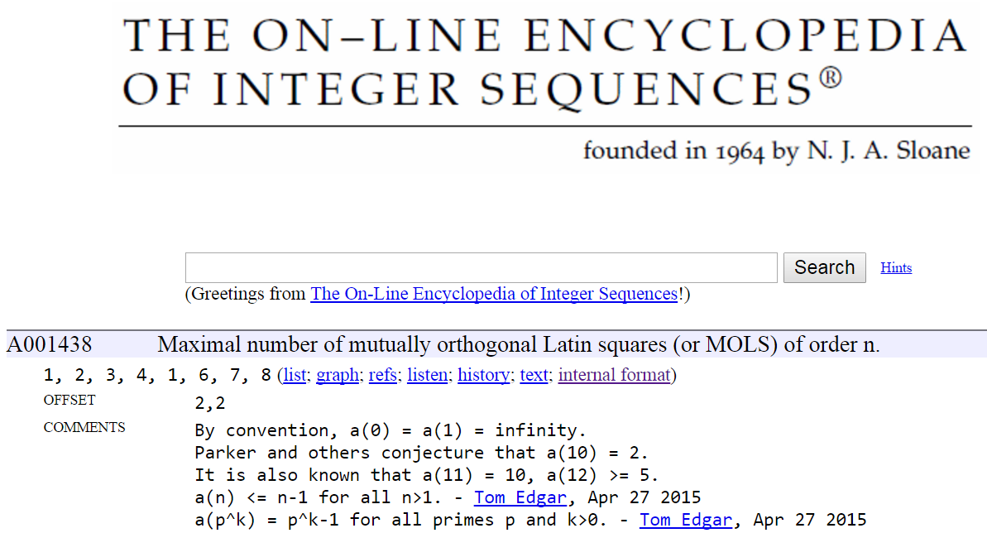

Slide 11
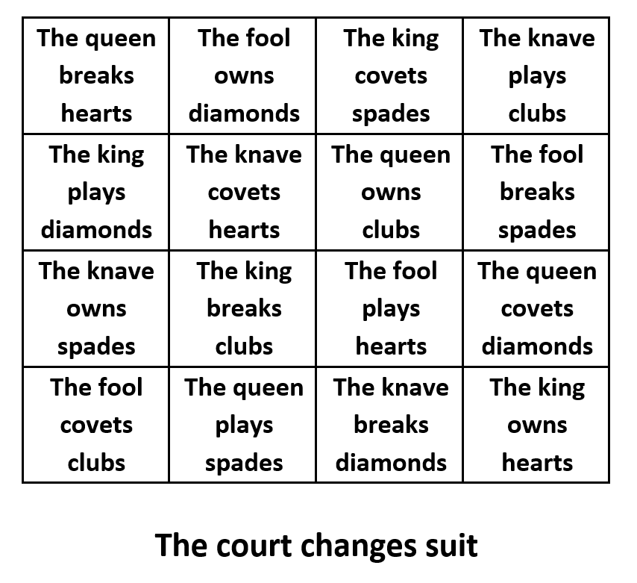

Slide 12


Slide 13
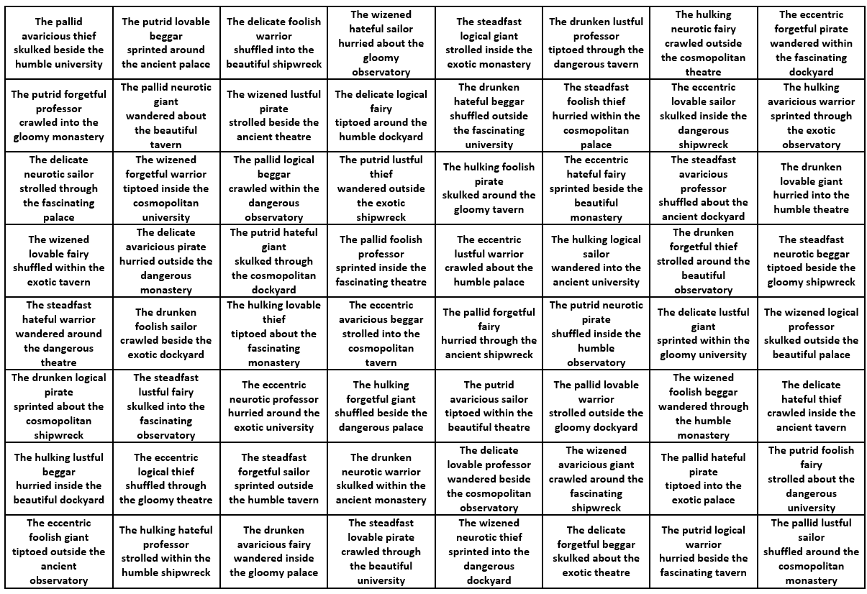

Slide 14

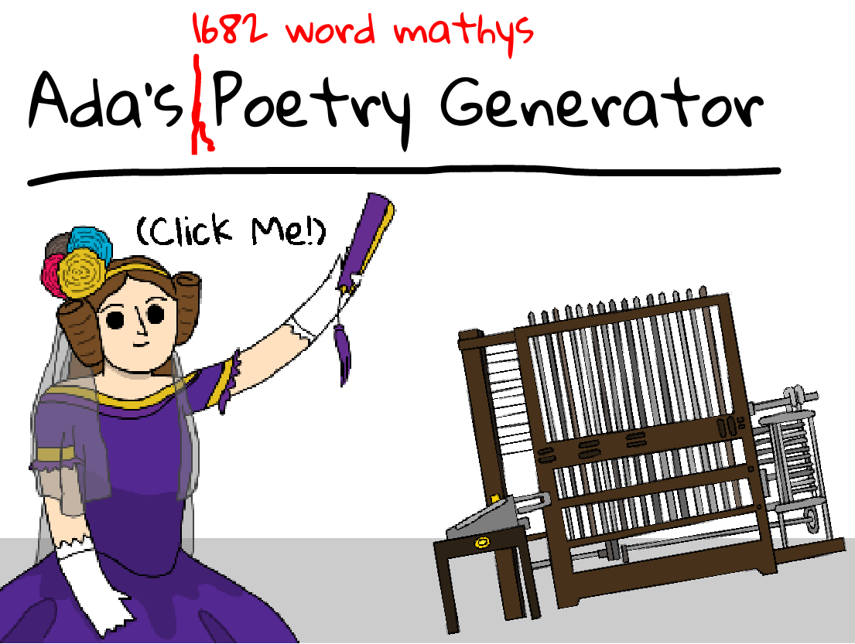
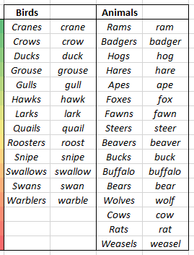




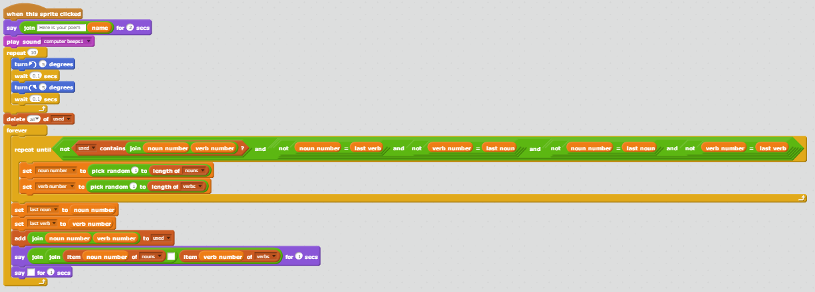
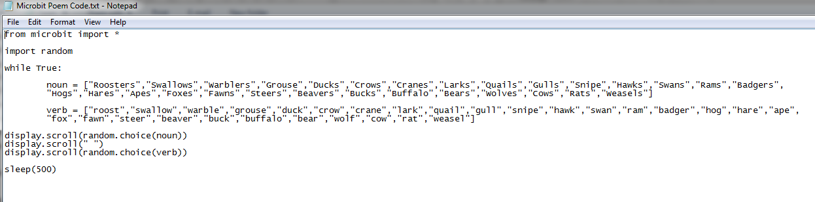
Ada Lovelace Day – 11th October

Slide 15
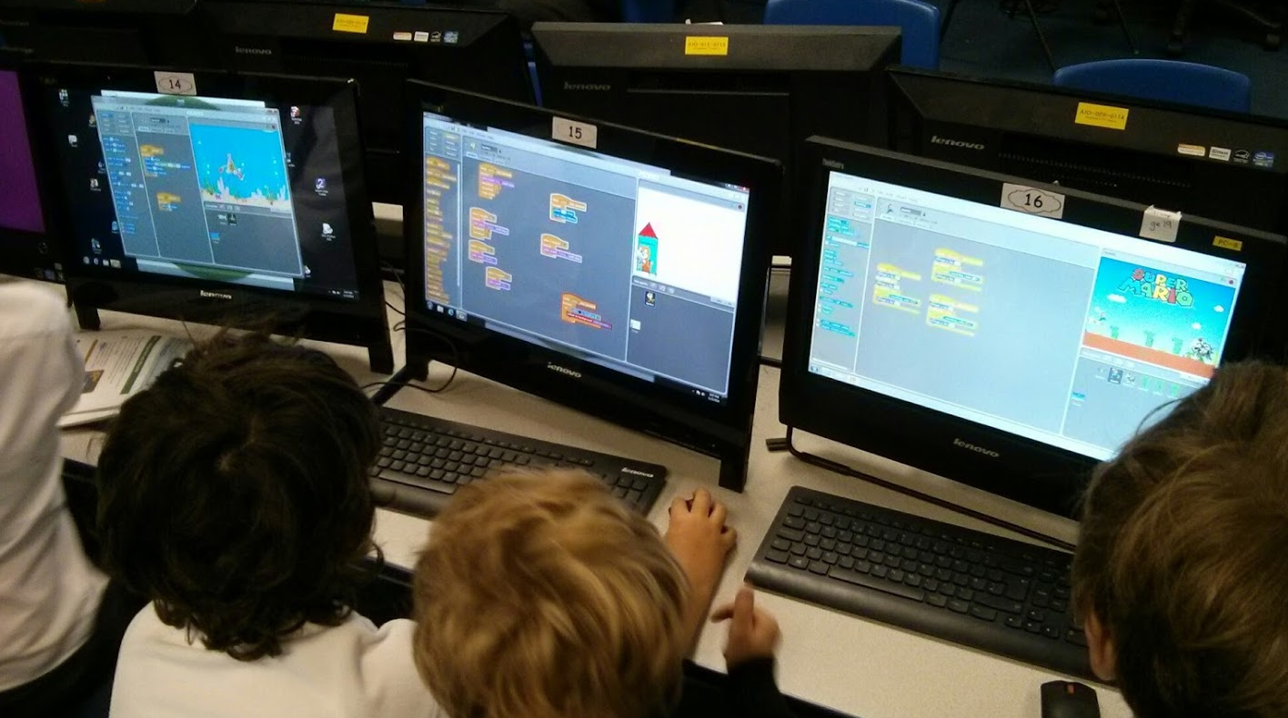
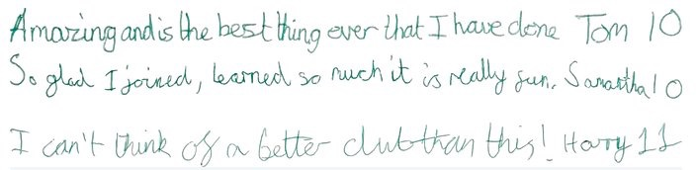
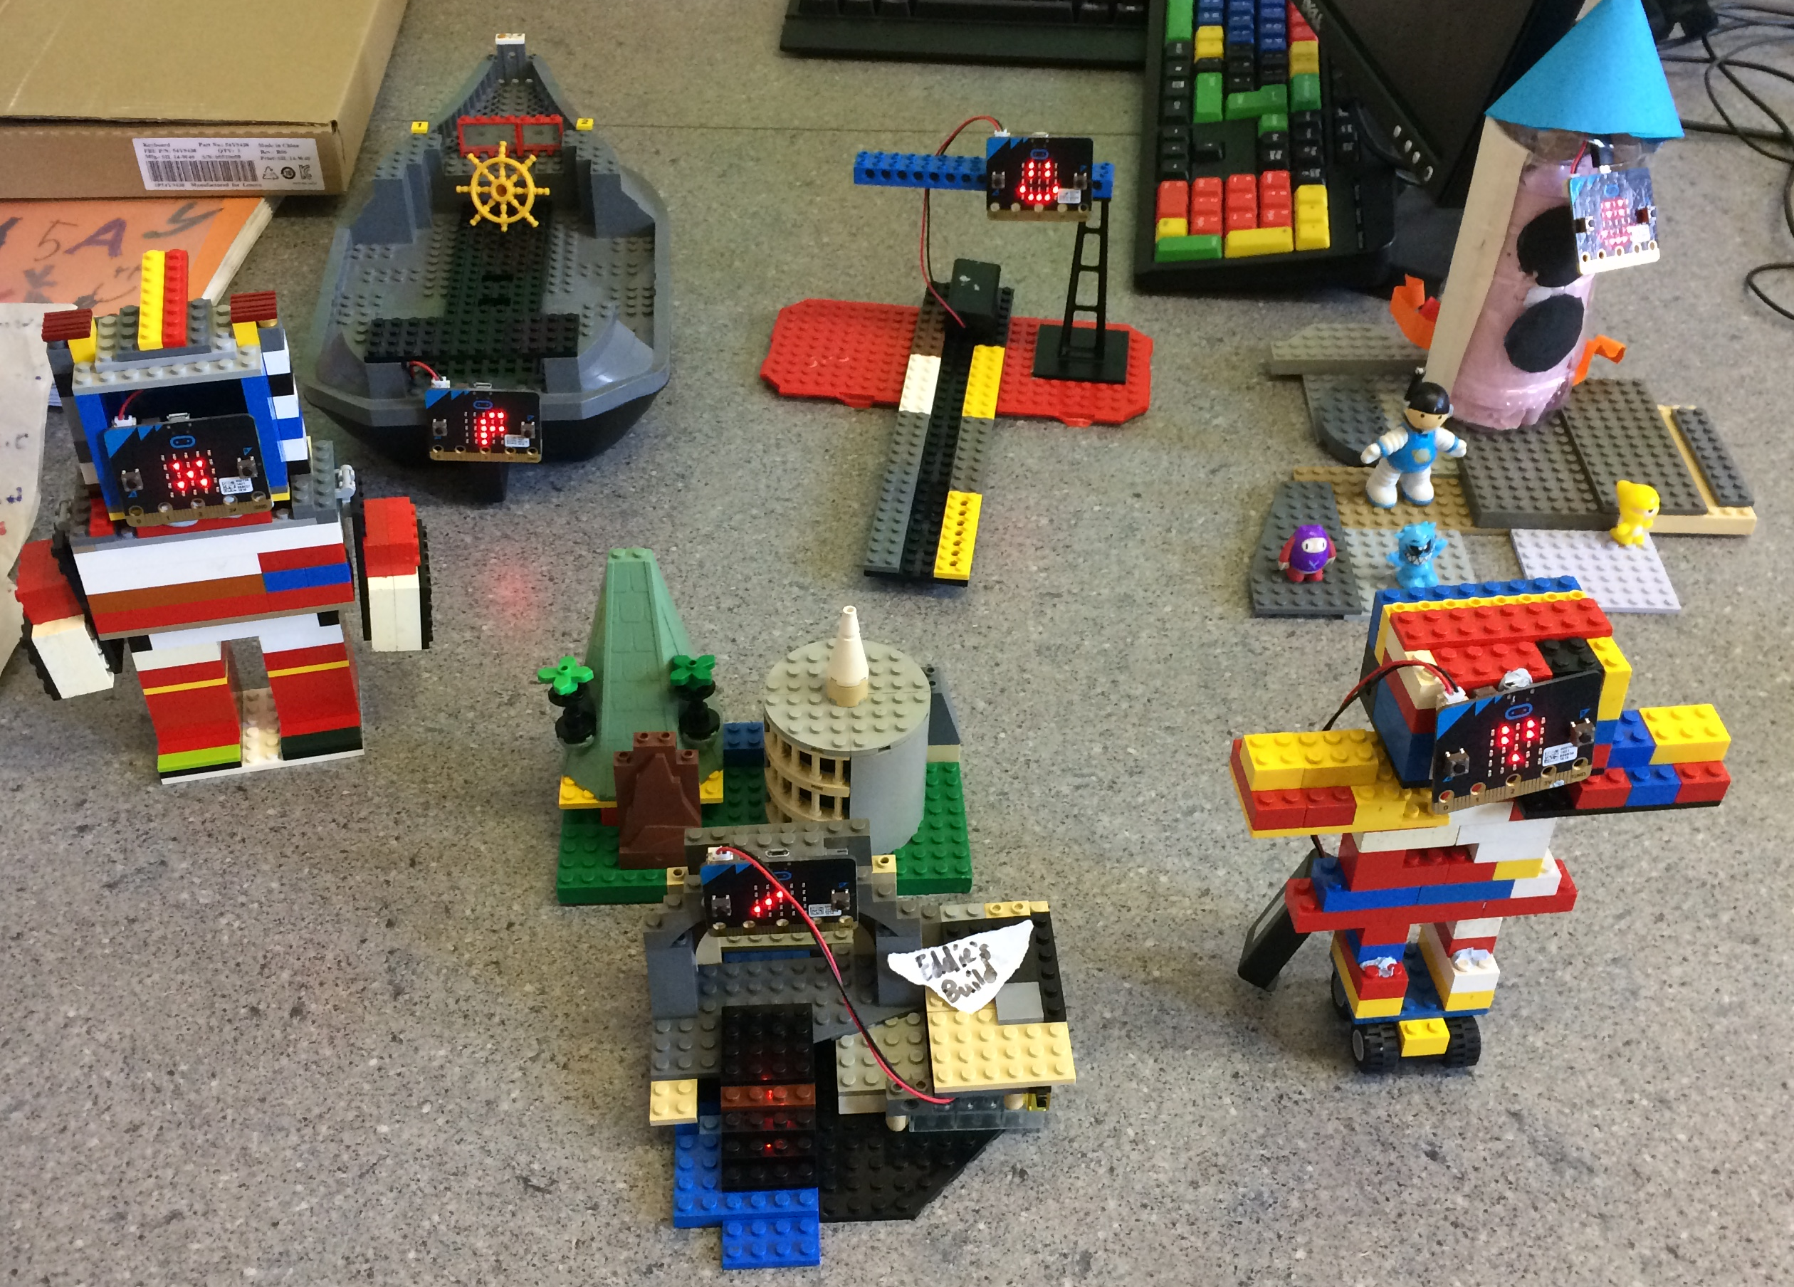
https://www.codeclub.org.uk/

