Slide 1

$$\frac{1}{4}, 6\frac{1}{4}, 12\frac{1}{4}$$

Slide 2
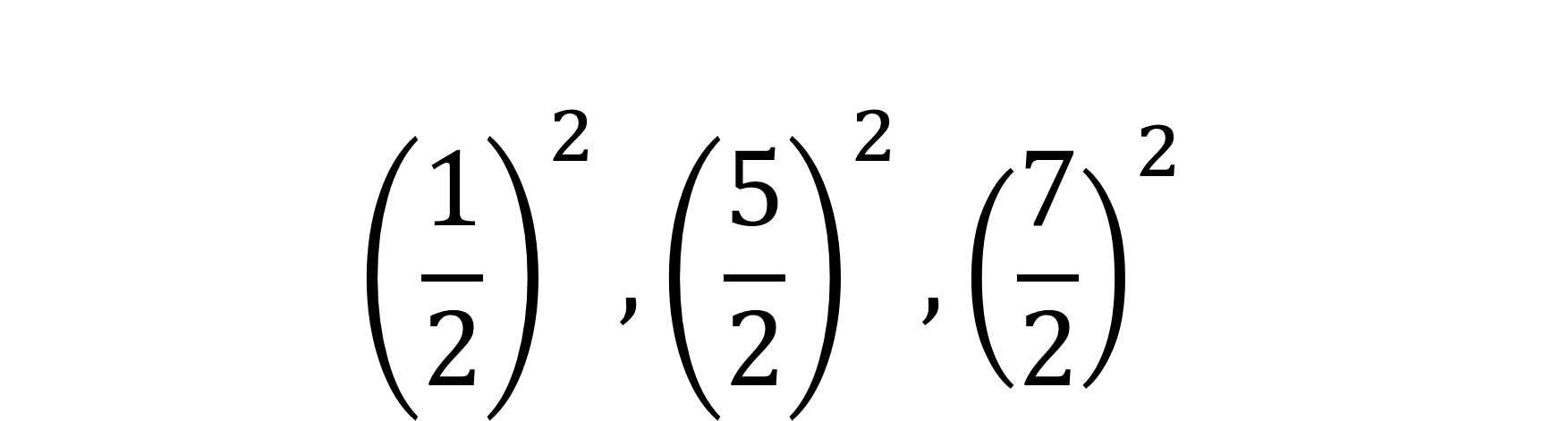
$${\left(\frac{1}{2}\right)}^{2}, {\left(\frac{5}{2}\right)}^{2}, {\left(\frac{7}{2}\right)}^{2}$$

Slide 3

$1^{2}, 5^{2}, 7^{2}$ $d=24$

Slide 4

$1^{2}, 5^{2}, 7^{2}$ $d=24$
$7^{2},{13}^{2},{17}^{2}$ $d=120$

Slide 5
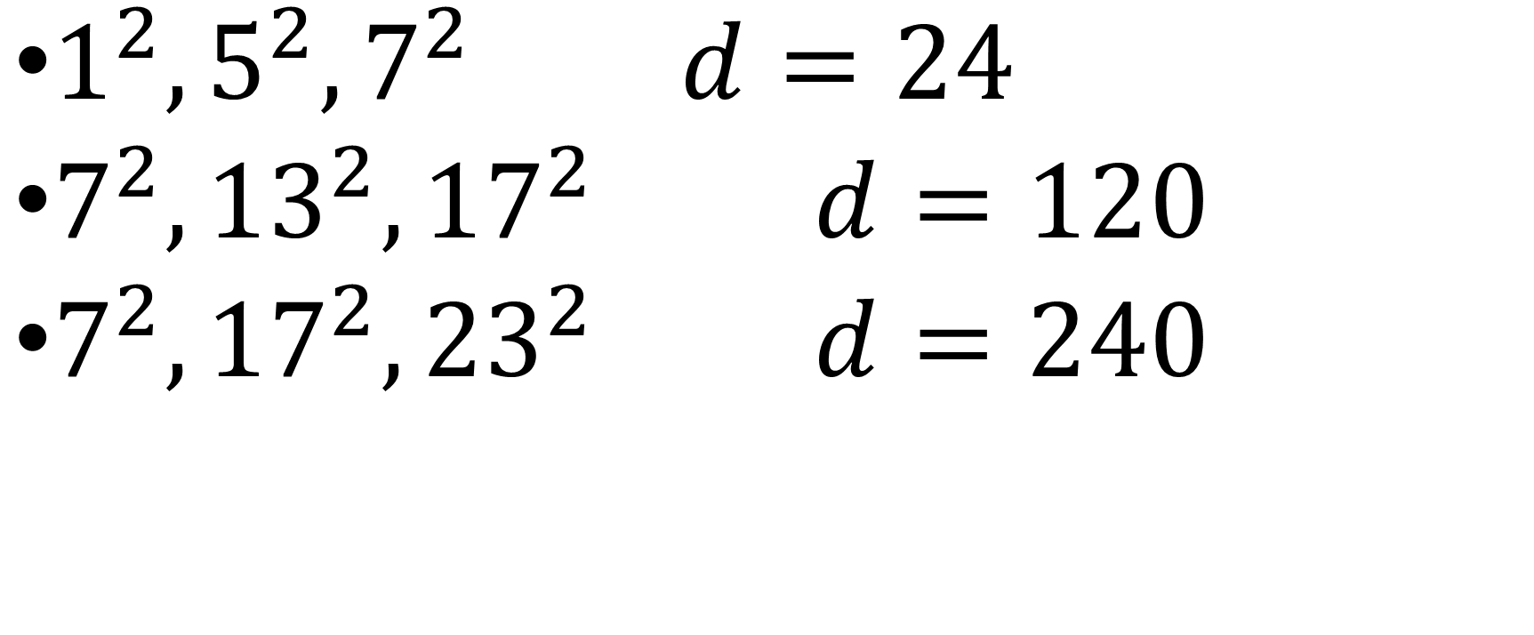
$1^{2}, 5^{2}, 7^{2}$ $d=24$
$7^{2},{13}^{2},{17}^{2}$ $d=120$
$7^{2},{17}^{2},{23}^{2}$ $d=240$

Slide 6

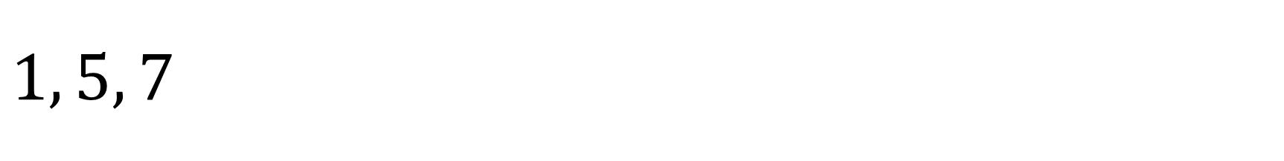
$1, 5, 7$
${\left(\frac{1}{n}\right)}^{2}, {\left(\frac{5}{n}\right)}^{2}, {\left(\frac{7}{n}\right)}^{2}$

Slide 7
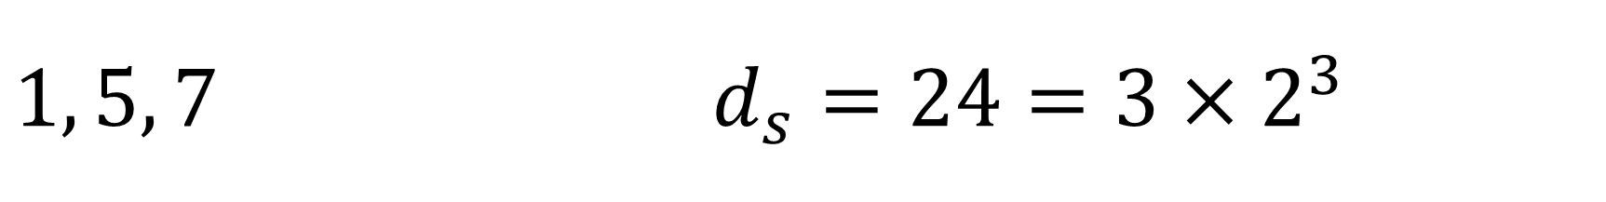
$1, 5, 7$ $d_{s}=24=3×2^{3}$
${\left(\frac{1}{n}\right)}^{2}, {\left(\frac{5}{n}\right)}^{2}, {\left(\frac{7}{n}\right)}^{2}$

Slide 8

$1, 5, 7$ $d_{s}=24=3×2^{3}$
${\left(\frac{1}{n}\right)}^{2}, {\left(\frac{5}{n}\right)}^{2}, {\left(\frac{7}{n}\right)}^{2}$
$n=2$

Slide 9

$1, 5, 7$ $d_{s}=24=3×2^{3}$
${\left(\frac{1}{2}\right)}^{2}, {\left(\frac{5}{2}\right)}^{2},{\left(\frac{7}{2}\right)}^{2}$
$\frac{1}{4},6\frac{1}{4},12\frac{1}{4}$
$d=6$

Slide 10

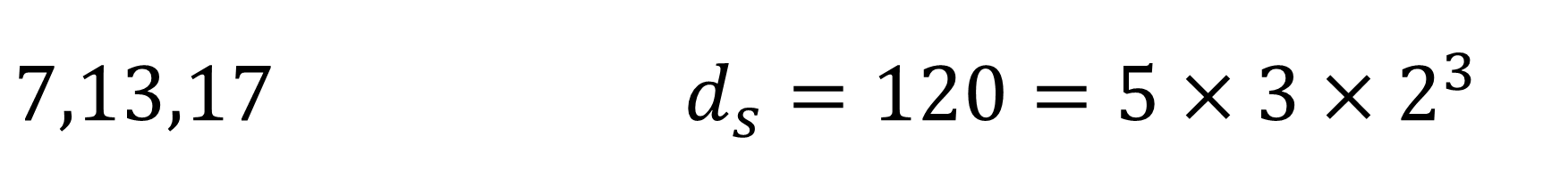
$7,13,17$ $d_{s}=120=5×3×2^{3}$
${\left(\frac{7}{n}\right)}^{2}, {\left(\frac{13}{n}\right)}^{2}, {\left(\frac{17}{n}\right)}^{2}$

Slide 11

$7,13,17$ $d_{s}=120=5×3×2^{3}$
${\left(\frac{7}{n}\right)}^{2}, {\left(\frac{13}{n}\right)}^{2}, {\left(\frac{17}{n}\right)}^{2}$
$n=2$

Slide 12

$7,13,17$ $d_{s}=120=5×3×2^{3}$
${\left(\frac{7}{2}\right)}^{2}, {\left(\frac{13}{2}\right)}^{2}, {\left(\frac{17}{2}\right)}^{2}$
$12\frac{1}{4}, 42\frac{1}{4},72\frac{1}{4}$
$d=30$

Slide 13

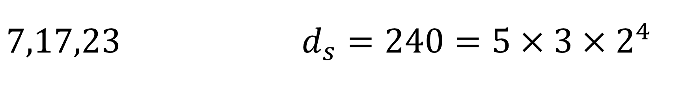
$7,17,23$ $d_{s}=240=5×3×2^{4}$
${\left(\frac{7}{n}\right)}^{2}, {\left(\frac{17}{n}\right)}^{2}, {\left(\frac{23}{n}\right)}^{2}$

Slide 14

$7,17,23$ $d_{s}=240=5×3×2^{4}$
${\left(\frac{7}{n}\right)}^{2}, {\left(\frac{17}{n}\right)}^{2}, {\left(\frac{23}{n}\right)}^{2}$
$n=2$
$n=4$

Slide 15

$7,17,23$ $d_{s}=240=5×3×2^{4}$
$n=2$
${\left(\frac{7}{2}\right)}^{2}, {\left(\frac{17}{2}\right)}^{2}, {\left(\frac{23}{2}\right)}^{2}$
$12\frac{1}{4}, 72\frac{1}{4}, 132\frac{1}{4}$
$d=60$

Slide 16

$7,17,23$ $d_{s}=240=5×3×2^{4}$
$n=4$
${\left(\frac{7}{4}\right)}^{2}, {\left(\frac{17}{4}\right)}^{2}, {\left(\frac{23}{4}\right)}^{2}$
$3\frac{1}{16}, 18\frac{1}{16},33\frac{1}{16}$
$d=15$

Slide 17

There is a 3 term AP of squares with $$d =5$$

