Slide 1
Guess Who
missed a trick?
Michael Gibson

Slide 2
“Standard” Guess Who?
(1979 version)

Slide 3
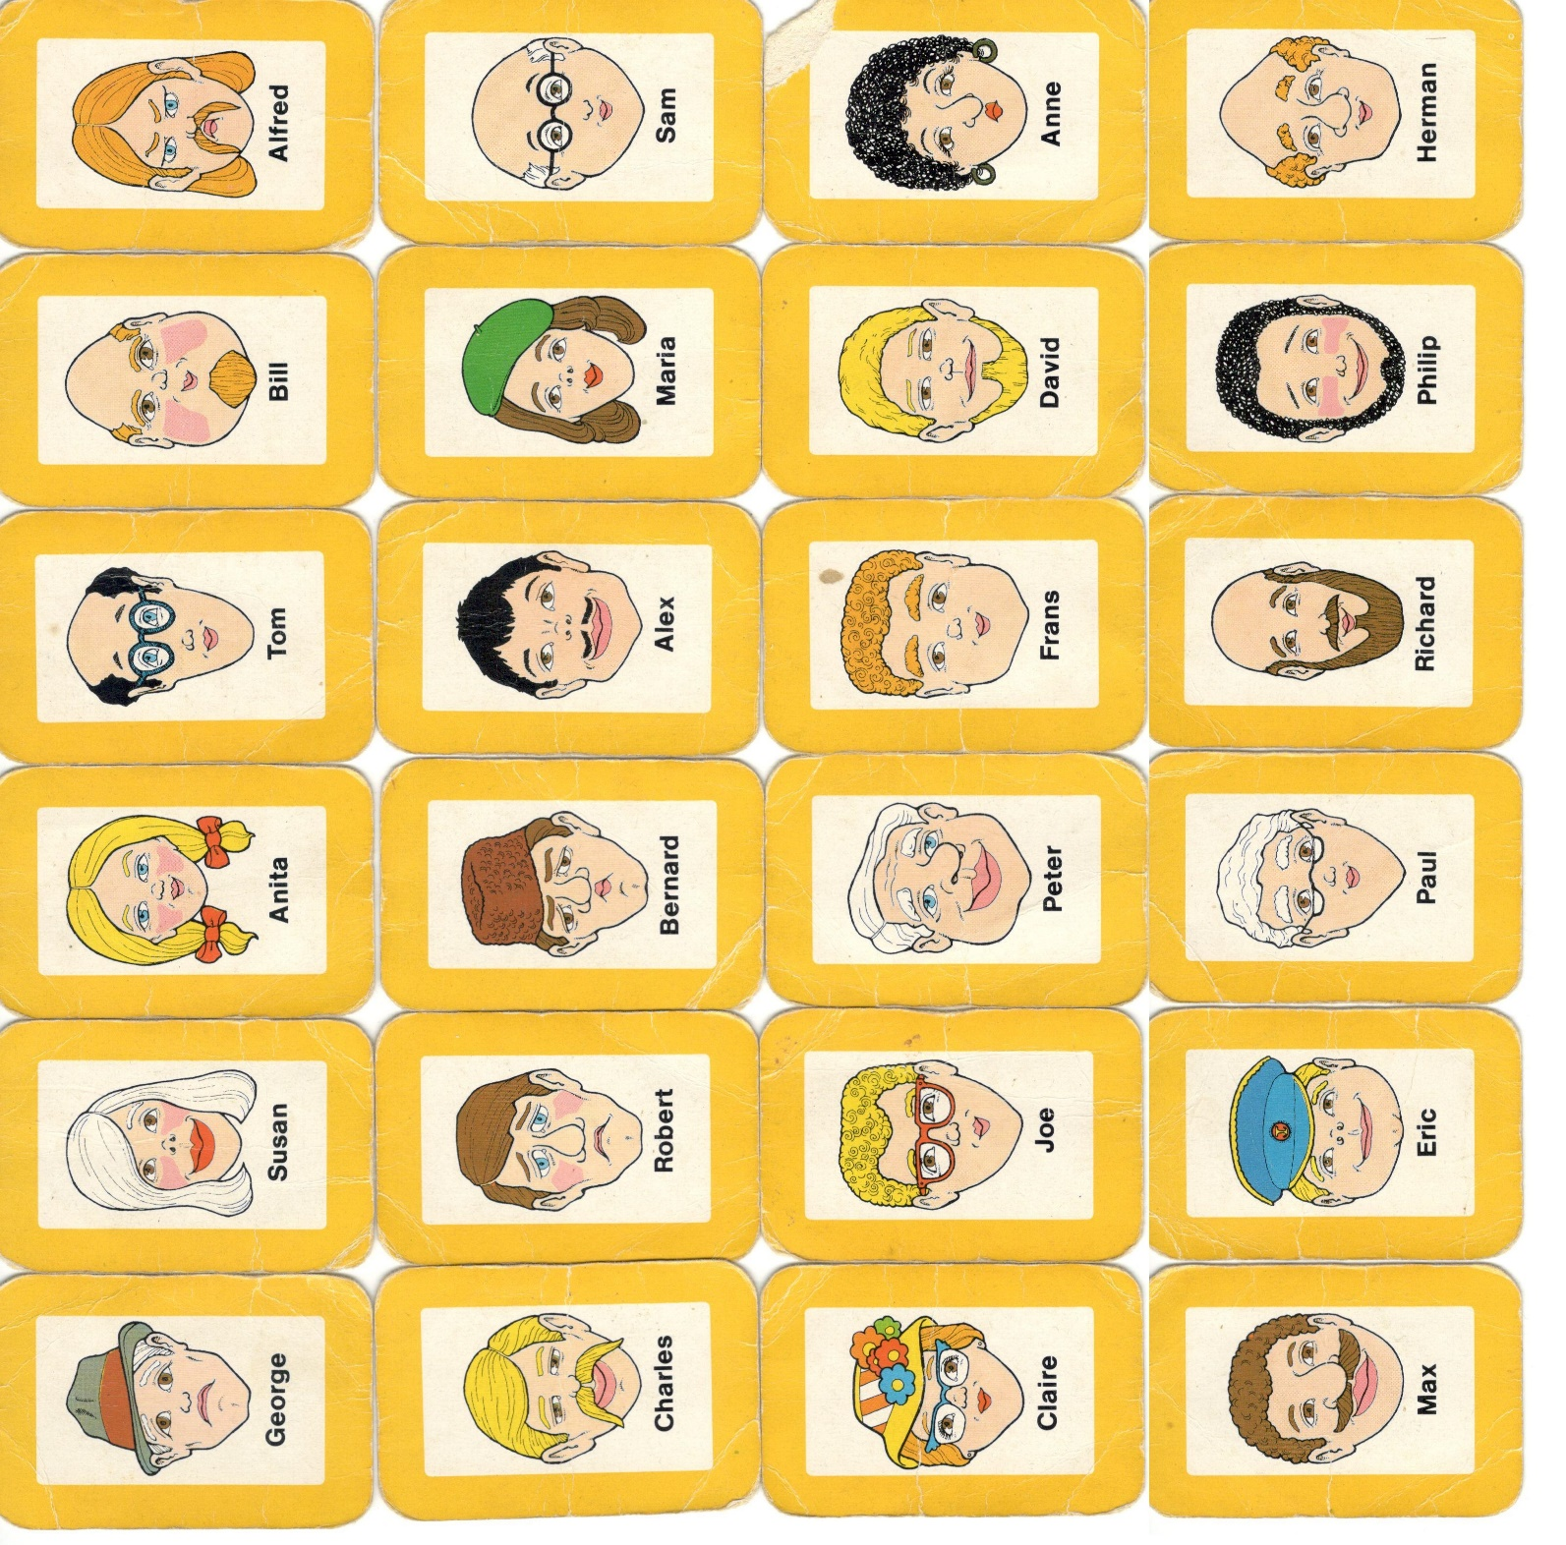

Slide 4
How this started…
During a game I asked “is yours bald?”
The reply was “I don’t know”!

Slide 5
Yes / No / Maybe
I will only ask 3 questions…

Slide 6
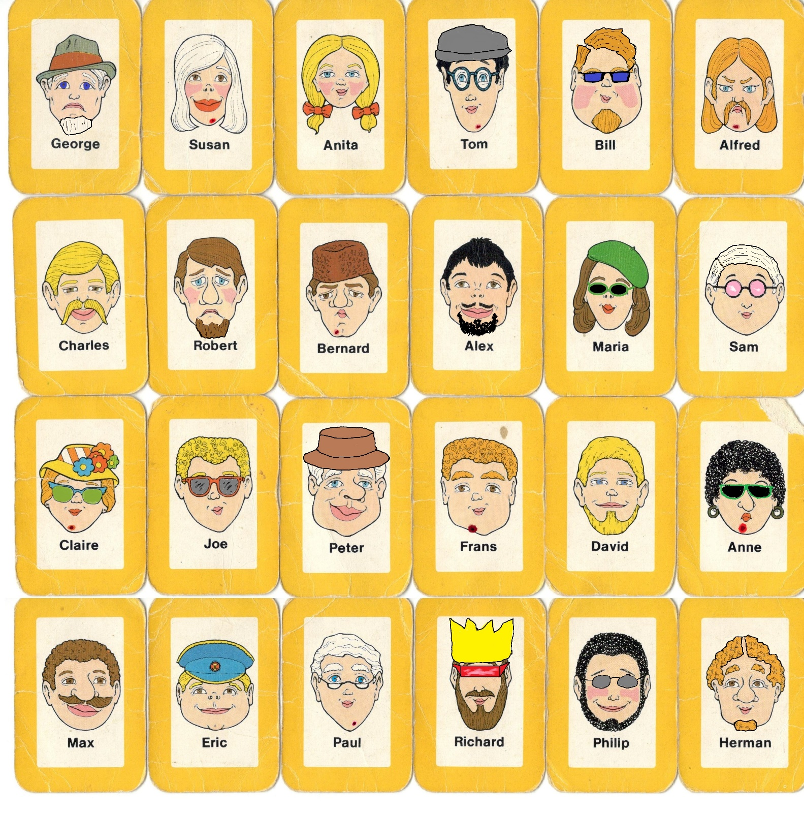

Slide 7
Could we add more people?

Slide 8
Other Applications of Ternary Logic…

Slide 9
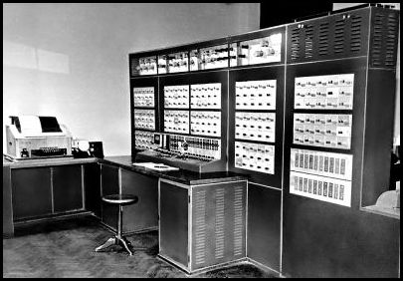
Setun Balanced Ternary Computer (Mosow State University 1958)
Some believe that Ternary Computing may make a comeback!

Slide 10
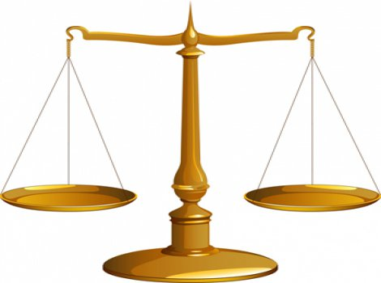
Any integer quantity up to 40 units can be measured with just these 4 weights:
1 3 9 27

Slide 11
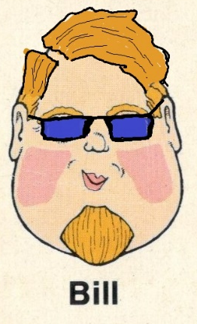
THIS IS BILL.
BILL SAYS “THANKS FOR LISTENING”!
BE LIKE BILL.

