Slide 1
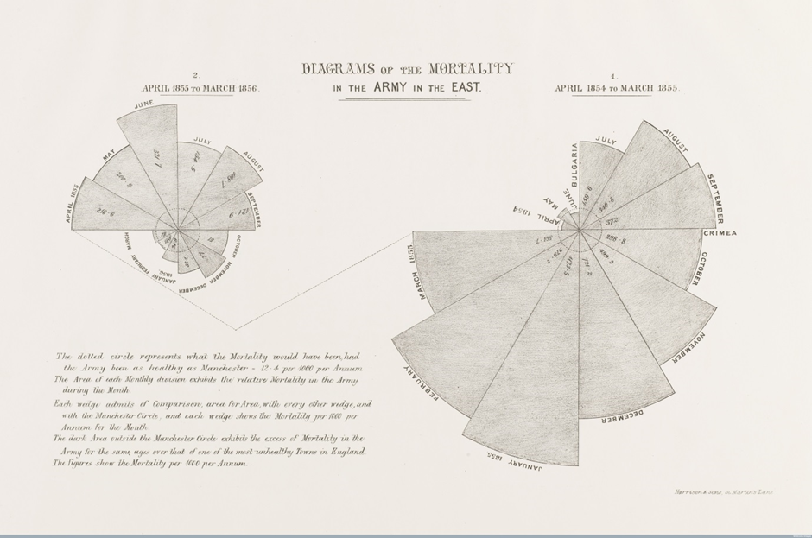

Slide 2
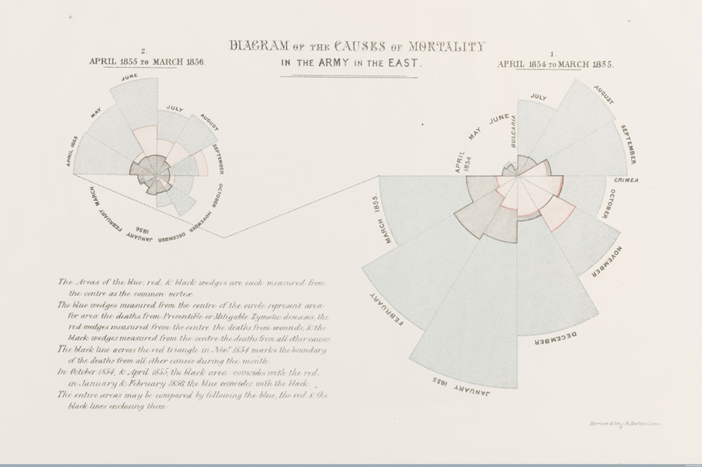

Slide 3
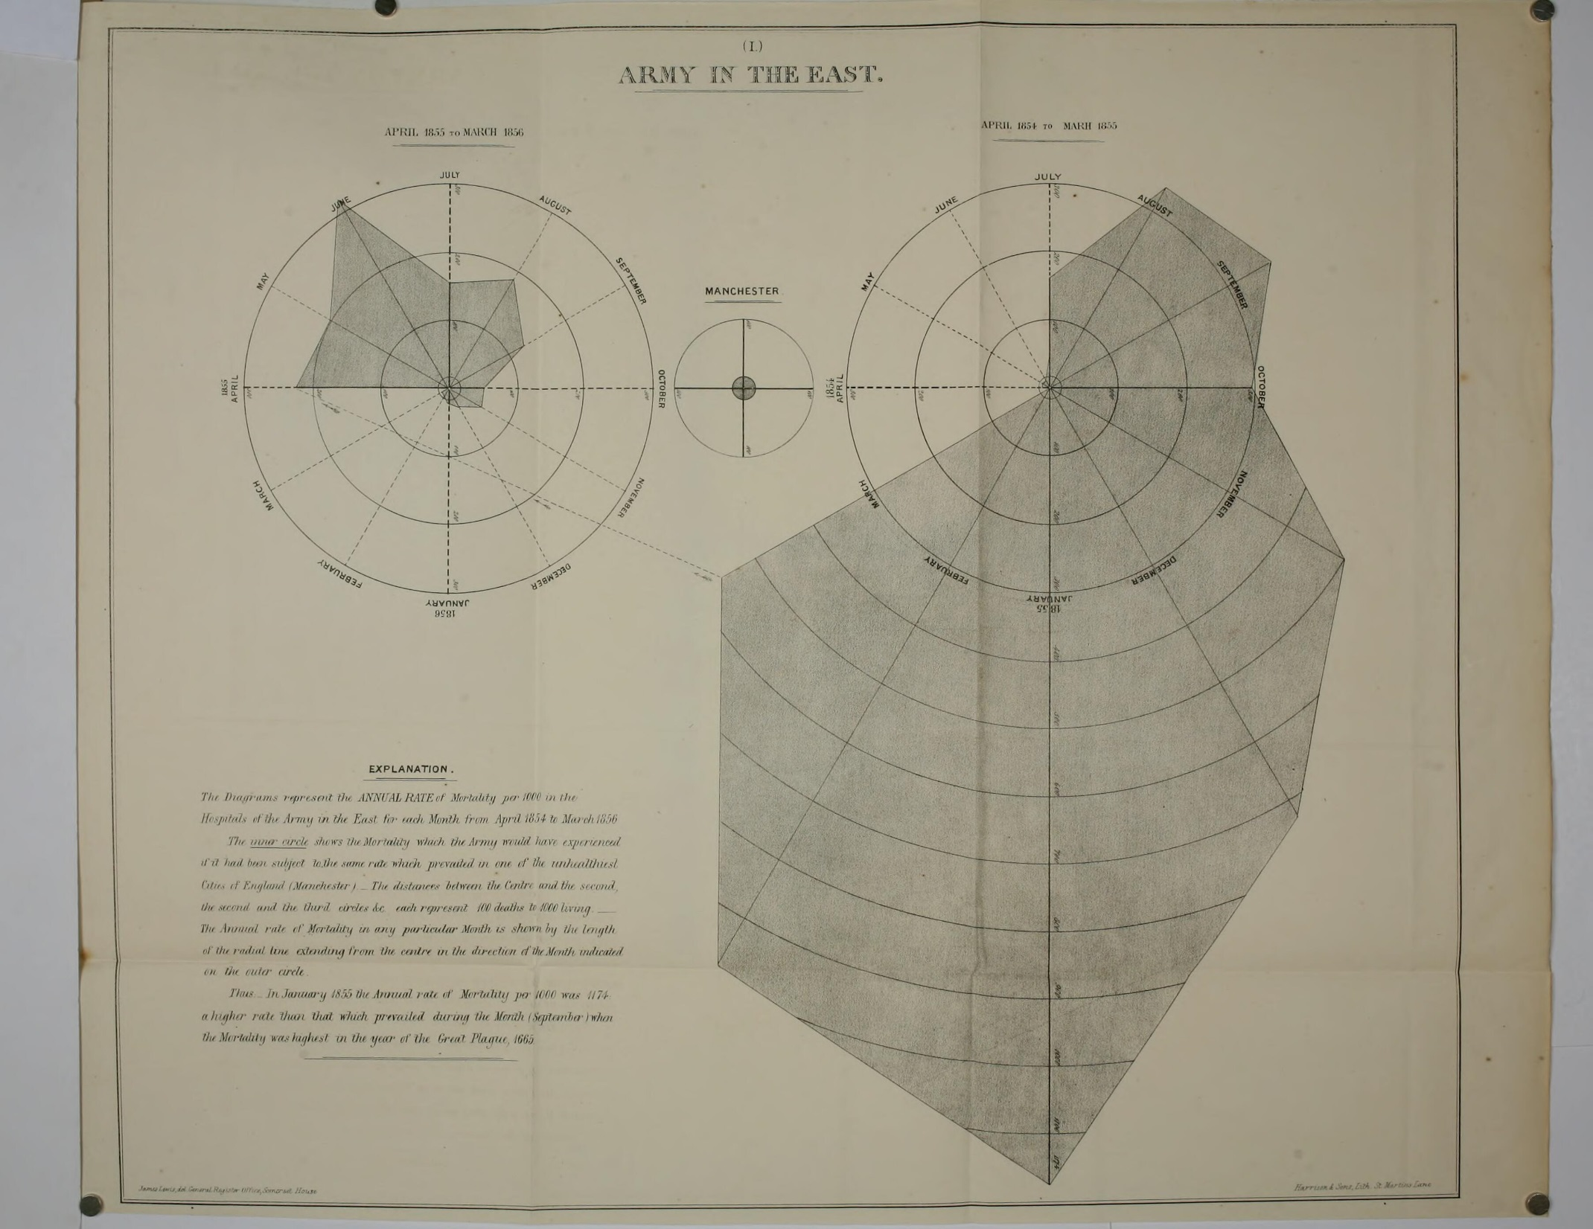

Slide 4
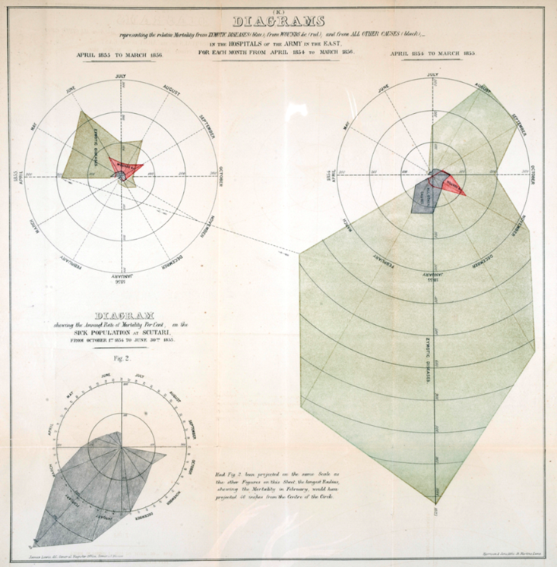

Slide 5
only “ignorant people conceive that the comparison is intended to be between the areas”

Slide 6
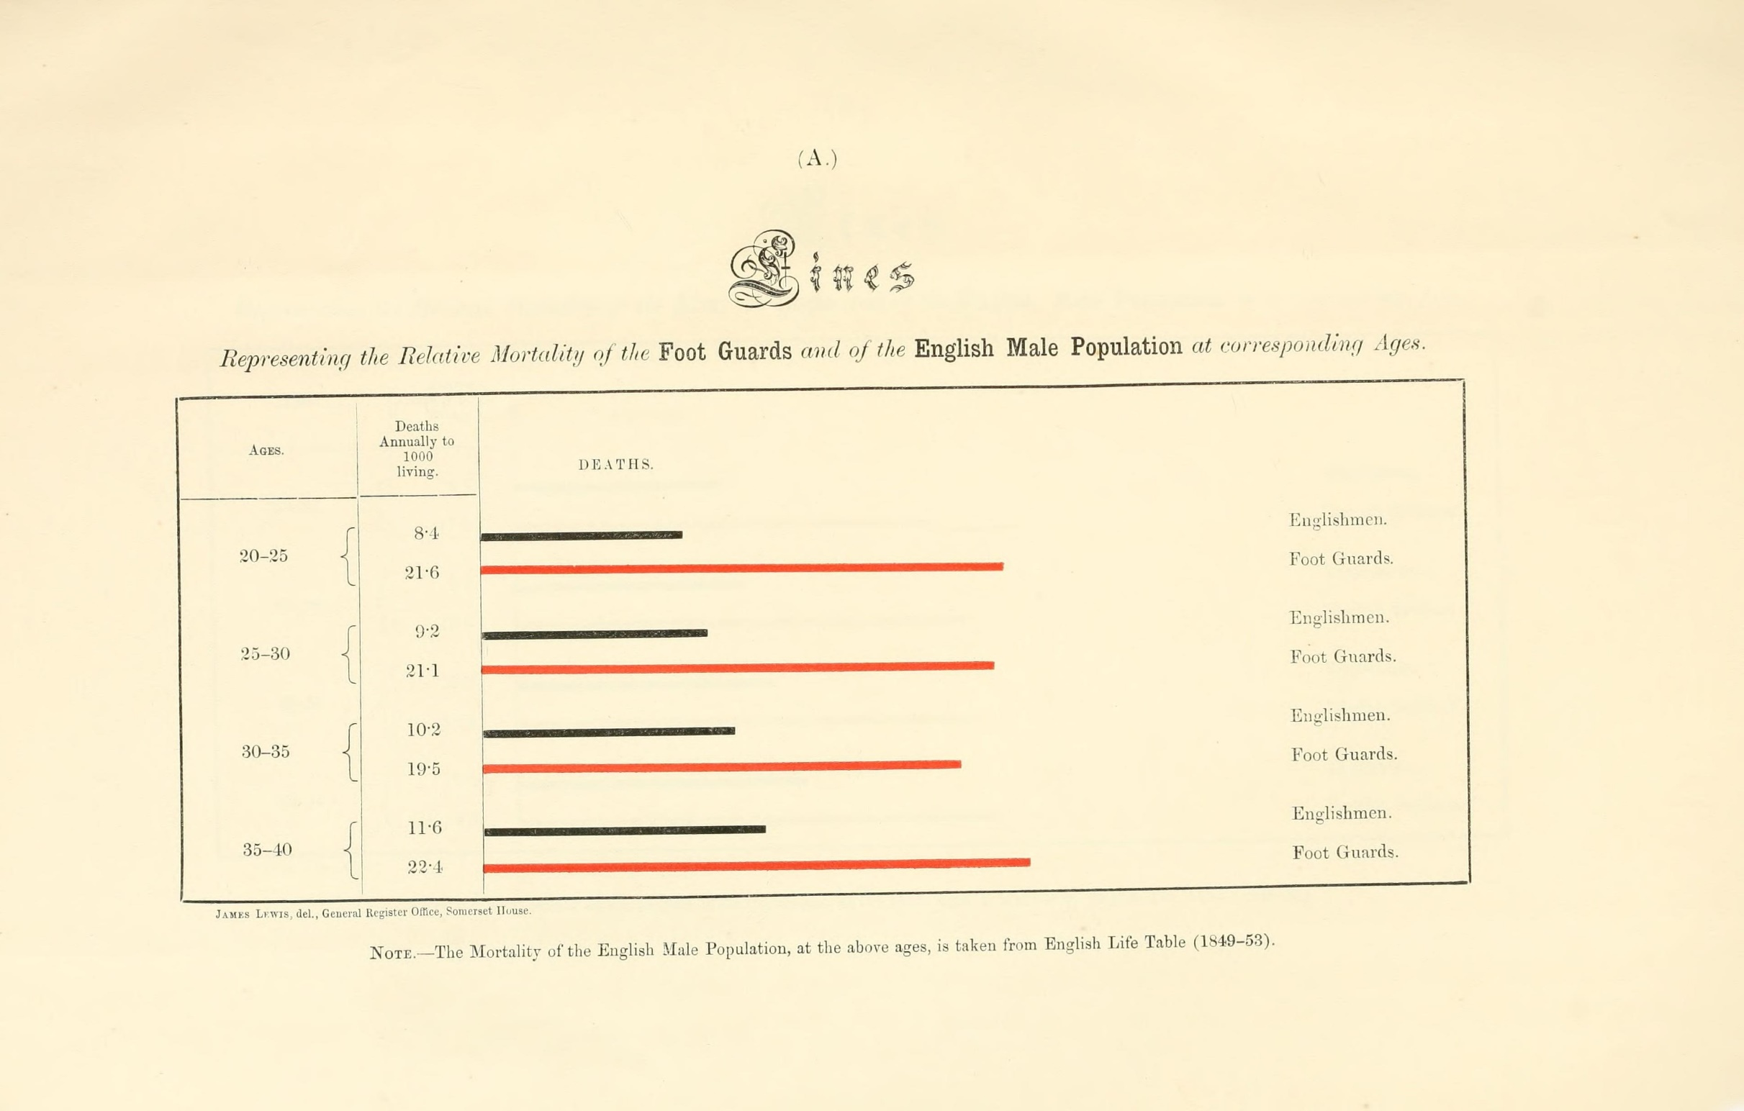

Slide 7
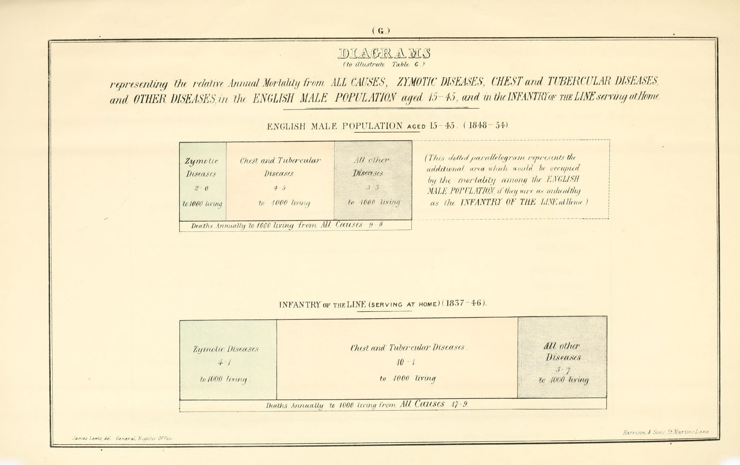

Slide 8


Slide 9
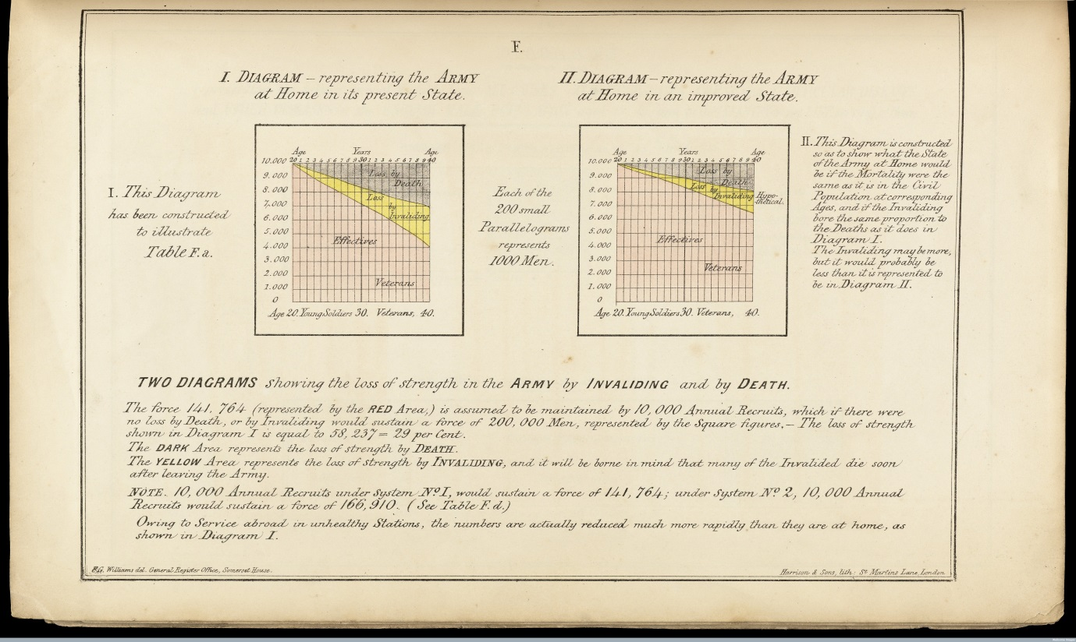

Slide 11
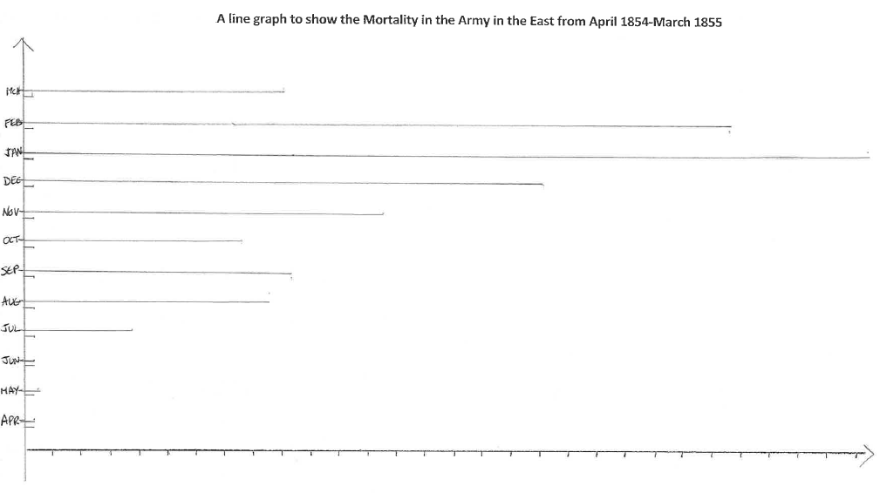

Slide 12
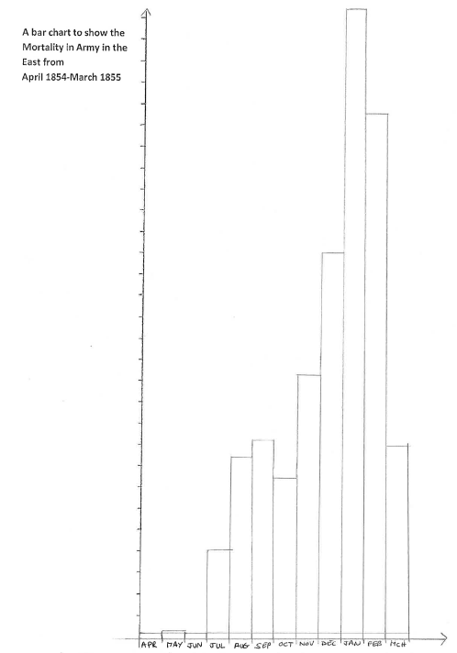

Slide 13
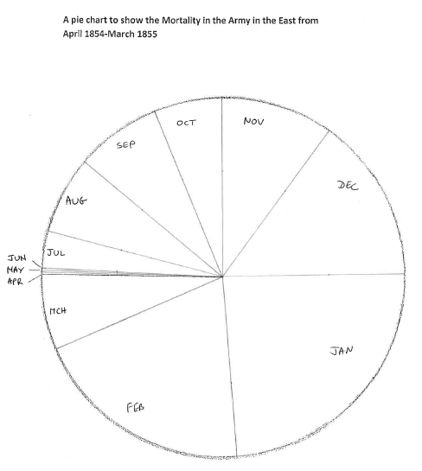

Slide 14
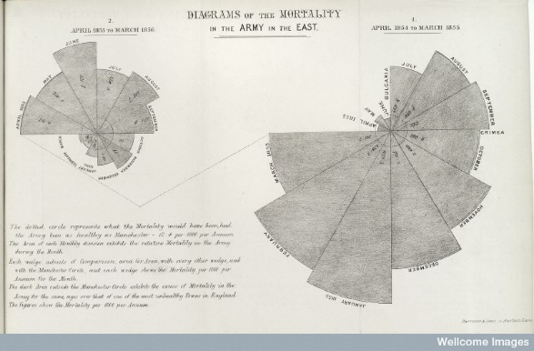

Slide 15
“Diagrams are of great utility for understanding certain questions of vital statistics by conveying ideas on the subject though the eye which cannot be so readily grasped when contained in figure”

