Slide 1
Mathematics of Matrimony

Slide 2
- Why am I doing this talk?
- Save the dates and graph theory
- Mathematical table planning

Slide 3
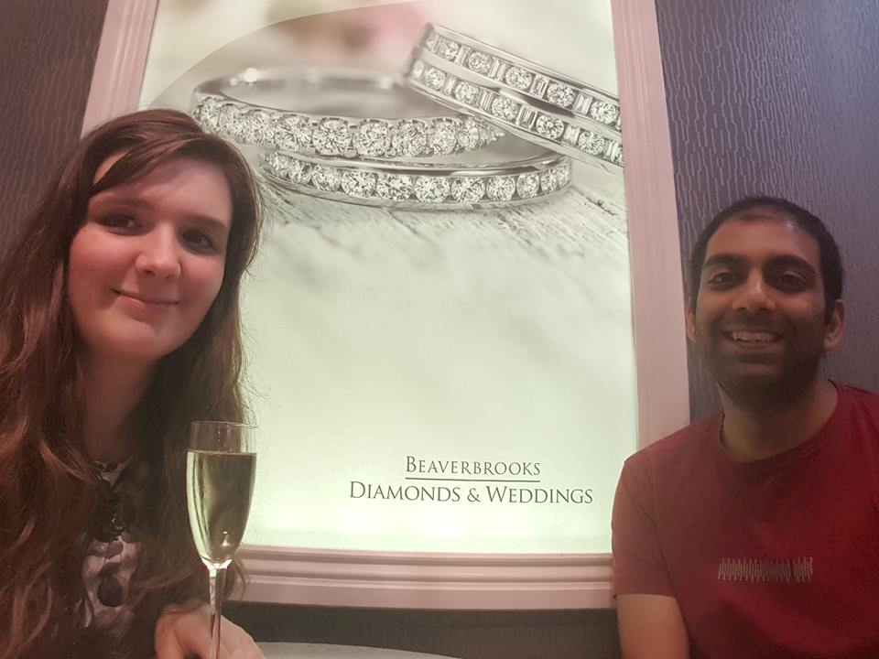
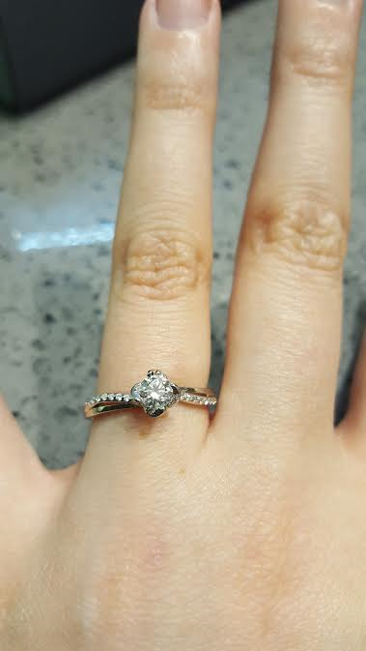

Slide 4
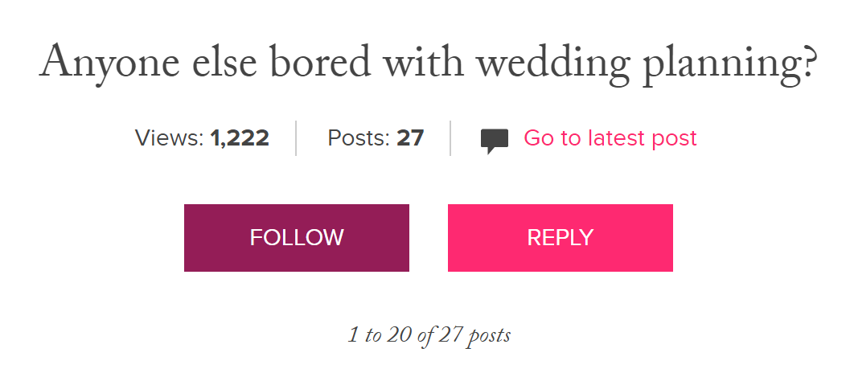

Slide 5
Save the Dates & Graph Theory

Slide 6
Save the Date defn:
A save the date is a notice stating the date of a significant event such as a wedding. It is typically sent to those likely to be interested or affected by the event and states the planned date of the occasion so that recipients who wish to attend know to keep that date free.

Slide 7
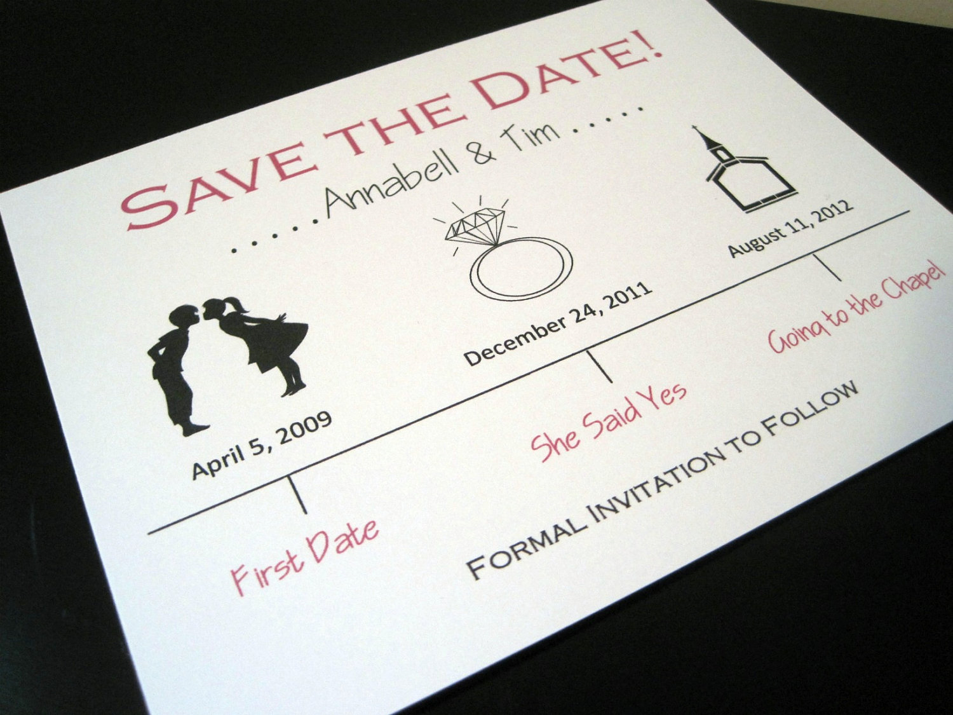

Slide 8
Papercutting defn:
Papercutting or paper cutting is the art of cutting paper designs. The art has evolved uniquely all over the world to adapt to different cultural styles.

Slide 9
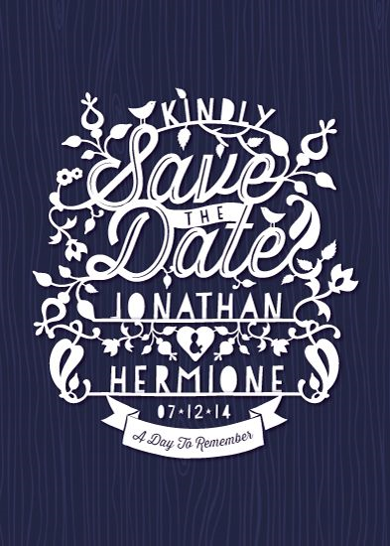

Slide 10
Graph Theory Defn:
In mathematics graph theory is the study of graphs, which are mathematical structures used to model pairwise relations between objects. A graph in this context is made up of vertices, nodes, or points which are connected by edges, arcs, or lines.

Slide 11
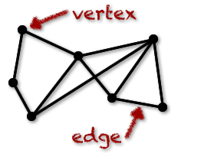

Slide 12


Slide 13
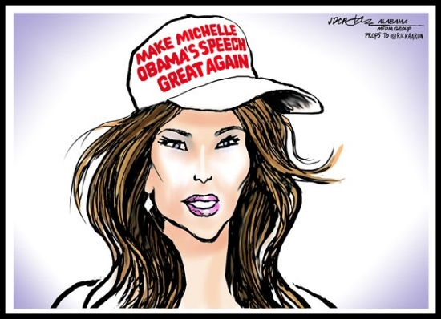

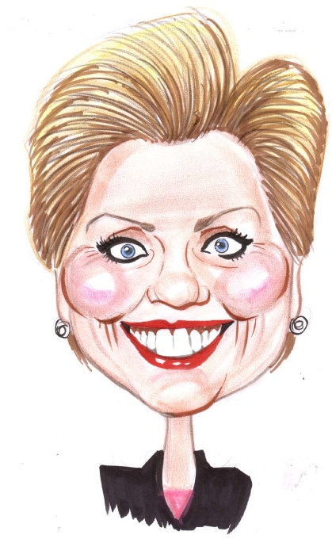
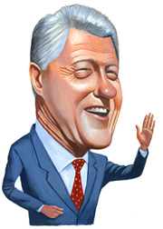
1
2

Slide 14
1
1
2
2
2
2
1
1

Slide 17
1
1
2
2
2
2
1
1

Slide 18
1
1
2
2
2
2
1
1

Slide 20

Mathematical table planning

Slide 21
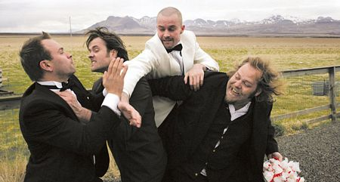

Slide 22

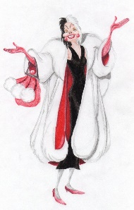



Slide 23
0
0
0
0

Slide 24
0
-5
-1
-8
0
0
0

Slide 25
0
-5
-1
-8
-10
0
-3
8
-3
-7
0
10
2
10
-10
0

Slide 26
-1
8
-3
10

Slide 27
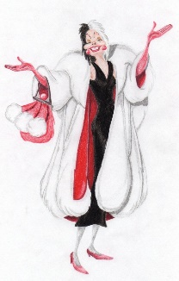
-1
-3
8
10
= (-1) + (-3) + 8 + 10
= 14

Slide 28
0
-5
-1
-8
-10
0
-3
8
-3
-7
0
10
2
10
-10
0

Slide 29
-5
-10
10
-10

Slide 30

-5
-10
10
-10
= (-5) + (-10) + 10 + (-10)
= -15

Slide 31
Numberphile – Stable Marriage Problem
Hannah Fry - Mathematics of Love

