Slide 1
Alex Elmsley
and the Hamming Code
Tony Mann
MathsJam 2016

Slide 2
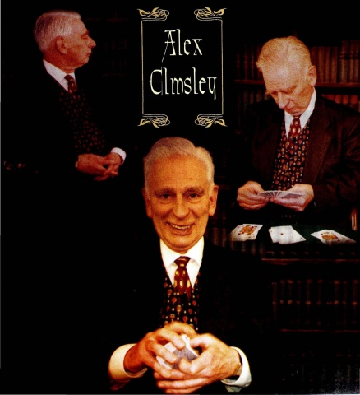
Alex Elmsley (1929 – 2006)

Slide 3
The Liar’s Matrix
58 | 36 | 6 | 12 | 14 | 17
16 | 76 | 46 | 52 | 54 | 57
65 | 5 | 35 | 21 | 27 | 24
22 | 42 | 72 | 66 | 60 | 63
51 | 31 | 1 | 15 | 13 | 10
11 | 71 | 41 | 55 | 53 | 50
25 | 45 | 75 | 61 | 67 | 64
62 | 2 | 32 | 26 | 20 | 23

Slide 4
The Liar’s Matrix
Choose any row,
and any number in that row.
Tell me the sequence of black and red numbers in that row, but lie about the colour of your chosen number.

Slide 5
The Liar’s Matrix
58 | 36 | 6 | 12 | 14 | 17
16 | 76 | 46 | 52 | 54 | 57
65 | 5 | 35 | 21 | 27 | 24
22 | 42 | 72 | 66 | 60 | 63
51 | 31 | 1 | 15 | 13 | 10
11 | 71 | 41 | 55 | 53 | 50
25 | 45 | 75 | 61 | 67 | 64
62 | 2 | 32 | 26 | 20 | 23

Slide 6
The Octal Pencil
You choose 42 (say) and tell me
“B R R R B R”
B = 1, R = 0
100 010 = 42 (Octal)
22 | 42 | 72 | 66 | 60 | 63

Slide 7
Alex Elmsley
"I consider myself to be a very good programer of the second class. I keep inventing wonderful techniques, and then discover that someone else has already invented them (but I'm catching up with him).

Slide 8
Alex Elmsley
"Not long after inventing the liar's matrix I discovered that a man named Hamming had been there first, a long time before. Hamming codes are widely used in the main stores of computer mainframes as a sophisticated security mechanism. If a store failure causes a single-bit error, it cannot only be detected, but corrected in flight because the erroneous bit can be identified.

Slide 9
Alex Elmsley
"I worked out the liar's matrix by trial and error. Later I read an article on Hamming codes that gave the mathematical analysis and a general method for their construction.
"All the same, I invented the liar's matrix all by myself!"

Slide 10
PLUG
Greenwich Maths Centre
with help from FMSP hosts
IMA Festival of Mathematics and its Applications
June 27 and 28 2017

Slide 11
If you have been,
thanks for listening
@Tony_Mann
A.Mann@gre.ac.uk
tonysmaths.blogspot.com

