Slide 1
Mathematics: Baking Boundaries

Slide 2
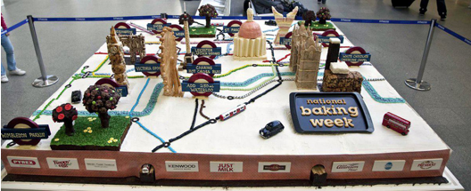

Slide 3
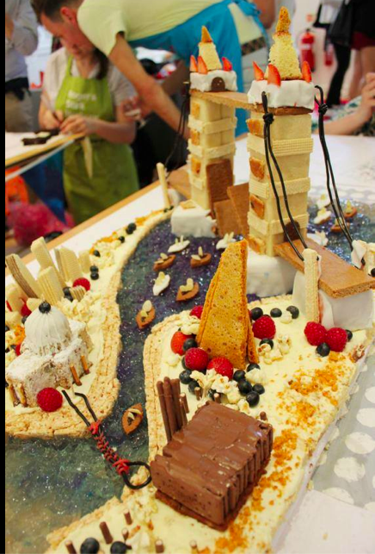

Slide 4
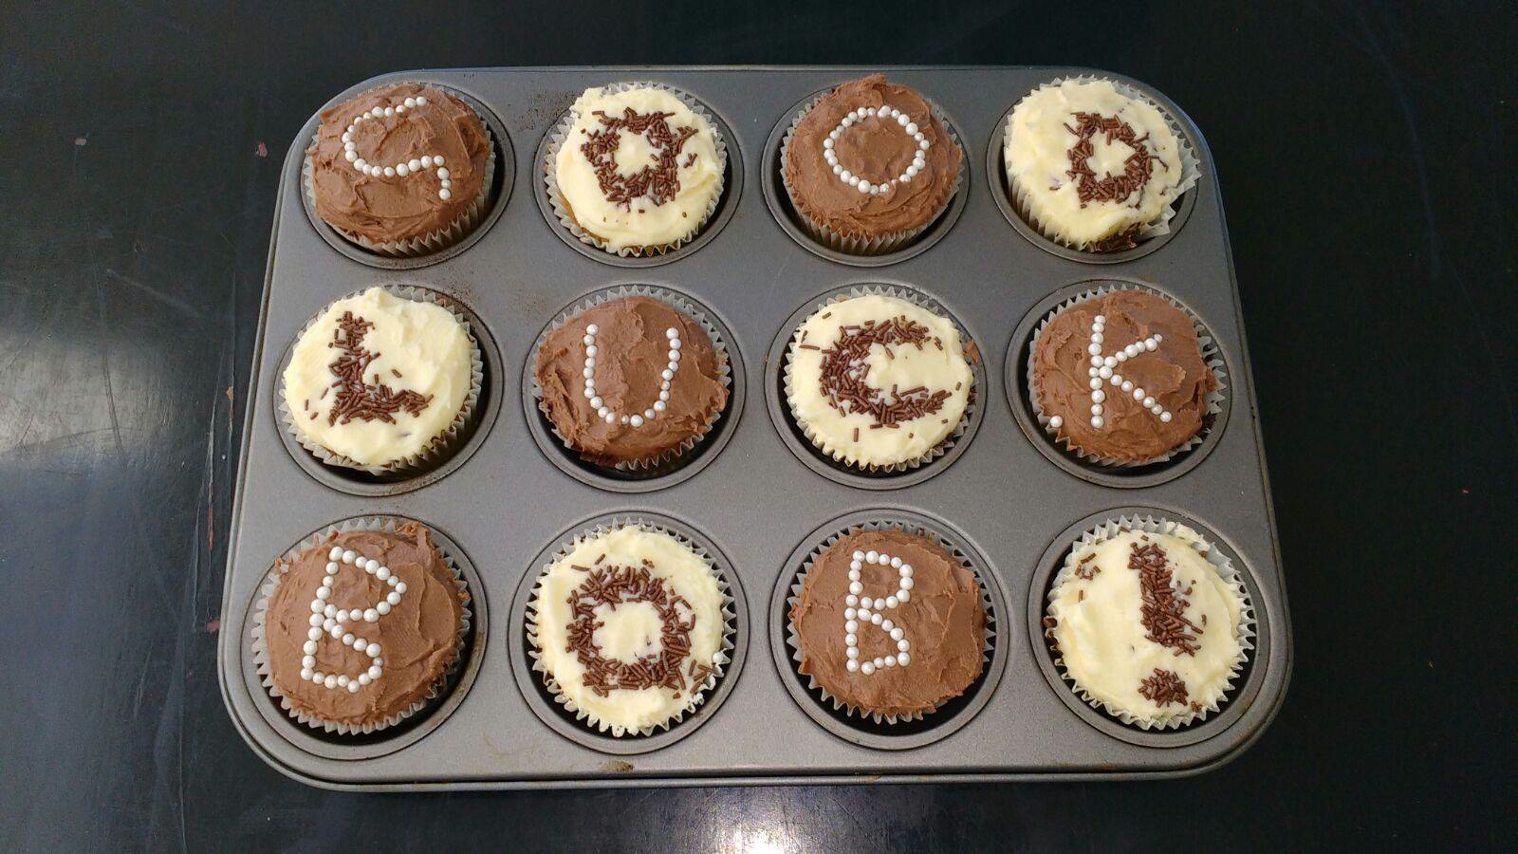

Slide 5
A Cake for Maths Jam

Slide 6
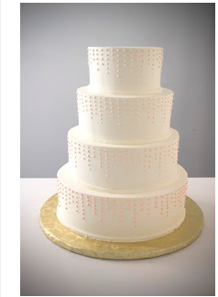

Slide 7

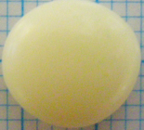
Rational Numbers
Integers
Whole numbers
Natural numbers

Slide 8
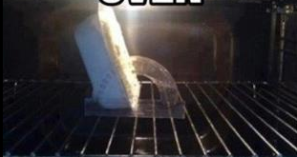

Slide 9
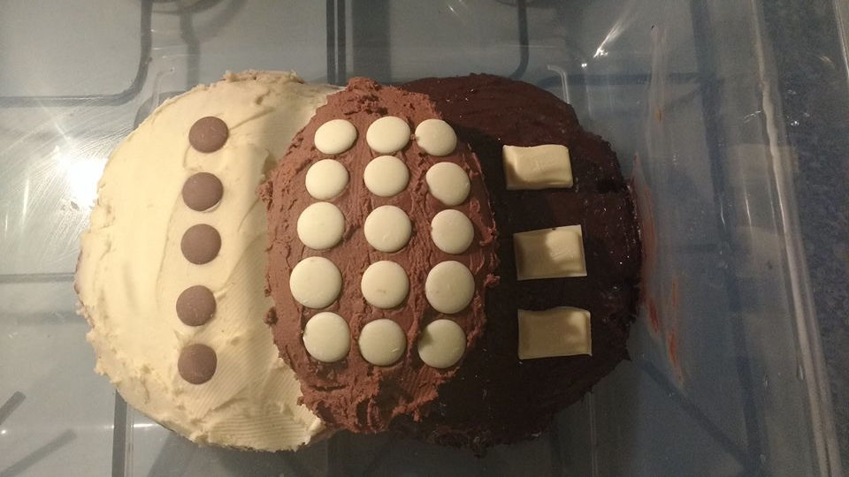

Slide 10

