Slide 1
Alison Talks Crap
MathsJam Conference 2017

Slide 2
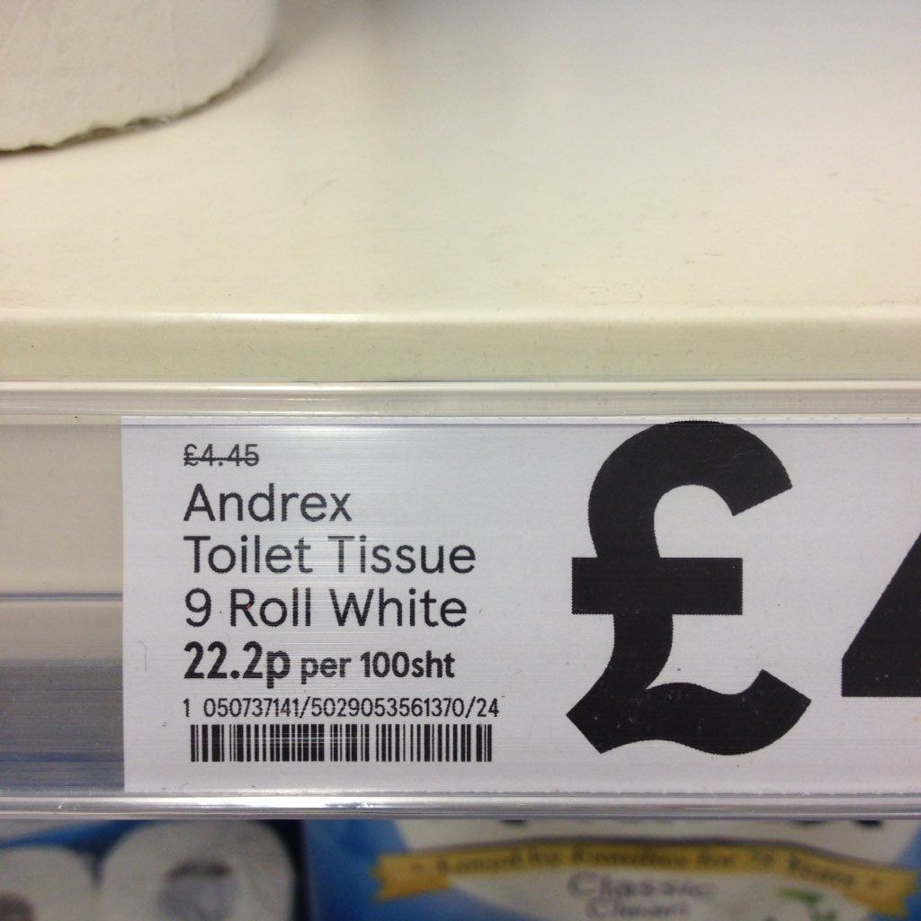

Slide 4
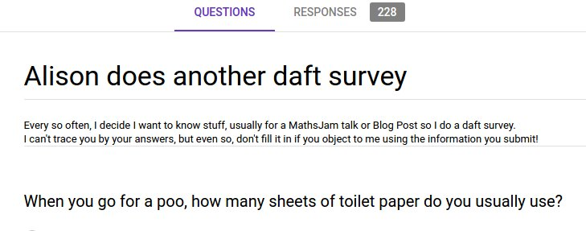

Slide 5
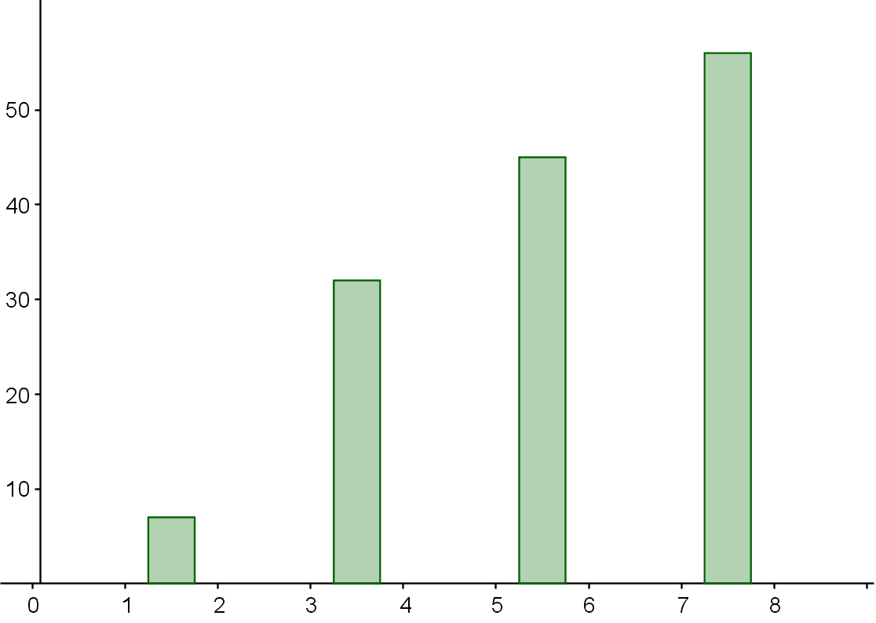
Number of people
Number of sheets

Slide 6
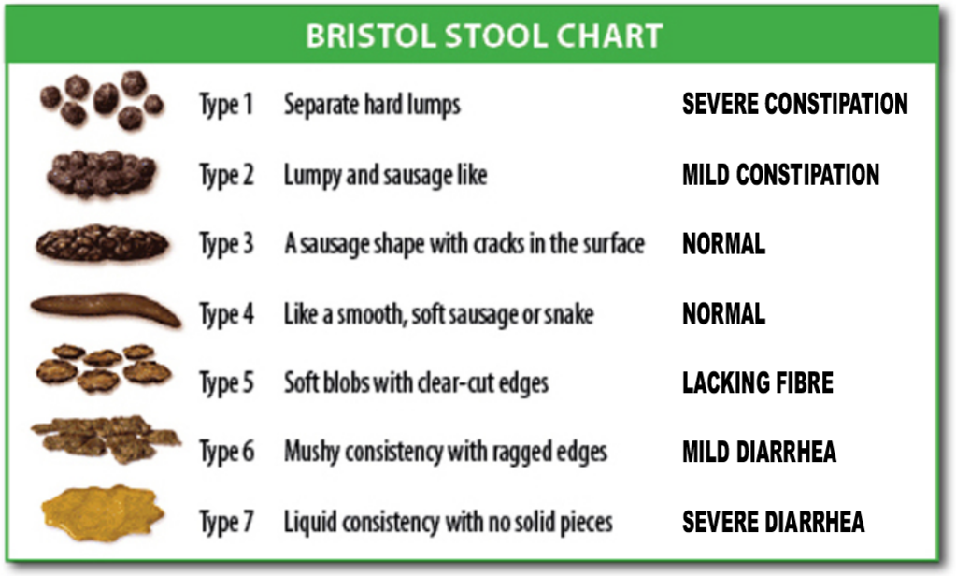

Slide 7
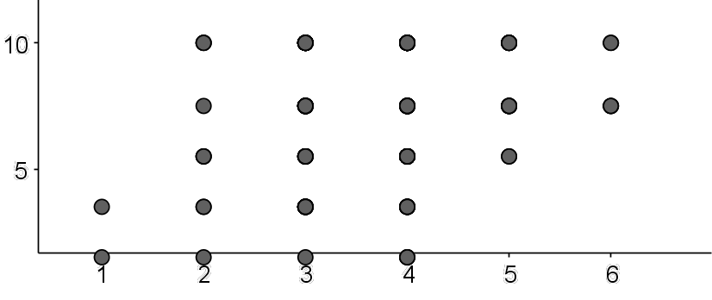
Number of
sheets
Average Bristol Stool rating

Slide 8
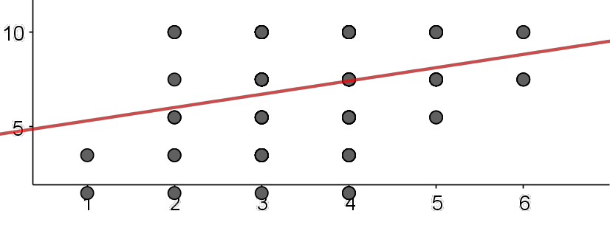

Slide 9
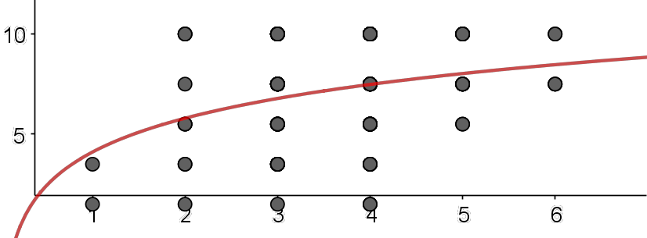

Slide 10
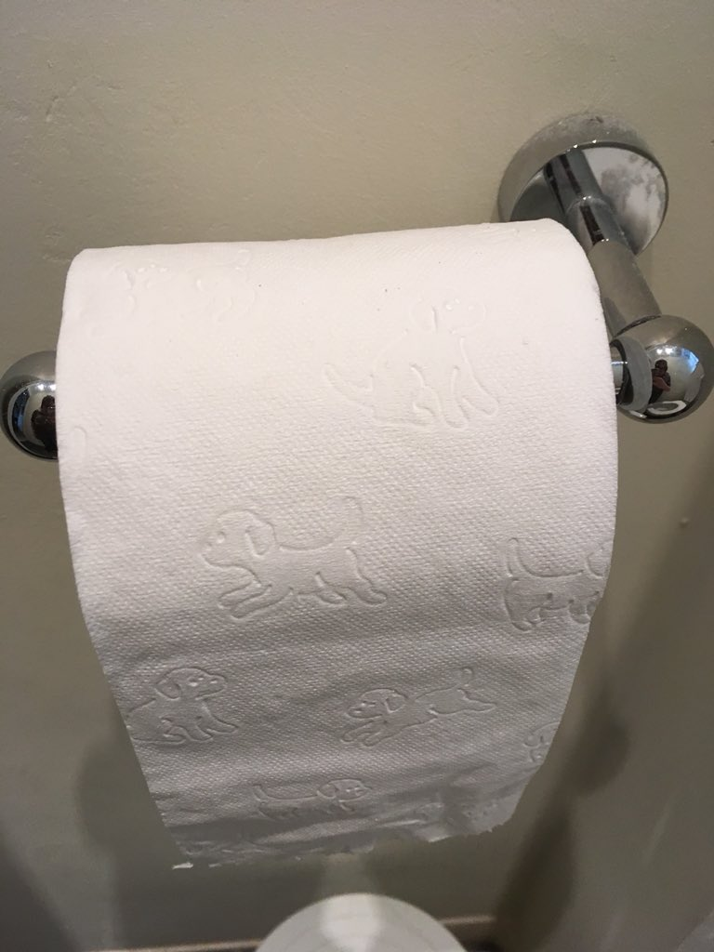
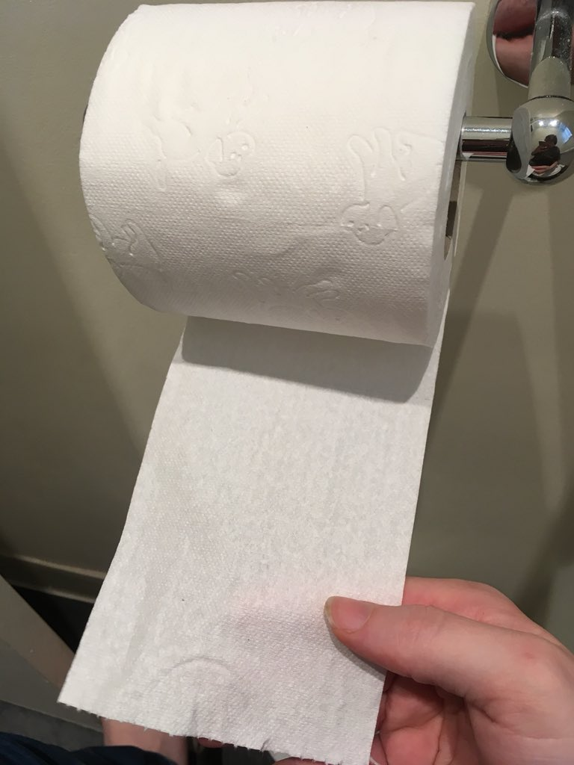
much sad!
wow!
such fun!
very upside!

Slide 11
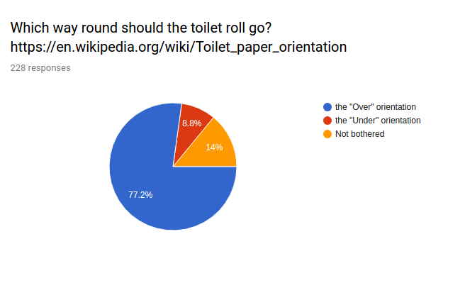

Slide 12


Slide 13


Slide 14
“George Carlin said you don't take a shit; you leave a shit.”

