Slide 1
Donald in Mathmagic Land
Belgin Seymenoglu
@SmokyFurby

Slide 2
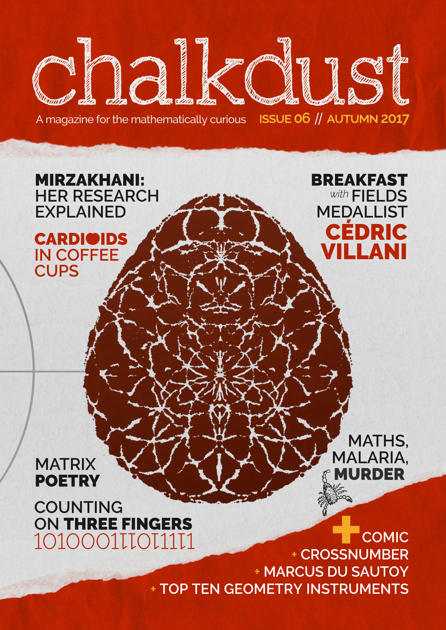
Write for us!
Deadline for issue 07
2 January 2018
Follow us!
@chalkdustmag
chalkdustmagazine.com

Slide 3
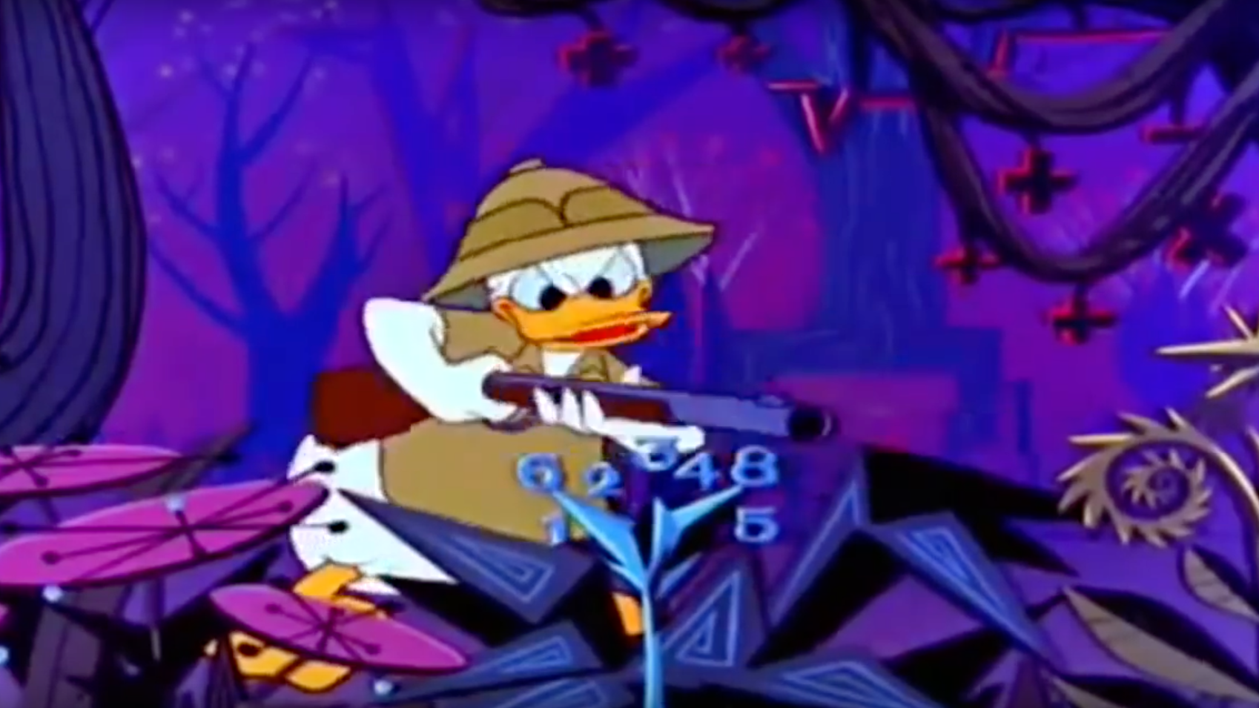

Slide 4
The power of the Golden ratio…

Slide 5
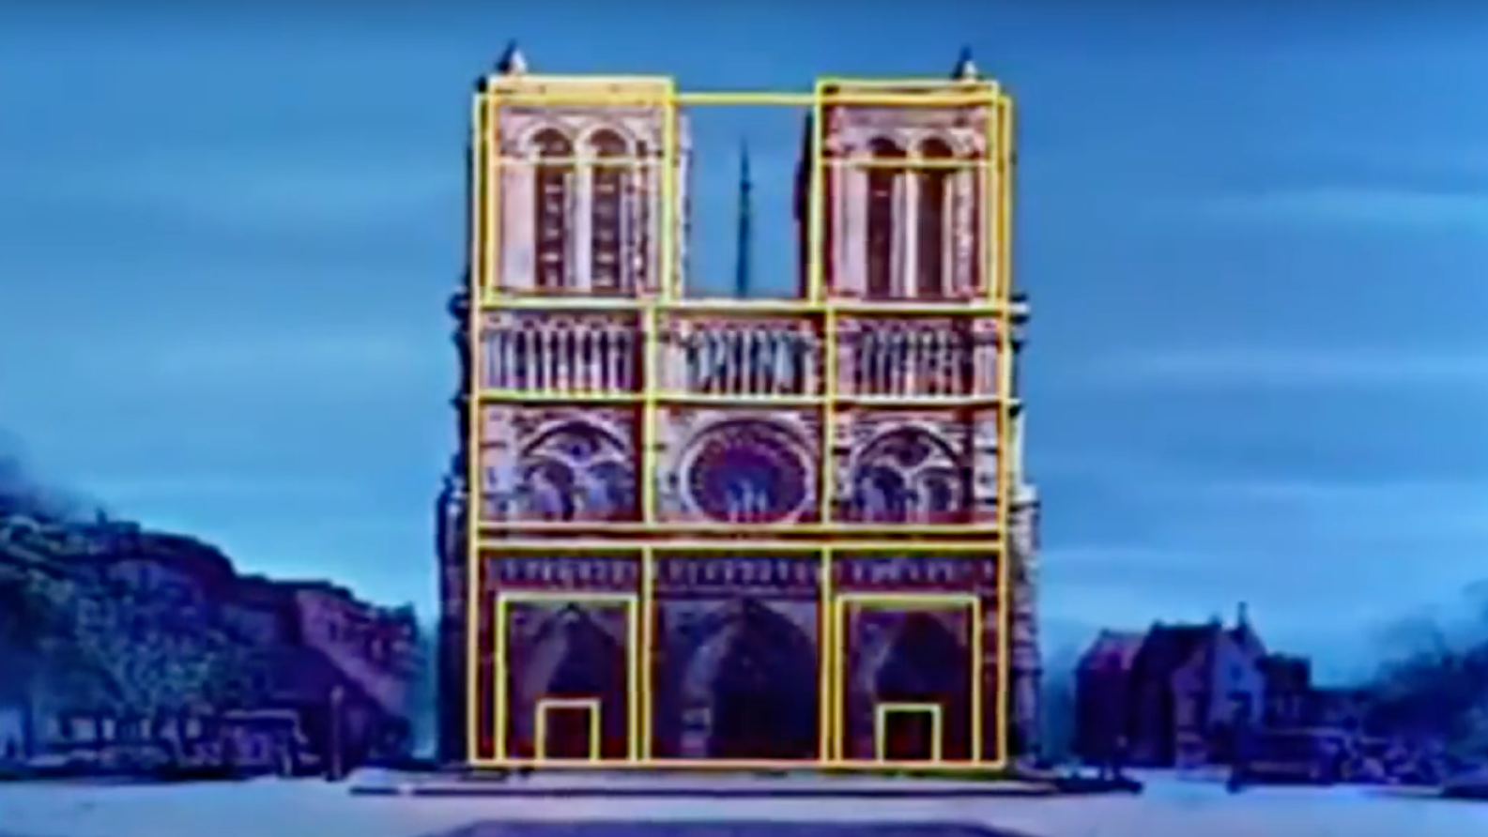

Slide 6
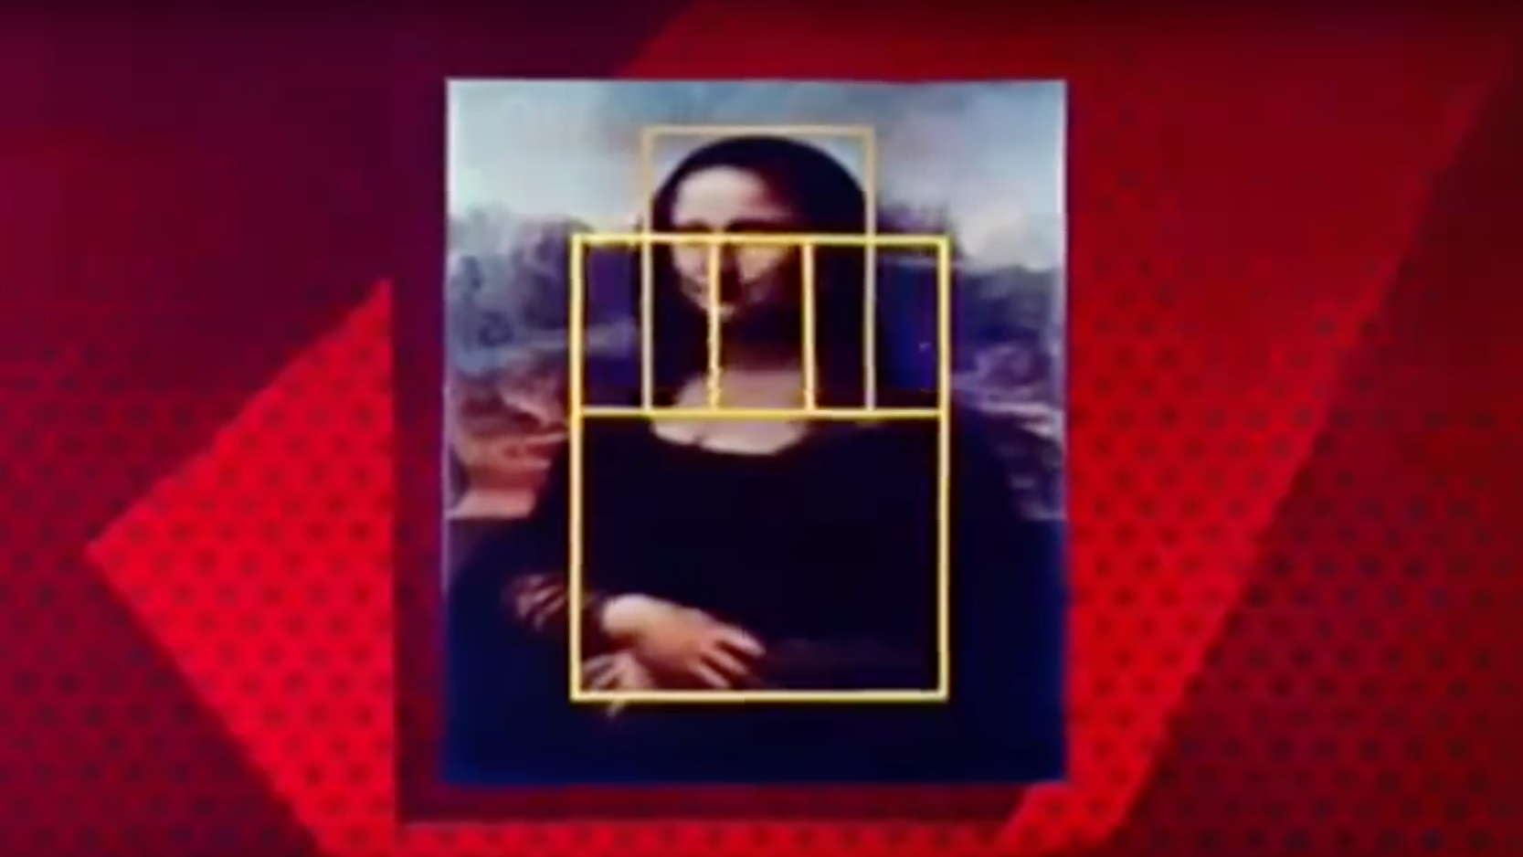

Slide 7
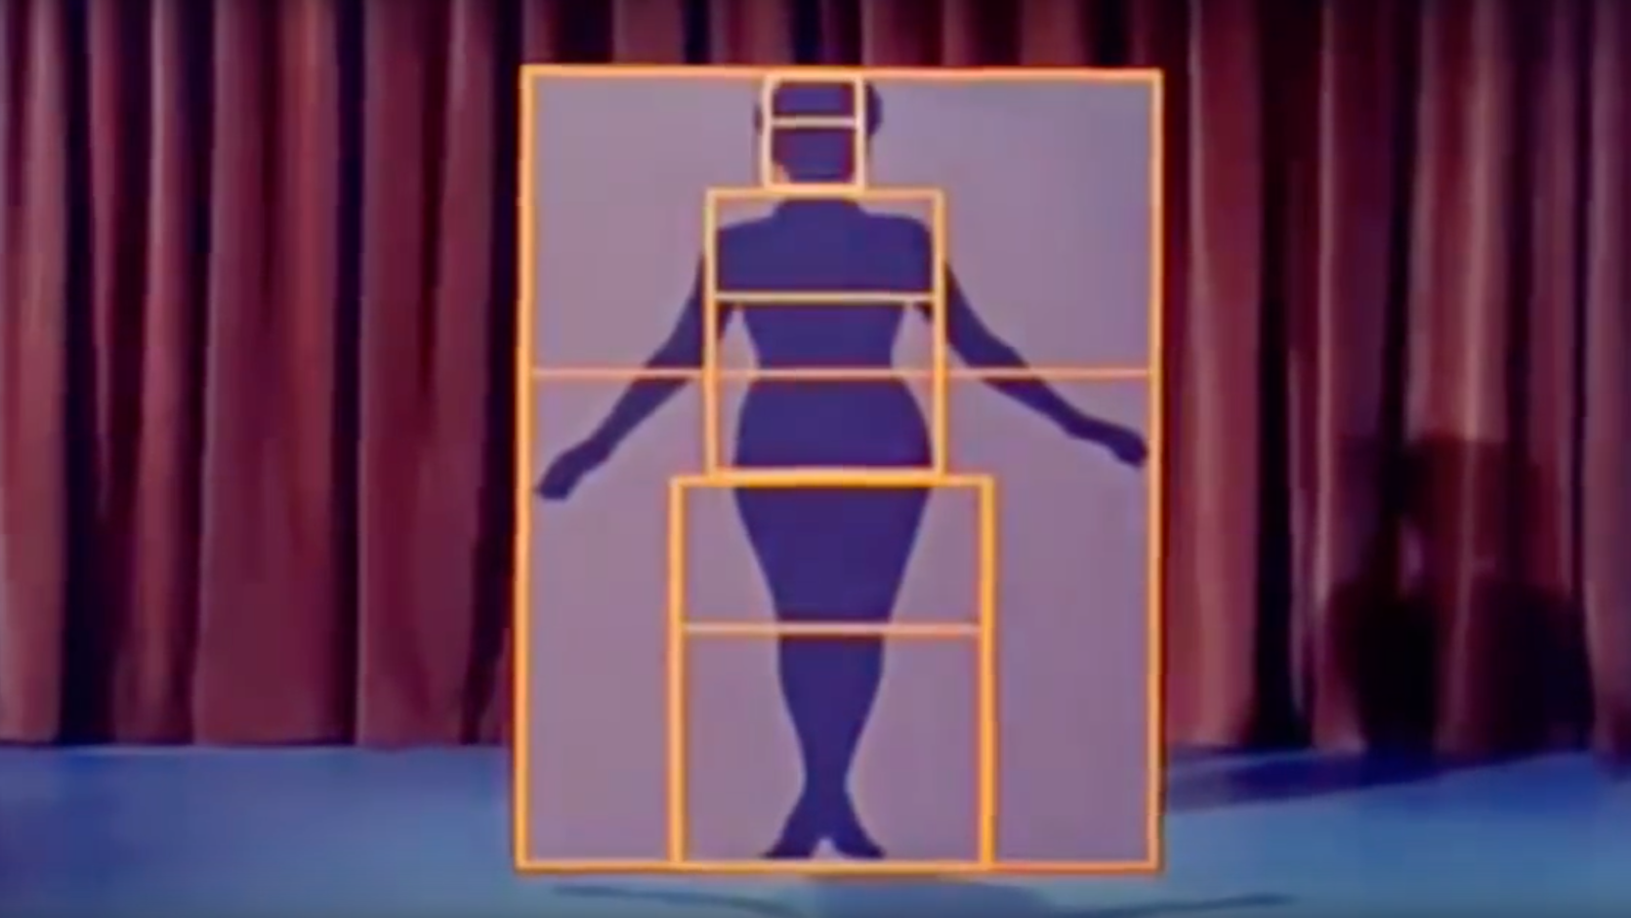

Slide 8
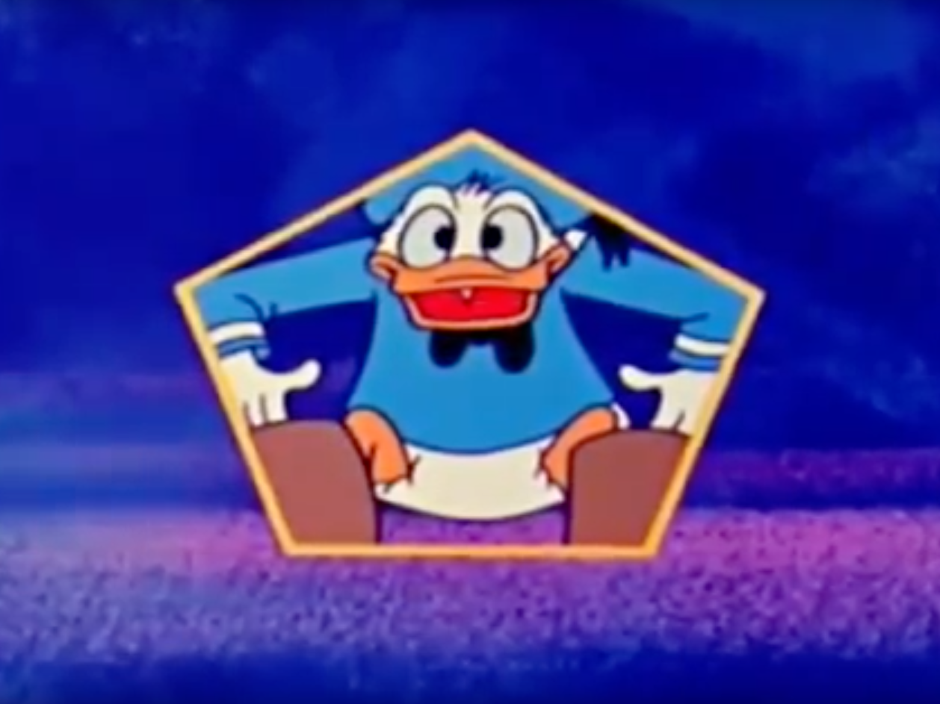

Slide 9
Pentagons in nature

Slide 10
Mind games

Slide 12
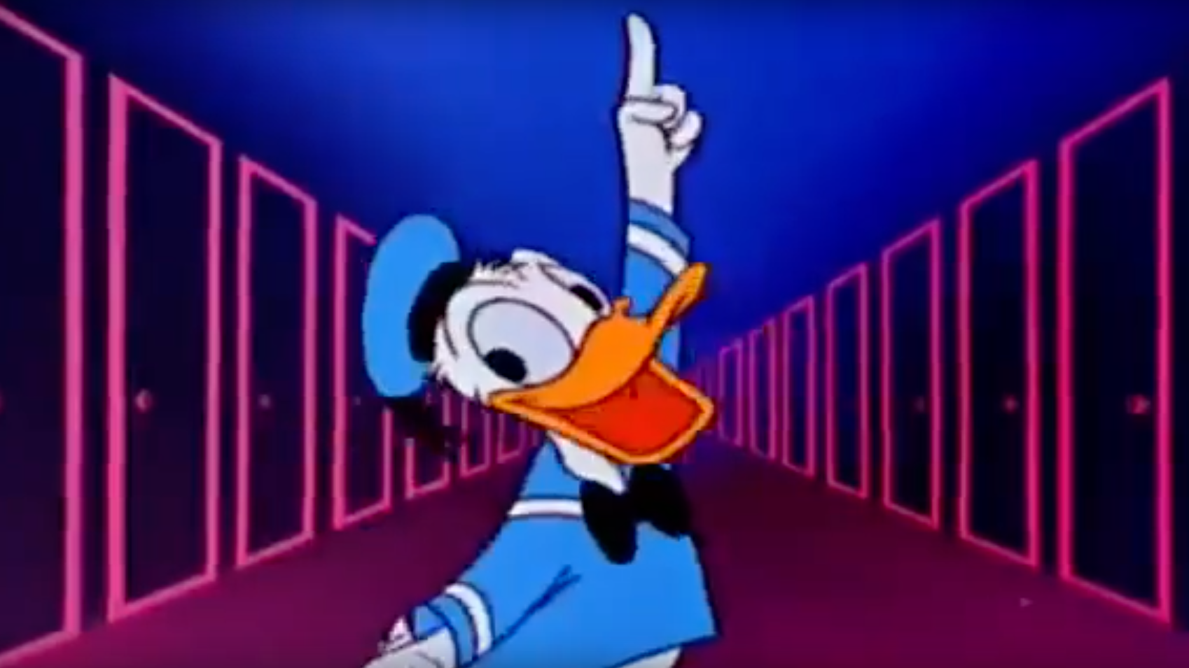

Slide 13
”Mathematics is the alphabet with which God has written the universe” (Galileo)

Slide 14
Thanks for listening!
Belgin Seymenoglu
@SmokyFurby

