Slide 1
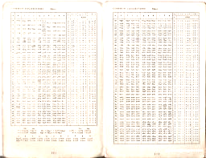
Geometric tables & boring logs Matthew Bibby, John Bibby mattbibby@gmail.com, jb43@York.ac.uk

Slide 2
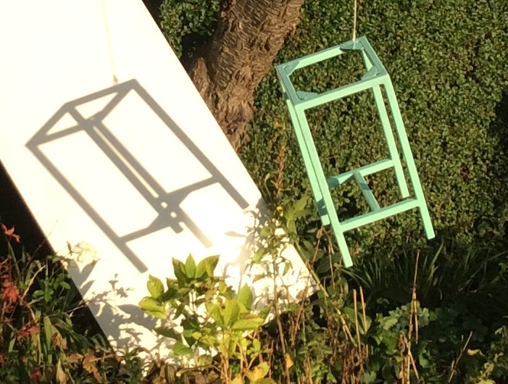
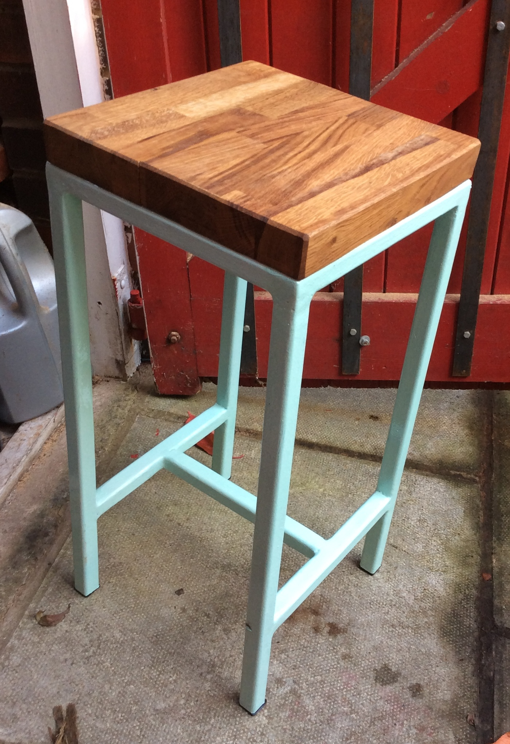
Geometric Tables

Slide 3
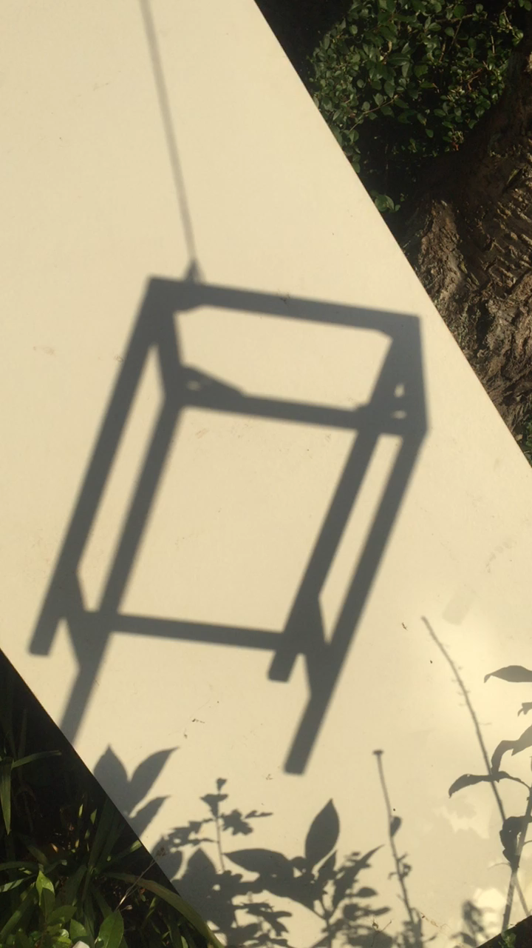
Which way is it rotating?

Slide 4
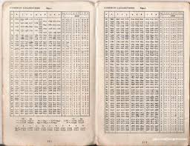
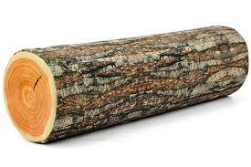

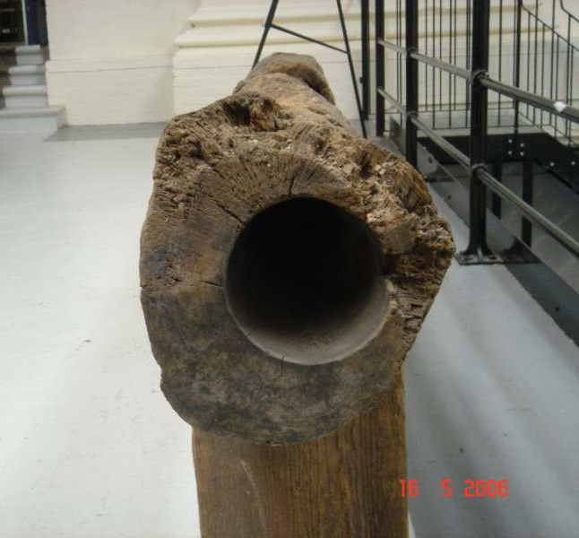
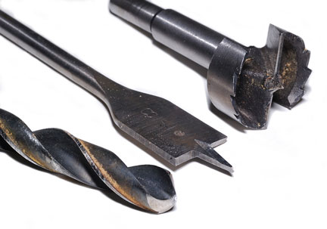
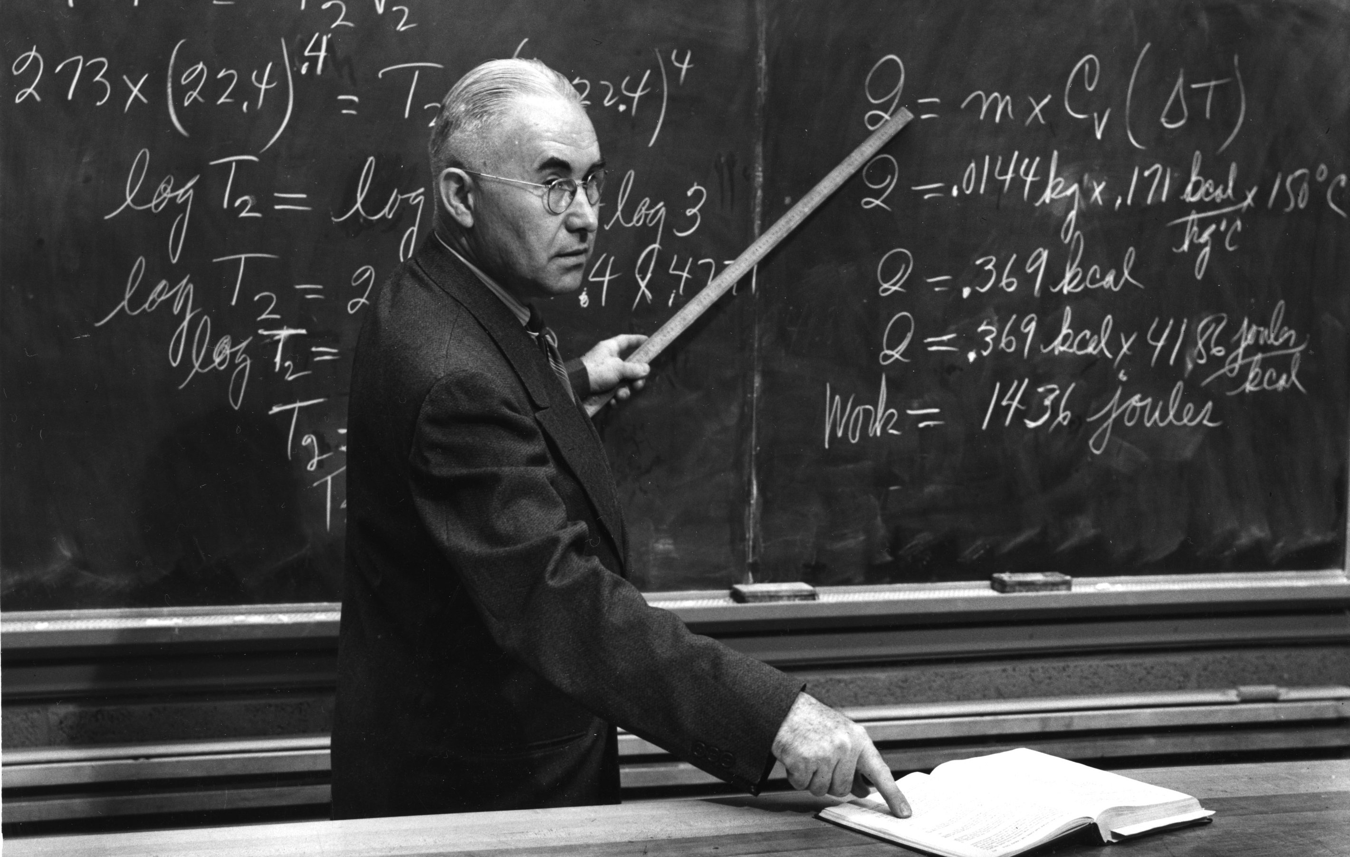
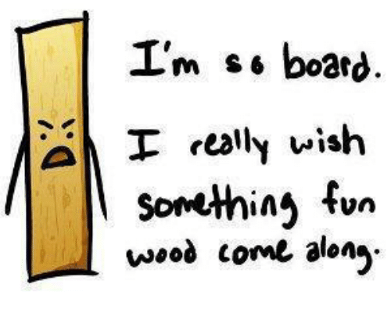

Boring Logs?
 |  | Logs
Boring

Slide 5
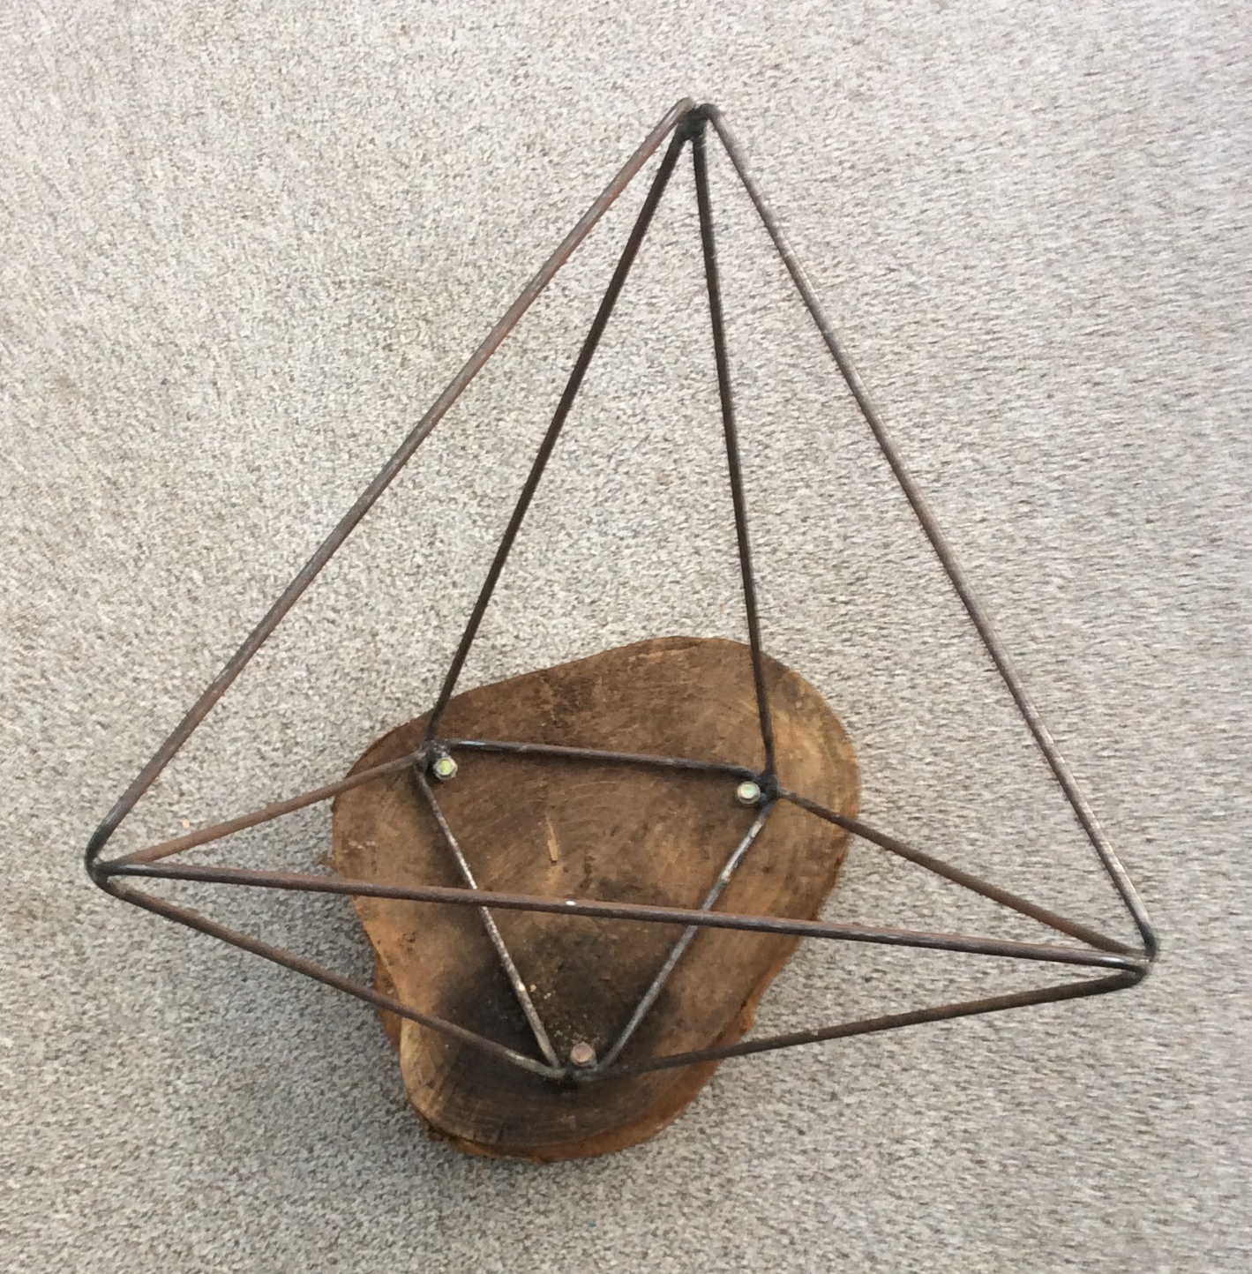
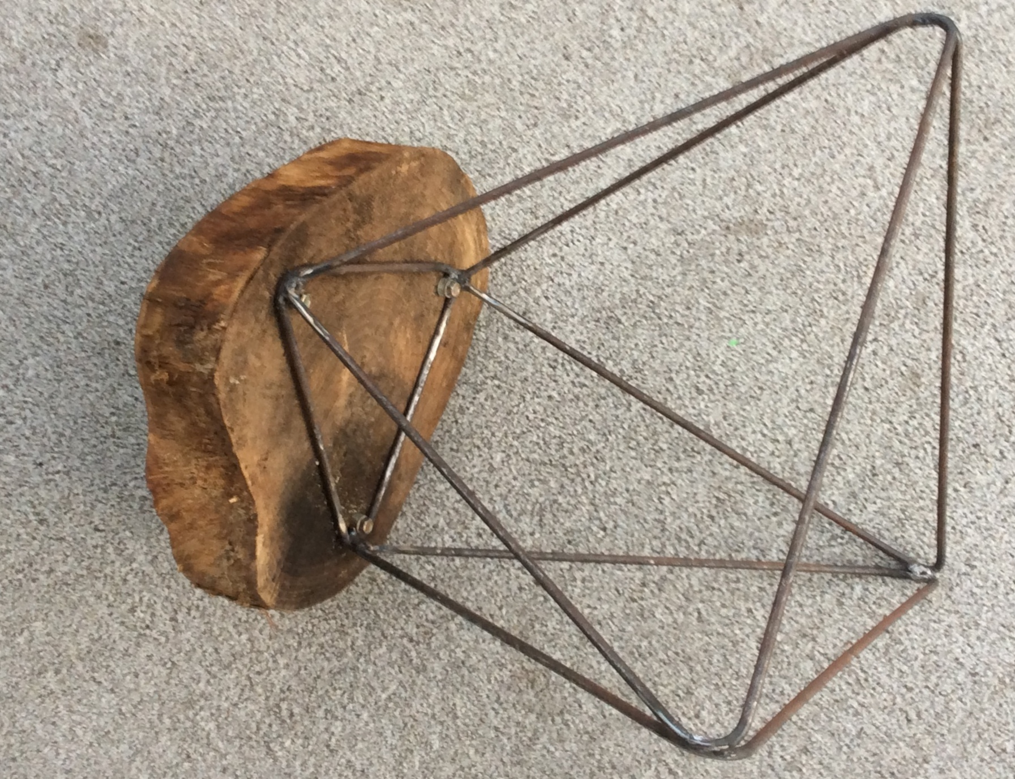
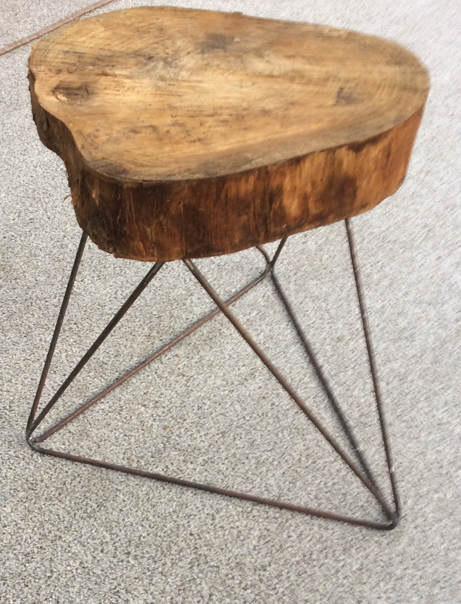
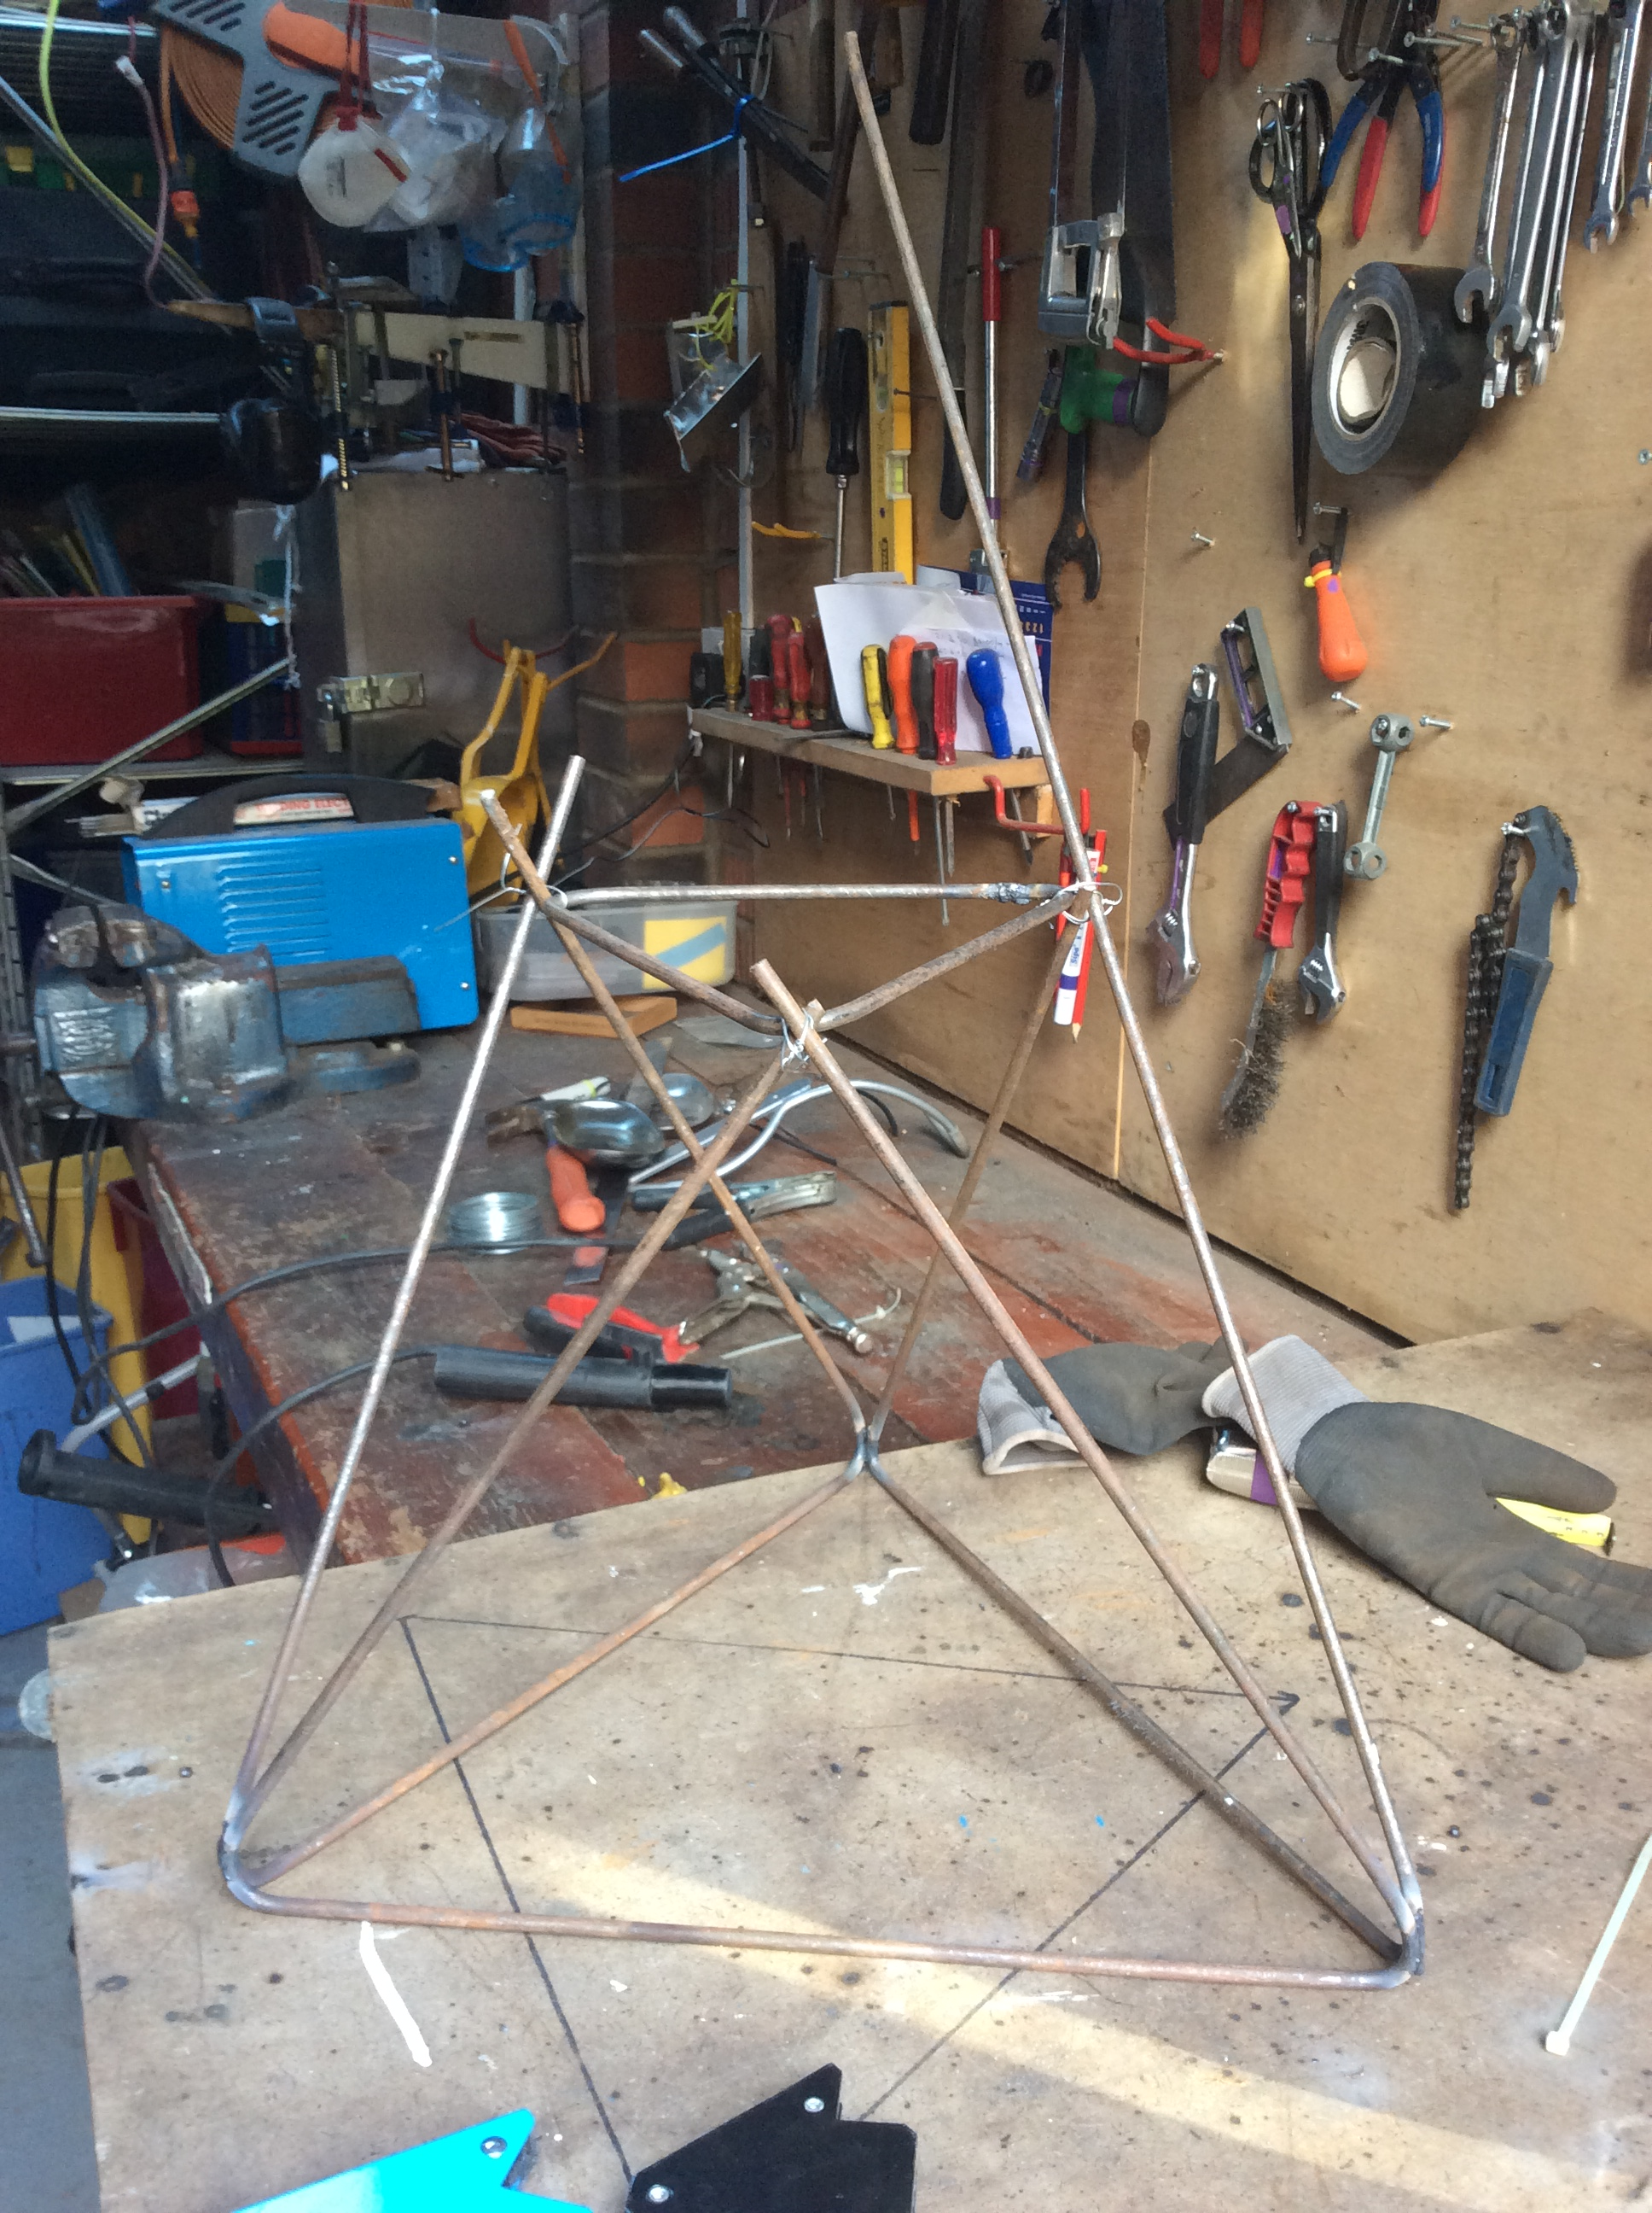
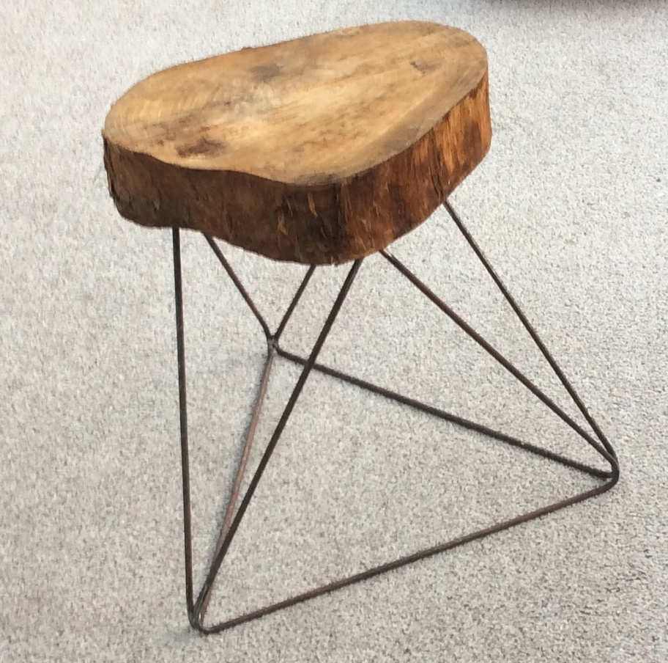

Slide 6
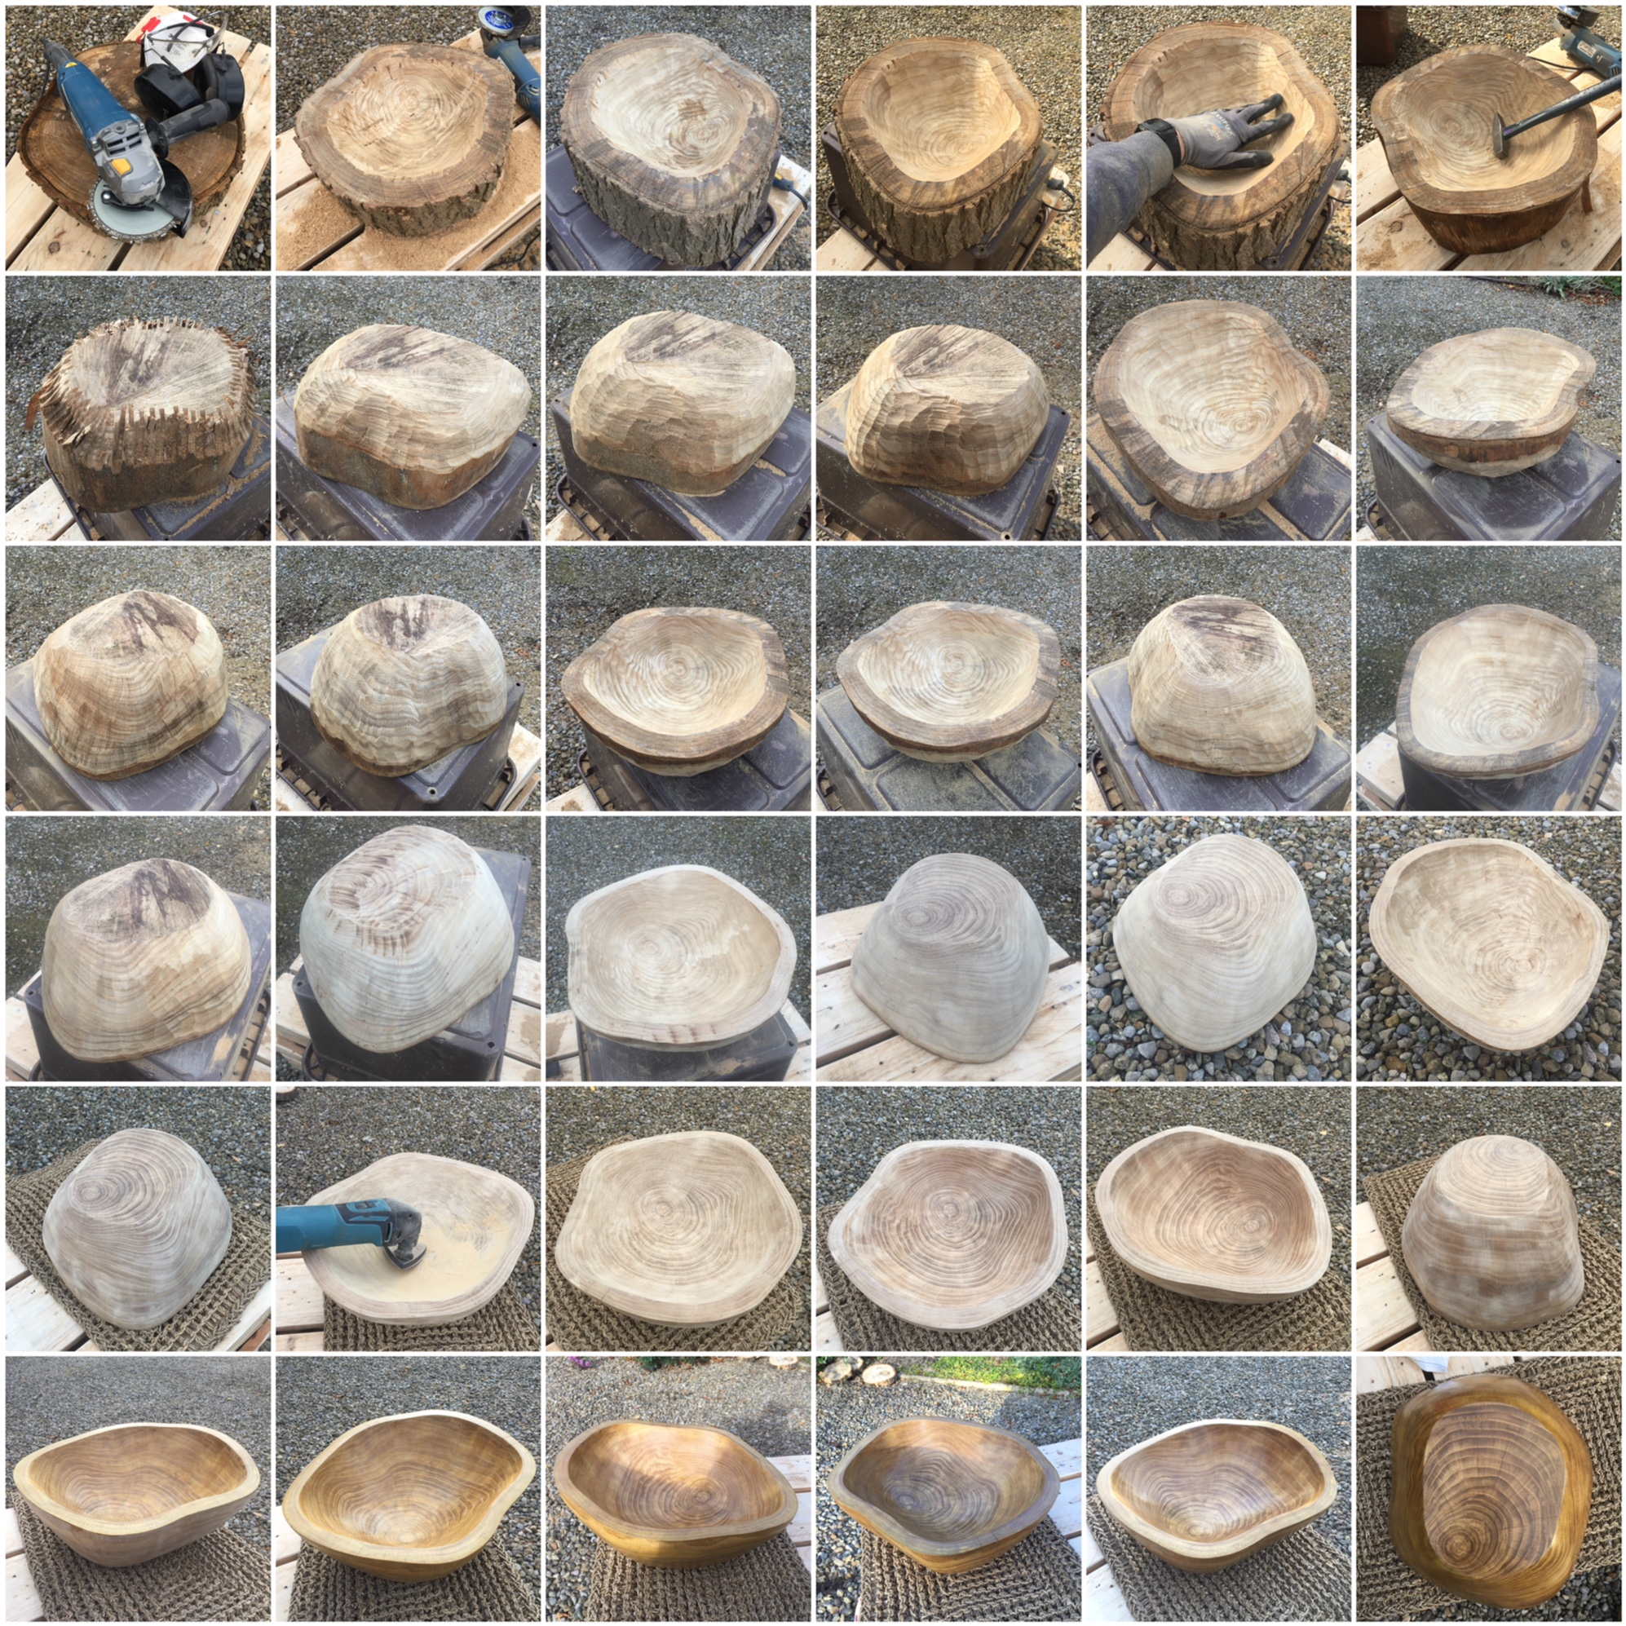

Slide 7
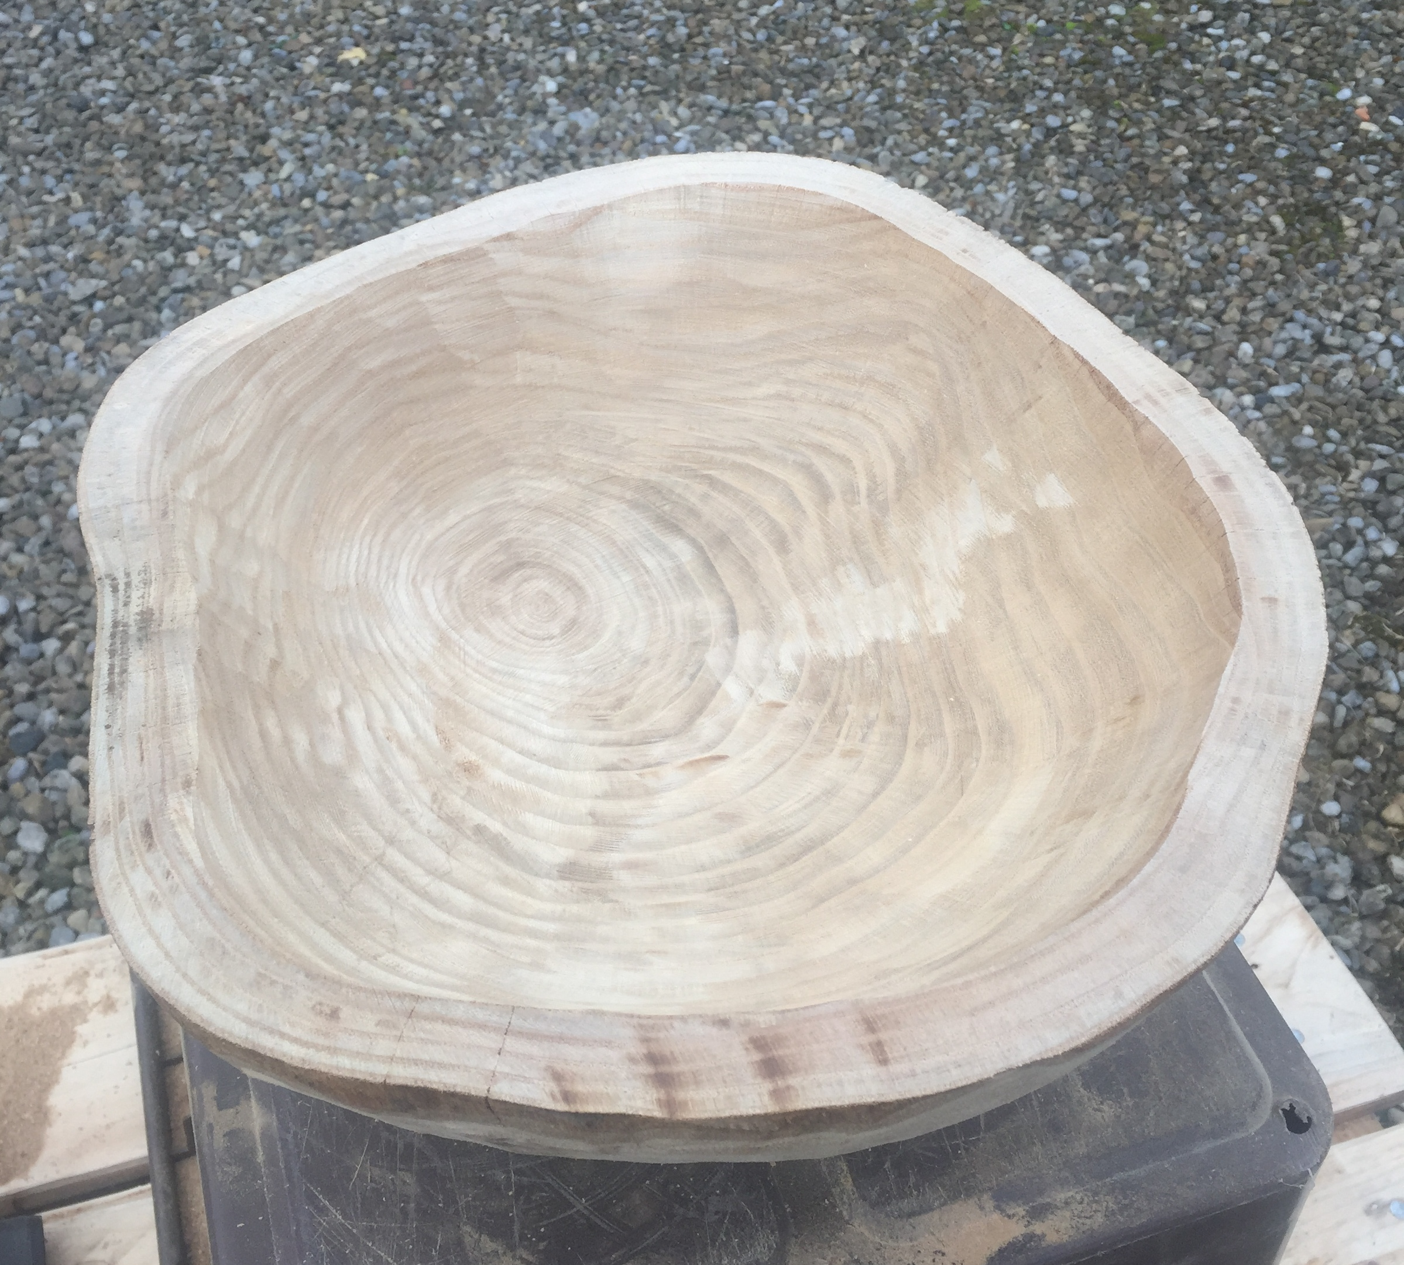
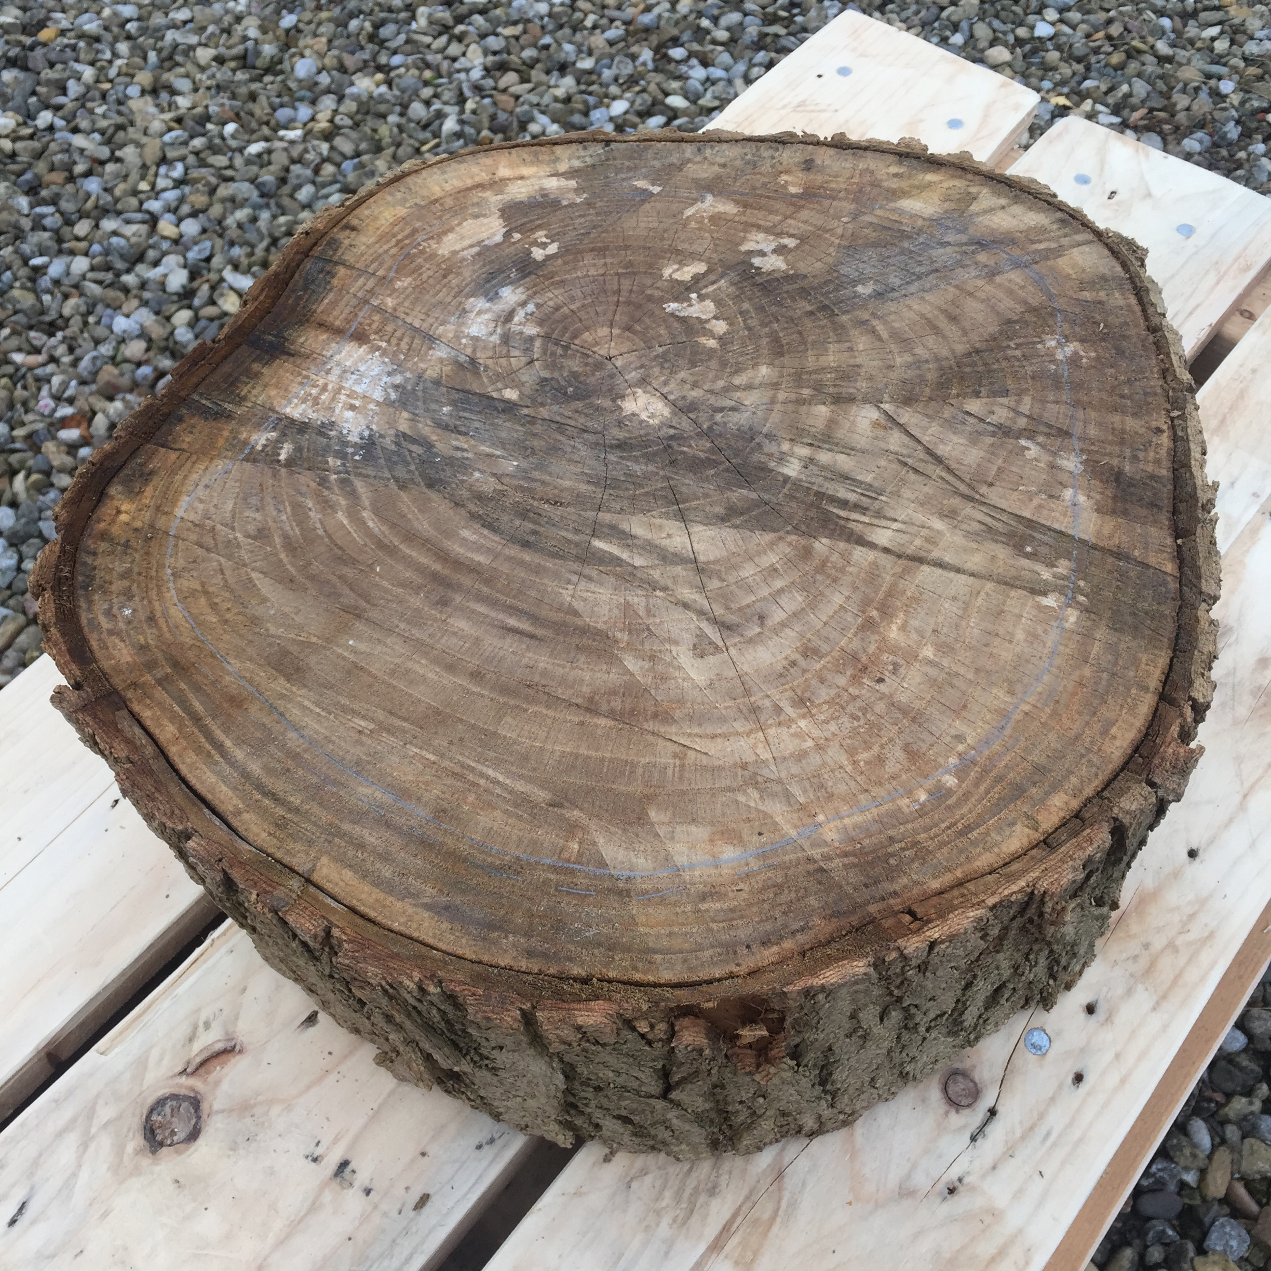
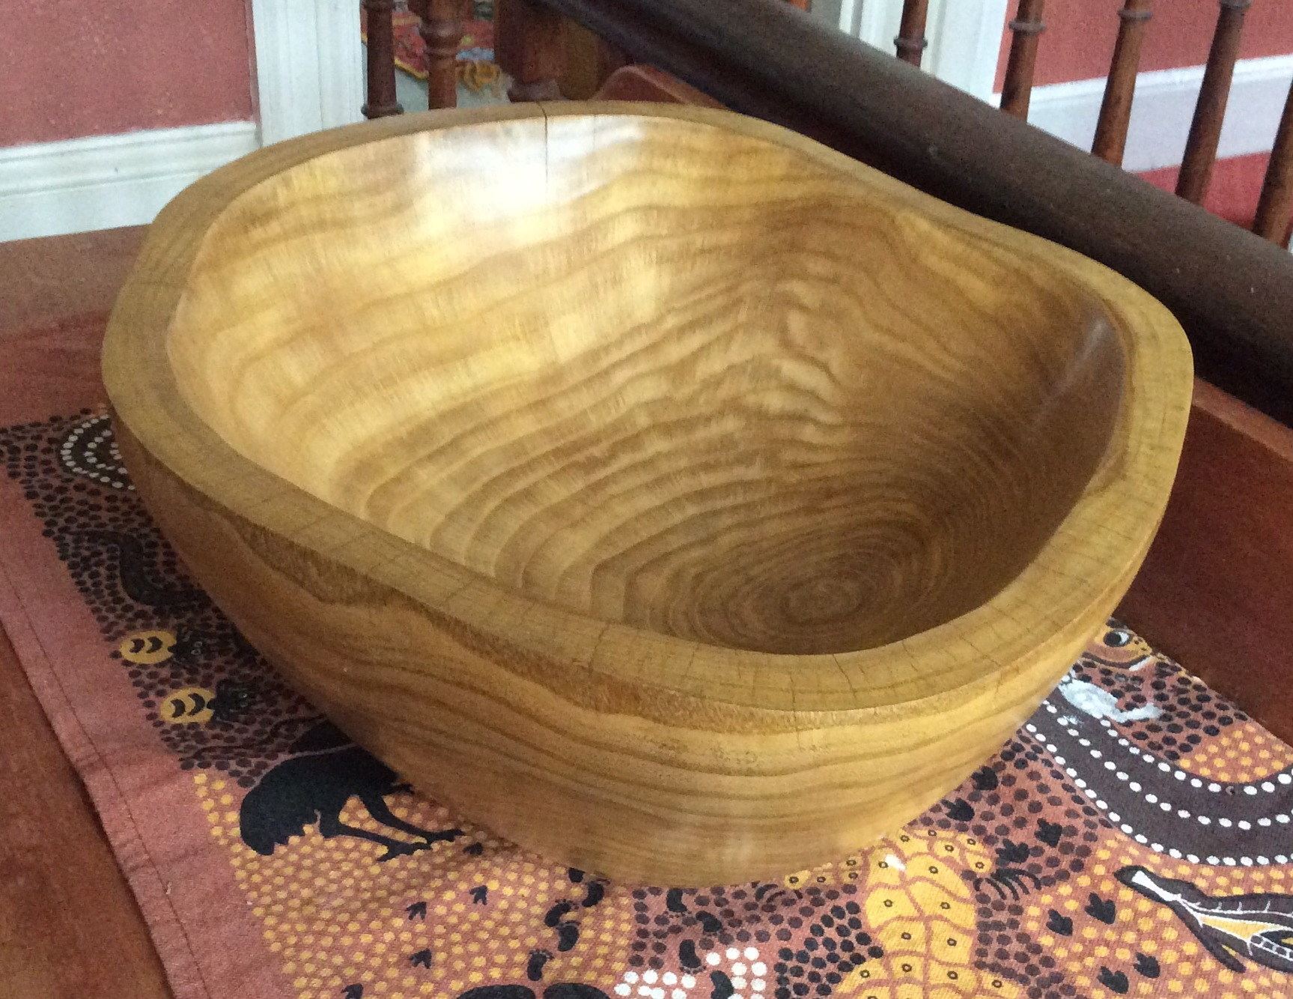
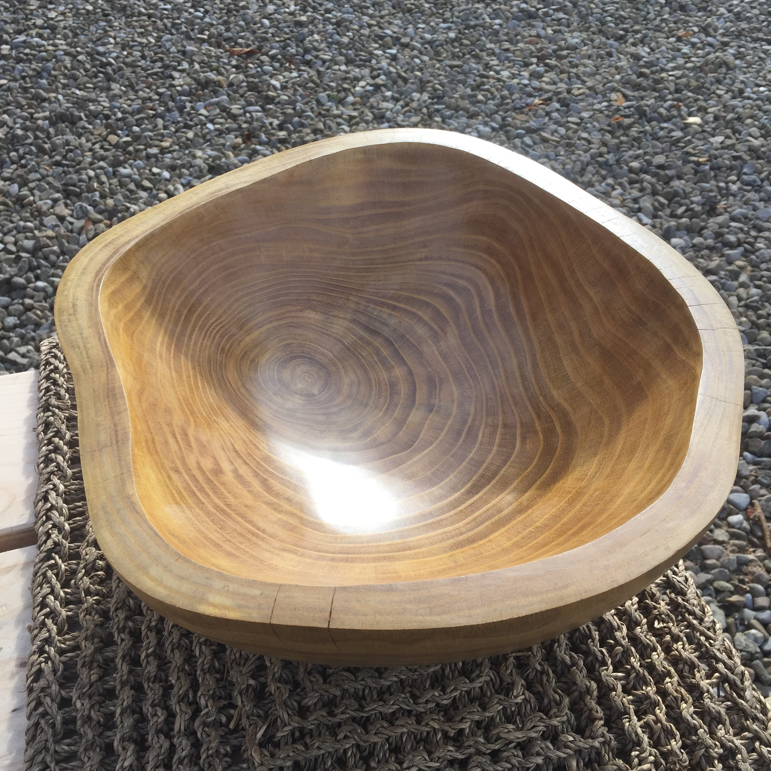
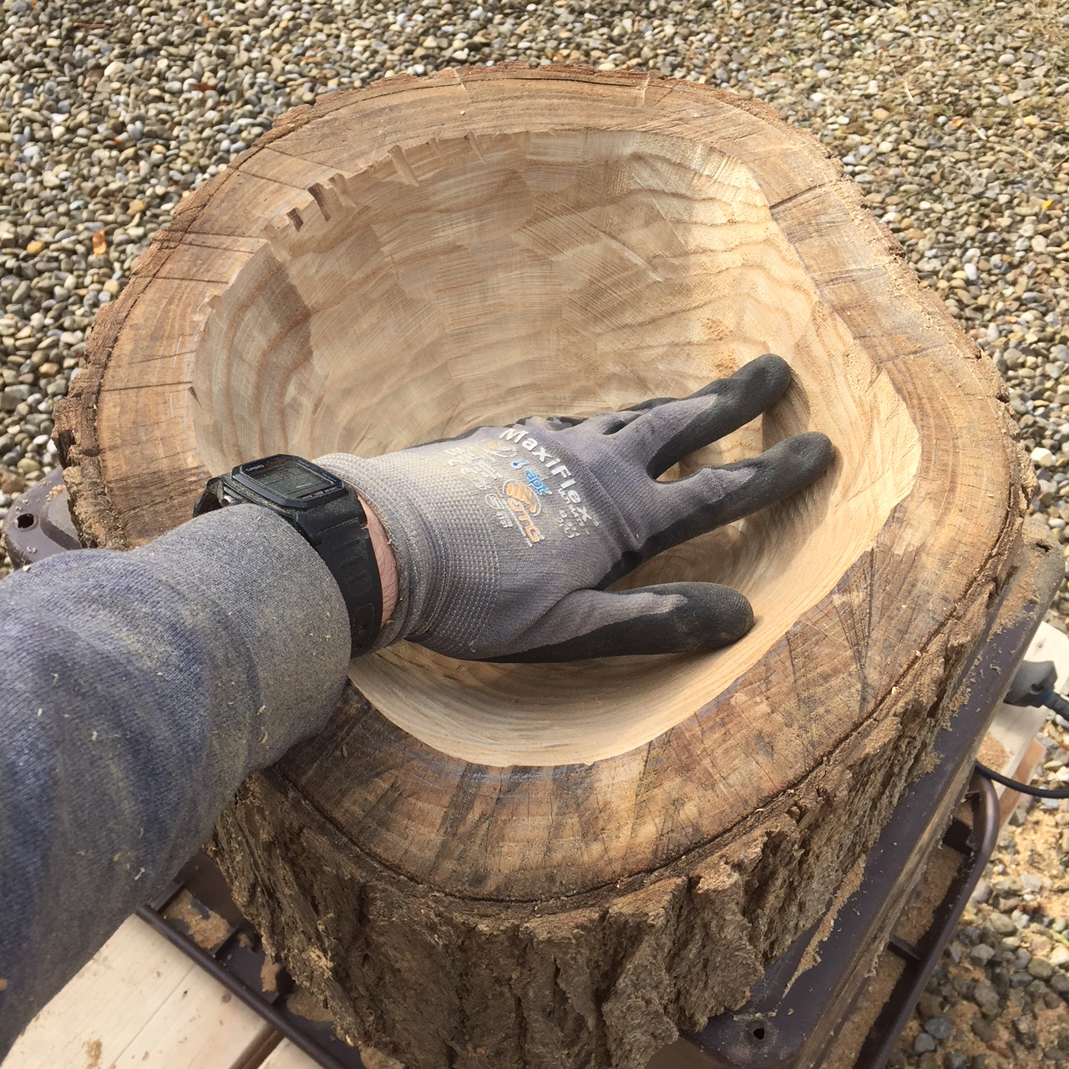

Slide 8
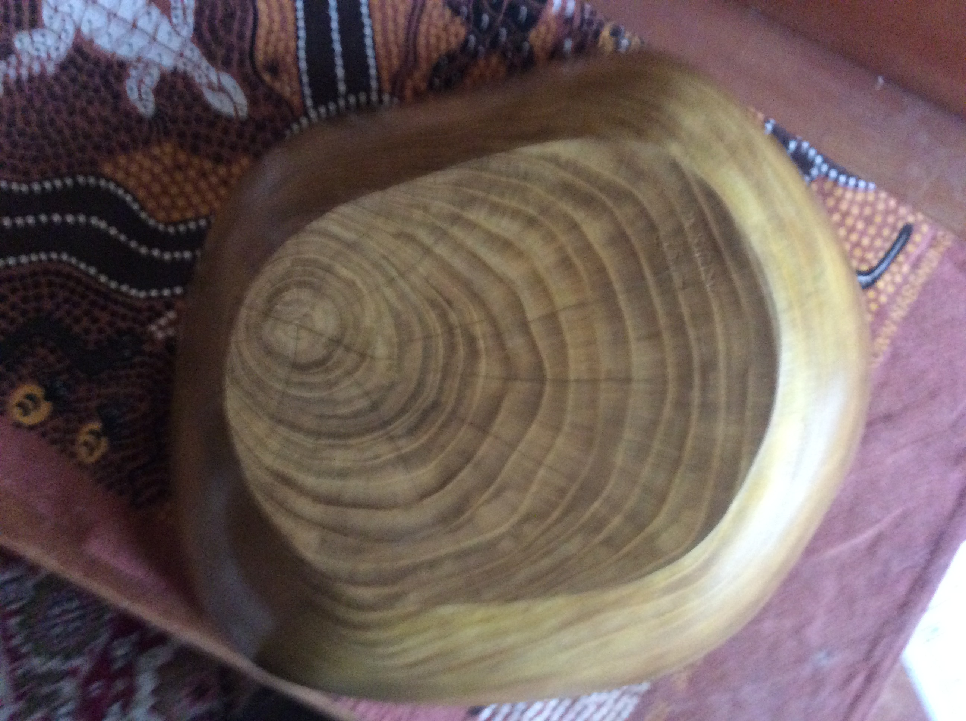
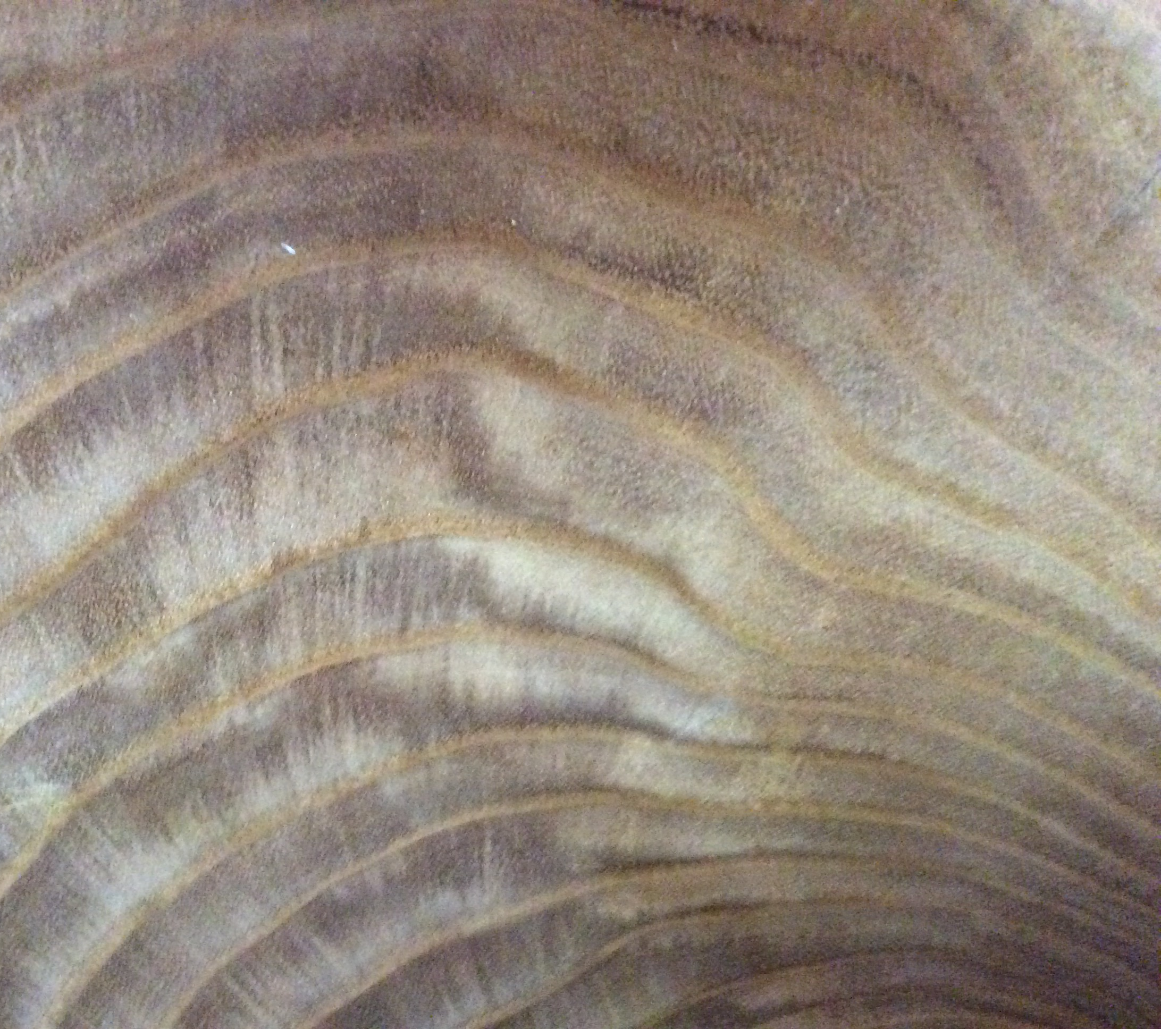
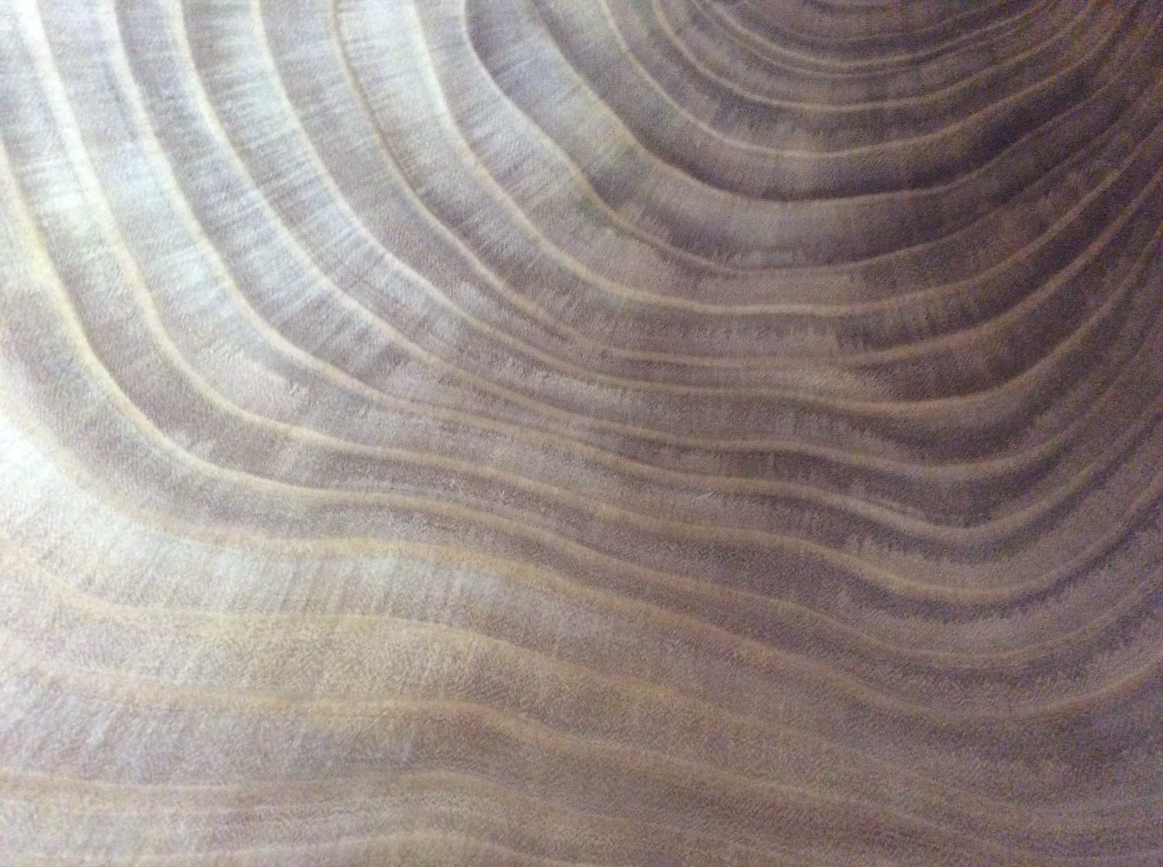

Slide 9
Where do the wavy lines come from?
Are the waves in the original tree-rings?
Or are they products of uneven boring?
Or both?

Slide 10
How to formulate mathematically?
Model the tree-ring pattern. (Cylinder containing cylinders?)
2. Model the pattern of carving.
(Spherical? Ellipsoidal? Combine with planar cuts?)
Perturb with random or sinusoidal variations (CAD could be useful!)

Slide 11
Q: Starting from circular tree-rings, how to bore if you want to get;
1. “Pure" ellipses
2. Nice sine curves
3. Other patterns ?
A: I don’t know.
Q: Is there any way you can get rings that cross each other? A: Probably not, but how to PROVE it?

Slide 12


Generalisations ?
Sticks of rock – can we suck them so the visible message differs from the original one?
Candles … ?

Slide 13
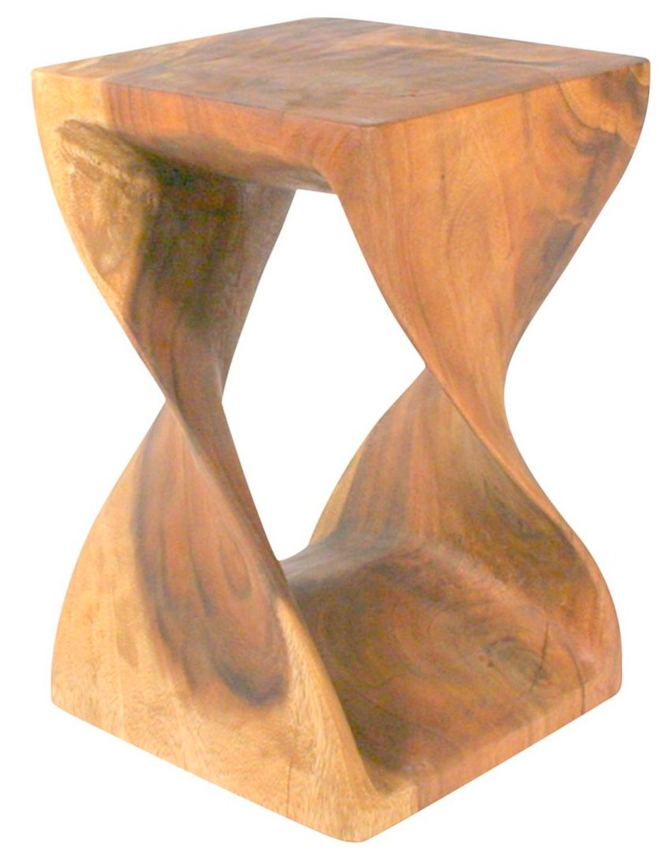
Future research:

Slide 14

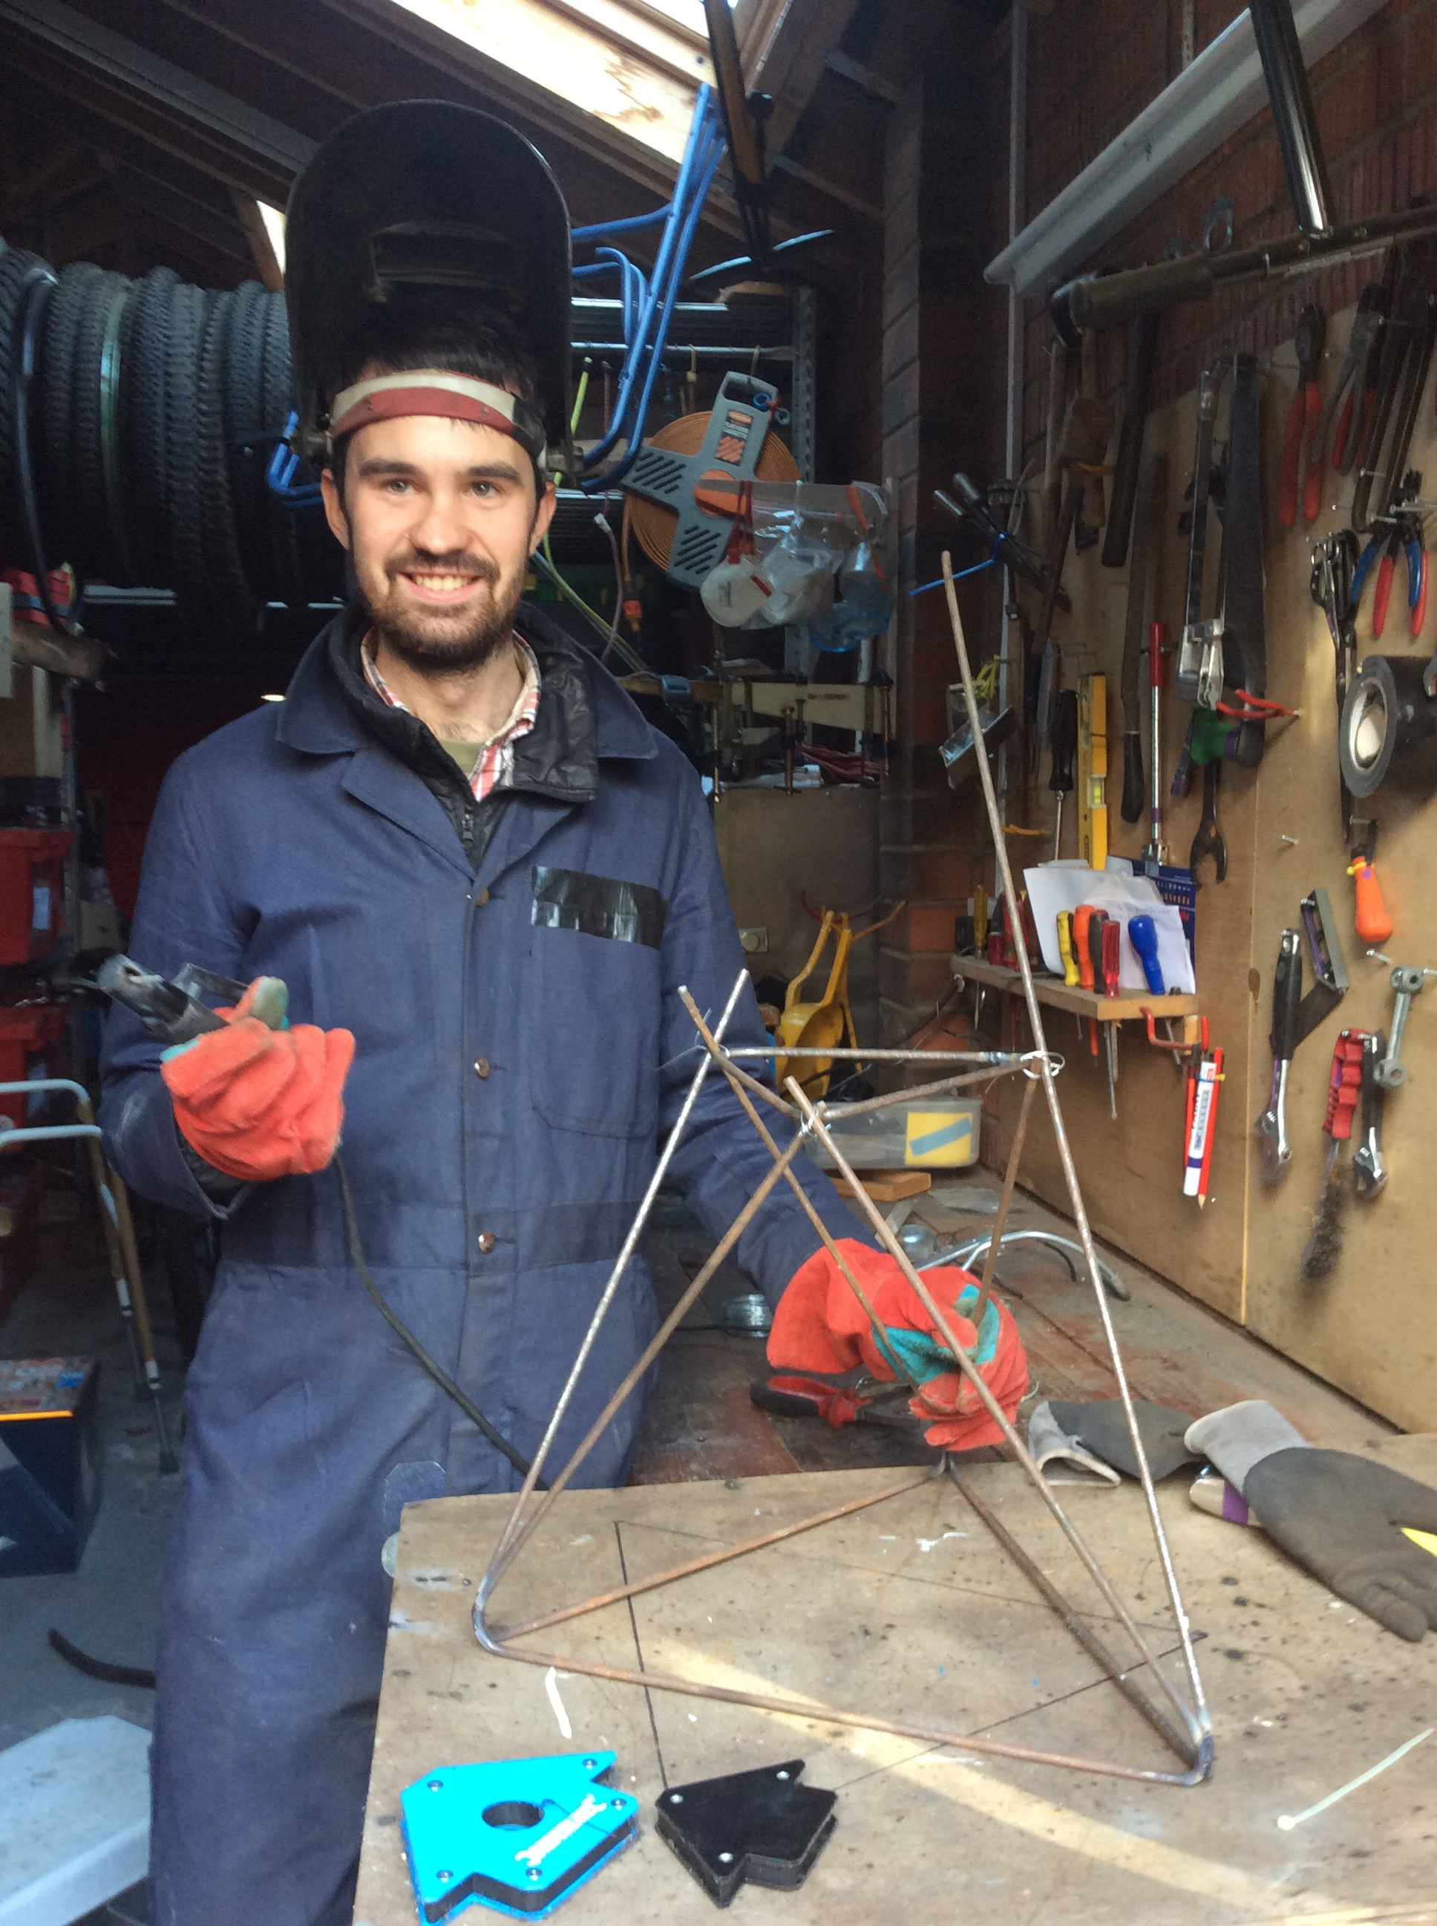
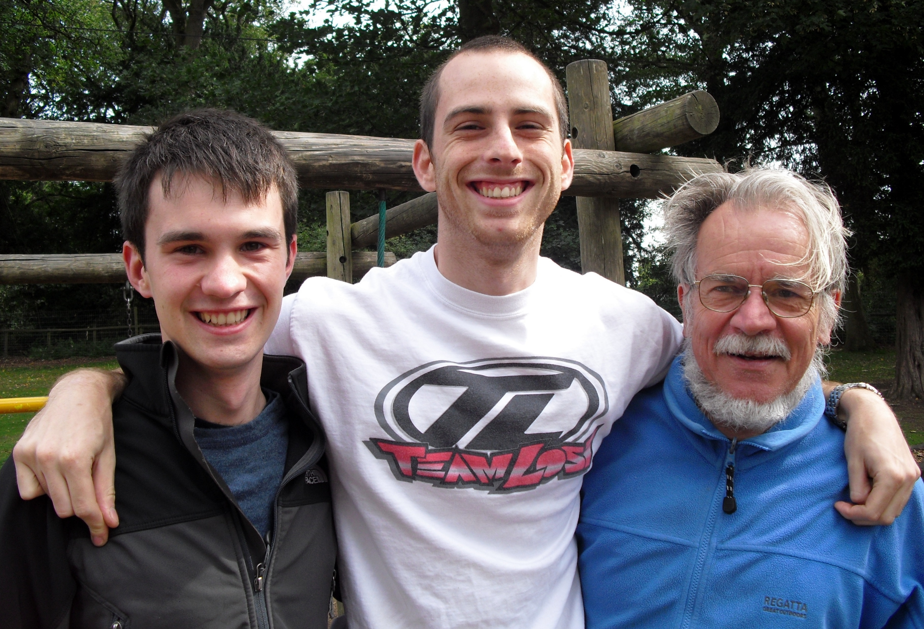
Thank you !!

