Slide 1
Multiplication
Magic or Madness
Multiplication is a quick (and accurate) technique to solve repeated addition calculations

Slide 2

Long Multiplication
Magic or Madness?

Slide 3
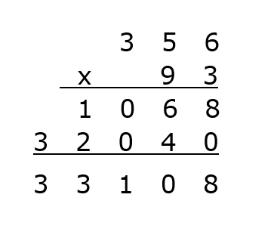
Column Multiplication 356 x 93
Notes:
This is probably the method most of us learnt in school; hands up if you were taught this at school?
Students frequently forget the zero when multiplying by 9 ! So at GCSE gain no marks as method incorrect.

Slide 4
Column Multiplication - decimal
.
‘Traditional’ Method ?
Madness ?
.
.
Notes:
Slightly tricky with decimals, students frequently just line-up the decimal through all the working which is what has been insisted upon throughout addition and subtraction exercises!
Counting digits after decimal point in question then ensuring same number of digits after decimal point in answer seems like madness to students!

Slide 5
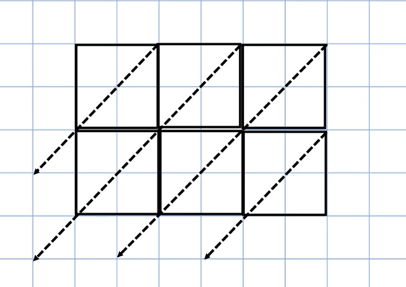
Gelosia Multiplication 356 x 93
Notes:
Gelosia is another method of long multiplication

Slide 6
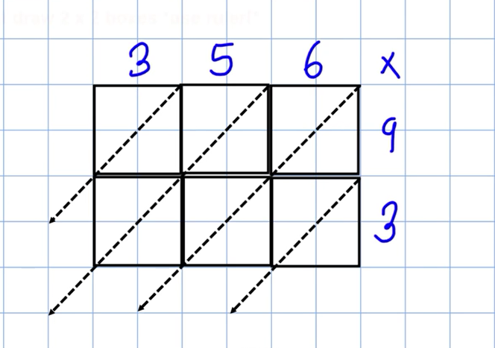
Gelosia Multiplication 356 x 93
Notes:
Hands-up: How many of you are familiar with Gelosia method?

Slide 7
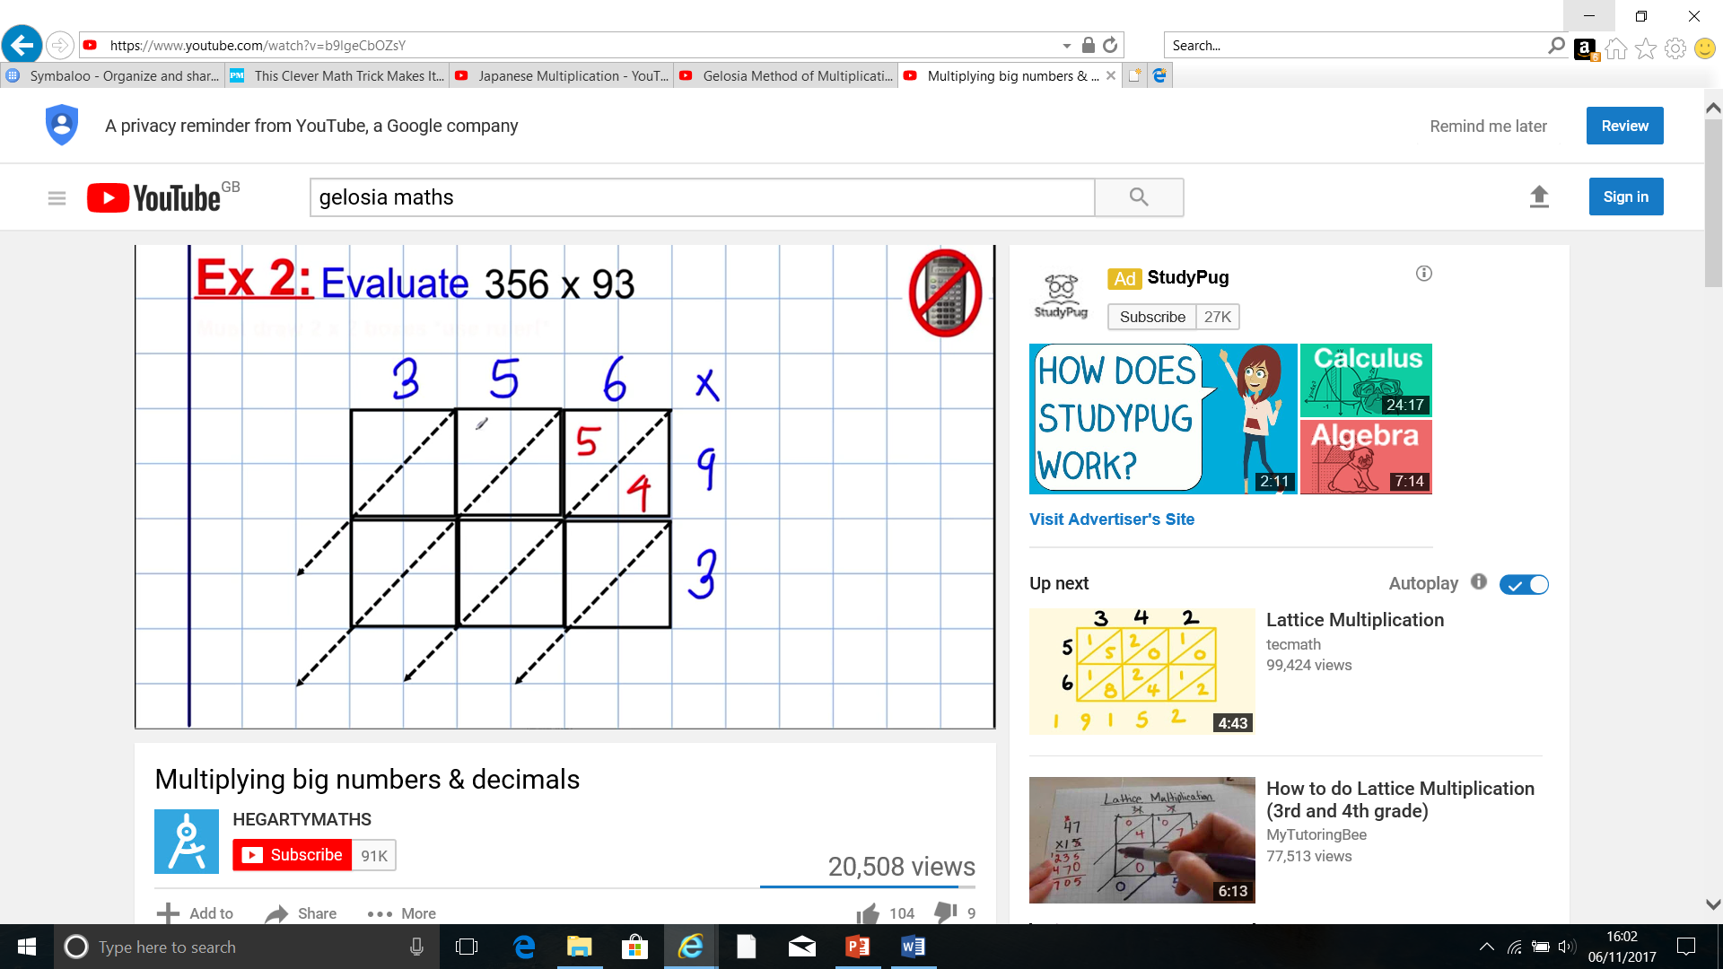
Gelosia Multiplication
Notes:
Each box has the answer to the multiplication of the values heading each row and column: so 6 x 9 = 54 written in the box

Slide 8
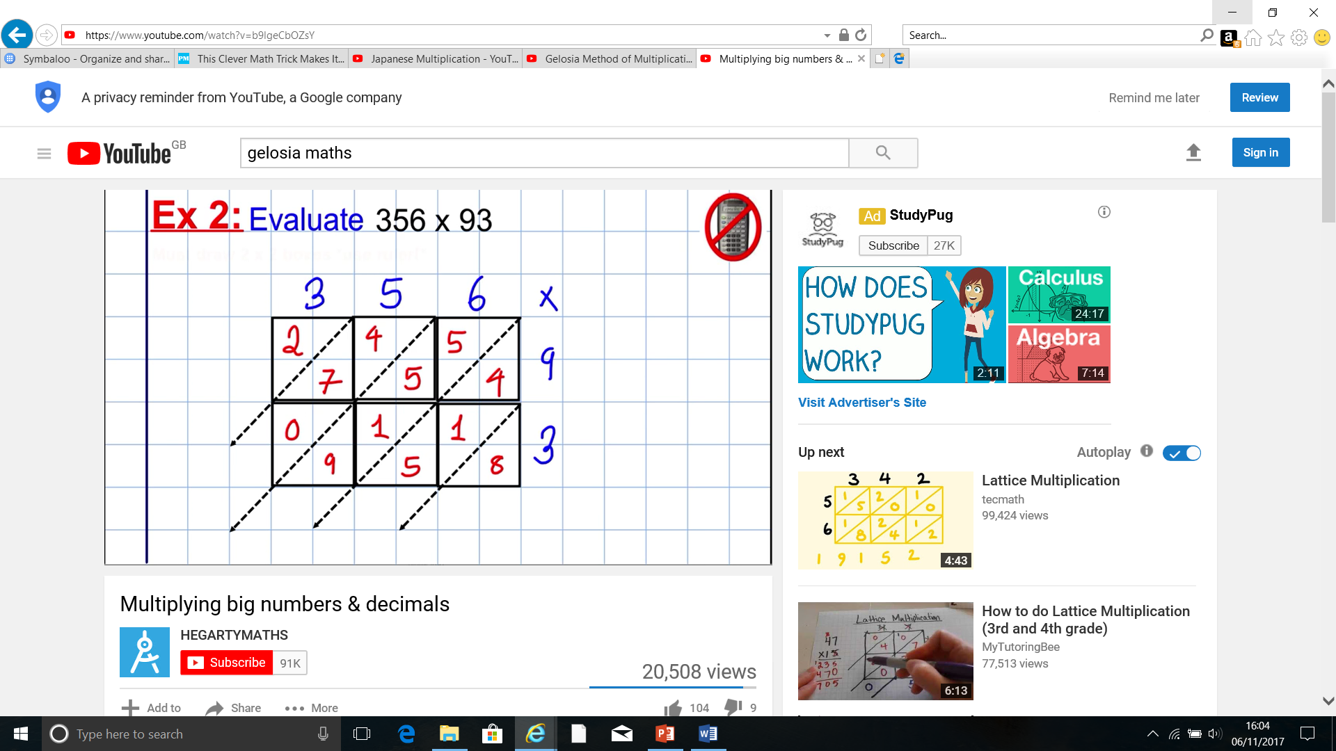
Gelosia Multiplication
Notes:
All 6 multiplications are calculated and written into relevant box, so now all the

Slide 9
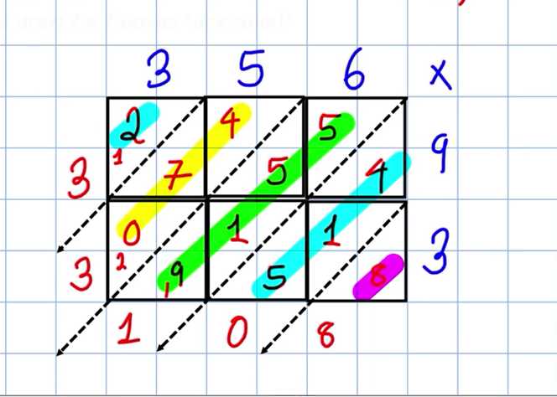
Gelosia Multiplication
Notes:
The diagonal columns are added to provide the answer 33108

Slide 10
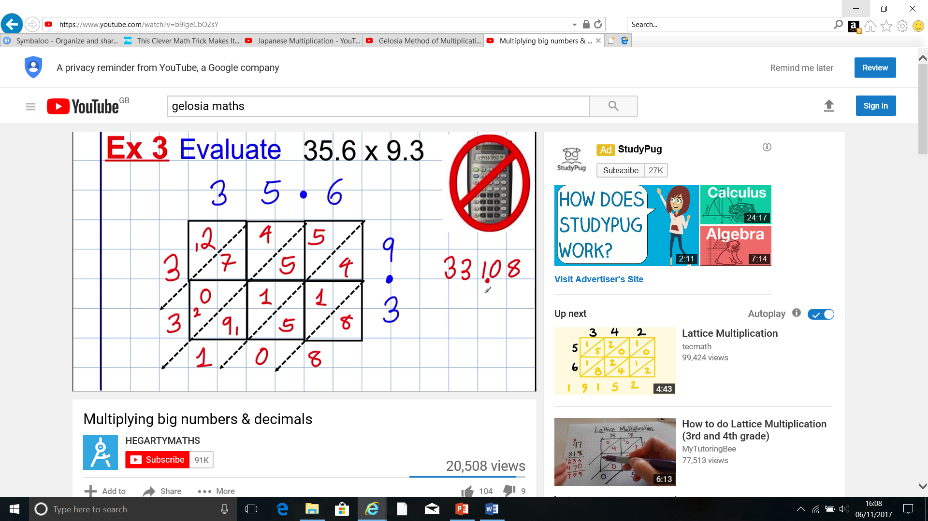
Gelosia Multiplication - decimal
Notes:
Identical method with decimal values

Slide 11
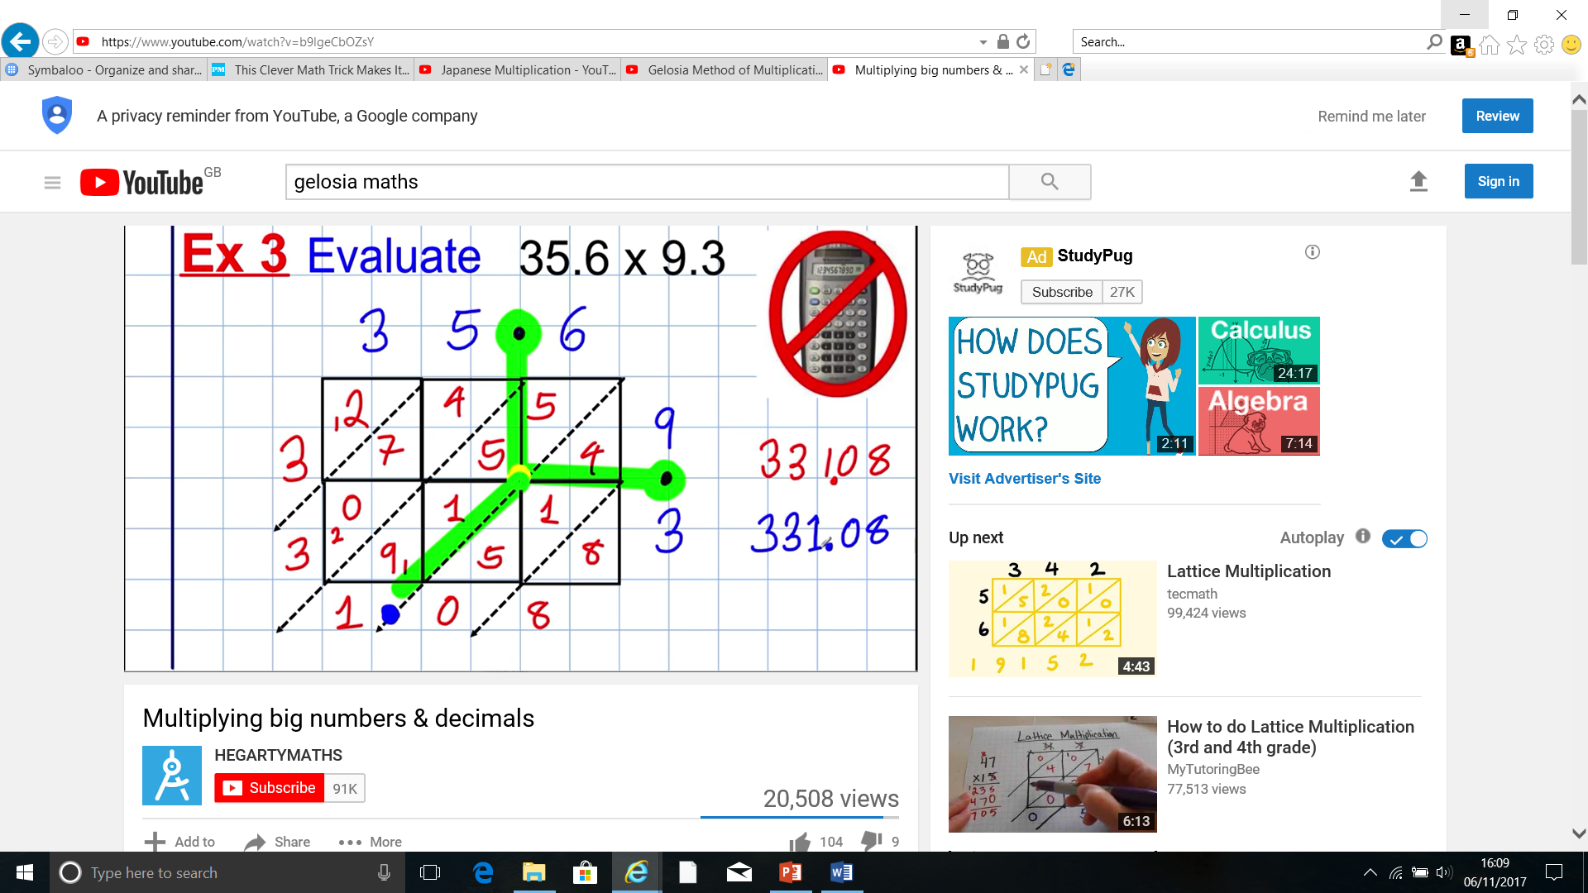
Gelosia Multiplication - decimal
Answer and decimal point all line-up – MAGIC !
Notes:
Unlike the column method it is easy to explain how the grid works including for decimal values.

Slide 12
Gelosia Multiplication
Column Multiplication
Origin – Europe 18th Century
Origin – from Hindu Mathematics
In Europe from 13th Century
Notes:
As a teacher I found parents very resistant to this ‘new fangled’ Gelosia multiplication – they were generally shocked but also placated to discover that it is much older than Column method. I suspect the column method became useful with the industrialisation of printing! Able students can manage the column method however weaker students struggle with the varying tactics!

Slide 13
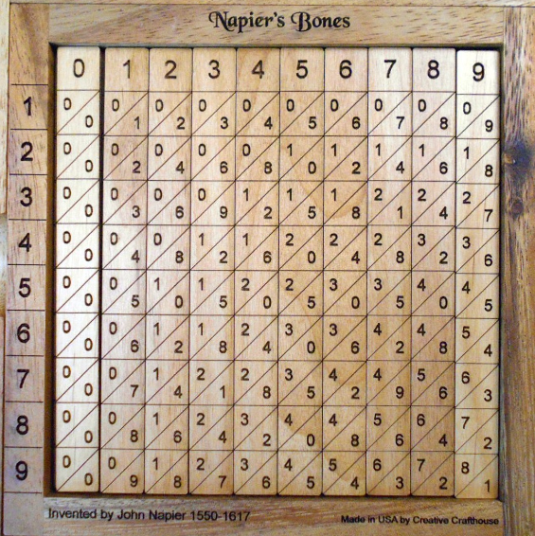
Napier’s Bones – Gelosia aid
Gelosia – 13th Century
Napier – 16th Century
Notes:
John Napier 1550 -1617; famous for his logarithms – developed after accidentally meeting Tycho Brahe when ship blown off-course in storm whilst he was accompanying James VI of Scotland (James 1 of England) on betrothal trip to meet Anne of Denmark!

Slide 14
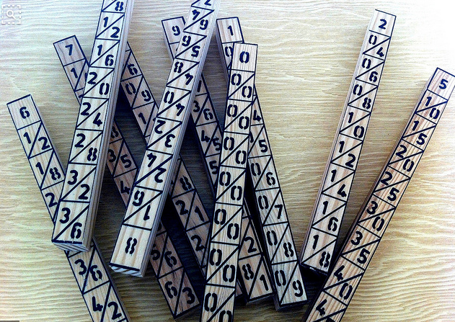
Napier’s Bones – Gelosia aid
Gelosia – 13th Century
Napier – 16th Century
Developed his calculating aid for use by the growing artisans and merchants.
Originally made from bone
Notes:
Napier 1550 -1617

Slide 15
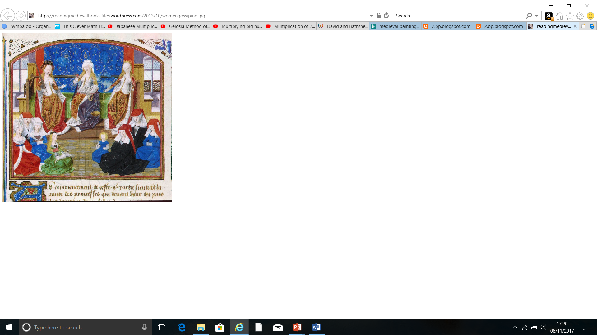
Medieval Italy: Gelosia = Grid

Slide 16
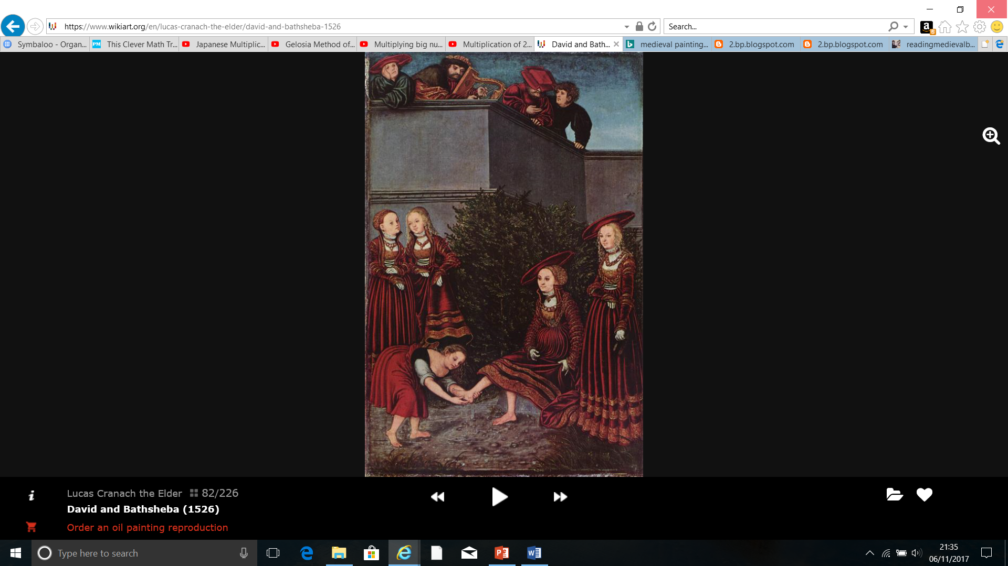
Gelosia = Grid
Gelosia = Grid
Gelosia
=
Jealousy

Slide 17
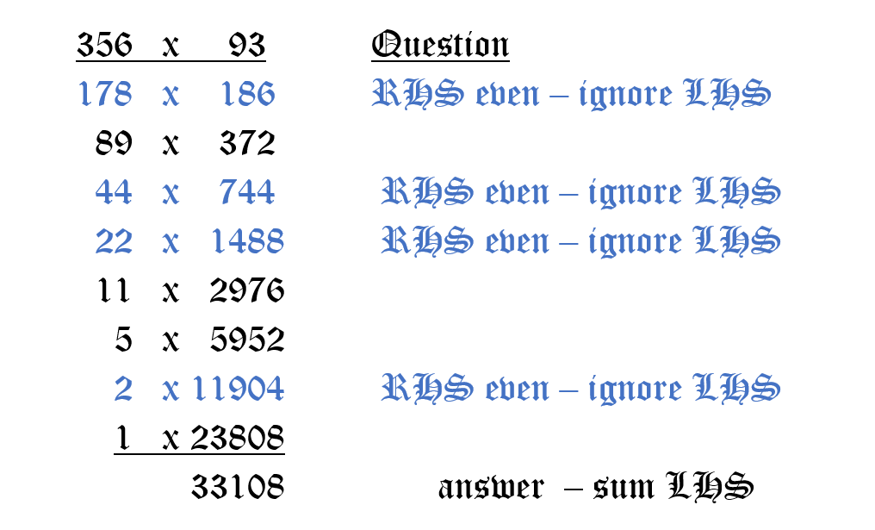
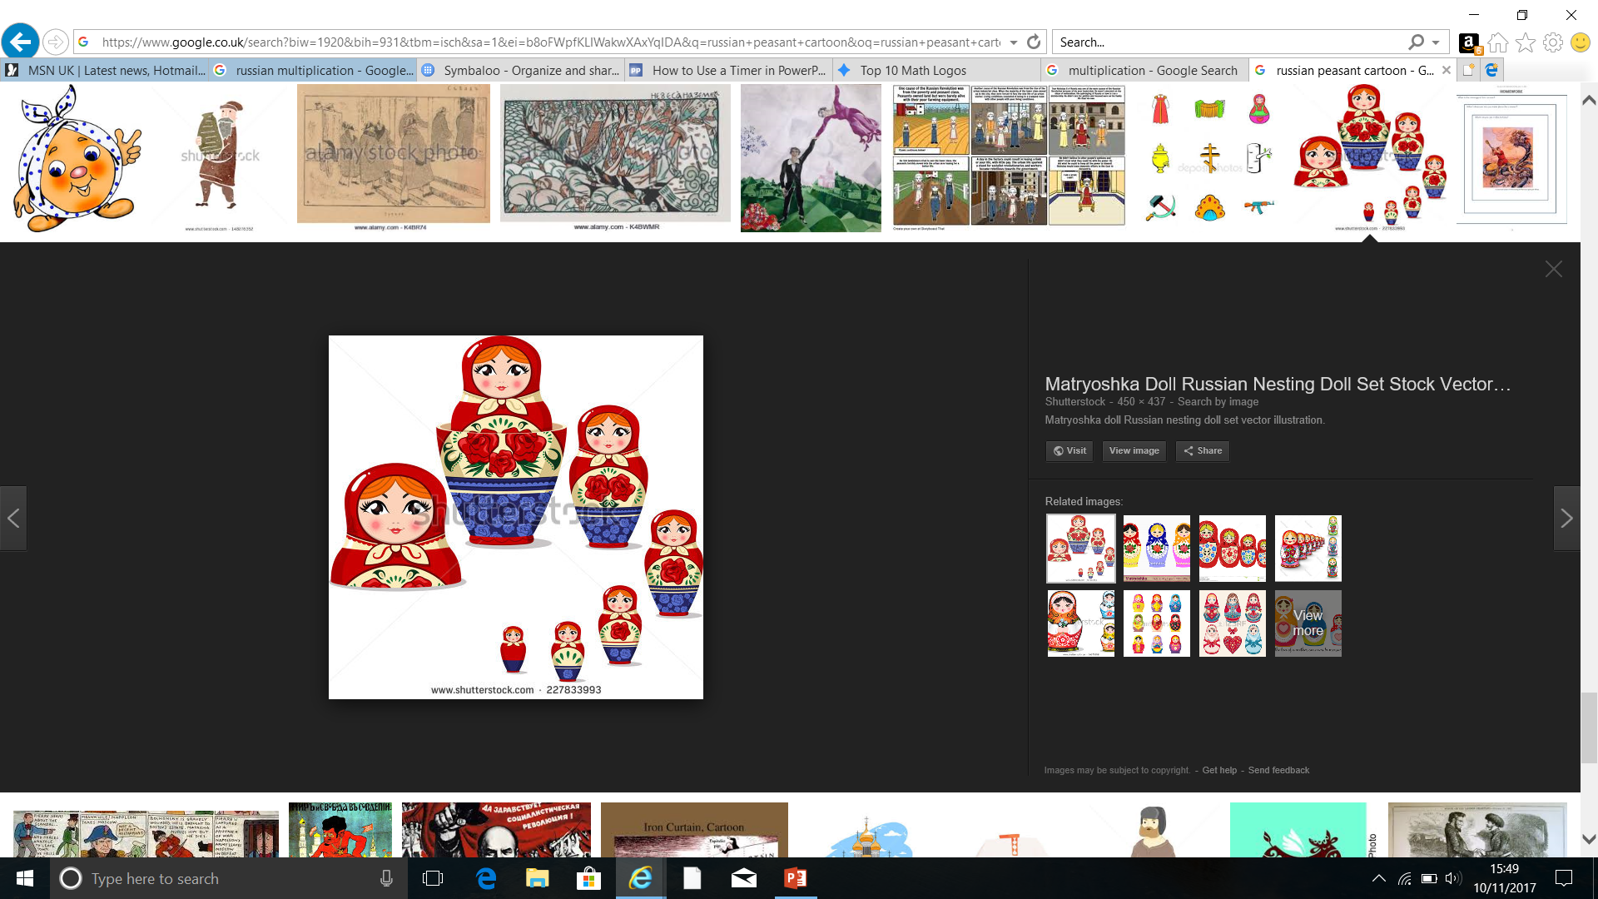
Russian Multiplication – halving & doubling
Notes:
Based on powers of 2

Slide 18
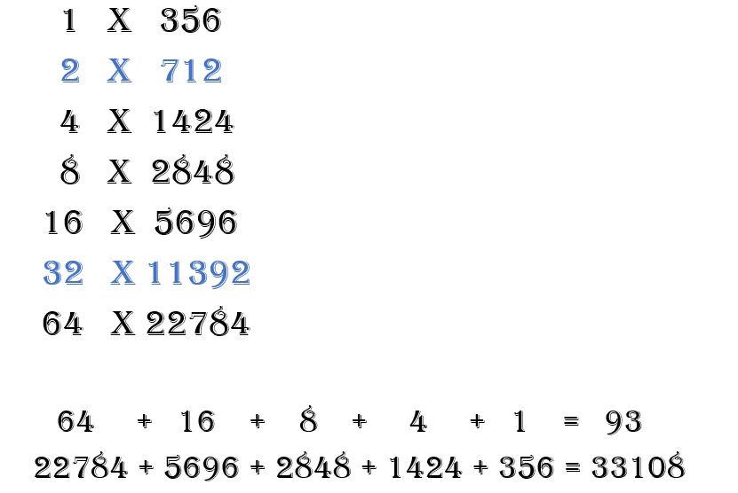
Egyptian Multiplication - doubling
Blue values ignored as values 2 and 32 not required to make multiplier 93
Notes:
Egyptian multiplication based on powers of 2 – similar principle to Russian

Slide 19
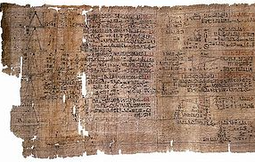
Egyptian Multiplication - doubling
Ahmes Papyrus (Rhind) 1500BC
‘Multiplication’ – follows from Egyptian – ‘duplation’
Notes:
Egyptian multiplication based on powers of 2 – similar principle to Russian

Slide 20
Alternative Grid – origin: 20th century
3 | 5 | 6
27000 | 4500 | 540 | 9
900 | 150 | 18 | 3
300 | 50 | 6
27000 | 4500 | 540 | 90
900 | 150 | 18 | 3
27000
4500
540
900
150
18
33108
Does not easily extend to decimal place calculations!
Why?
Notes:
Personally I cannot think why anyone invented this method! I perceive that the main objective with any long multiplication method – is to make calculation easier/quicker.
This grid method requires students to have excellent place value understanding; often students randomly add zeroes with extensive errors!

Slide 21
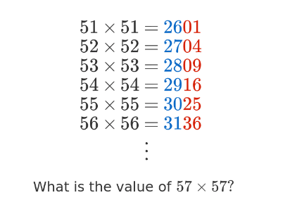
Amazing Multiplication

Slide 22
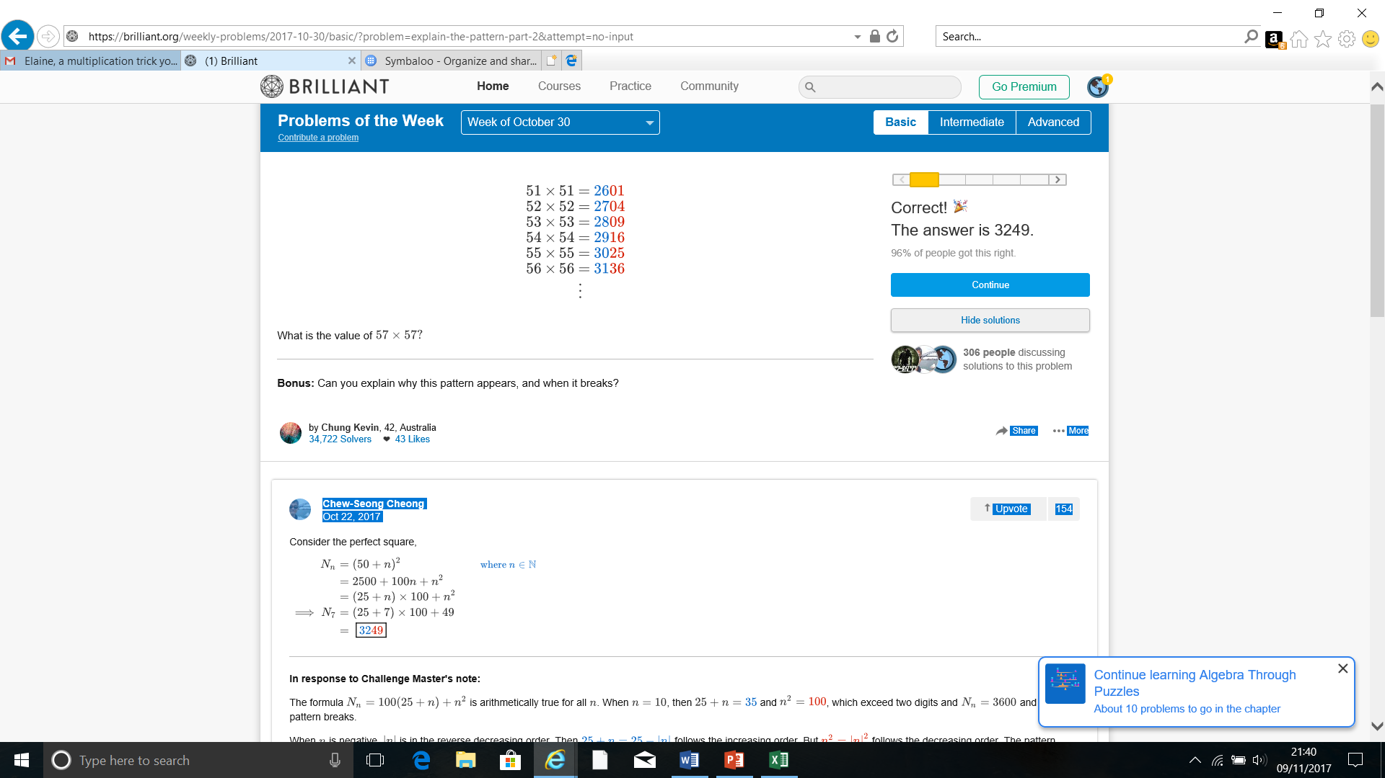
Multiplication – Magic !

Slide 23
Long Multiplication
Magic or Madness
Elaine Smith & Lynda Goldenberg

