Slide 1
Logical deduction games
Matt Peperell
@mattpep

Slide 2
Penultima
Notes:
ordinary chess set
unusual; >=1 umpires

Slide 3
Zendo
Notes:
icehouse pyramids (visualiser)

Slide 4
Mao
Notes:
has base rules + potentially additional
apologies for opinionatedness; dislike for 2 reasons:
anti social
gives unfair advantage to those who know base

Slide 5
Eleusis
Notes:
ordinary playing cards
not necessarily complete decks
goal is to have empty hand

Slide 6
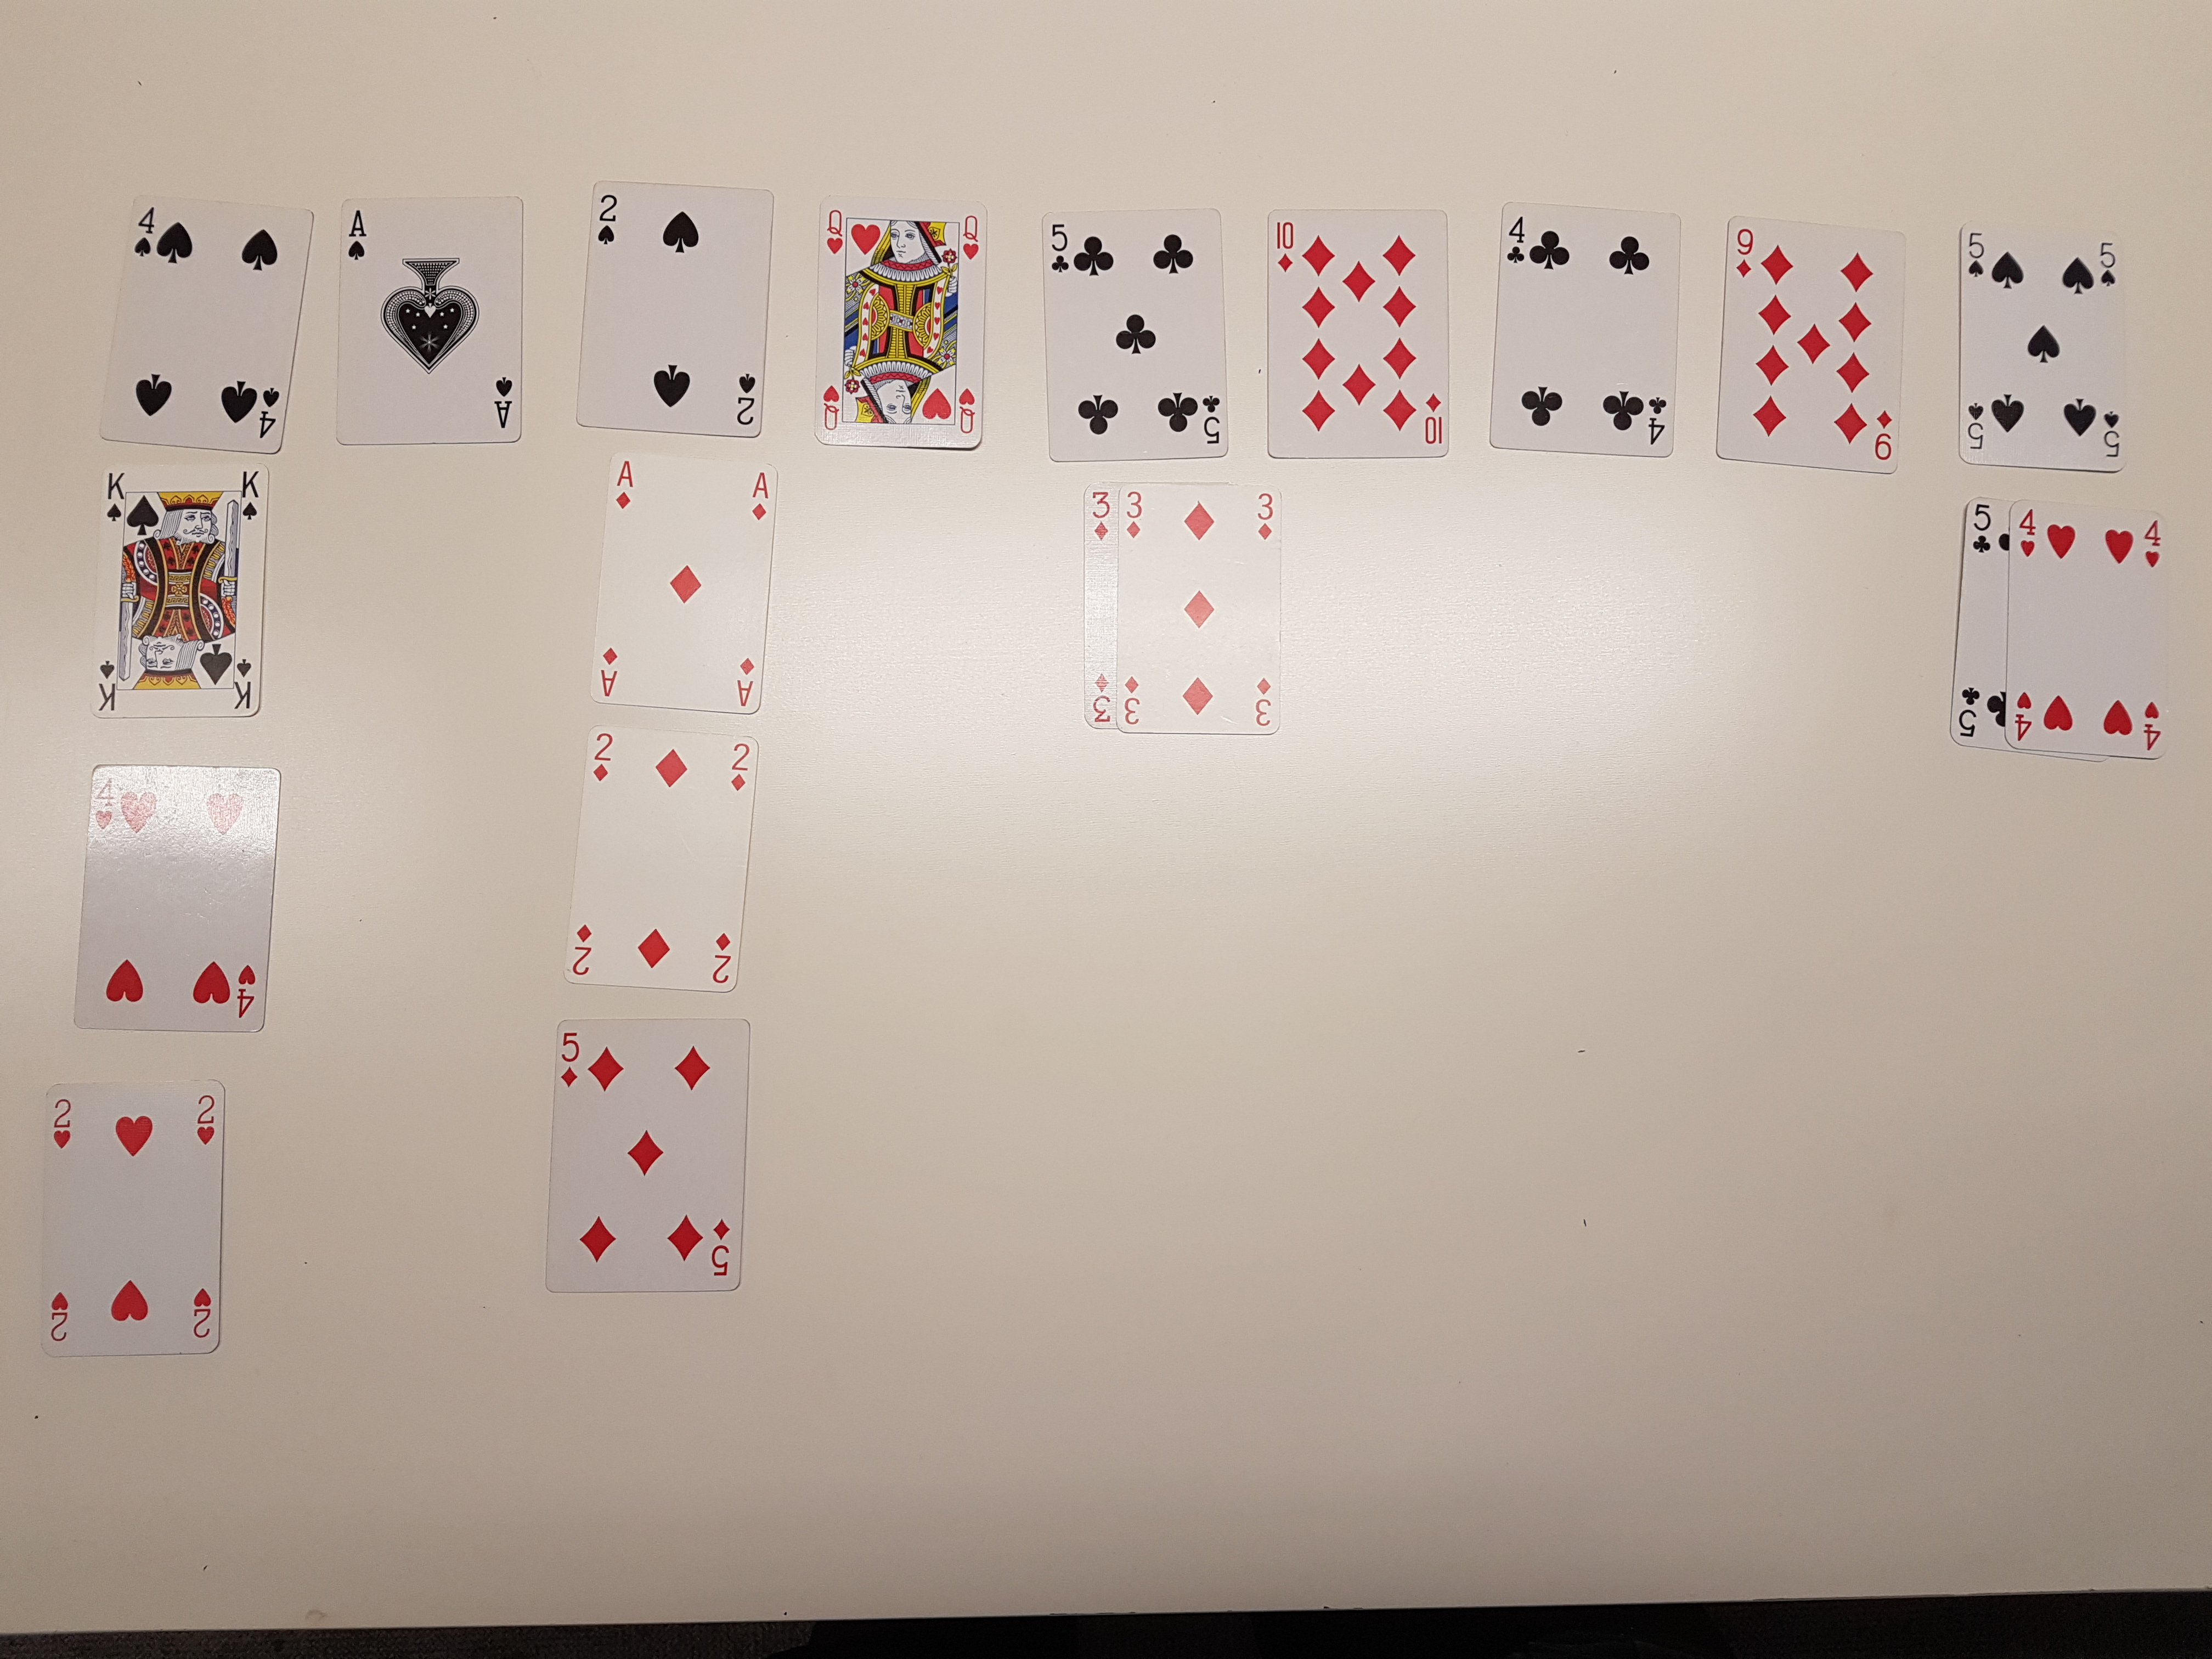
Mid-game
Eleusis

Slide 7
Comparison
Feature | Penultima | Eleusis | Xendo
Equipment | Chess set | Playing cards | Icehouse pyramids
Participants | 2 players 1+ umpires | 4+ | 3+
Scoring Mechanism | None | Optional, but non-trivial | None

Slide 8
Who wants to play?

