Slide 1
A Programmed Deck
Pedro Freitas
MathsJam 2017

Slide 2
Sum and difference
My talk was about stacking a deck of cards so one could perform the following trick:
Ask someone to think of two integers, between one and ten, and tell you their sum and difference.
You “insert” the sum and difference into the deck, and it gives you back the original numbers.
There are two aspects to this trick: the stack and the way you draw cards from the deck.

Slide 3
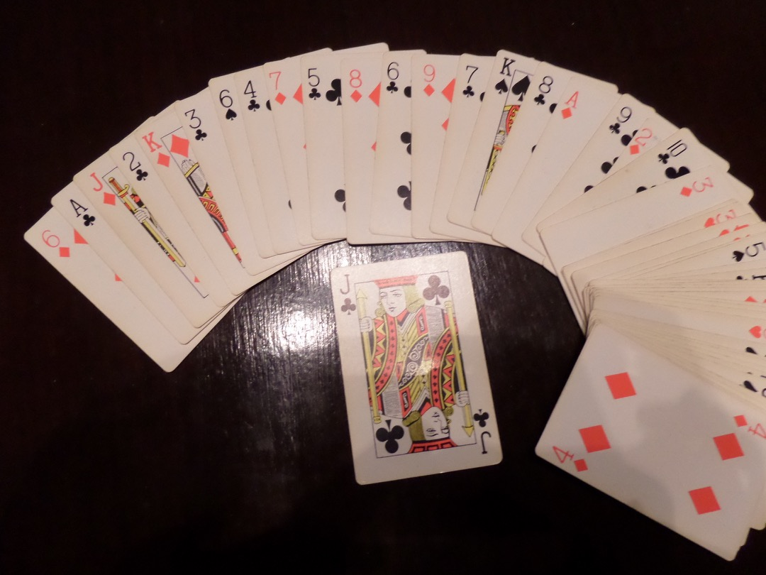
The stack
The club cards must be placed in the even positions: ace on the 2nd, two on the 4th, and so on, through the ten of clubs.
The remaining cards don’t have any specific ordering.
The Jack of clubs must be on the table, separated from the rest of the deck.

Slide 4
Drawing the cards
Take the deck in hand, face down. Let’s say the sum of the numbers is s and the difference is d.
— Deal s cards from the top of the deck onto the table, one at a time (reversing the order).
— Collect the pile, turn it face up and add it to the bottom of the deck (the rest of the deck will still be facing down).
— Add the Jack of clubs to the top of the deck.
— Take two cards simultaneously from the top and bottom of the deck onto the table, do this d times. This is called the Klondike shuffle or the milk shuffle.
— The next two cards, dealt also from top and bottom, will have the original numbers.

Slide 5
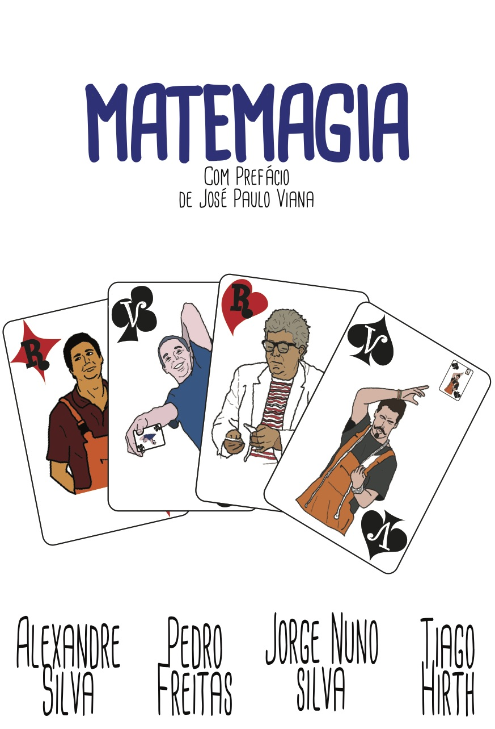
For more tricks like this…
English translation coming soon…

