Slide 1
From a twitter puzzle to Landau’s 4th problem in <5min
Philipp Reinhard

Slide 2
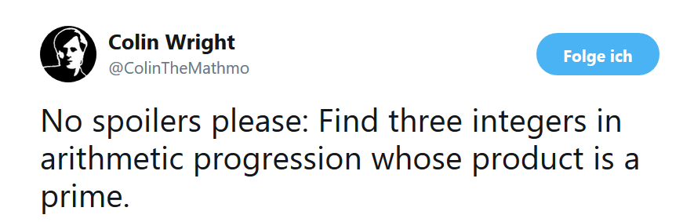

Slightly more precise:
Find an arithmetic progression $a,b, c ∈ℤ :abc$ is prime in $ℕ$
Looks impossible, but then think again (after this talk).

Slide 3

Modifying the riddle:
Find an arithmetic progression $a,b, c ∈ℚ :abc$ is prime in ℕ
How many solutions?

Slide 4

Modifying the riddle 2: going complex
Find an arithmetic progression $a,b, c ∈𝔾= ℤ+\text{i}ℤ :abc$ is prime in ℕ
Gaussians for benefit and profit
Primes in 𝔾 relate to the primes in ℕ (prime classification theorem).
Finding a general form of the solutions (and the proof that these are all solutions) is easier than it might look.

Slide 5
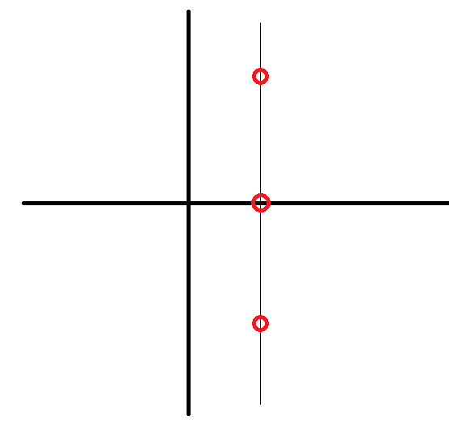

The only candidates which are not part of the original riddle are of the form
$$a=1−\text{i}n$$
$$b=1$$
$$c=1+\text{i}n$$
The product gives $abc=n^{2}+1$.
How many of the $n^{2}+1$ are prime in ℕ?
Lots of examples ($2^{2}+1=5, 4^{2}+1=17, 6^{2}+1=37)$

Slide 6
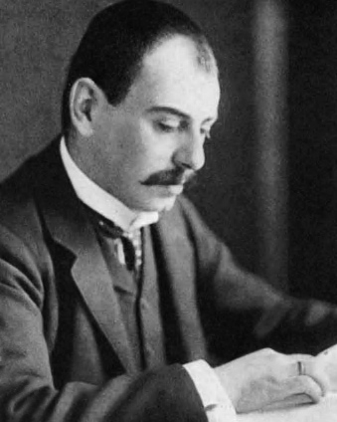
Edmund Landau presented 4 problems in 1912 (IMC in Cambridge)
1: Twin prime conjecture
Status: still unsolved
2: Goldbach conjecture
Status: Still unsolved

Slide 7

3. Legendre conjecture: there is always a prime between $n^{2}$ and ${(n+1)}^{2}$.
Status: still unsolved
4. no name conjecture: there are infinitely many primes of the form $n^{2}+1$.
Status: still unsolved

Slide 8

Next puzzle
Find two non-isomorphic groups $A$ and $B$ with the following homomorphisms
An injection $A↪B$
A surjection $A↠B$
An injection $B↪A$
A surjection $B↠A$ What about TOP?

Slide 9

Better next puzzle
Train fares *usually/supposedly* define a metric $d\left(x,y\right)$ on the set of all train stations
(1) Positivity: $d\left(x,y\right)>0, d\left(x,x\right)=0$
(2) Symmetry: $d\left(x,y\right)=d\left(y,x\right)$
(3) Triangle inequality
British trains don’t satisfy (3), especially when the 3 stations are on the same line (just why??). How can you visualise this?

