Slide 1

In A Spin
Rachel Wright @RachelandDesign

Slide 2
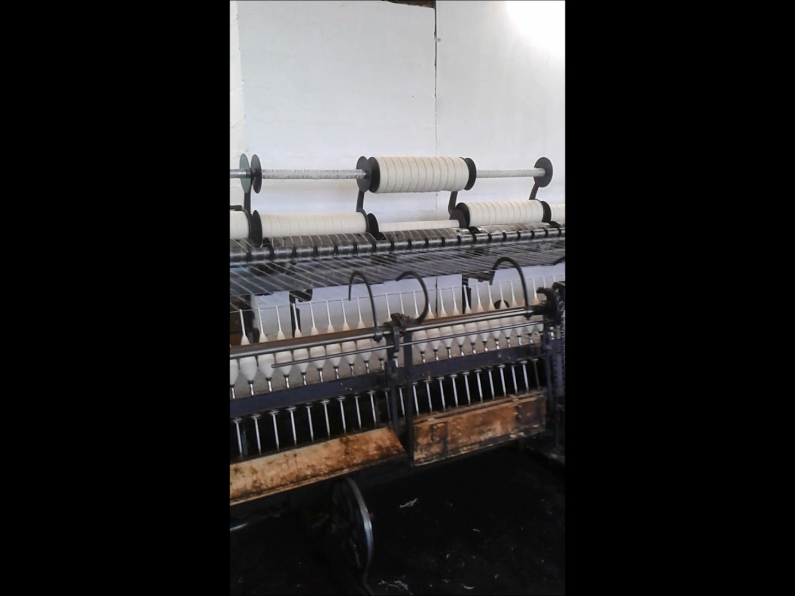

Slide 3
