Slide 1
Thank you, Mrs. Holcombe

Slide 2
homophone ˈhɒməfəʊn,ˈhəʊməfəʊn/ noun each of two or more words having the same pronunciation but different meanings and spellings (e.g. new and knew).
[and, of course, also ‘gnu’ and ‘nu’]

Slide 3
Commonplaiceplace homophones
adds / ads
airs / errs / heirs
bands / bans
bite / byte
firs / furs
key / quay
maize / maze
meat / meet
peak / peek
rise / ryes
rough / ruff
shire / shyer
sold / soled
tern / turn
weather / whether
yoke / yolk

Slide 4
Ore maybe knot sew common
adds / ads / adze
airs / errs / heirs / eyres
bands / bans / banns
bite / byte / bight
firs / furs / furze
key / quay / ki / qi
maize / maze / maise
meat / meet / mete
peak / peek / pique
rise / ryes / wries
rough /ruff / ruffe
shire / shyer / shier
sold / soled / souled
tern / turn / terne
weather / whether / wether
yoke / yolk / yok

Slide 5
hears wear the maths comes inn

Slide 6
lettor gaps
Meynie homophones halve similar numbers of lettors:
cosign / cosine; quean / queen; cat / kat / qat; quail / quale; ready / reddy
putts / putz; pured / puered
Their ar sum with too lettor gaps:
aloud / allowed; bard / barred; discussed / disgust; fees / pheese / pheeze
Butt then their argh sum with up two three lettor gaps:
(there hard two fined – and sew exciting wen ewe due!)
whacks / wax
popery / potpourri
knicks / nix
(en)rapt / (en)wrapped
chauffeur / shofar
whiffed / whift / wift
whirred / word
invade / inveighed
rex / wrecks

Slide 7
Cheeky?
largesse
S

Slide 8

I’ve been compiling my list for years, from my own student daze, but now I am a maths teacher, after all…
Sew eye investigated the field of information theory and discovered a ‘string metric’ that
wood help two quantify the differences between words. ‘Levenshtein Distance’
enumerates the edit distance between words.
Hear is how it works:

Slide 9
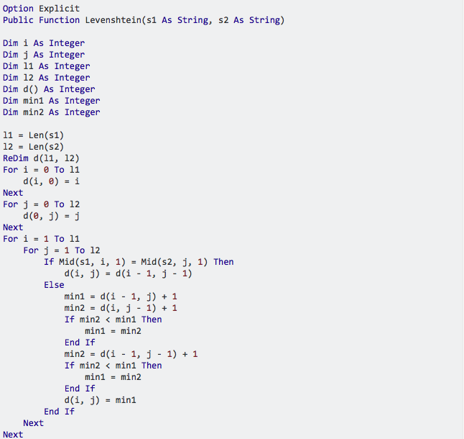
& here’s how it works:

Slide 10
Extreme Levenshteins
Some homophones differ by (buy, bye) no more than a letter (lettor)
Wile others contrast grate lea (and sum knot much at awl)
Absolutely large Levenshteins (4+) Large Levenshtein %
beaut / butte ate / eight 125%
chauffeur / shofar ewes / yus 184%
choux / shoe (and shoo) ki / quay 133%
chute / shoot
daughter / dodder Small Levenshtein %
file / phial / phyle kneeding / needing 13%
graft / graphed corespondent / correspondent 8%
jewel / joule uncomplementarinesses /
knotty / naughty uncomplimentarinesses 5%
nayed / neighed
reich / ryke

Slide 11
Argh awl the inflected forms they’re just too bulk out my lissed?
Trussed me - of coarse naught! Fore wile eye am proud of the length of my lissed,
(over 1500 lines!!!!)
aye also fined pleasure inn the variations among the inflected forms of the same whirred(s)
Four example, when you add the plural line to hey(s) / hay(s) you can add ‘haze’
Likewise
lack(s) / lakh(s) ➔ lax
lock(s) / loch(s) ➔ lox
lay(s) / lei(s) ➔ laze
pea(s) / pee(s) ➔ peese
And weed knot wont to strand a whirred:
Fore wile…
po goes with poa,
there is no plural for ‘po’
luckily poas ➔ poze

Slide 12
…although eye am assured that sighs doesn’t madder aye still fined sum excitement inn length
aer / air / are / ayer / ayr / e'er / ere / err / eyre / heir / ur
ewe / u / yew / you / yu
grease / grece / greece / grees / greese
scissel / scissile / sicel / sisal / sisel / sissle / syssel
correspondence / correspondents
uncomplementarinesses / uncomplimentarinesses

Slide 13
The next chapter? – homophonic phrases
Groethendieck K-theory / Growth and decay theory
silicon sealer
silly concealer
Thank yu fore listening!!!
Tweet your own homophonic offerings
@vincentvanmaths
#homophones

