Slide 1
Context vs. Content
Transferable skills and problem solving
Wendy Foad

Slide 2
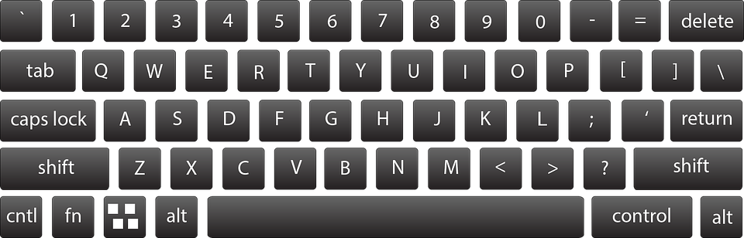

Slide 3
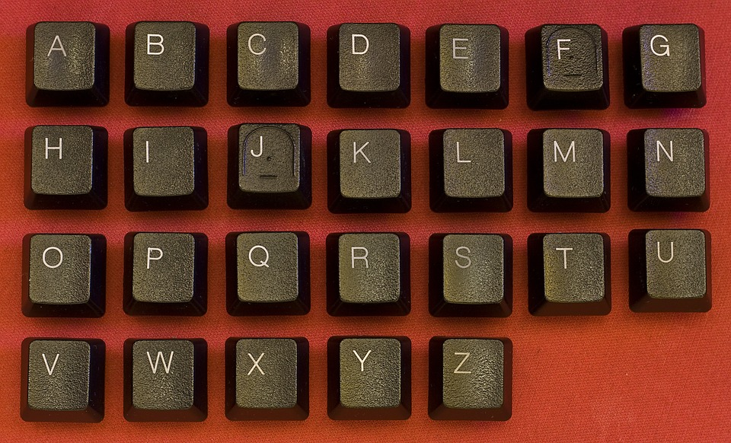

Slide 4
141-3a-3b-2c=0

Slide 5
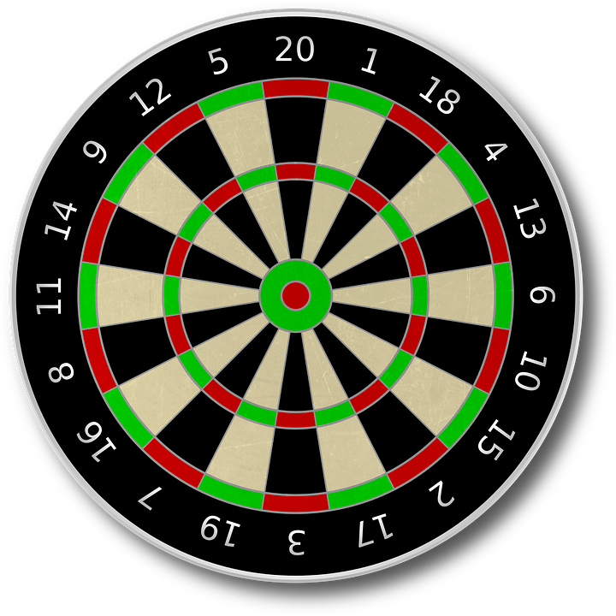

141-3a-3b-2c=0
Your score: 141

Slide 6
141-3a-3b-2c=0
Your score: 141
treble 20
treble 19
double 12
0

Slide 7
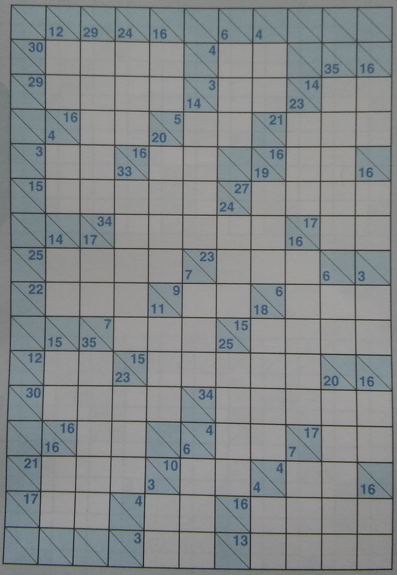

Slide 9
22:
9,8,5
9,7,6

Slide 10
22:
9,8,5
9,7,6
9 + 8 + 5 = ?

Slide 11
22:
9,8,5
9,7,6
9 + 8 + 5 = ?
5 + 8 + 9 = ? ?

Slide 12
?

