Slide 1
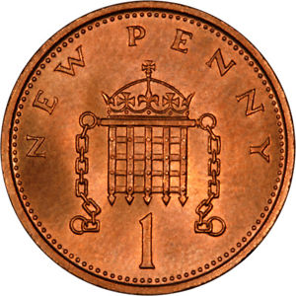
?
Adam Townsend
@Pecnut
Notes:
I have new data
And loads of code for you to play with

Slide 2
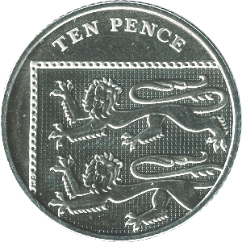
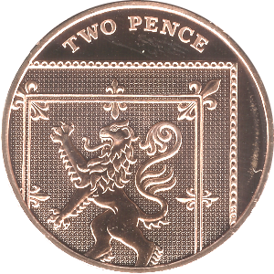
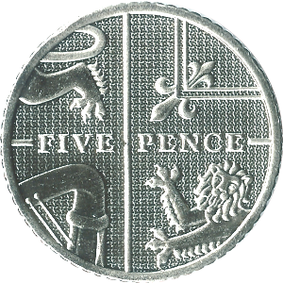
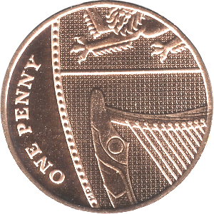
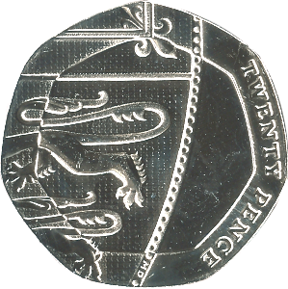
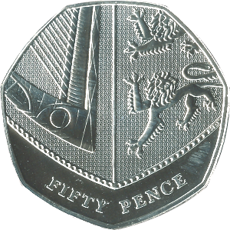

Slide 4
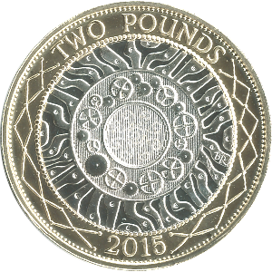
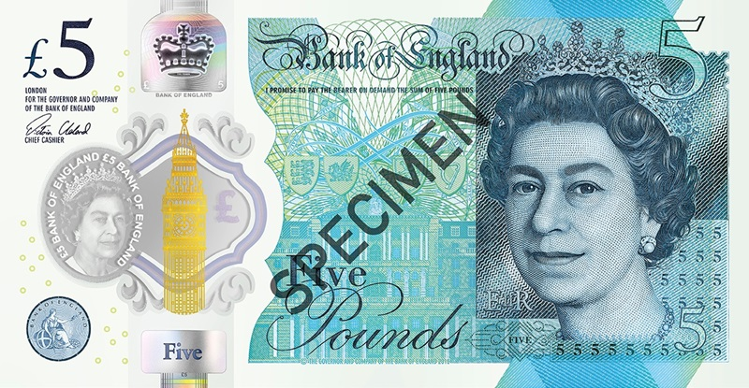
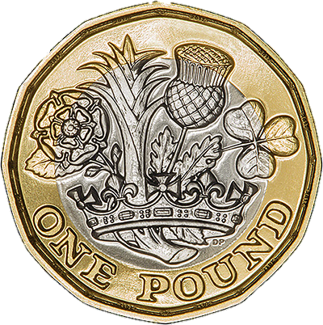
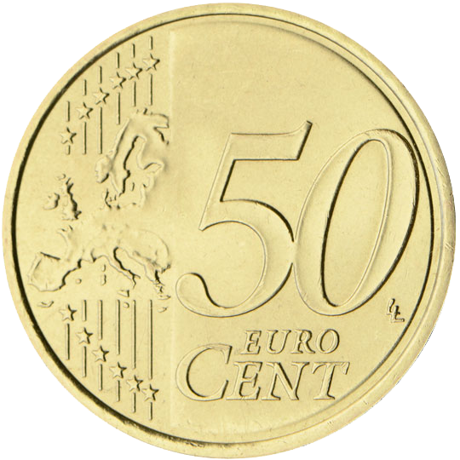
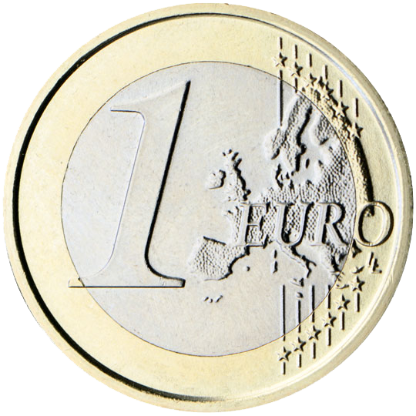
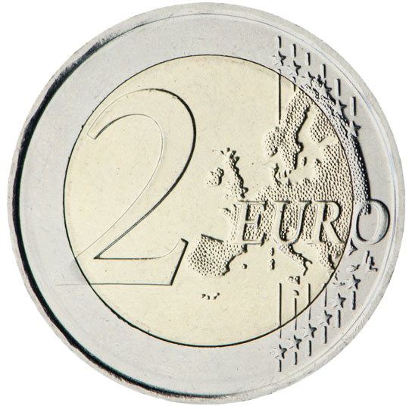
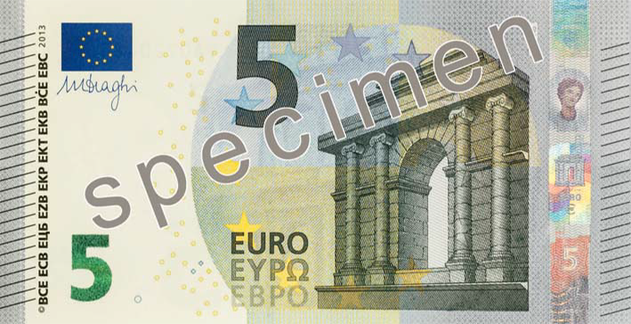
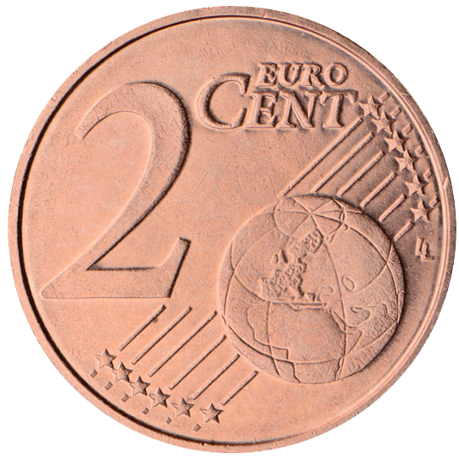
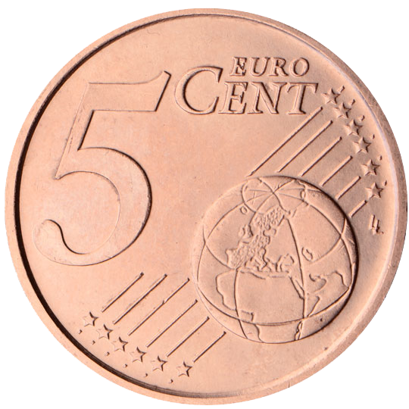
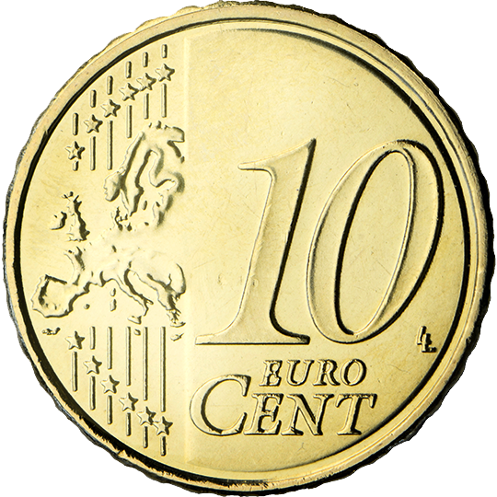
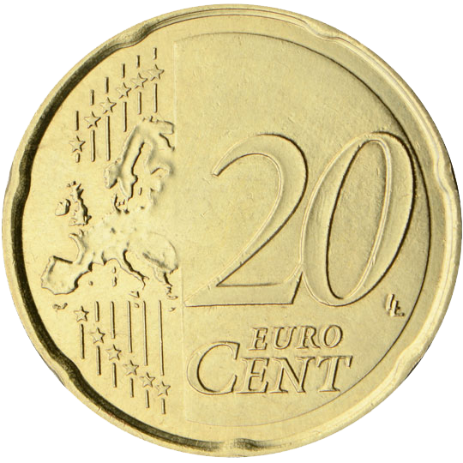
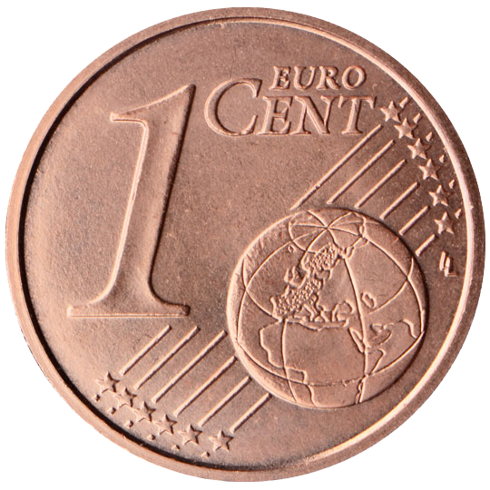
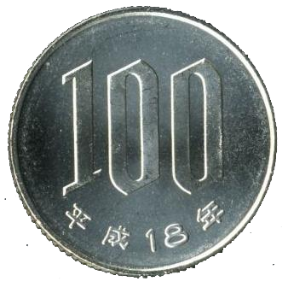
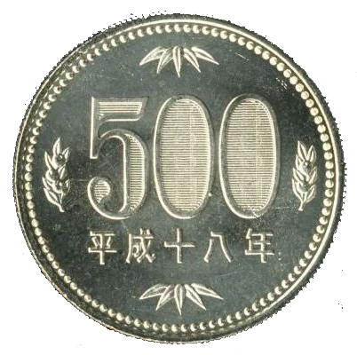
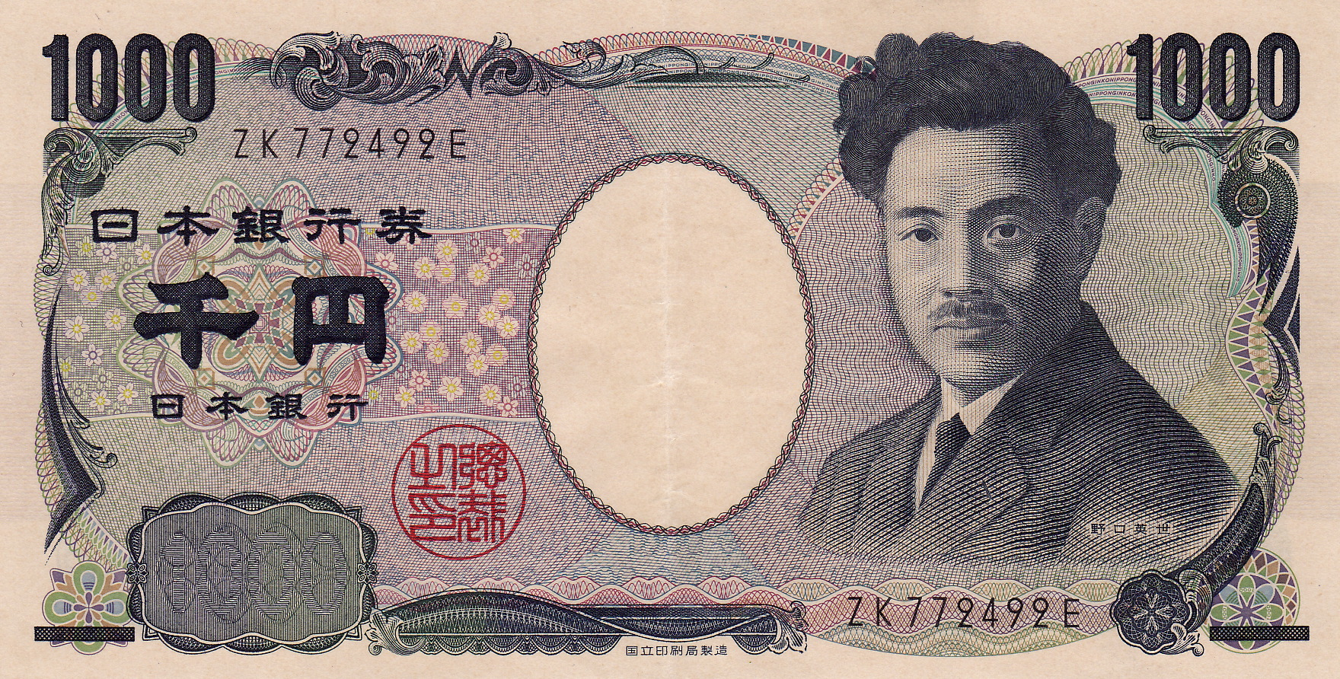
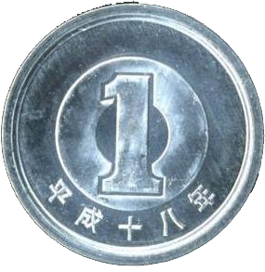
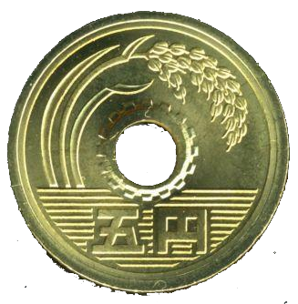
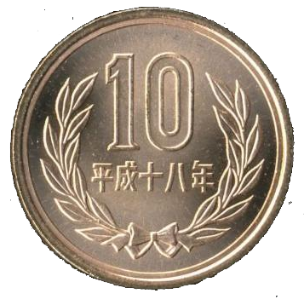
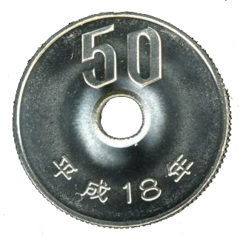
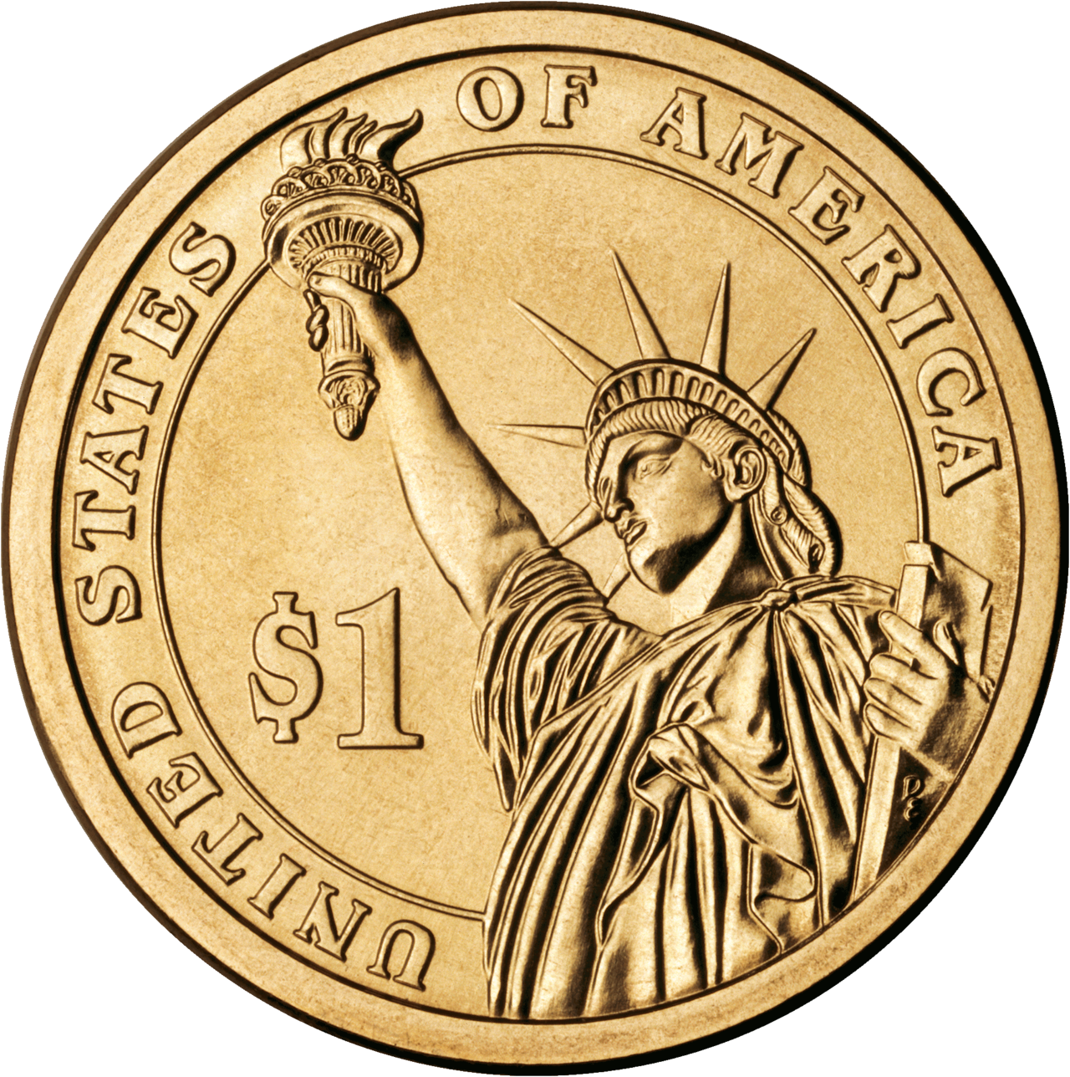
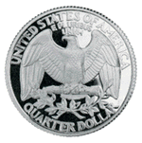
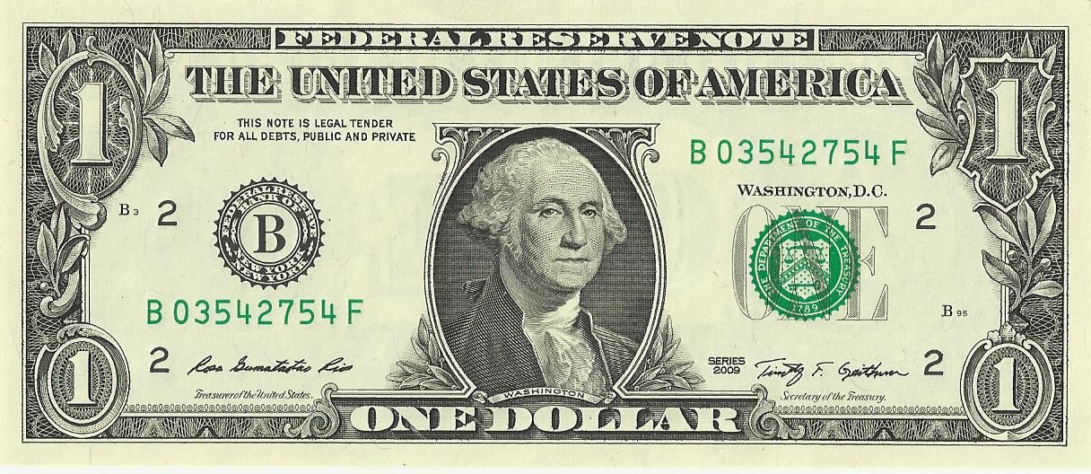
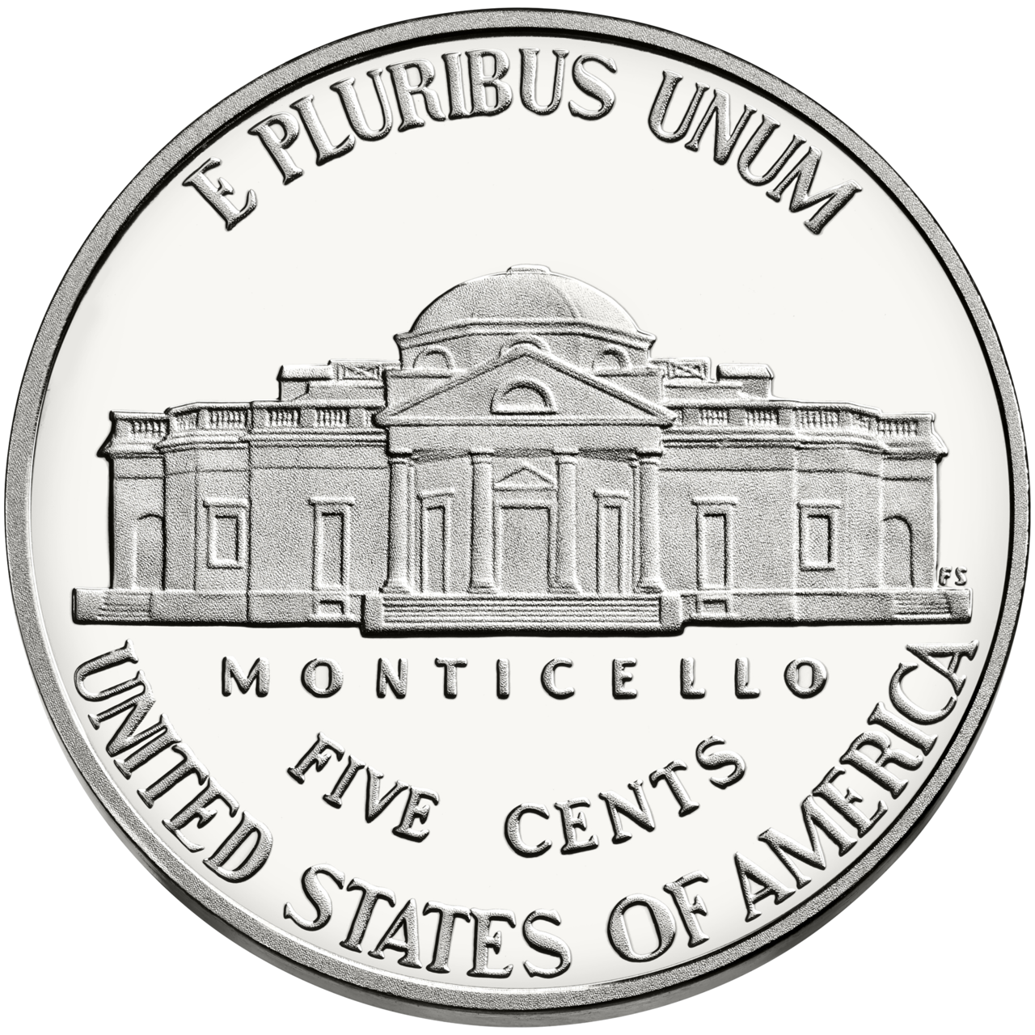
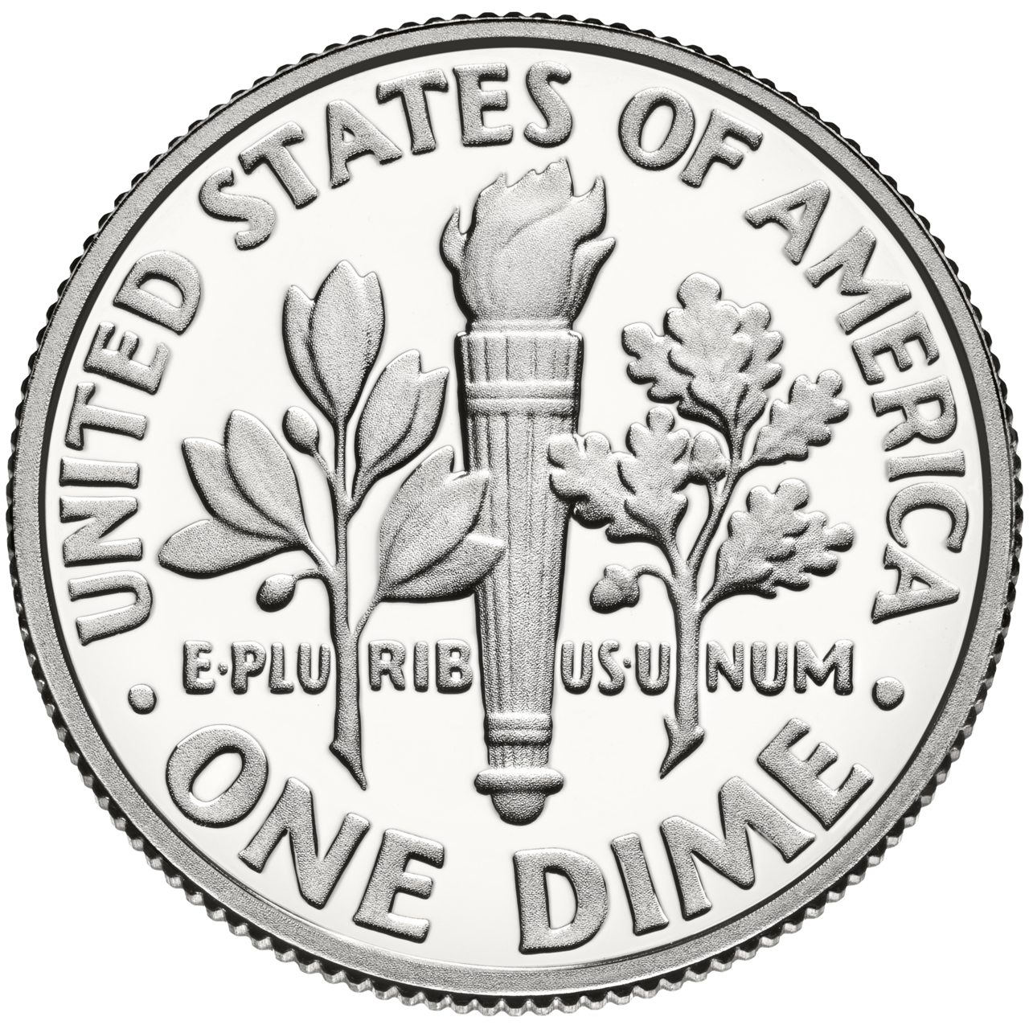
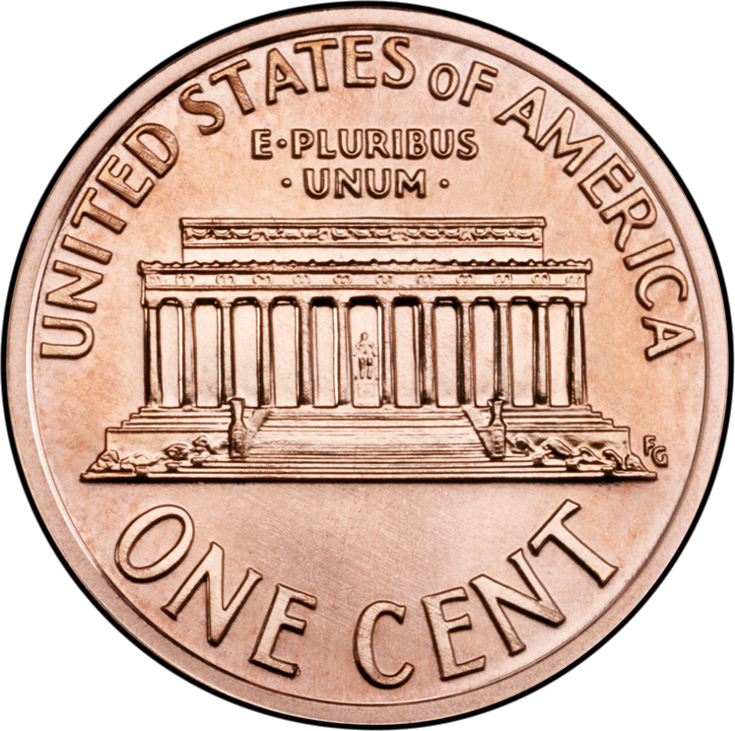
Notes:
My aim is to reduce the coins in your pockets. Naively we can just cut down the number of coins. We can go from the left (EUR), from the middle (JPY), or from the right (USD). Middle increases number of coins you need though.

Slide 5
How many coins do you expect in change?

Slide 6
1. Even distribution of prices 2. You get most efficient change

Slide 7
Notes:
Why self-service machines suck

Slide 8
How many coins do you expect in change?

Slide 10
UK / Euro

Slide 11
UK no 1p or 2p
UK / Euro

Slide 12
UK no 1p or 2p
UK / Euro
UK 1960

Slide 13
UK no 1p or 2p
UK / Euro
UK 1960
Sainsbury’s

Slide 14
UK no 1p or 2p
UK / Euro
UK 1960
Sainsbury’s
UK stamps

Slide 15
UK no 1p or 2p
UK / Euro
UK 1960
Sainsbury’s
UK stamps
Harry Potter

Slide 16
Real price data?

Slide 17
%

Slide 18
%
£1
£2
£3
£0
£4

Slide 19
%
£1
£2
£0.50
£1.50
£3
£0
£3.50
£4
£4.50

Slide 20
%
£0.99
£1.99
£2.99
£3.99
£4.99

Slide 23
£1.75
Notes:
TO SAVE POCKETS EVERYWHERE

Slide 24
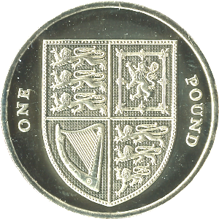

Slide 27
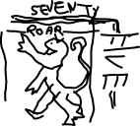
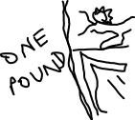

Slide 28
Add this coin
Adam Townsend
@Pecnut
github.com/pecnut

Slide 29
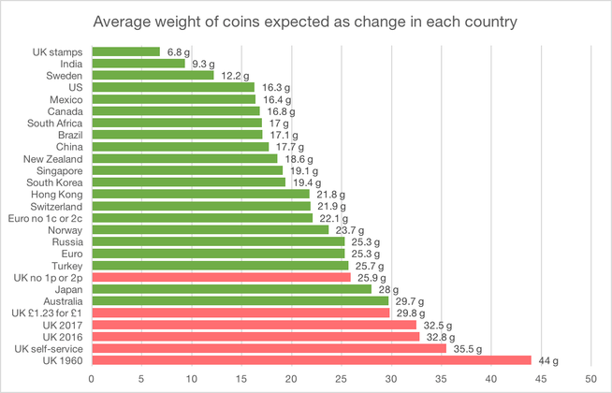

Slide 30
Choose any coin?
Number | Coins | Number expected
2 | 1p, 22p or 1p, 23p | 21.3
3 | 1p, 14p, 61p | 9.98
4 | 1p, 7p, 57p, 80p | 6.82
5 | 1p, 6p, 20p, 85p, £1.21 | 5.45

Slide 31
Negapenny?

