Slide 1

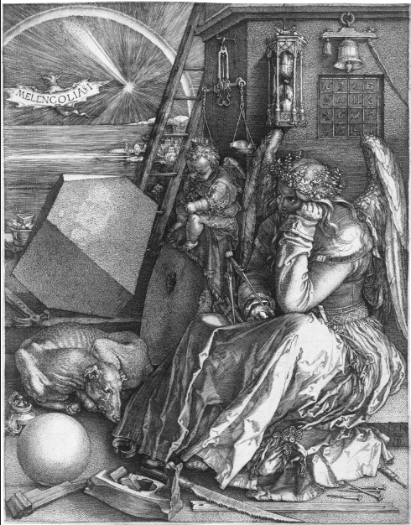

Image credits: Ad Meskens via Wikimedia Commons
Notes:
Slide 17 has a larger version of the picture. Ask the students to look at the picture and to tell you mathematical images they can see in the picture.
(Magic square (first occurrence in Western art); compasses; 3d polyhedron (probably truncated rhombohedron =stretched cube with corners cut off (!)); spherical ball; hour glass; balance; sundial

Slide 2
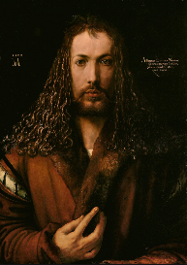
“Melancolia” by Albrecht Durer
German artist lived 1471-1528
Durer was interested in the links between art and maths
Image credits: Ad Meskens via Wikimedia Commons
Notes:
Tell the students we are now moving onto think about the fact that magic squares could be larger…
Sometimes these squares appear in art. Slide 16 gives some background information about Durer.

Slide 3
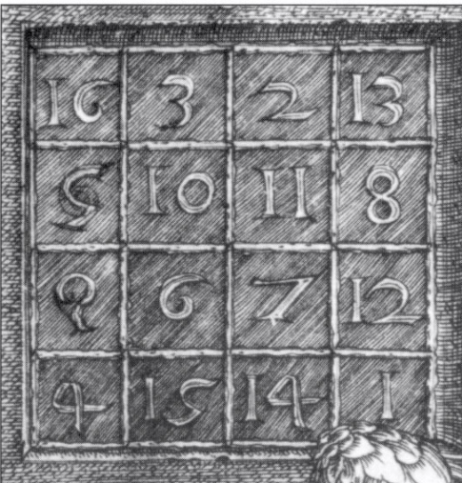
What do you notice about the numbers in the magic square?
What is the magic total?
Durer lived from 1471-1528. There is a clue in the magic square as to when the picture was painted. Can you guess which year it was painted?
34
1514 (in centre bottom row)
Image credits: Ad Meskens via Wikimedia Commons
Notes:
Display slide 18. Look more closely at the magic square. What do you notice? What is the total? (34 (always total for 4x4 square made using 1-16): answer appears on first click)
What year do you think this was painted in? (Remind them of Durer’s dates)(1514, at bottom! Answer appears on second click)

Slide 4
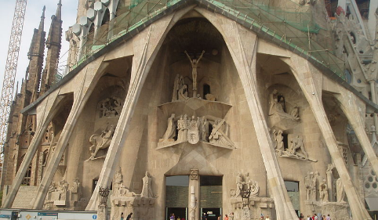
The Passion Façade of the Sagrada Familia, Barcelona
Image credits: Jeremy Keith, Bernard Gagnon - all via Wikimedia Commons
Notes:
Slide 22 is a picture of the passion façade of the cathedral in Barcelona, Spain, which is still under construction. It was designed by Gaudi and construction started in 1882. The plan is for it to be complete by 2026, which will be 100 years since Gaudi died.
On the first click a circle appears, which is a ring round the magic square sculpted into the façade. A close up appears on the next slide. The sculptor’s name was Subirachs

Slide 5
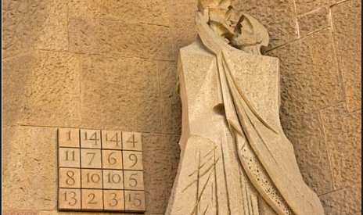
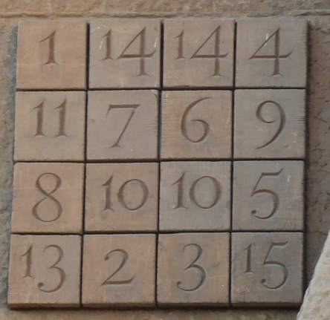
The Passion Façade of the Sagrada Familia, Barcelona
What do you notice about this magic square?
What is its magic total?
How is it different to the Durer one?
How is it the same as the Durer one?
33
Image credits: Jeremy Keith, Bernard Gagnon - all via Wikimedia Commons
Notes:
Explain that this magic square appears on the Passion façade of the cathedral. It is telling the Bible story of the death and resurrection of Jesus.
Why did the sculptor make the magic total 33? (Answer: because Jesus was 33 when he died)
How does the square differ from the magic squares with total of 34? (Answer: 4 numbers have been reduced by one; there is a changed number in each column, row and diagonal
Students can now compare the Durer square with the Barcelona one.
Collect ideas about what is the same, what is different.
Answer: Subirachs’ square consists of many of these same features as Dürer's. However, Subirachs chose to create a square with the magic sum of 33. To fashion such a square, four of the numbers are reduced by one. The numbers 12 and 16 become 11 and 15, while 11 and 15 become 10 and 14. Numbers 12 and 16 are therefore missing from the square, while 10 and 14 have become duplicated. Having made these alterations Subirachs then rotated Dürer's magic square through 180°. Another “wow” moment for the Masterclass!

Slide 6
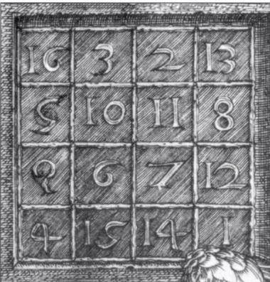


Take Durer’s magic square
Turn it through 90°
Turn it through 90° again
Compare the two magic squares
1 | 14 | 15 | 4
12 | 7 | 6 | 9
8 | 11 | 10 | 5
13 | 2 | 3 | 16
(Easy to read version of upside down Durer square)
Image credits: Ad Meskens via Wikimedia Commons
Notes:
This is illustrated, with an animation, on slide 24. The animation shows the rotation of Durer’s square through 180 degrees, and then by comparing the numbers in corresponding positions it is clear that just 4 numbers have been changed, but the arrangement of the rows and columns is identical.

Slide 7
Take Durer’s magic square
Turn it through 90°
Turn it through 90° again
Essentially they’re the same!!
Compare the two magic squares
1 | 14 | 15 | 4
12 | 7 | 6 | 9
8 | 11 | 10 | 5
13 | 2 | 3 | 16
(Easy to read version of upside down Durer square)
Image credits: Ad Meskens via Wikimedia Commons
Notes:
This is illustrated, with an animation, on slide 24. The animation shows the rotation of Durer’s square through 180 degrees, and then by comparing the numbers in corresponding positions it is clear that just 4 numbers have been changed, but the arrangement of the rows and columns is identical.

