Slide 1
COLLAPSIBLE
POLYHEDRA
by Barney Maunder-Taylor
E: barney@houseofmaths.co.uk
F: @houseofmathsuk
T: @BarneyMT1

Slide 2
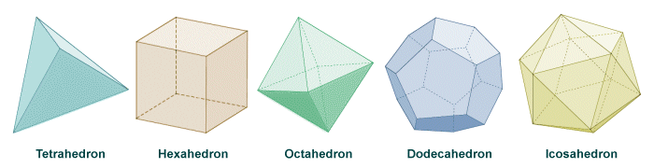
Platonic Solids?

Slide 3
“Flatonic” Solids!

Slide 4
Flatonic Axioms:
MODIFICATION:
- Fold a face
- Skip an edge

Slide 5
Flatonic Axioms:
MODIFICATION:
- Fold a face
- Skip an edge
CONVEXITY

Slide 6
Flatonic Axioms:
MODIFICATION:
- Fold a face
- Skip an edge
CONVEXITY
RIGIDITY

Slide 7
Flatonic Axioms:
MODIFICATION:
- Fold a face
- Skip an edge
CONVEXITY
RIGIDITY
SIMPLICITY

Slide 8
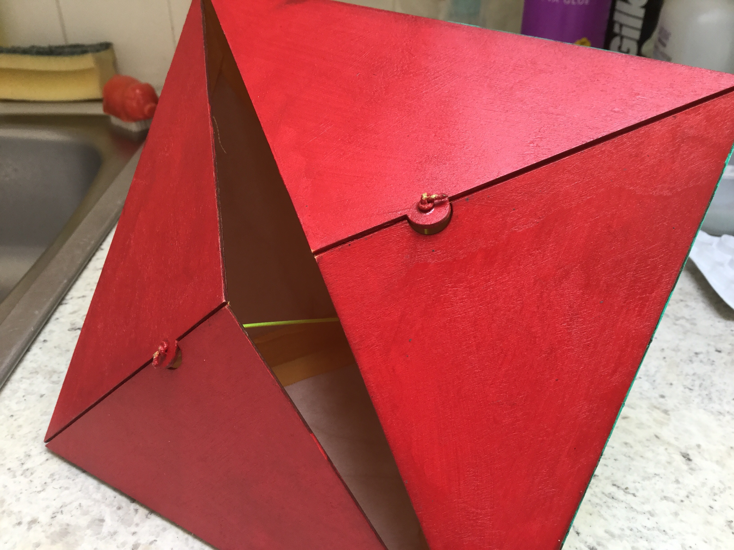

Slide 9
FLATONIC DODECAHEDRON NET:
KEY:
Hinged joint
Free edge

Slide 12
Internal loop

Slide 13
Internal loop
Drawstring

Slide 14
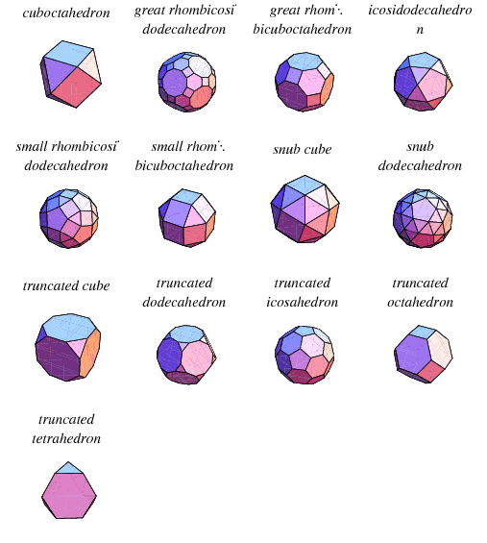
Archimedean
Solids
Image: Wolfram Mathworld

Slide 15
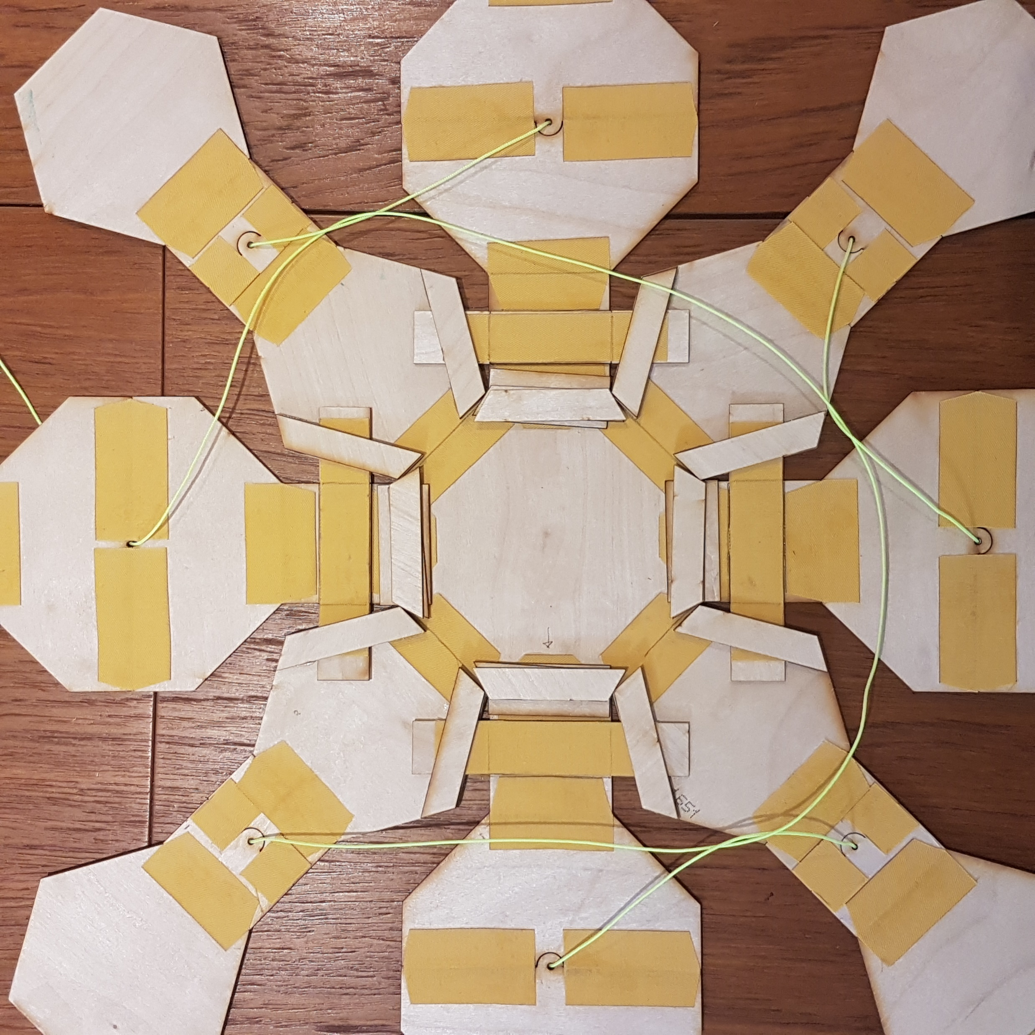
GREAT RHOMBICUBOCTAHEDRON

Slide 16
GREAT RHOMBICUBOCTAHEDRON

Slide 17
COLLAPSIBLE
POLYHEDRA
by Barney Maunder-Taylor
E: barney@houseofmaths.co.uk
F: @houseofmathsuk
T: @BarneyMT1

