Slide 1
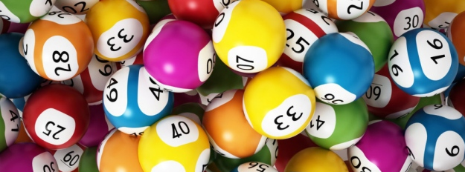
How lucky is the Bonus Ball
Claire Cohen

Slide 2




Background

Slide 3
Numbers Chosen
 | 1 | 2 | 3 | 4 | 5 | 6 | 7 | 8 | 9
10 | 11 | 12 | 13 | 14 | 15 | 16 | 17 | 18 | 19
20 | 21 | 22 | 23 | 24 | 25 | 26 | 27 | 28 | 29
30 | 31 | 32 | 33 | 34 | 35 | 36 | 37 | 38 | 39
40 | 41 | 42 | 43 | 44 | 45 | 46 | 47 | 48 | 49
50 | 51 | 52 | 53 | 54 | 55 | 56 | 57 | 58 | 59
Notes:
This heat map shows the numbers people chose. The darker the square, the more times the number was chosen.
The most popular “catageries” were “numbers between 10-30”, Multiples of 5, Numbers ending in 2, Numbers ending in 7.
Numbers over 49 not at all popular – possibly because when it started the lottery only went to 49.

Slide 4
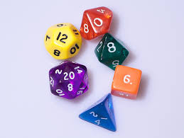
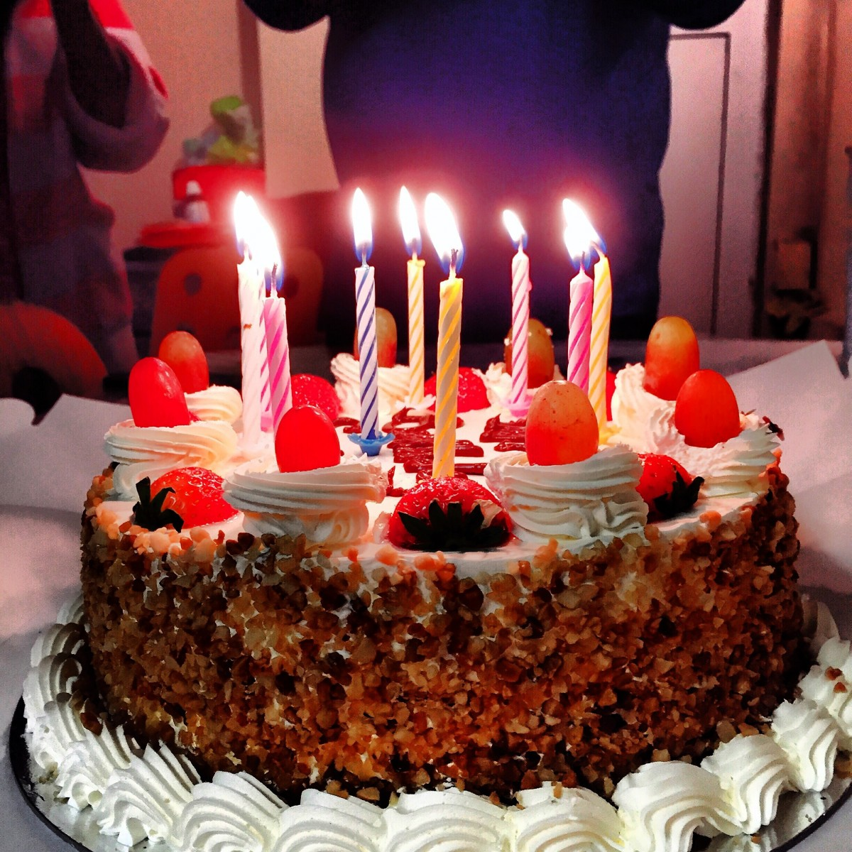
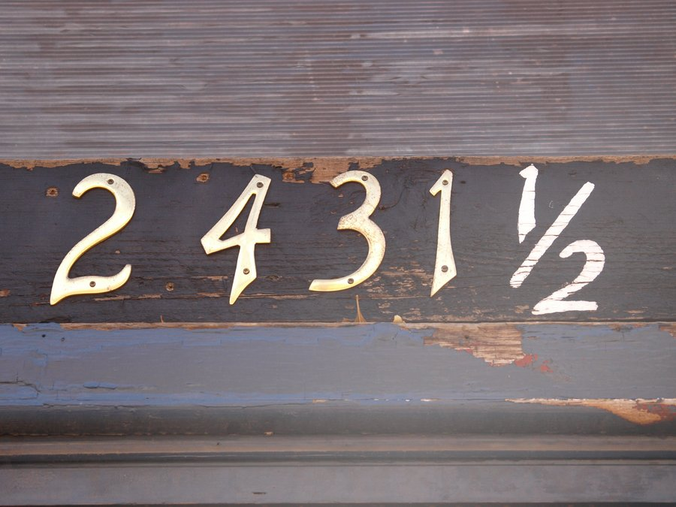
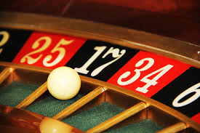
Why might the choices have been made

Slide 5

Outliers/ Surprises

Slide 6
Actual results
Most common numbers
8
11
36
37
38
45

Slide 7
Thanks for listening!

