Slide 1
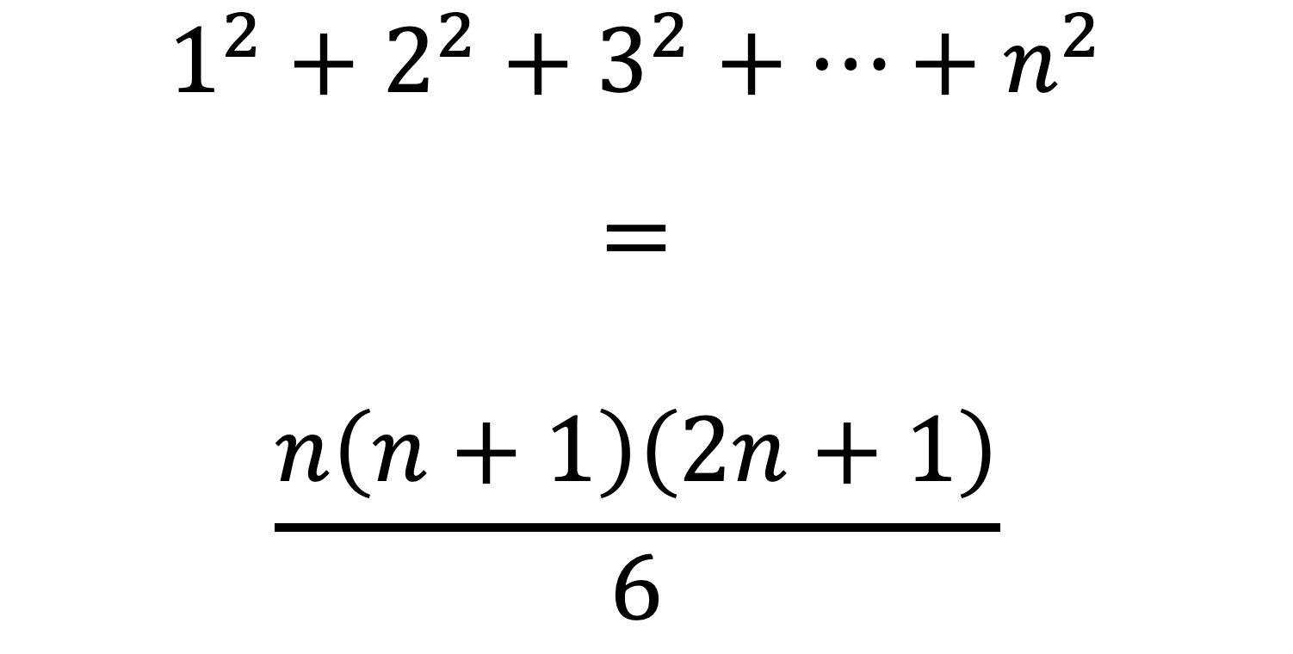
$$1^{2}+2^{2}+3^{2}+…+n^{2} \\ = \\ \frac{n\left(n+1\right)\left(2n+1\right)}{6}$$

Slide 2
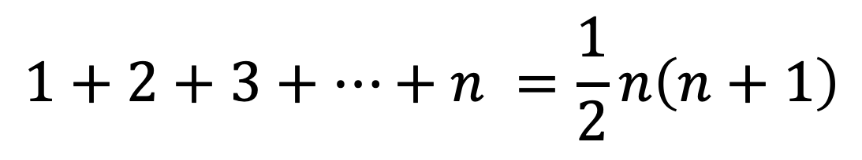
$$1+2+3+…+n =\frac{1}{2}n\left(n+1\right)$$
$$1$$ | $$+ 2$$ | $$+ 3$$ | $$…$$ | $$+ (n−2)$$ | $$+ (n−1)$$ | $$+n$$
$$n$$ | $$+ (n−1)$$ | $$+ (n−2)$$ | $$…$$ | $$+ 3$$ | $$+ 2$$ | $$+ 1$$

Slide 3
$$1$$ | $$+ 2$$ | $$+ 3$$ | $$…$$ | $$+ (n−2)$$ | $$+ (n−1)$$ | $$+n$$
$$n$$ | $$+ (n−1)$$ | $$+ (n−2)$$ | $$…$$ | $$+ 3$$ | $$+ 2$$ | $$+ 1$$

Slide 4
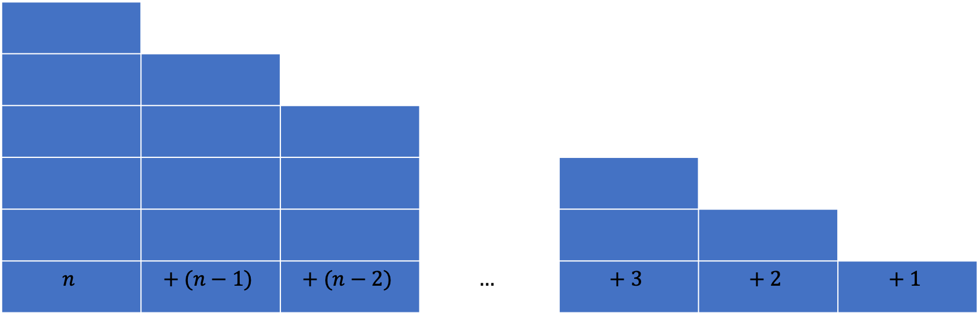
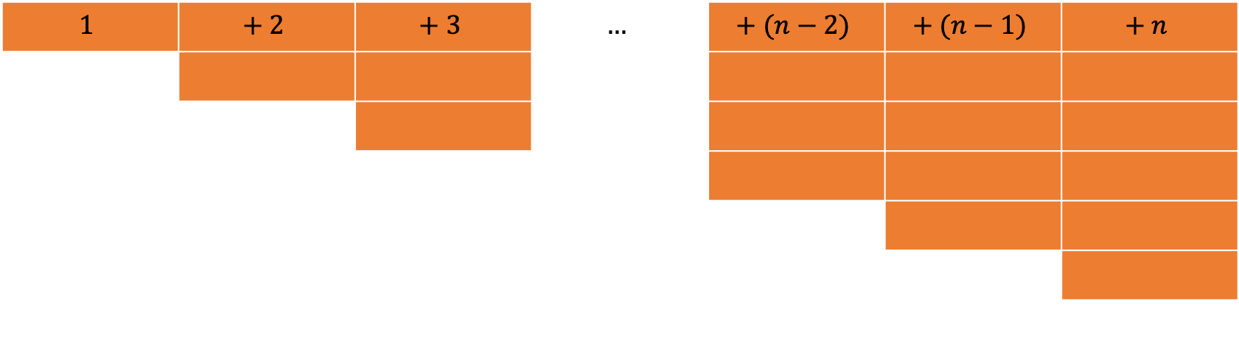
$$1$$ | $$+ 2$$ | $$+ 3$$ | $$…$$ | $$+ (n−2)$$ | $$+ (n−1)$$ | $$+ n$$
$$n$$ | $$+ (n−1)$$ | $$+ (n−2)$$ | $$…$$ | $$+ 3$$ | $$+ 2$$ | $$+ 1$$

Slide 5
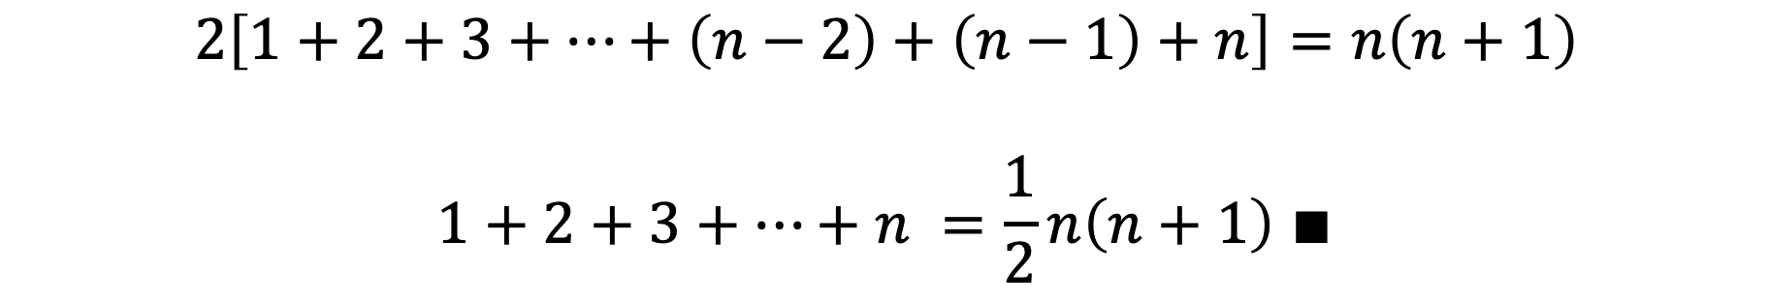
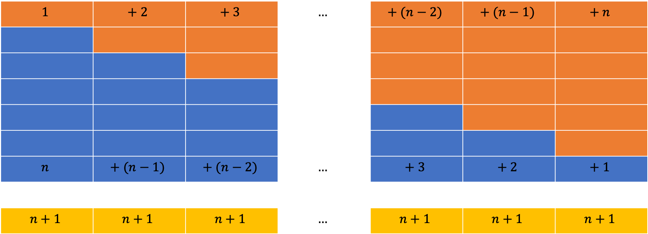
$$1$$ | $$+ 2$$ | $$+ 3$$ | $$…$$ | $$+ (n−2)$$ | $$+ (n−1)$$ | $$+ n$$
$$n$$ | $$+ (n−1)$$ | $$+ (n−2)$$ | $$…$$ | $$+ 3$$ | $$+ 2$$ | $$+ 1$$
$$n+1$$ | $$n+1$$ | $$n+1$$ | $$…$$ | $$n+1$$ | $$n+1$$ | $$n+1$$
$$2\left[1+2+3+…+\left(n−2\right)+\left(n−1\right)+n\right]=n\left(n+1\right)$$
$$1+2+3+…+n =\frac{1}{2}n\left(n+1\right) ∎$$

Slide 6
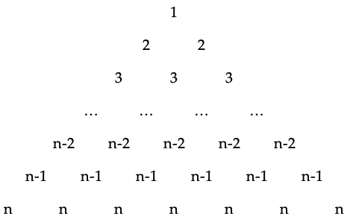

$$1^{2}+2^{2}+3^{2}+…+n^{2}$$

Slide 7
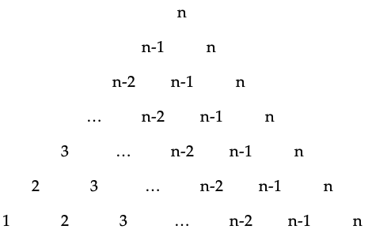
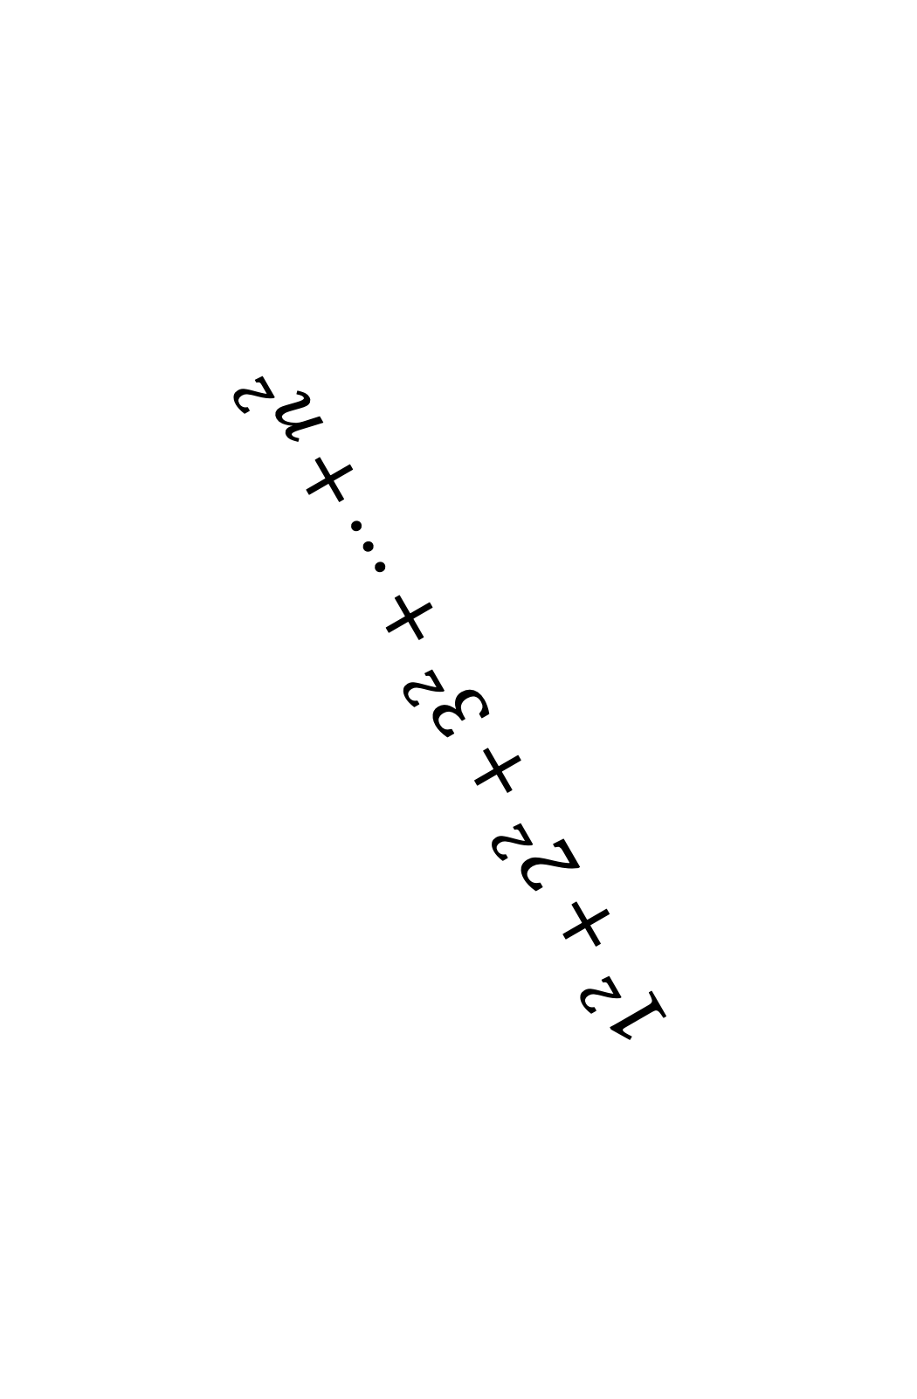
$$1^{2}+2^{2}+3^{2}+…+n^{2}$$

Slide 8
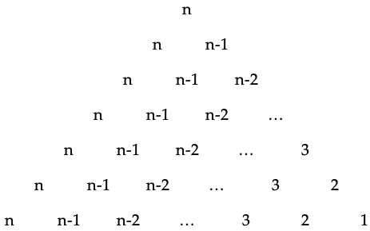
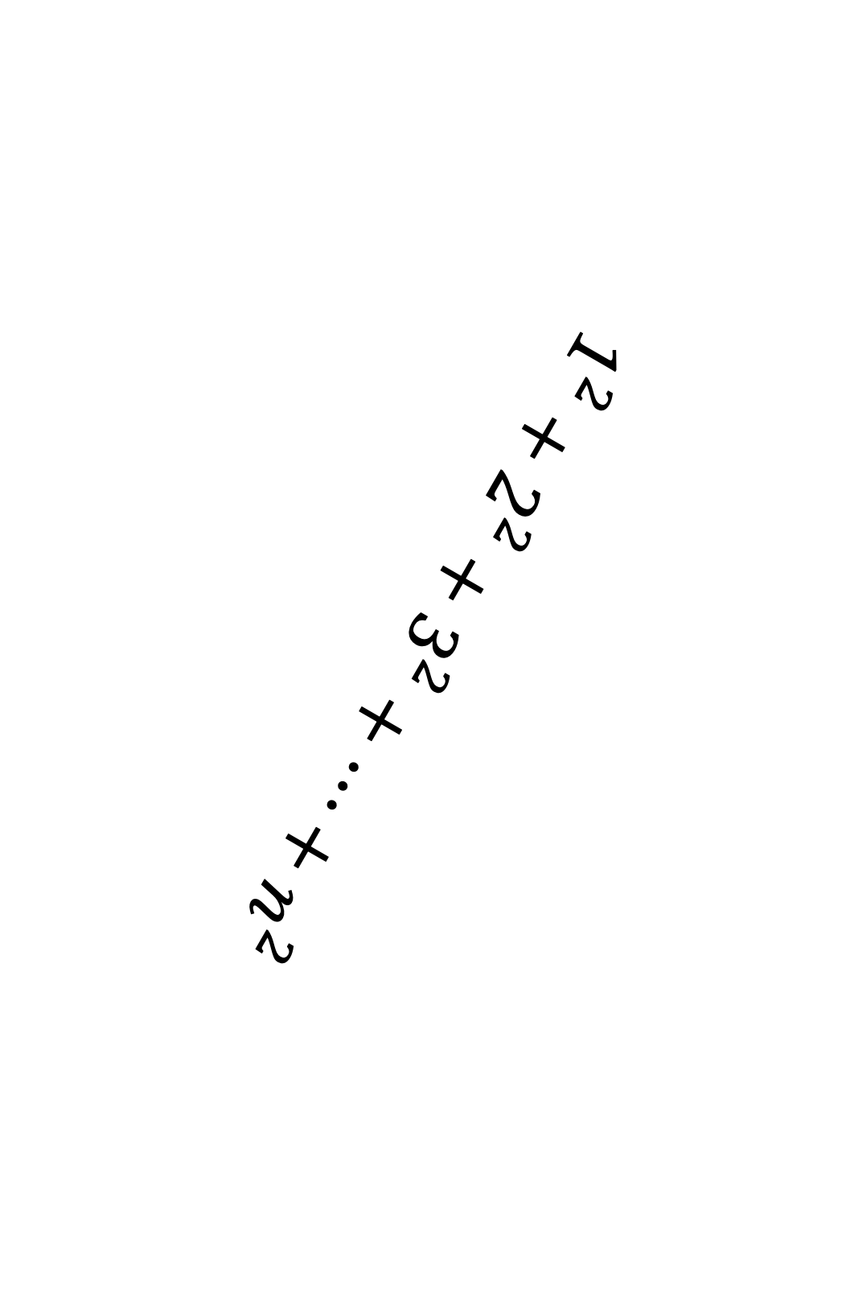
$$1^{2}+2^{2}+3^{2}+…+n^{2}$$

Slide 9
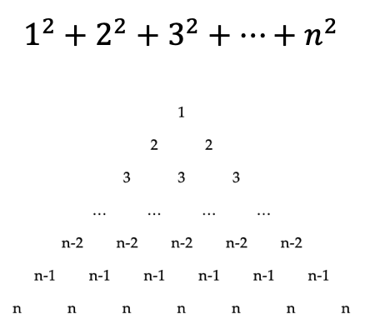
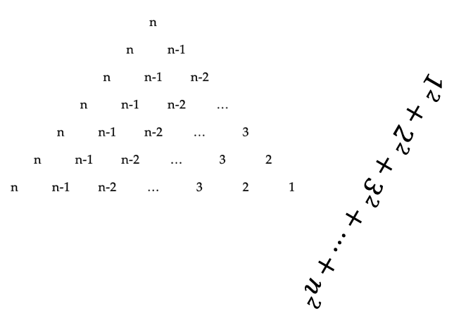
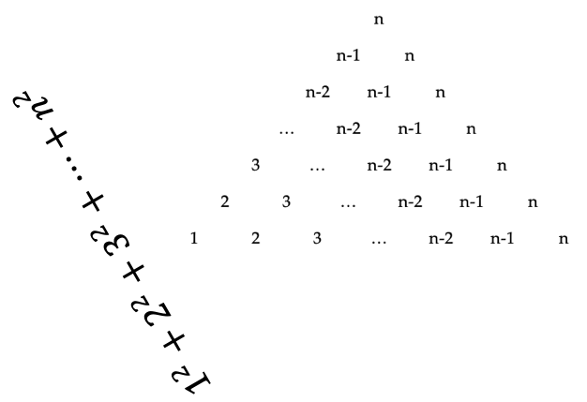
2n+1

Slide 10
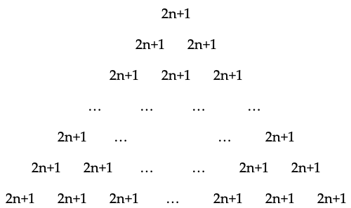
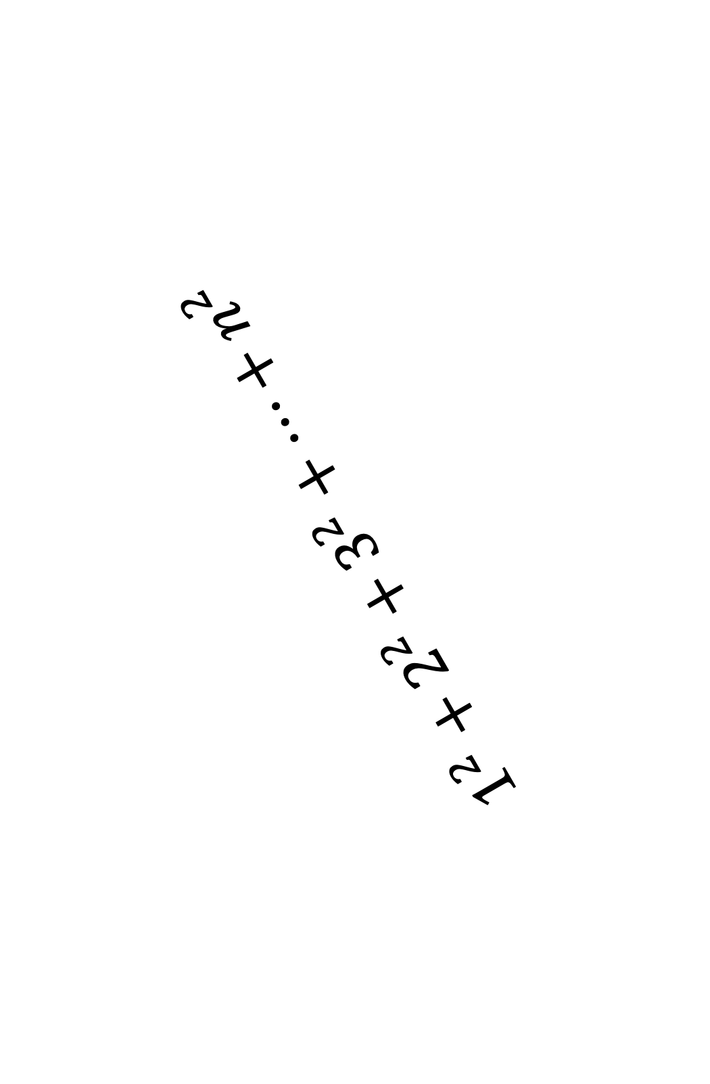
$$1^{2}+2^{2}+3^{2}+…+n^{2}$$
$$1^{2}+2^{2}+3^{2}+…+n^{2}$$
$$1^{2}+2^{2}+3^{2}+…+n^{2}$$

Slide 11

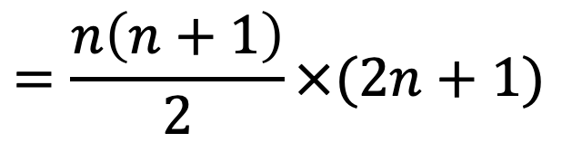

$$3\left(1^{2}+2^{2}+3^{2}+…+n^{2}\right)=$$
$$1\left(2n+1\right)+ \\ 2\left(2n+1\right)+ \\ 3\left(2n+1\right)+ \\ … \\ \left(n−2\right)\left(2n+1\right)+ \\ \left(n−1\right)\left(2n+1\right)+ \\ n(2n+1)$$
$$=\frac{n\left(n+1\right)}{2}×(2n+1)$$

Slide 12
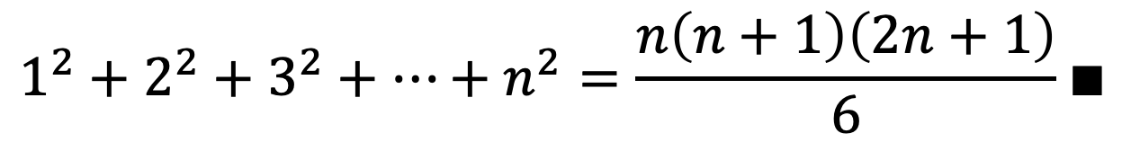
$$1^{2}+2^{2}+3^{2}+…+n^{2}=\frac{n\left(n+1\right)\left(2n+1\right)}{6}∎$$

