Slide 1
Changing Contexts
Jo Morgan
@mathsjem
resourceaholic.com

Slide 2
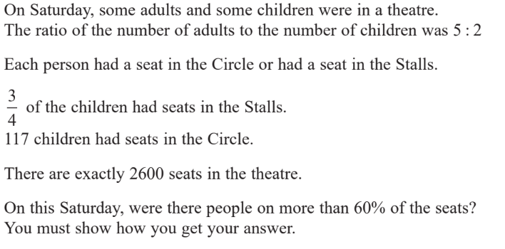
Notes:
Edexcel Higher Paper 2 2017

Slide 3





Slide 4

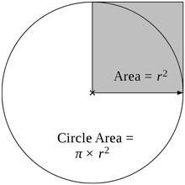


Slide 5
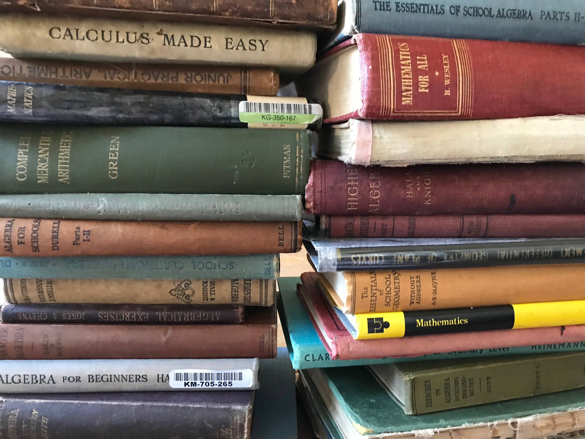
Notes:
Someone in the future could look out our exams and textbooks and infer things about life in 2018. We can do the same if we look back at old maths textbooks.

Slide 6
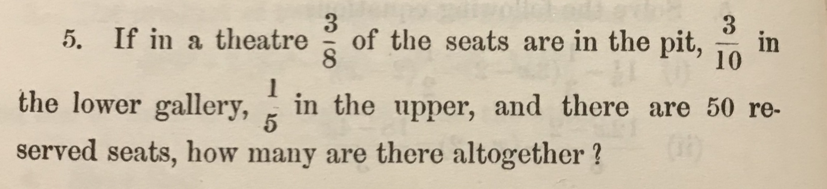
Notes:
Algebraical exercises 1900

Slide 7
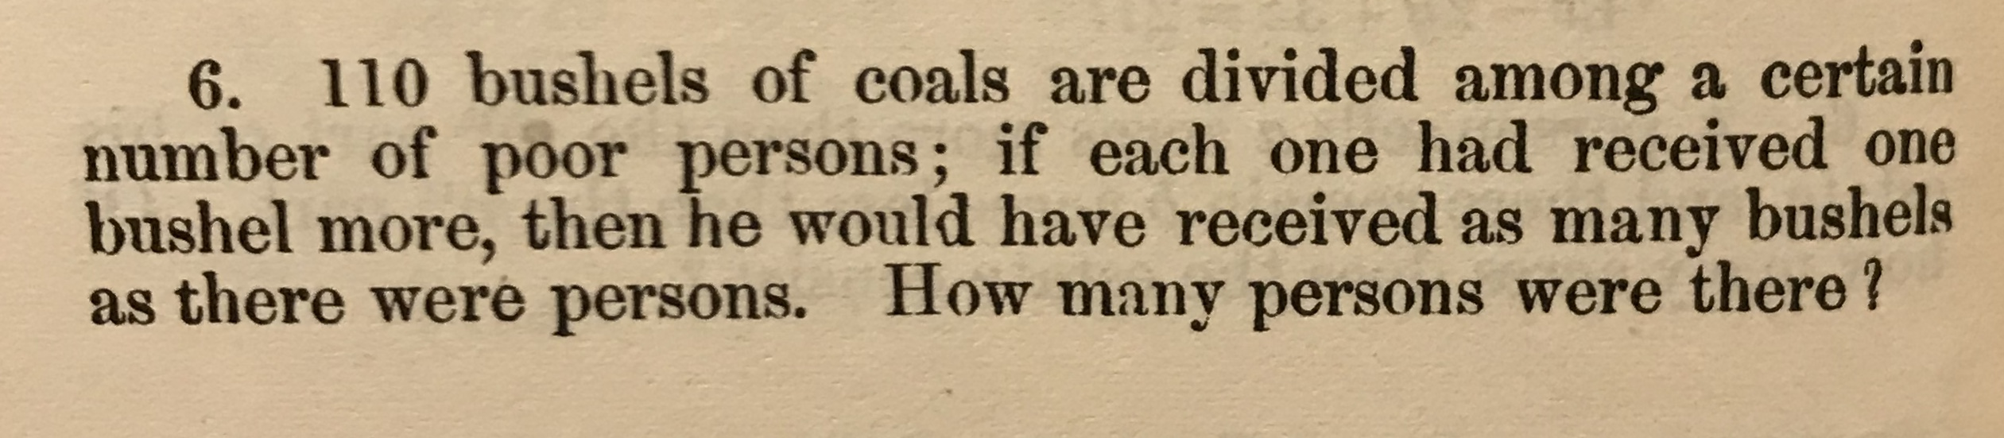
Notes:
Algebraical exercises 1900

Slide 8
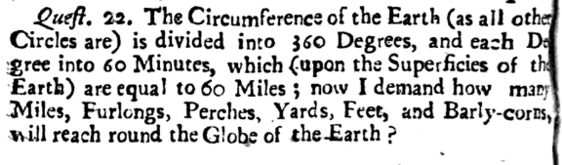
Notes:
https://books.google.co.uk/books?id=f1QMAAAAYAAJ&printsec=frontcover&source=gbs_ge_summary_r&cad=0#v=onepage&q&f=false 1677 (17th Century)

Slide 9
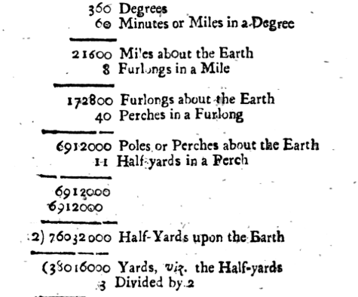
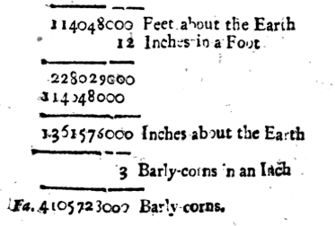

Slide 10
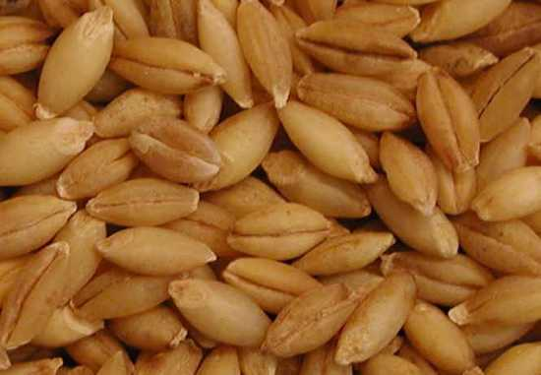
The barleycorn is a small English unit of length equal to ​¹⁄₃ of an inch (i.e close to 0.8467 cm) still used as the basis of shoe sizes in English-speaking countries. It is referenced as far back as the 10th Century.
Notes:
Shoe sizes progress in barleycorns. The difference between a size 3 and size 4 is a barleycorn
Under the c. AD 1300 Composition of Yards and Perches, one of the statutes of uncertain date that was notionally in force until the 1824 Weights and Measures Act, "3 barly cornes dry and rounde" were to serve as the basis for the inch and thence the larger units of feet, yards, perches and thus of the acre, an important unit of area. The notion of three barleycorns composing an inch certainly predates this statute, however, appearing in the 10th-century Welsh Laws of Hywel Dda. As modern studies show, the actual length of a kernel of barley varies from as short as 4–7 mm (0.16–0.28 in) to as long as 12–15 mm (0.47–0.59 in) depending on the cultivar.^{[4][5]} Older sources claimed the average length of a grain of barley being 0.345 in (8.8 mm).^{[6]}

Slide 11


