Slide 1
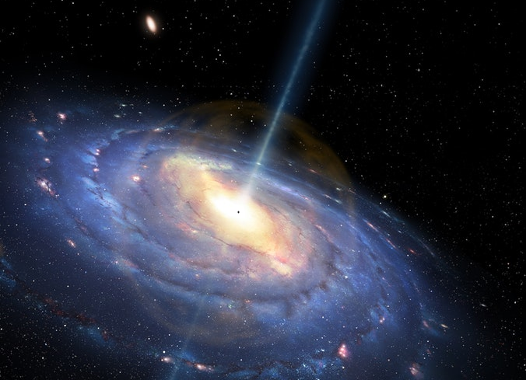
Mass of a Black hole:
(A bit of history and simple arithmetic!)
Sagittarius A*
Mick de Pomerai

Slide 2
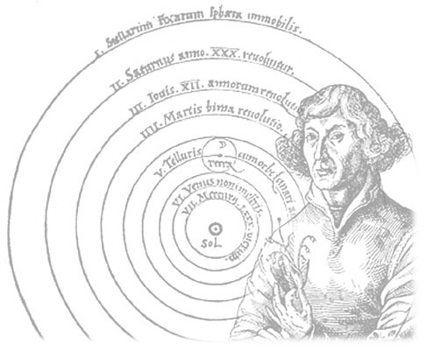
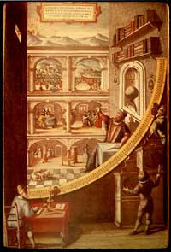
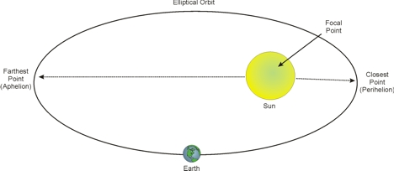
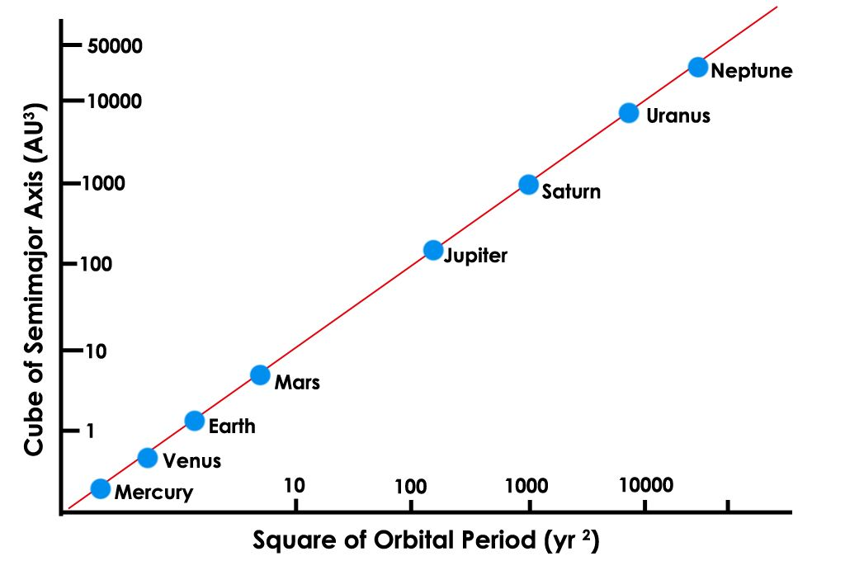
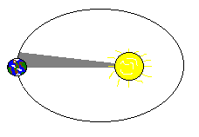

Myth: Nicolaus Copernicus (1473 -1543), Polish monk, simply “thought up” a heliocentric model of the Solar System…
Mania: ideas pursued by Tycho Brahe (1546-1601), Danish nobleman, measured positions of planets & stars to ± 2 minutes of arc at Uraniborg - huge tables of data but ?? how to interpret…
Math: Johannes Kepler (1571-1630), German mathematician, Copernican enthusiast, analysed Brahe’s data => published Harmonices Mundi 1618, introducing model of elliptical orbits.
focus
T ² r ³
Equal areas, equal times
Notes:
Copernicus referred in De Revolutionibus to having read (of) the works of Aristarchus of Samos (about 310 – 230 BC), whilst studying in Padua in N. Italy in his early twenties.
Brahe’s Observatory on the island of Uraniborg between Denmark & Sweden, was heavily financed by Brahe and by the Danish King – costing around ¼ of Denmark’s GDP at the time! Uraniborg has been suggested as the original location for Shakespeare’s “Tempest”
Kepler may well have been amongst the first to use Napier’s logarithms to make his calculations of planetary orbits from Brahe’s data. “When you can’t work it out with a pencil…”! Whichever way, calculating the planets’ slightly elliptical orbits from thousands of observations of celestial positions and time, and deriving his three laws of planetary motion, was a masterpiece of maths!

Slide 3
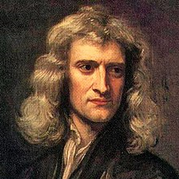

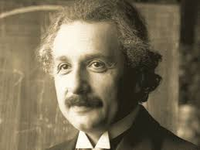
Mad Genius?: 1687 - Isaac Newton (1642-1726): publishes Theory of Gravitation as part of the Principia (Fluxions, blah blah)…
F = - GMm (applies to ellipses where r is semi-major axis) . r²
Misrepresented: Robert Hooke’s work on circular motion tells us: F = - mω²r where ω = 2π/T and T is the orbital period. Combines to give:
r ³ = GMT² i.e. Kepler’s 3rd Law with bells & whistles! . 4π²
Fast forward to the 20th Century…
Masterful: 1915 – Albert Einstein (1879 -1955): General Theory of Relativity, which predicts Black Holes… objects so dense that their escape velocity exceeds the speed of light, c.
Notes:
We all know about Newton. Not only did he try to destroy Leibniz, he stitched up Robert Hooke as well – which is why there are no contemporary portraits! Hooke almost certainly derived this equation following his observations of a mass on a spring resting on a rotating turntable. He contributed much to Newton’s understanding of Gravitation. And why do biologists mostly seem to ignore Hooke’s amazing book, Micrografia?
Einstein – what can one say? Special Relativity is easy, but General Relativity is heavy stuff!

Slide 4
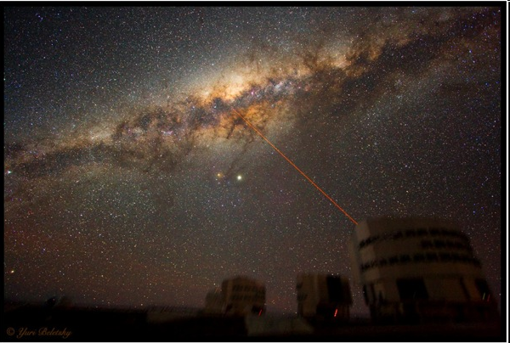
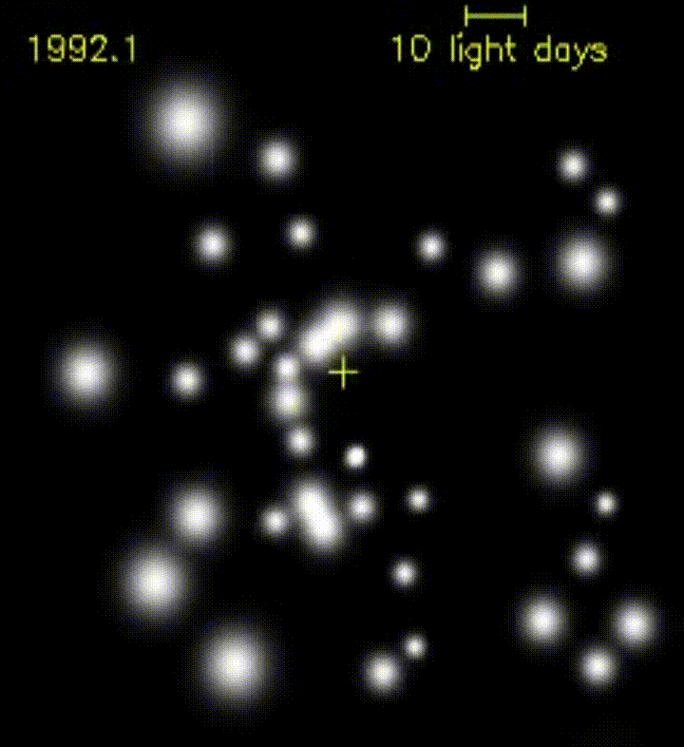
1930: discovery that much radio “static” originates from an object in constellation Sagittarius, later termed A*.
Problem: Sagittarius A* appears to be near centre of our galaxy, optically obscured by interstellar gas & dust
1990s to early 2000s – infra-red observations with the Keck telescope, Hawaii, & the VLT at Paranal, Chile.
Revealed orbits of stars near the galactic centre – but no object seen at the common focus of their ellipses…
Explanation? A supermassive Black Hole (producing radio “static” as material spirals into it).
But how massive? You work it out (data on next slide)
Notes:
Sagittarius A* discovered by Carl Jansky of Bell Telephone Labs.
VLT stands for, yes, Very Large Telescope (array)!

Slide 5
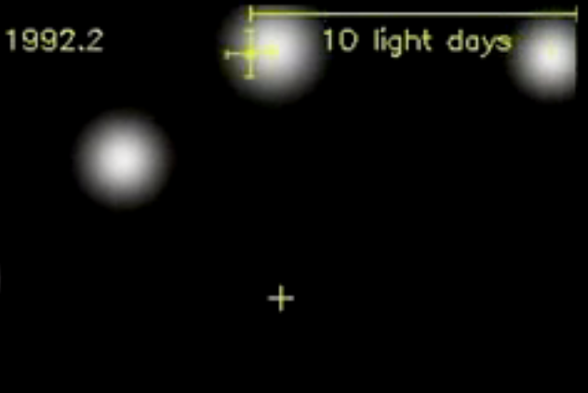
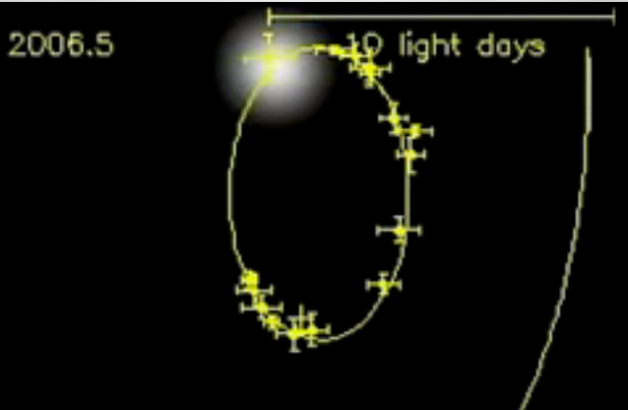
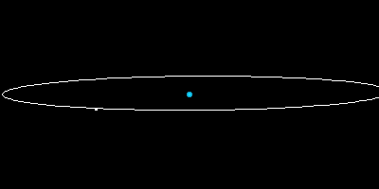
Estimate orbital period, T, in years (decimal) and semi-major axis, r, in light-days.
Convert T into seconds (1 y = 3.1 x 10⁷ s) and r into metres (c = 3.0 x 10⁸ ms⁻¹ and 1 day = 8.6 x 10⁴ s)
Use r³ = GMT² / 4π² to find M (G = 6.7 x10⁻¹¹ m³kg⁻¹s⁻²).
To give a sensible answer, we can convert M (in kg) to something more meaningful – say, a multiple of our Sun’s mass (2.0 x 10³⁰ kg)…
As a physicist(!) I have to consider likely sources of error – can you see an obvious one, and figure out how its magnitude might be estimated?
(click for help)
Have Fun!
Notes:
To save time: T is 14.3 years.5 and r is about 4.5 light days
Should give answer around 2.4 million times the mass of our Sun, but thought to be nearer 4 million…
How is the elliptical orbit oriented to Earth? Apparently on a tilt, so r is actually greater than it appears.
How do we know? Measurements of the Doppler shift of light from the star due to its component of motion towards (blue shift) & away from (red shift) the Earth.

