Slide 1



Ubiquitous Permutations
Pedro Freitas
CIUHCT and FCUL
Partially supported through Project FCT UID/HIS/00286/2013

Slide 2
Last year at the MathsJam Gathering...
Milk (or Klondike) shuffle:
$$\left[\begin{matrix}1 & 2 & 3 & 4 & 5 & 6 & 7 & 8 & 9 & 10 & 11 & 12 \\ 6 & 7 & 5 & 8 & 4 & 9 & 3 & 10 & 2 & 11 & 1 & 12\end{matrix}\right]$$
Milk shuffle with drop:
$$\left[\begin{matrix}1 & 2 & 3 & 4 & 5 & 6 & 7 & 8 & 9 & 10 & 11 & 12 \\ 7 & 6 & 8 & 5 & 9 & 4 & 10 & 3 & 11 & 2 & 12 & 1\end{matrix}\right]$$
The notation lists the position of the objects before and after the permutation.

Slide 3
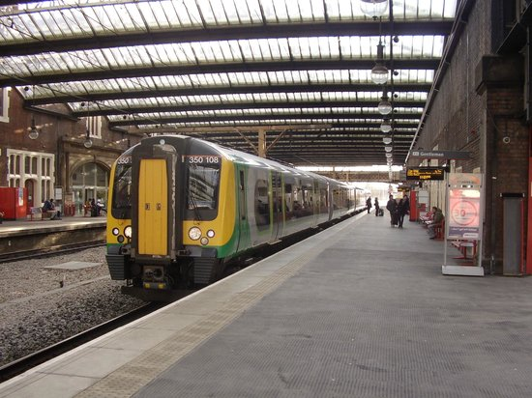
On the way to the Gathering...
Φlipp Reinhard:
- Have you heard about this piece by Messiaen?
(Actual photo of Stoke-on-Trent train station)

Slide 4
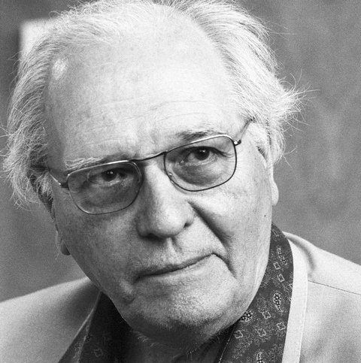
L’île de feu 2
Messiaen developed a system, called interversions for generating the
pitches, durations and intensities
of the notes in the piece L’île de feu 2 (The island of fire 2), the fourth movement of Quatre études de rythme (Four Rhythm Studies, 1949/50).

Slide 5

Interversions
Original: 12 11 10 9 8 7 6 5 4 3 2 1
Interversion I: 6 7 5 8 4 9 3 10 2 11 1 12 Interversion II: 3 9 10 4 2 8 11 5 1 7 12 6 Interversion III: 11 8 5 2 1 4 7 10 12 9 6 3 Interversion IV: 7 4 10 1 12 2 9 5 6 8 3 11 Interversion V: 9 2 5 12 6 1 8 10 3 4 11 7 Interversion VI: 8 1 10 6 3 12 4 5 11 2 7 9 Interversion VII: 4 12 5 3 11 6 2 10 7 1 9 8 Interversion VIII: 2 6 10 11 7 3 1 5 9 12 8 4 Interversion IX: 1 3 5 7 9 11 12 10 8 6 4 2 Interversion X: 12 11 10 9 8 7 6 5 4 3 2 1
This is the milk shuffle with drop!
You can actually use it to generate the interversions.

Slide 6
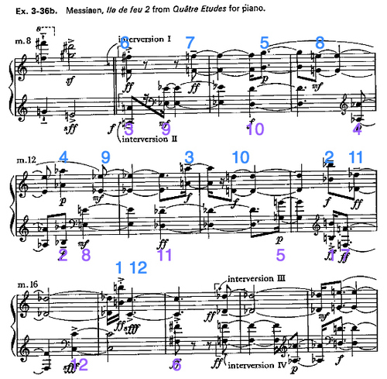
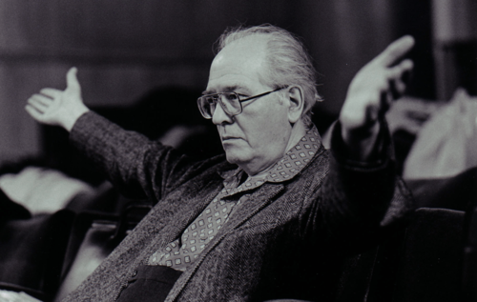
The score
Interversion I: 6 7 5 8 4 9 3 10 2 11 1 12 Interversion II: 3 9 10 4 2 8 11 5 1 7 12 6 Interversion III: 11 8 5 2 1 4 7 10 12 9 6 3 Interversion IV: 7 4 10 1 12 2 9 5 6 8 3 11

Slide 7
The Mathieu Group M₁₂
Theorem. Every finite simple group is isomorphic to groups in one of 3 infinite families, or to a list of 26 sporadic groups.
The Mathieu groups M₁₁ M₁₂ M₂₂ M₂₃ and M₂₄ are part of the sporadic groups.
The Mathieu group M₁₂ has 95040 elements and is generated by the permutations that give the
milk shuffles:
simple: (1 11 10 8 4 5 3 7 3 9 6)(12) and with drop: (1 12 11 9 5 4 6 2 10 7)(3 8)

