Slide 1
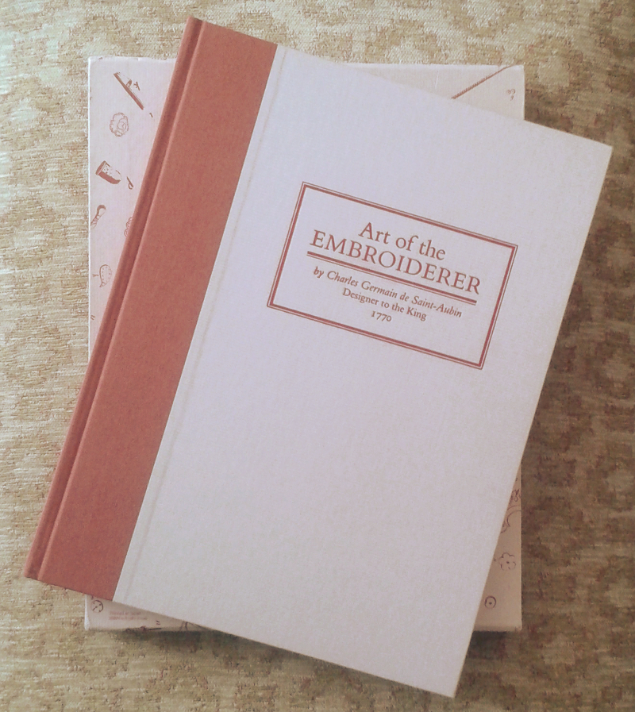
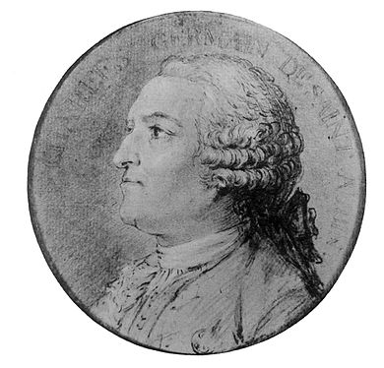

Slide 2
Chenille: A pack of chenille of four strands, each one four aunes, usually weights one gros and three-quarters. Ordinary colours – such as gray, yellow, green or blue – are sold for twenty sols; in red or bright red they cost twenty-five sols. Chenille is made and sold by Ribbonmakers. For chenille to be of good quality, it must have many hairs, evenly cut. It is made in a number of thicknesses; those spun threads [as opposed to the lighter quality woven threads] are less costly and not as good. Chenille may be applied threaded on a needle or couched onto the fabric or in a chain stitch made with a hook.

Slide 3
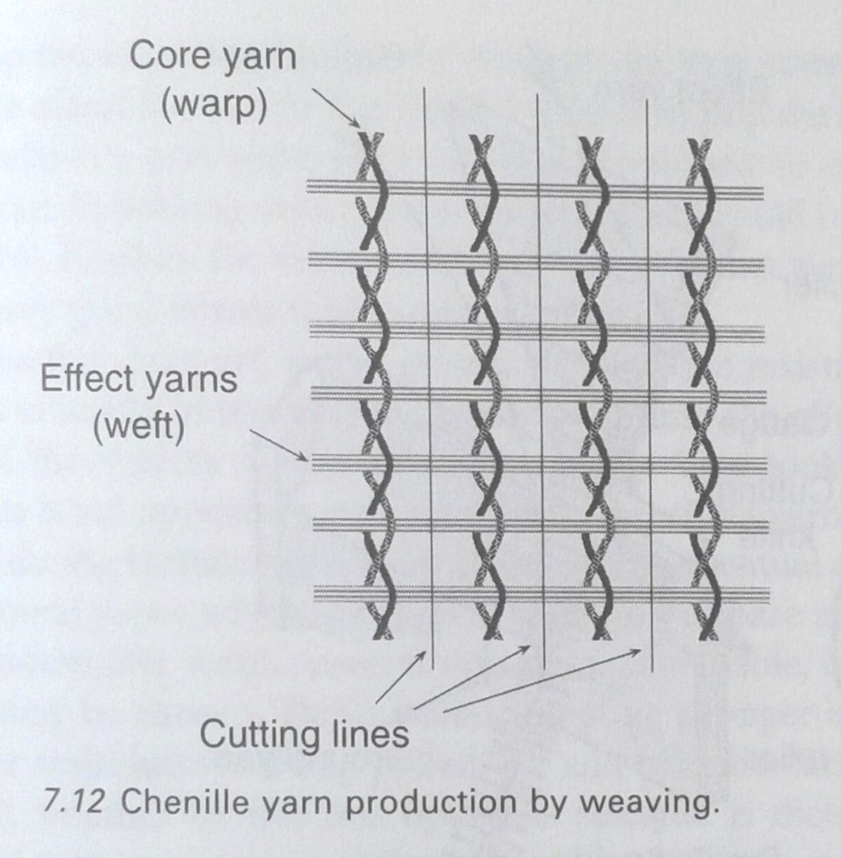

Slide 4
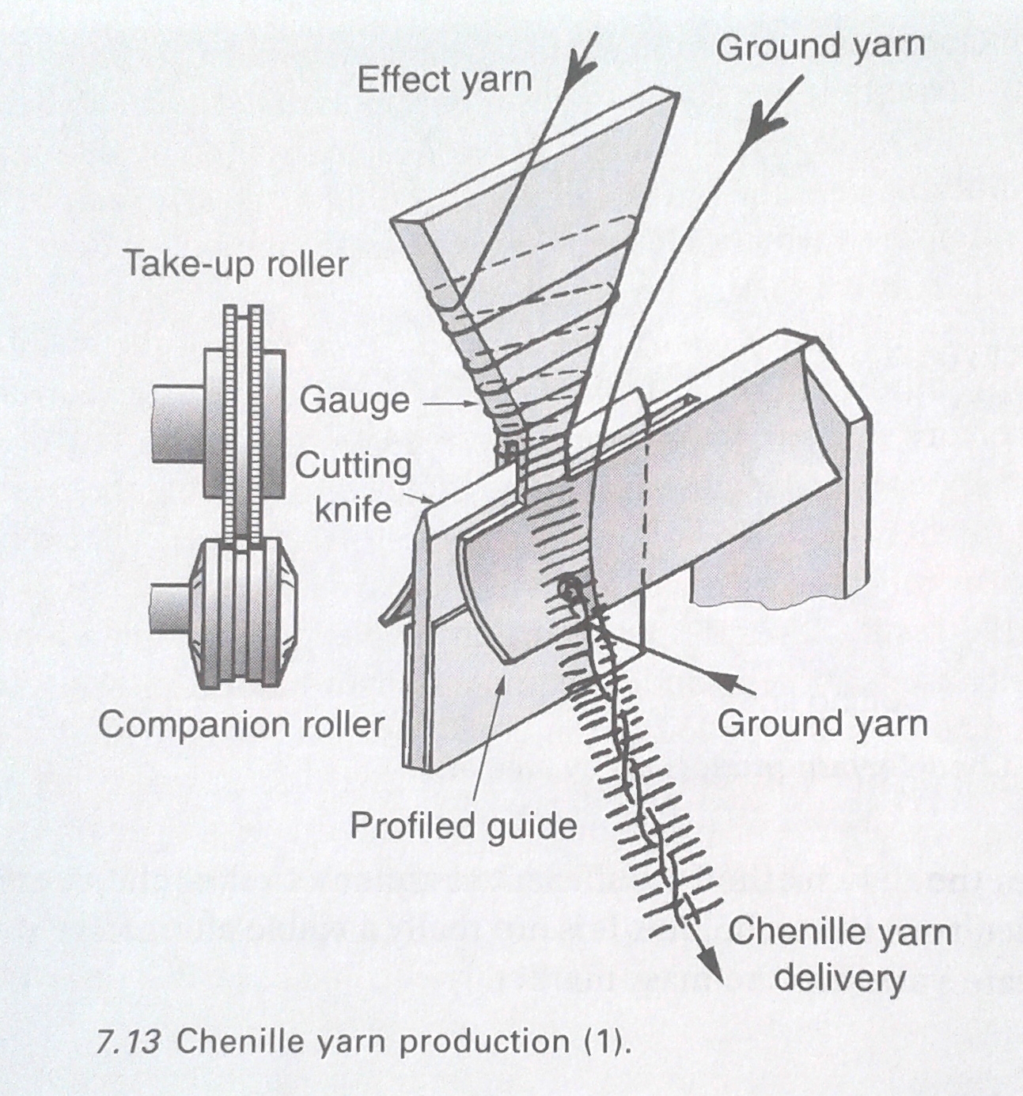
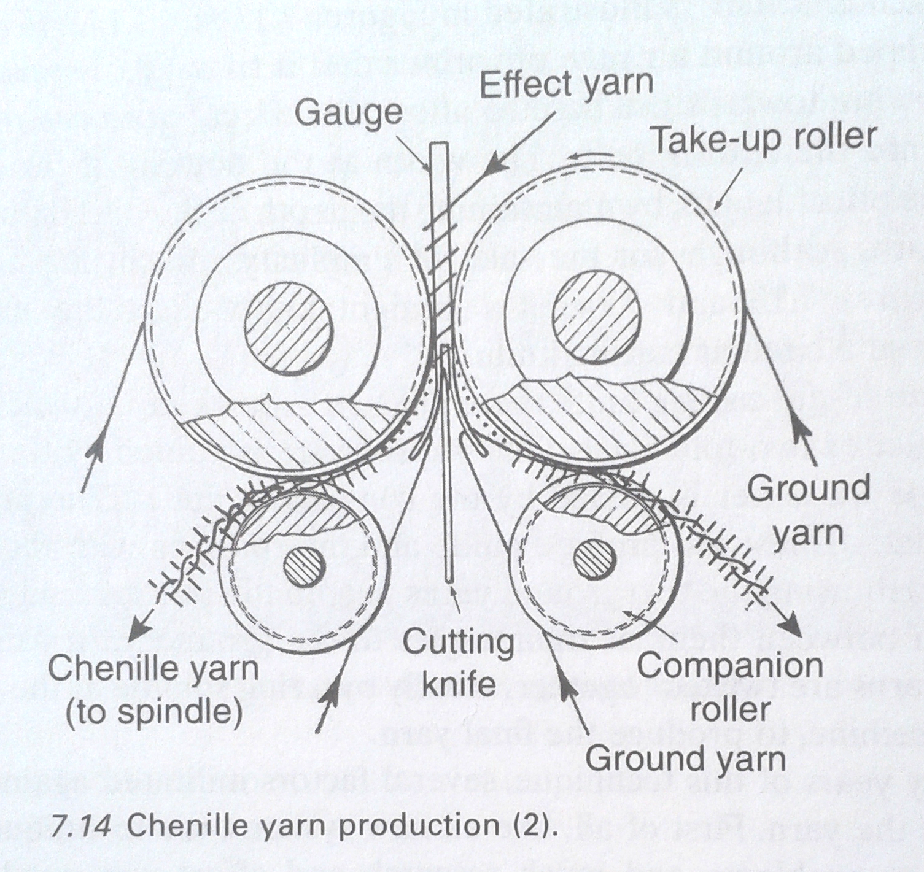
Modern Chenille Spinning

Slide 5
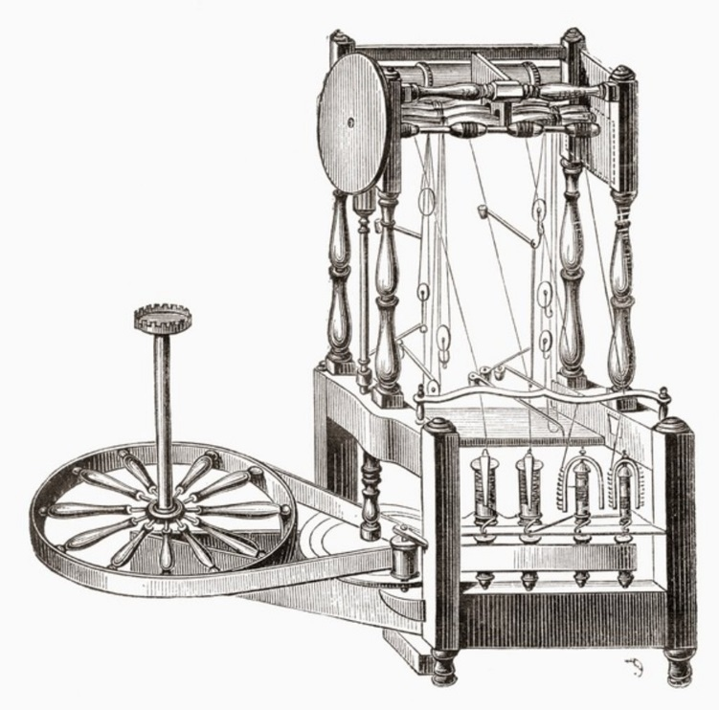
Arkwright’s water frame

Slide 6
