Slide 1
42

Slide 2
42
Not Quite Life, The Universe And Everything!

Slide 3
42
Not Quite Life, The Universe And Everything!
But why 42?

Slide 4
42

Slide 5
42
When asked Adams said it was … Simply a joke!

Slide 6
42
When asked Adams said it was … Simply a joke!
… and that …
42 had no special relevance!

Slide 7
4 X 5 = 12

Slide 8
4 X 5 = 12
4 x 6 = 13

Slide 9
4 X 5 = 12
4 x 6 = 13
4 x 7 = ….

Slide 10
4 X 5 = 12
4 x 6 = 13
4 x 7 = ….
Oh dear, I’ll never get to 20 at that rate.

Slide 11
4 X 5 = 12
4 x 6 = 13
4 x 7 = ….
Oh dear, I’ll never get to 20 at that rate.
From A. L. Taylor’s book
“The White Knight. A study of C. L. Dodgson.”

Slide 12
4 x 5 = 12 in base 18

Slide 13
4 x 5 = 12 in base 18
4 x 6 = 13 in base 21

Slide 14
4 x 5 = 12 in base 18
4 x 6 = 13 in base 21
Continuing we could get …

Slide 15
4 x 5 = 12 in base 18
4 x 6 = 13 in base 21
Continuing we could get …
4 x 7 = 14 in base 24

Slide 16
4 x 5 = 12 in base 18
4 x 6 = 13 in base 21
Continuing we could get …
4 x 7 = 14 in base 24
4 x 8 = 15 in base 27

Slide 17
4 x 5 = 12 in base 18
4 x 6 = 13 in base 21
Continuing we could get …
4 x 7 = 14 in base 24
4 x 8 = 15 in base 27
And eventually to …

Slide 18
4 x 5 = 12 in base 18
4 x 6 = 13 in base 21
Continuing we could get …
4 x 7 = 14 in base 24
4 x 8 = 15 in base 27
And eventually to …
4 x 12 = 19 in base 39

Slide 19
4 x 5 = 12 in base 18
4 x 6 = 13 in base 21
Continuing we could get …
4 x 7 = 14 in base 24
4 x 8 = 15 in base 27
And eventually to …
4 x 12 = 19 in base 39
The next step, 4 x 13, does not give 20 in base 42

Slide 20
The Hitchhiker’s Guide was first broadcast in 1978

Slide 21
The Hitchhiker’s Guide was first broadcast in 1978
40 years ago

Slide 22
The Hitchhiker’s Guide was first broadcast in 1978
40 years ago
But even after that length of time Deep Thought’s response of 42 does tend to make me, and I suspect other people as well, more aware of the number when it comes up in other contexts

Slide 23


Slide 24
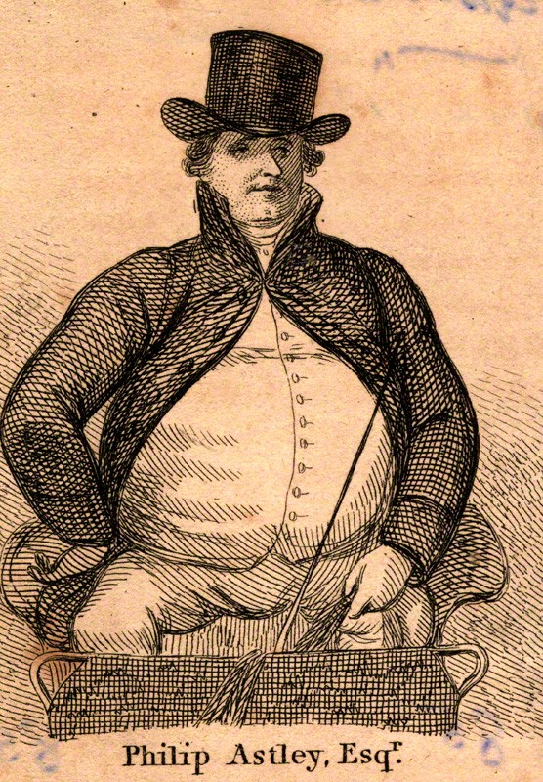

Slide 25
