Slide 1
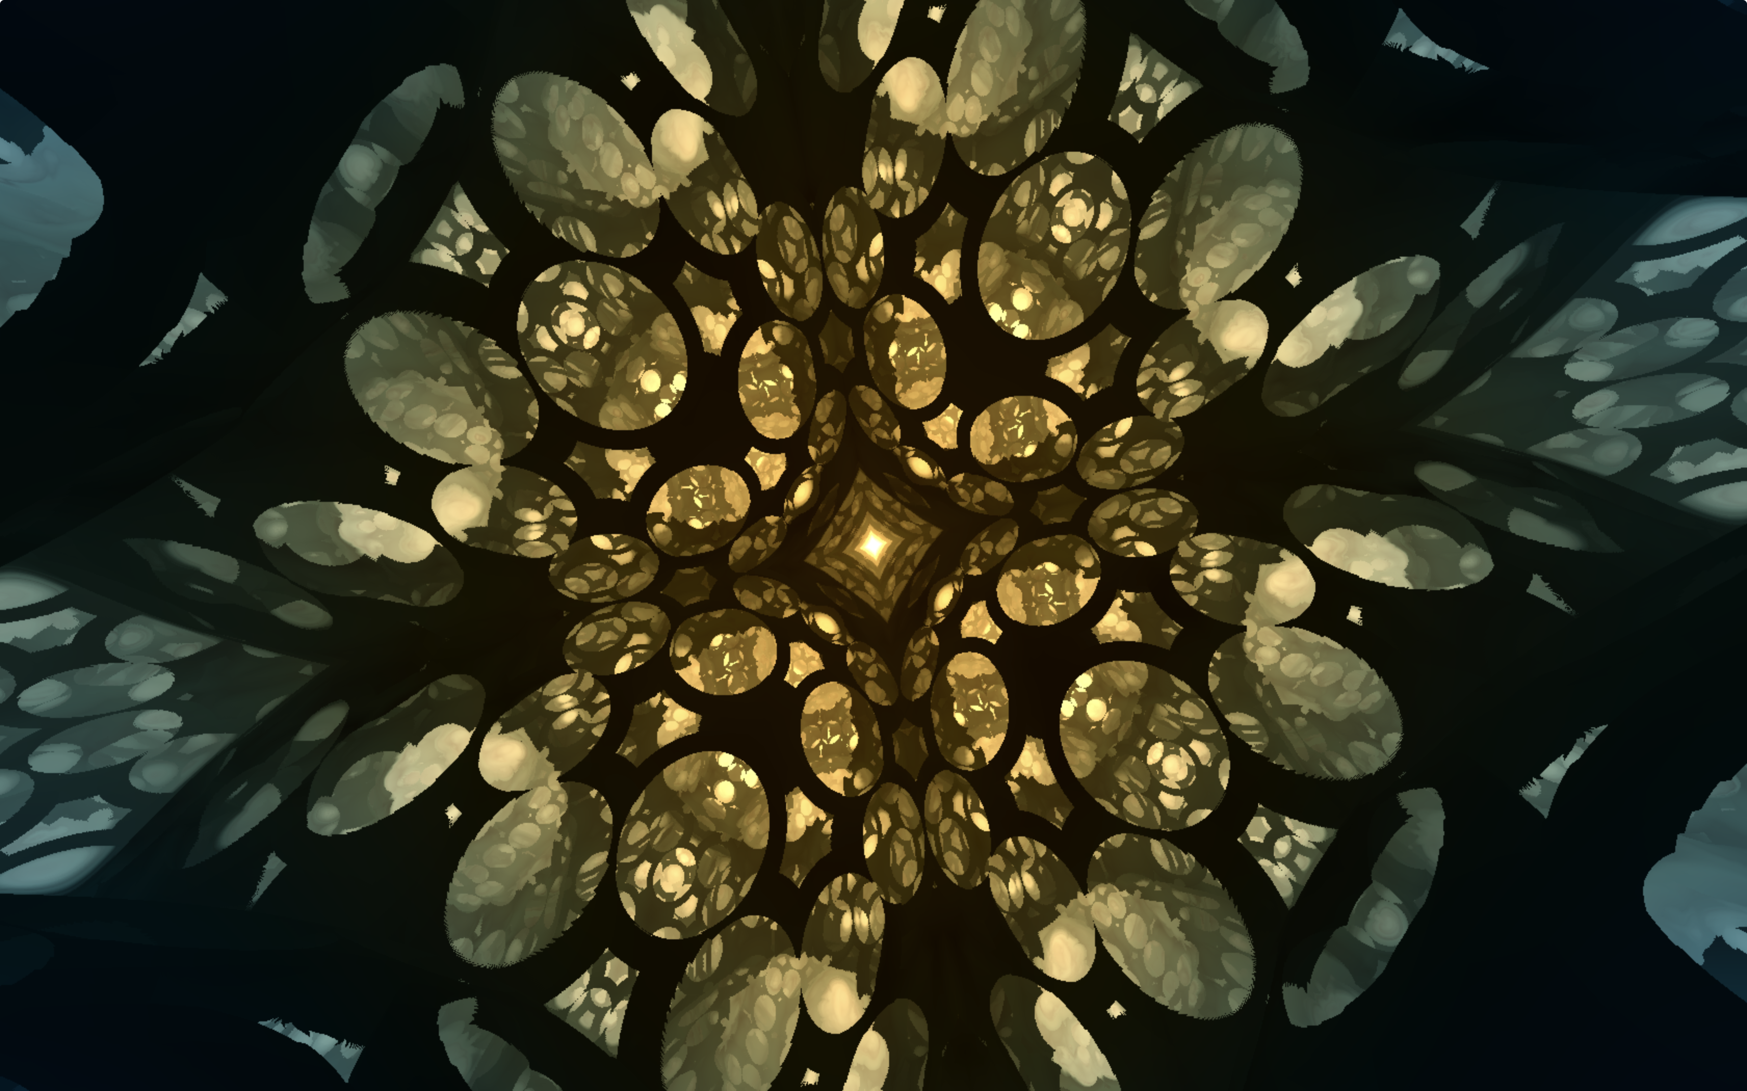
Digital Art & Distance Functions
Will Kirkby
@willkirkby

Slide 2
x² + y² = r²

Slide 3
sqrt(x² + y²) = r

Slide 4

sqrt(x² + y²) - r

Slide 5
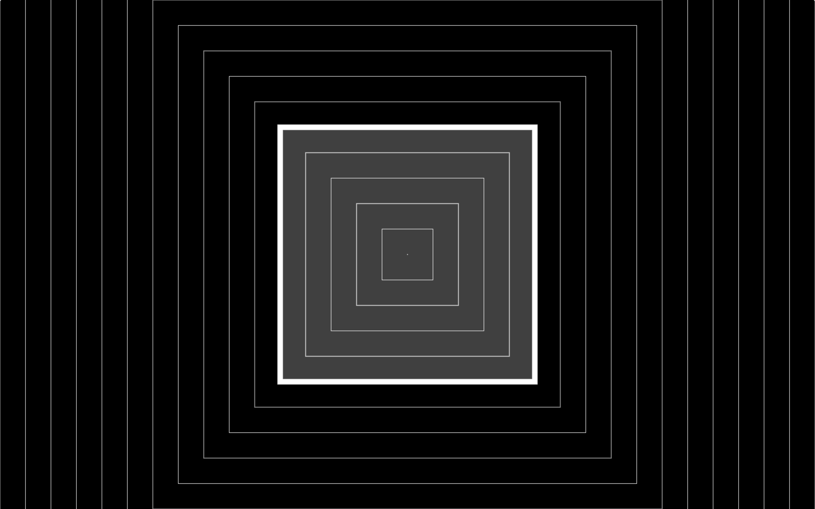
lazy rectangle: max(abs(x) - w, abs(y) - h)

Slide 6

actual rectangle: something complicated

Slide 7
“That’s great! But can I find where a ray intersects the boundary?”

Slide 10
“But can I combine shapes?”

Slide 11

union: min(a, b)

Slide 12

intersection: max(a, b)

Slide 13
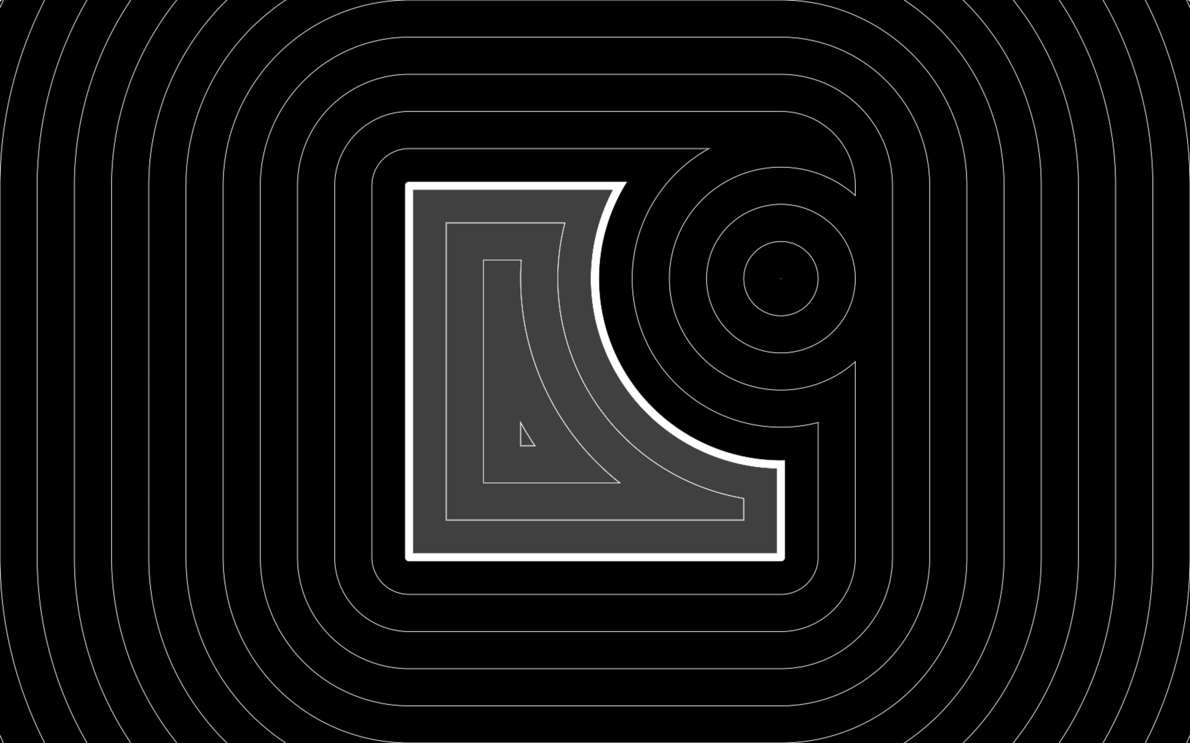
subtraction: max(a, -b)

Slide 14
“But does it scale to 3D?”

Slide 15
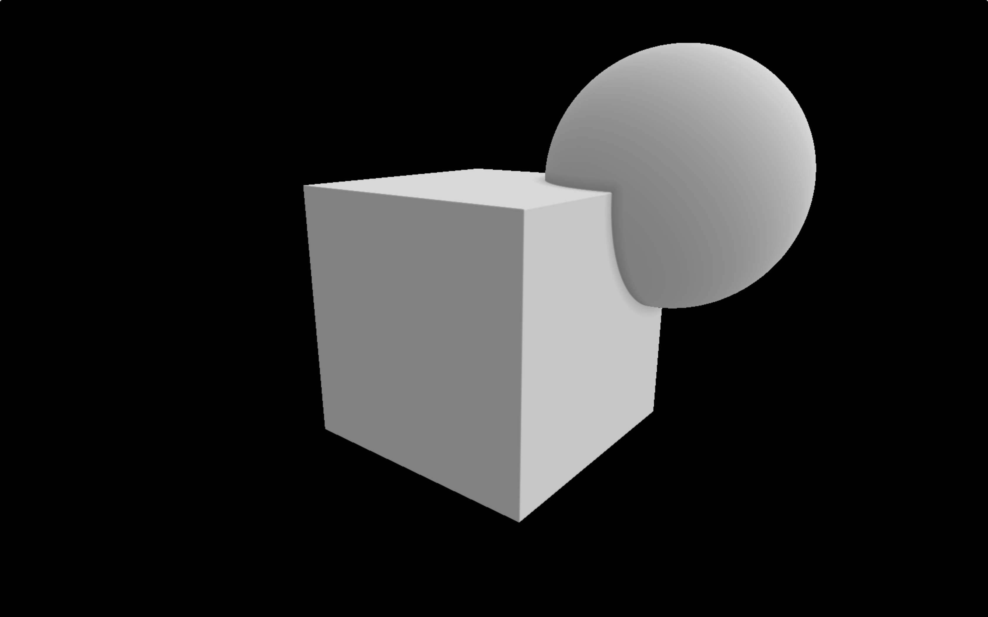

Slide 16
“Where are you going with this?”

Slide 17
The Demoscene
Art as software, typically animated with music
Limited hardware or small executable size
Procedural content and lots of patterns

Slide 18
“The Scene Is Dead” by Razor 1911

Slide 19
Thanks for your time!
@willkirkby

