Slide 1
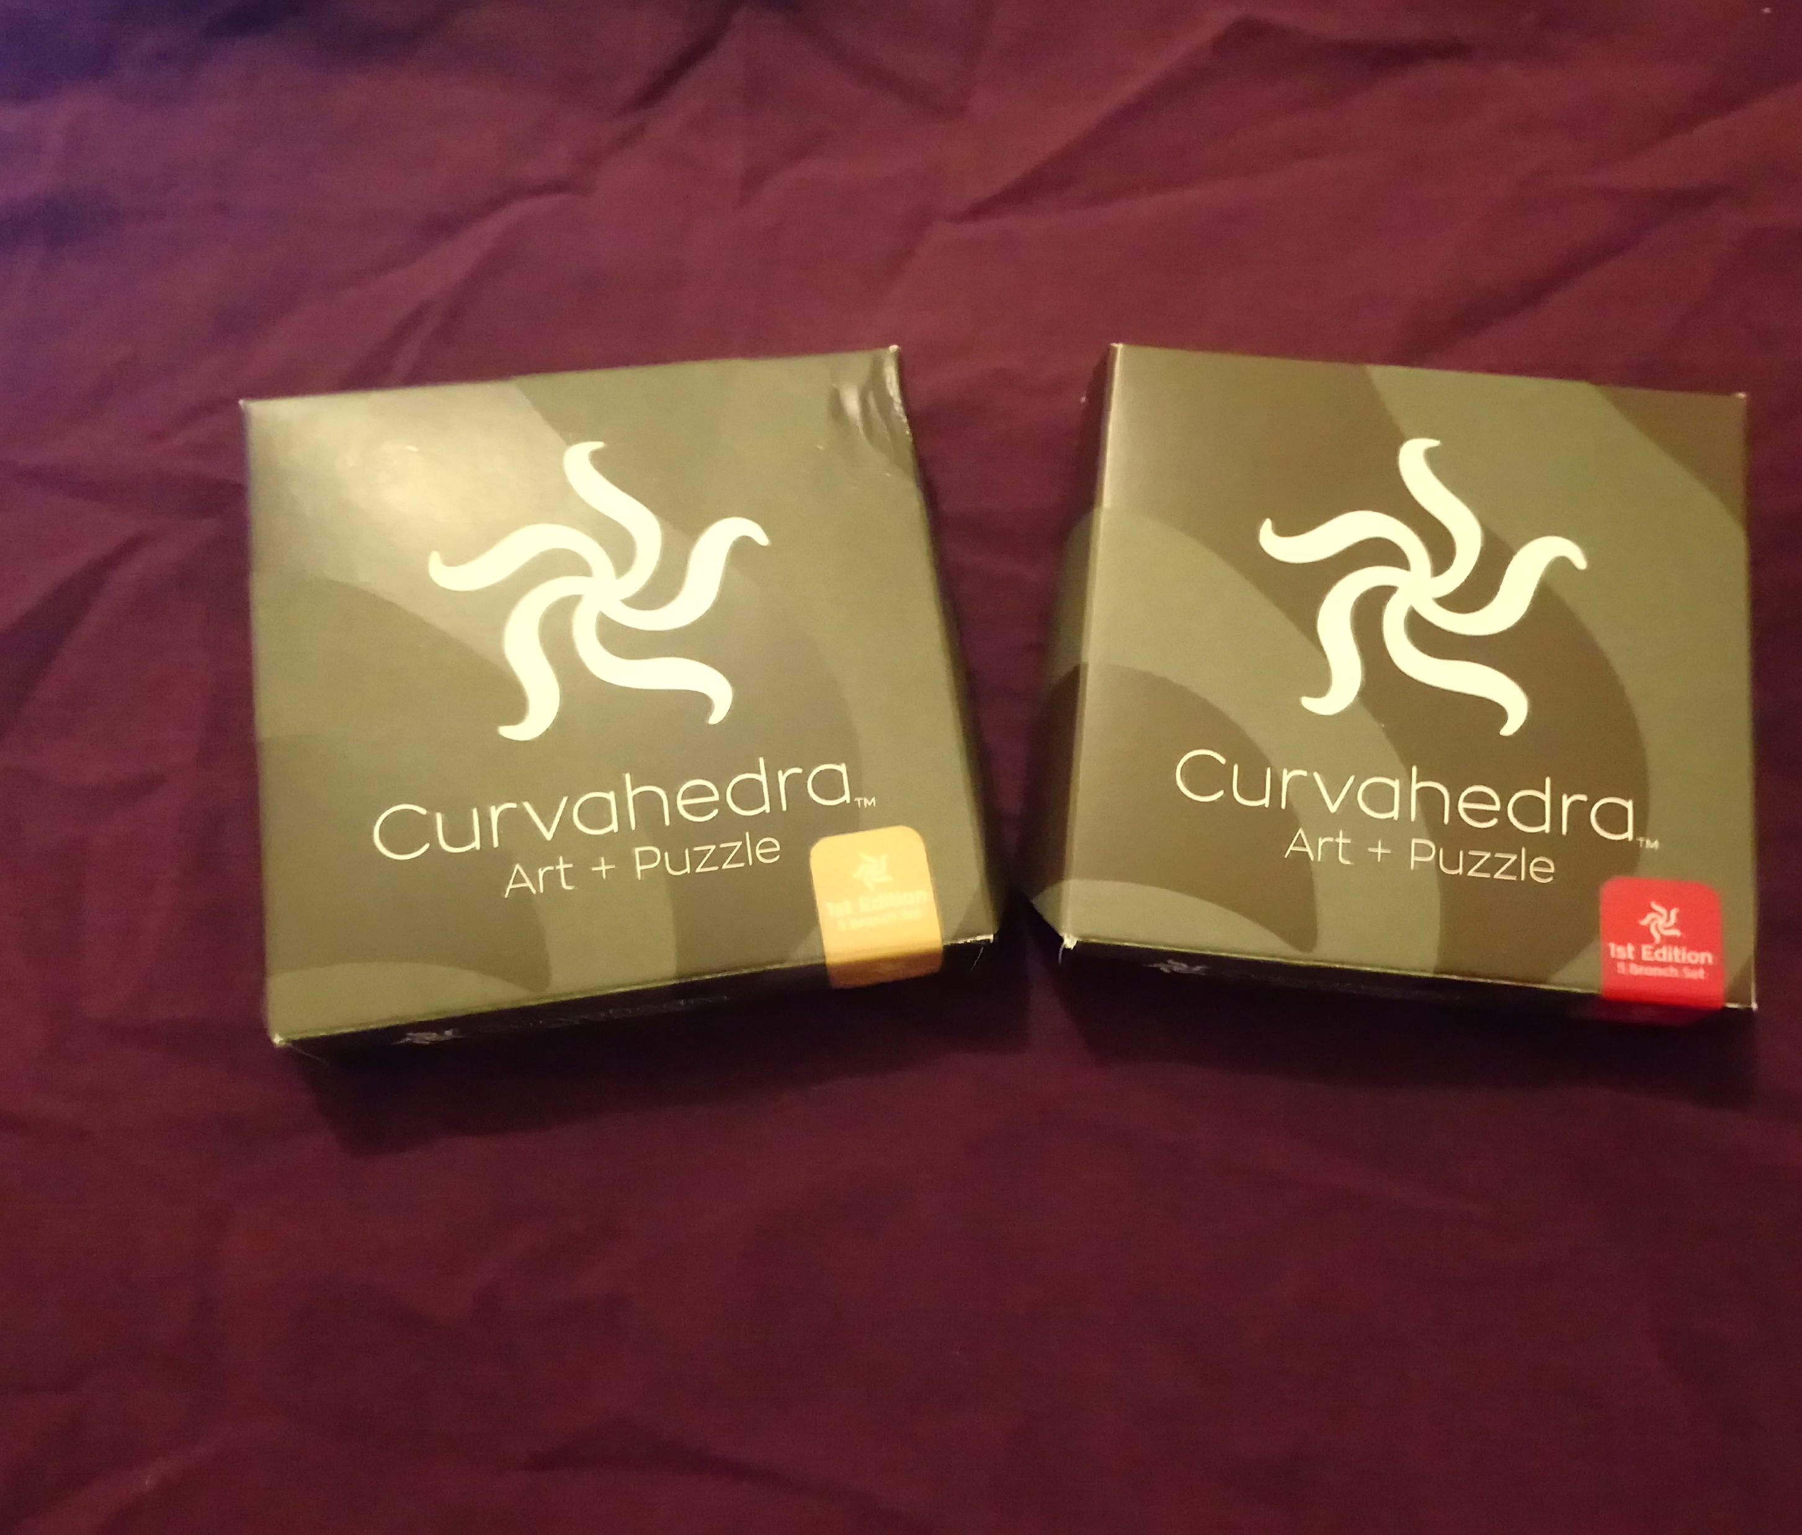
Exploring Shapes With Curvahedra
Some interesting topology and shapes made with Curvahedra.
www.curvahedra.com
@curvahedra

Slide 2
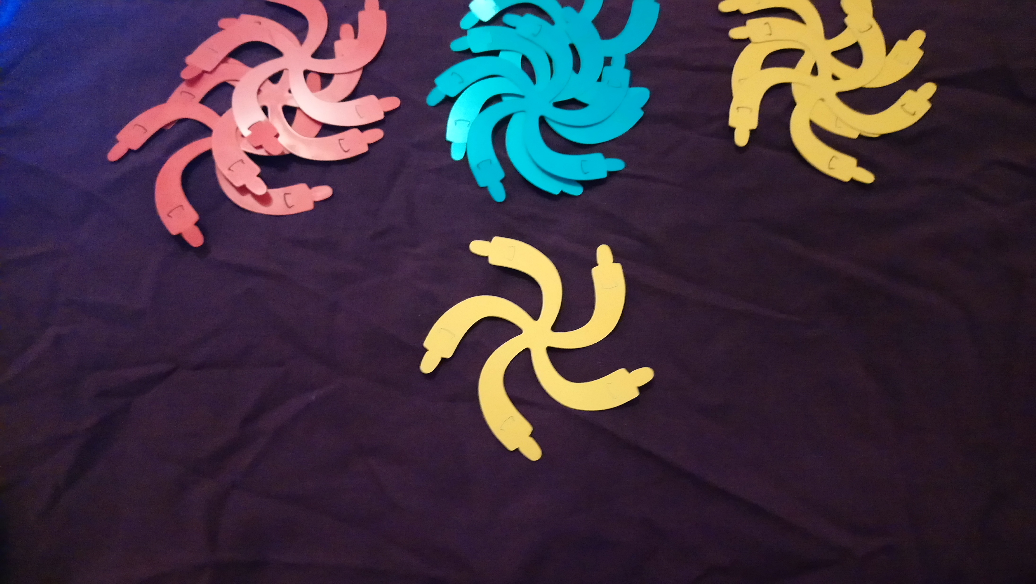
Notes:
Photos of pieces – basic shape. Made of mylar. You can use them to make…. Whatever you want.

Slide 3
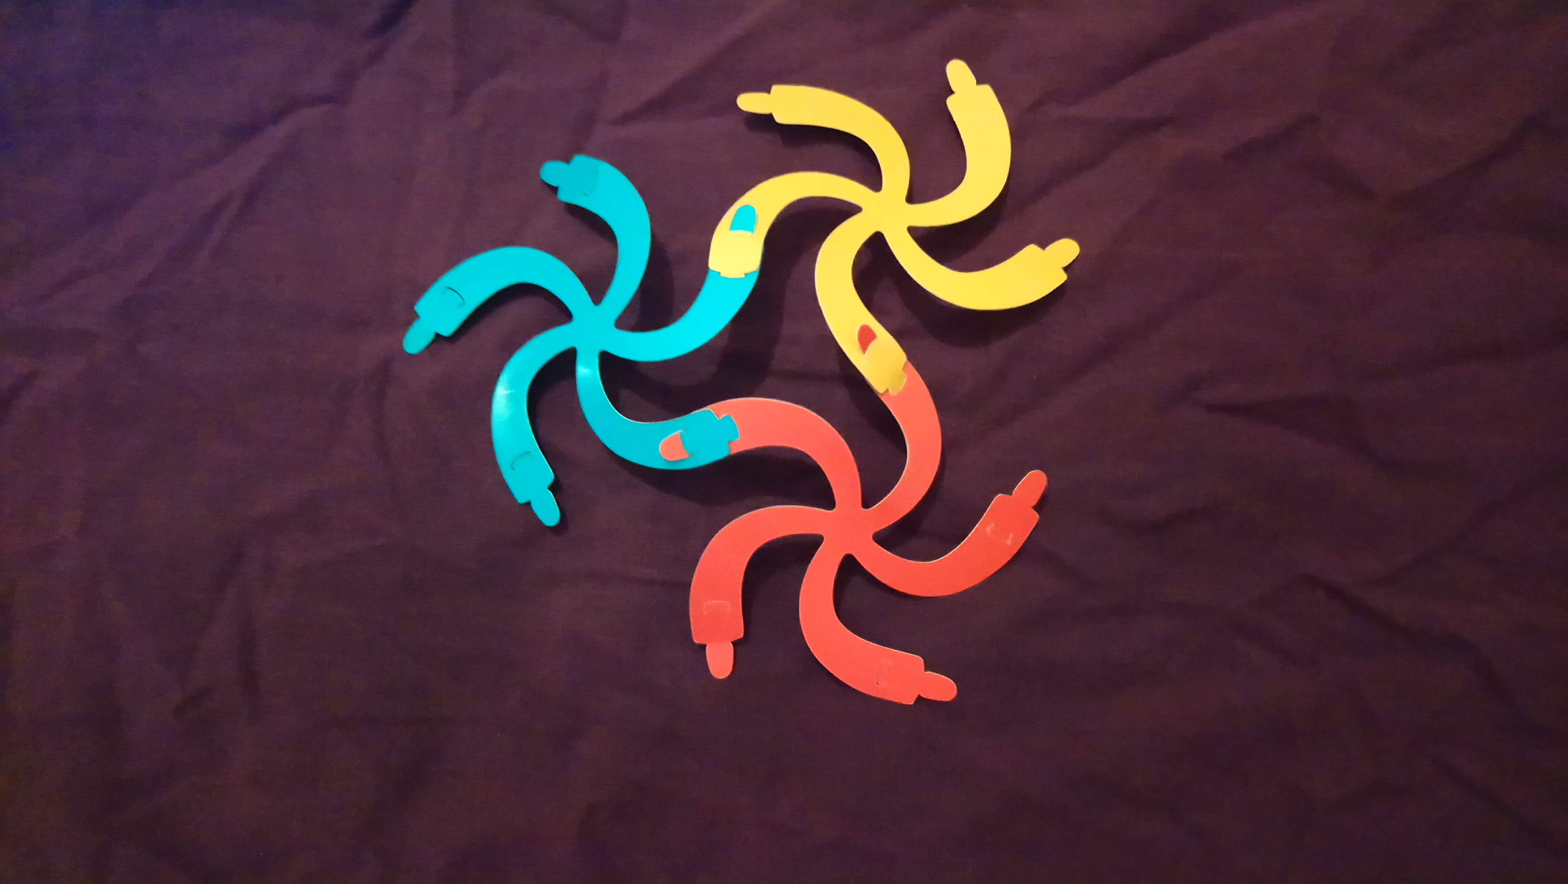
Notes:
In the box, it gives the basic building block as the triangle, which is three pieces.

Slide 4
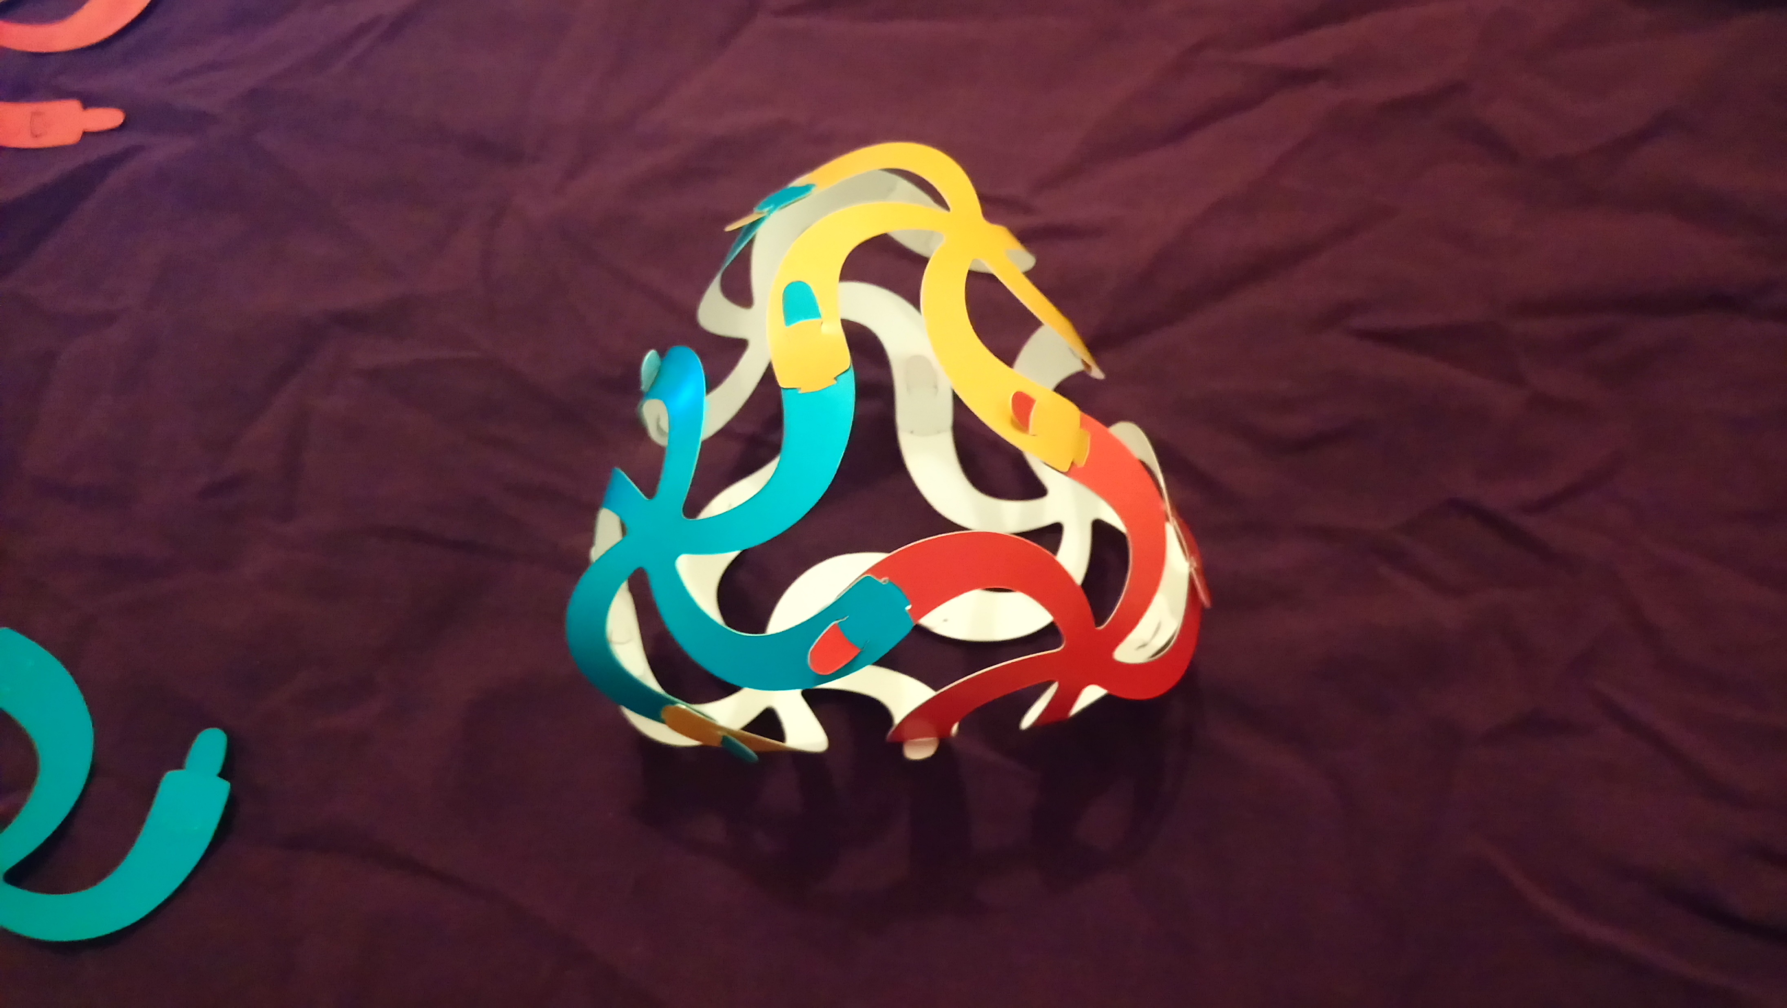
Notes:
Heart – 6 pieces

Slide 5
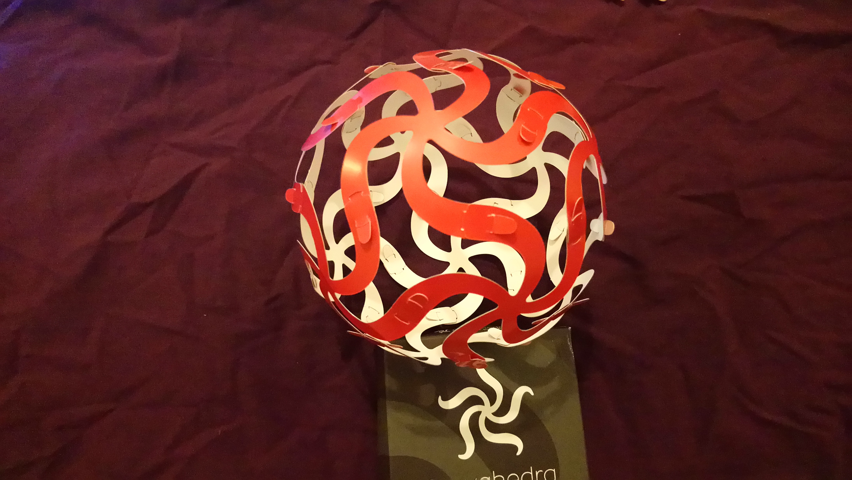
Notes:
Ball

Slide 6
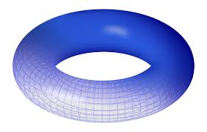
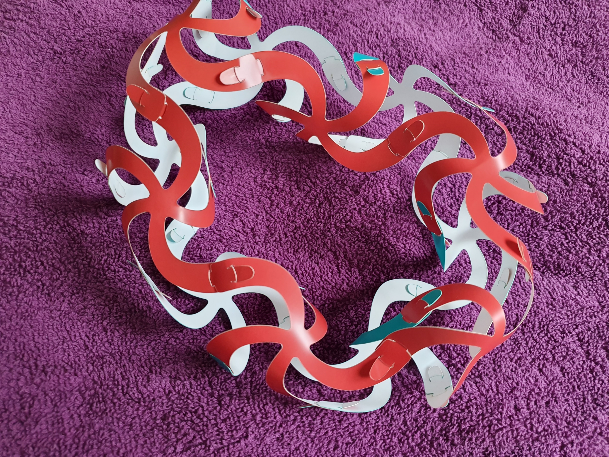
Torus
Notes:
Torus

Slide 7
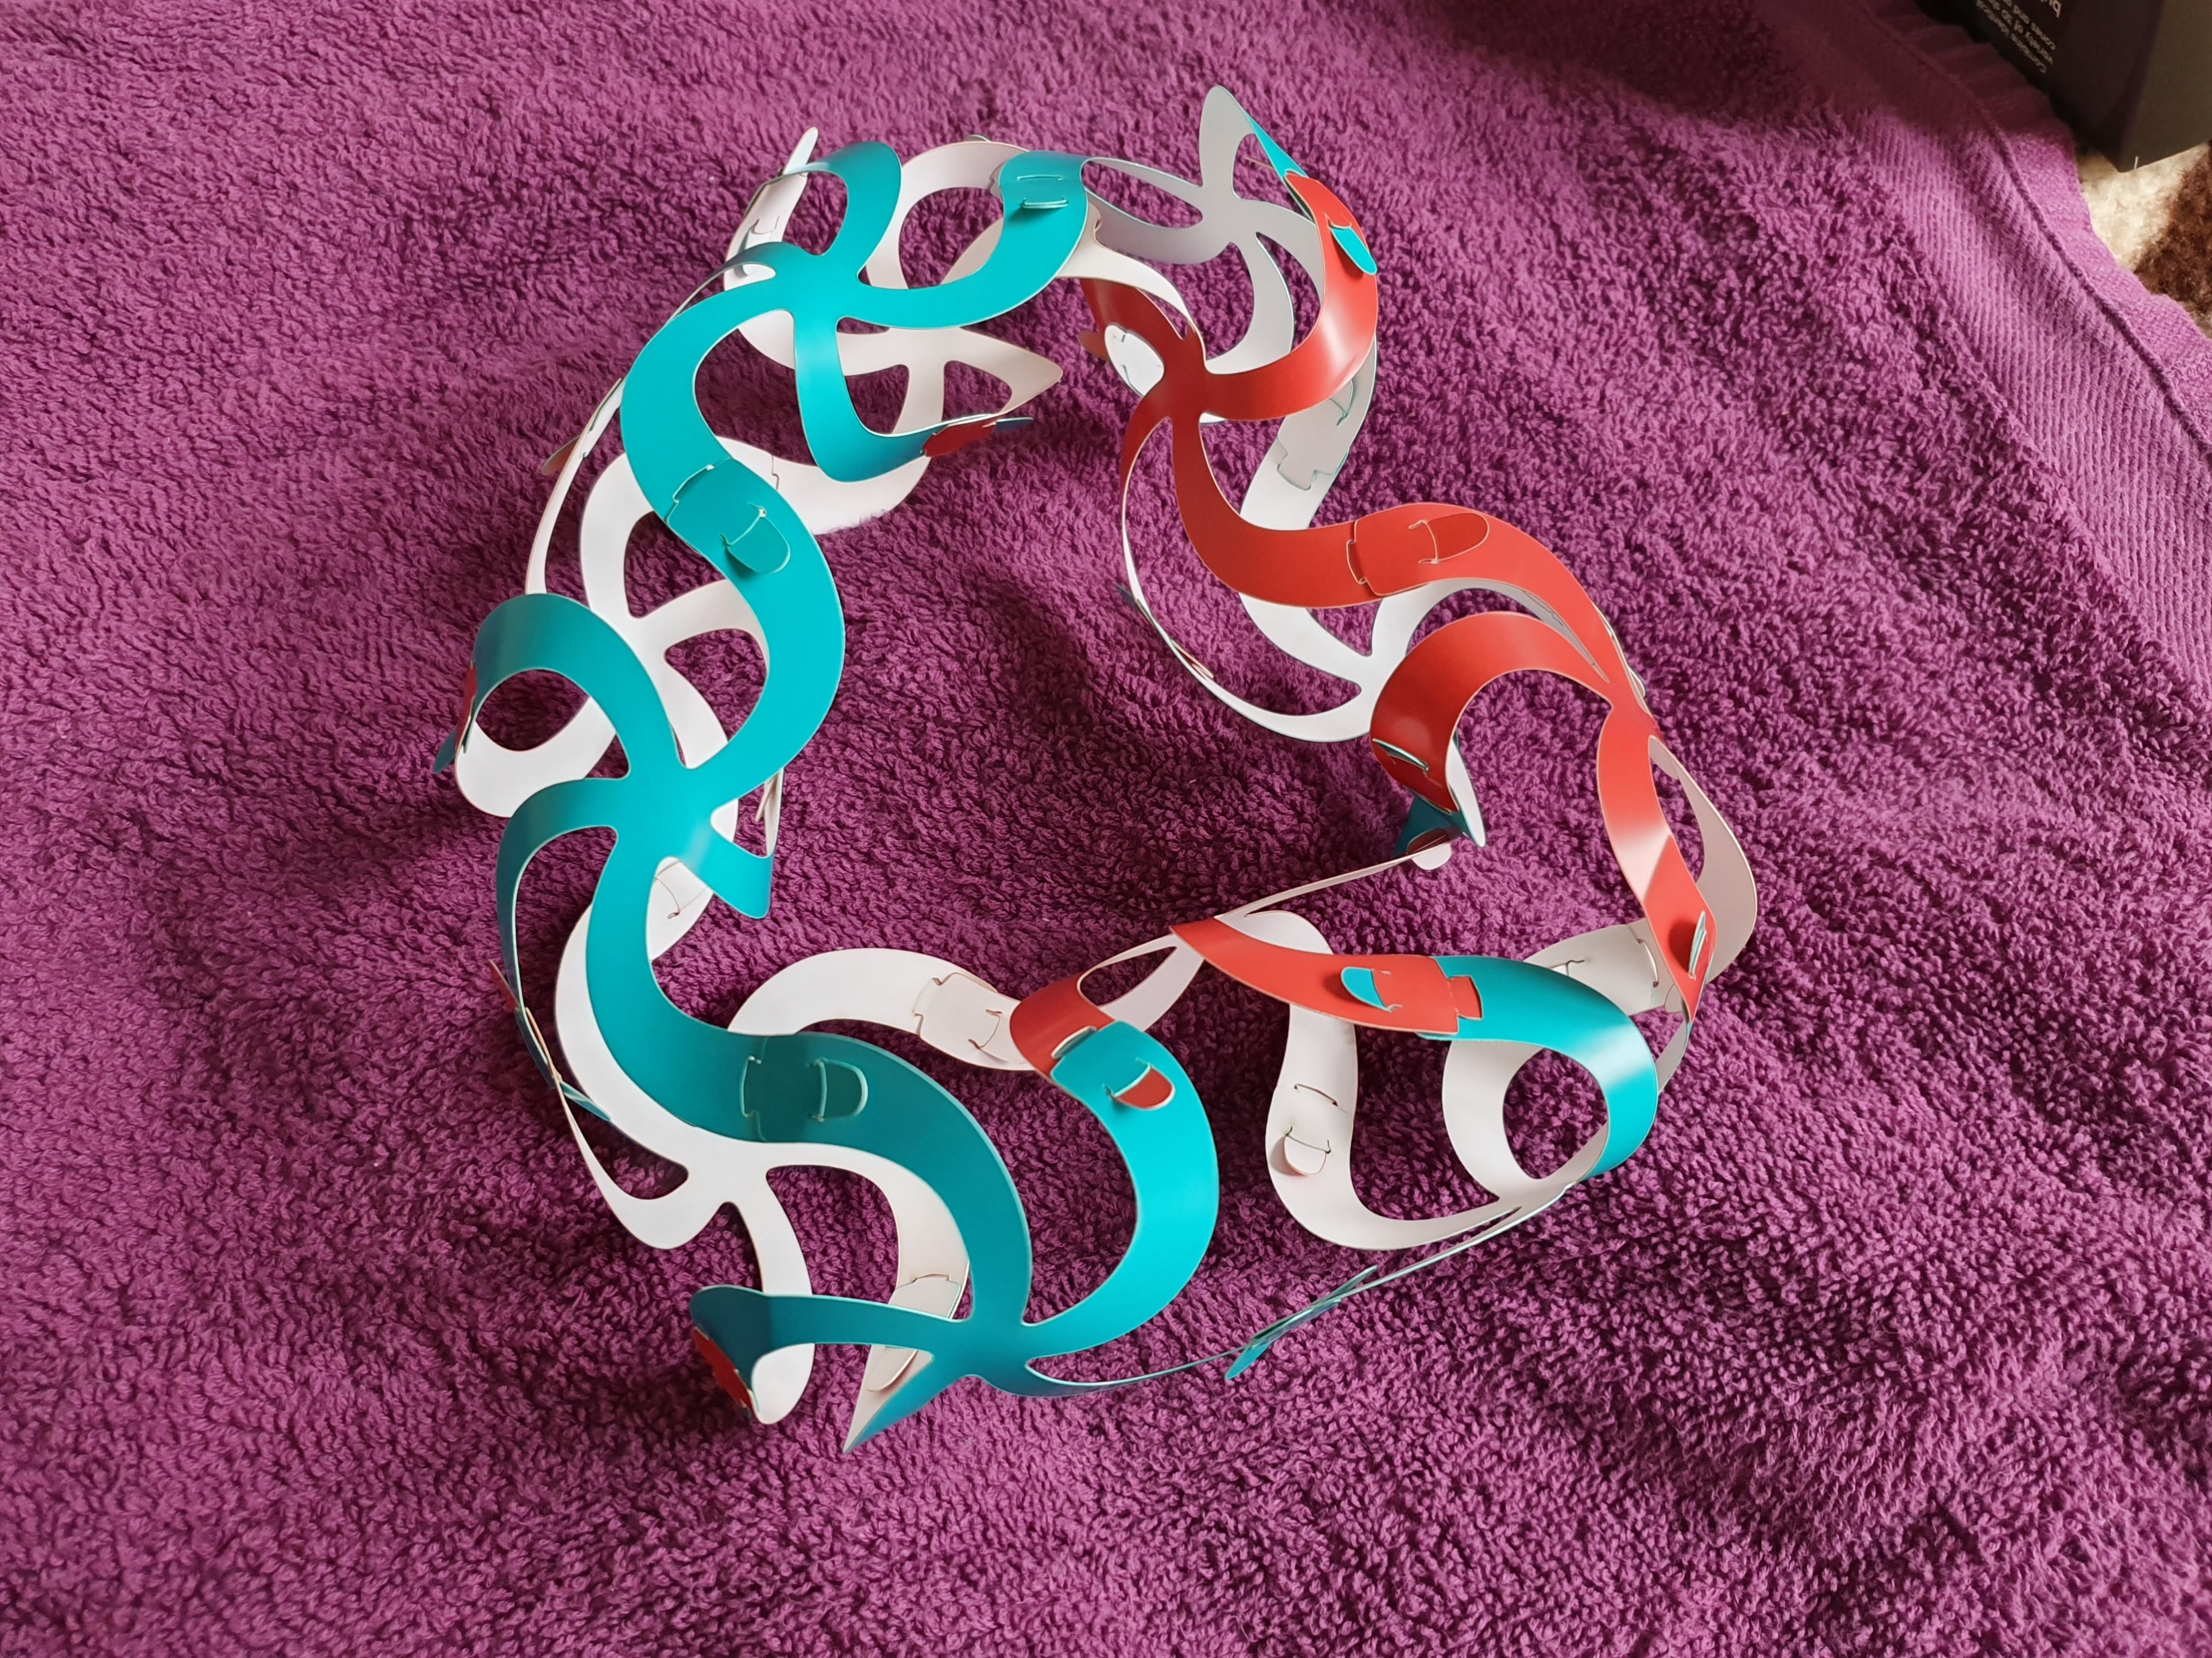
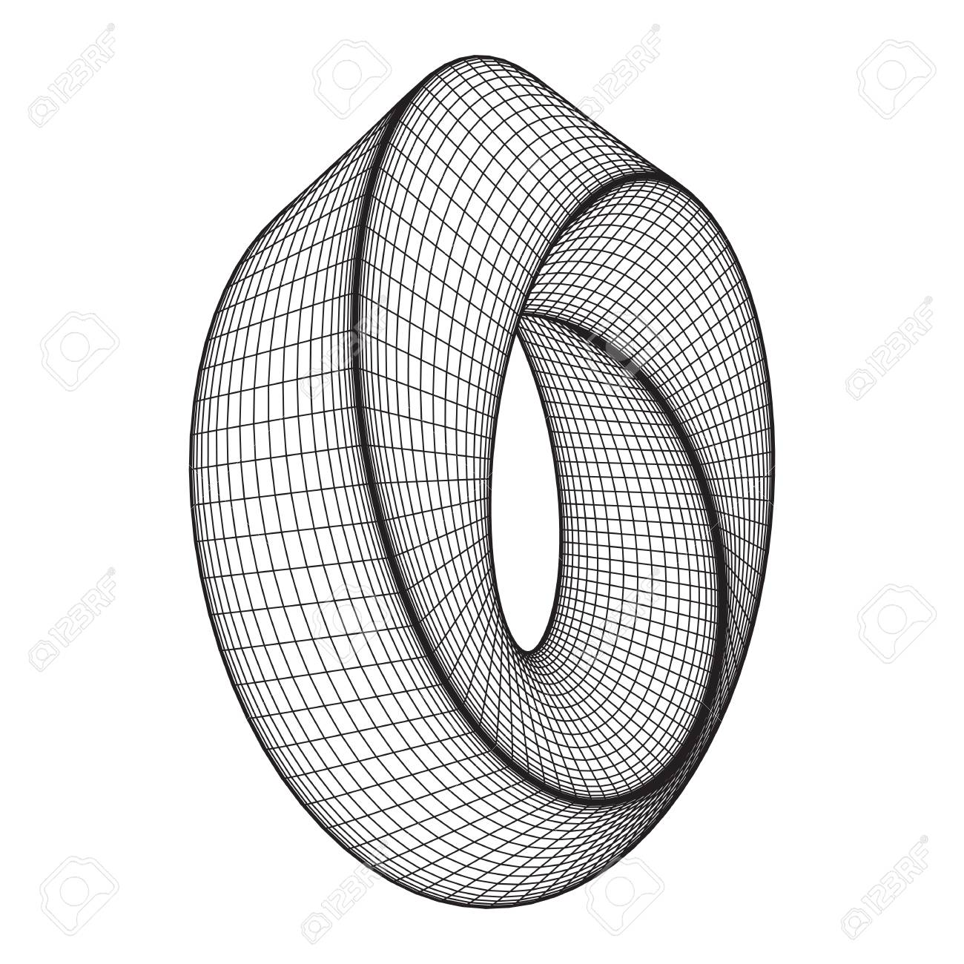
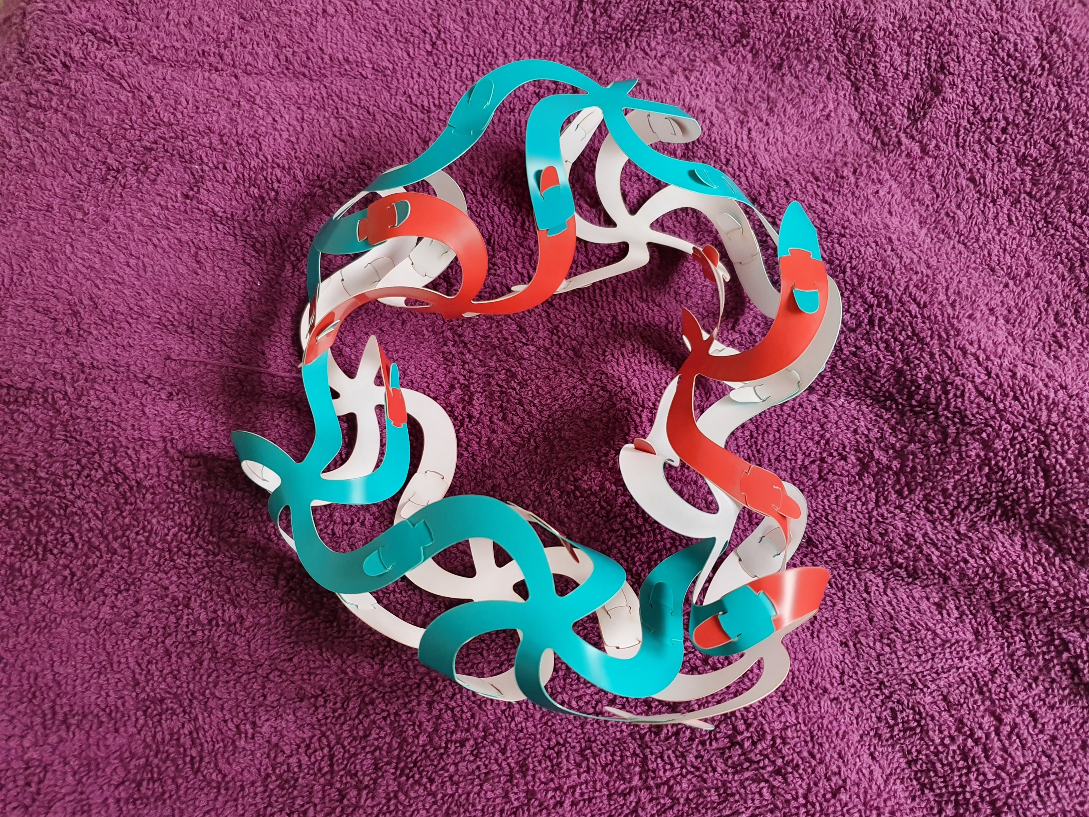
Mobius Strip
Notes:
Mobius Strip

Slide 8
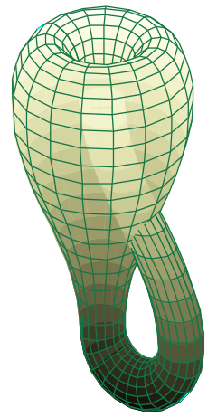
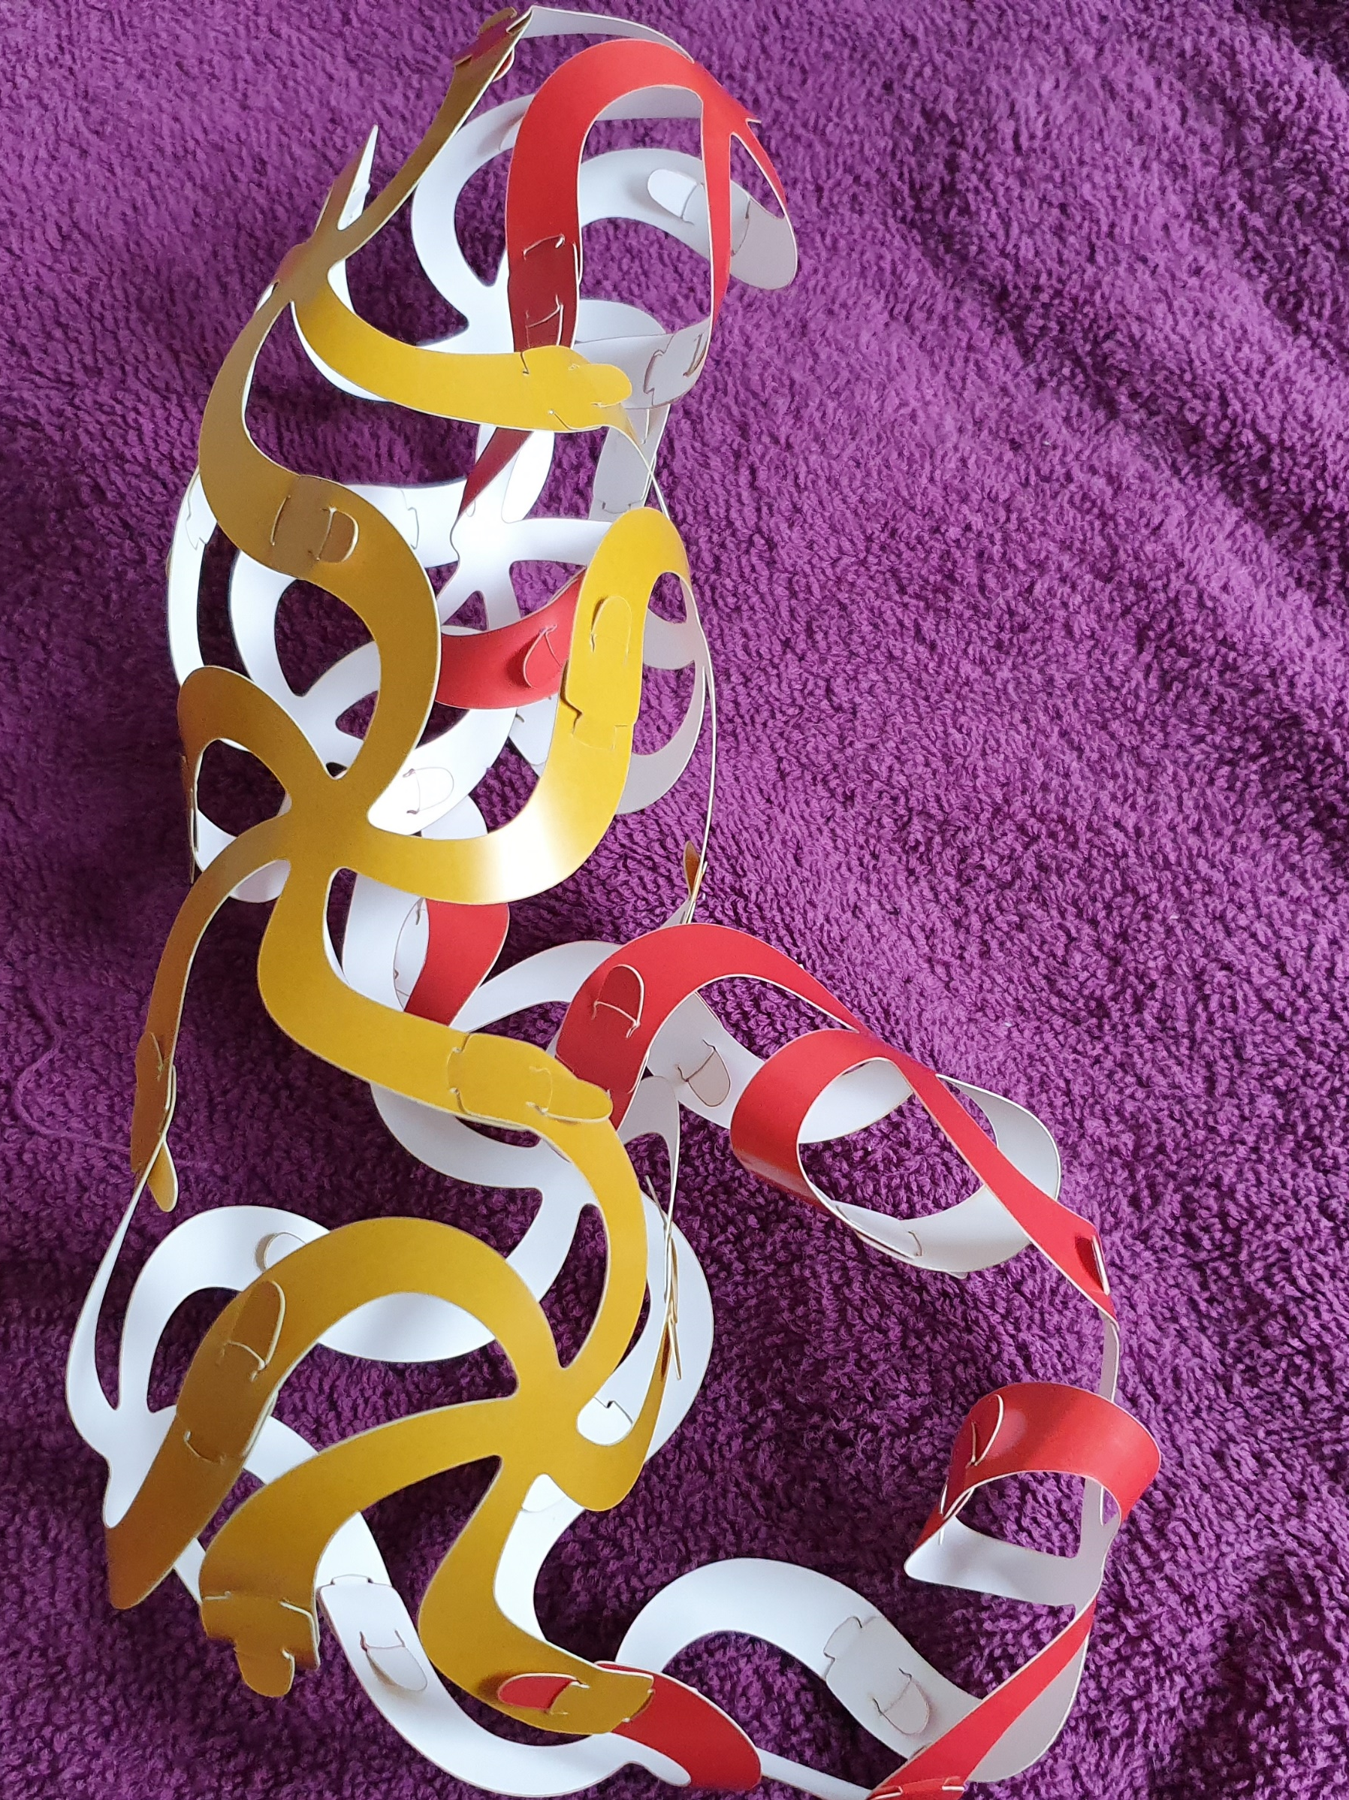
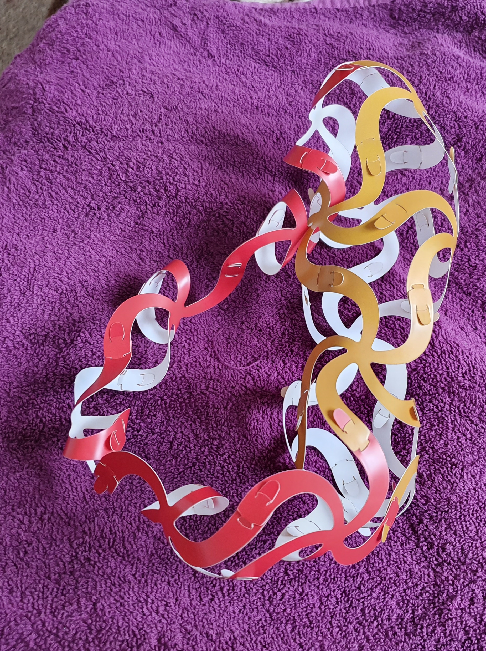
Klein Bottle
Notes:
Klein Bottle… oops wrong picture!

Slide 9
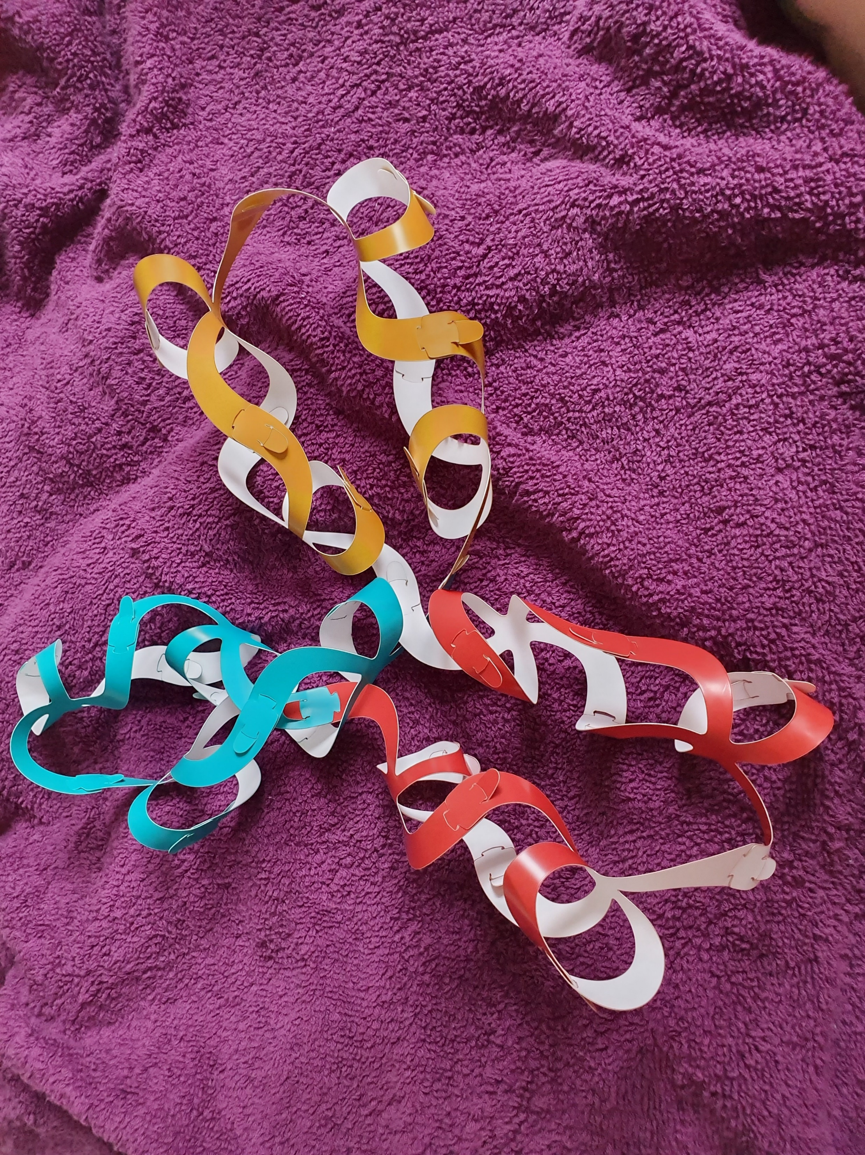
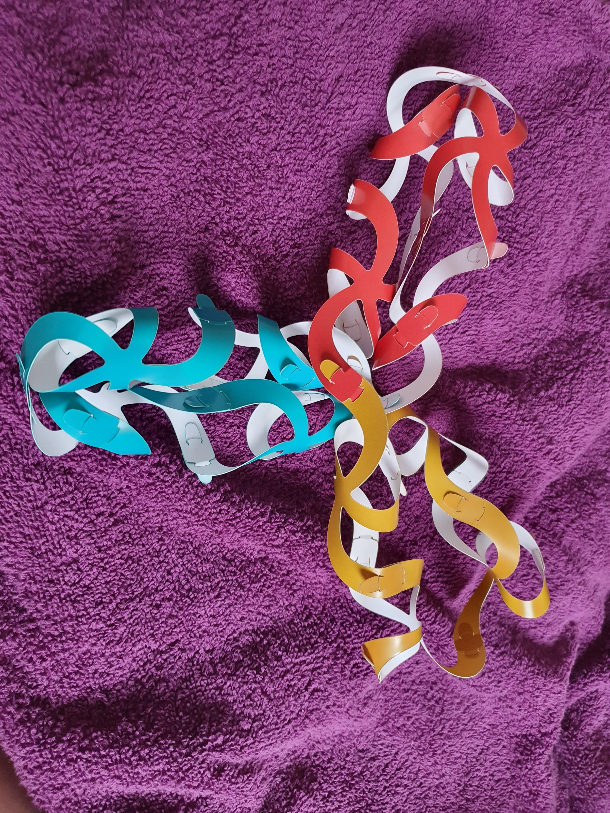
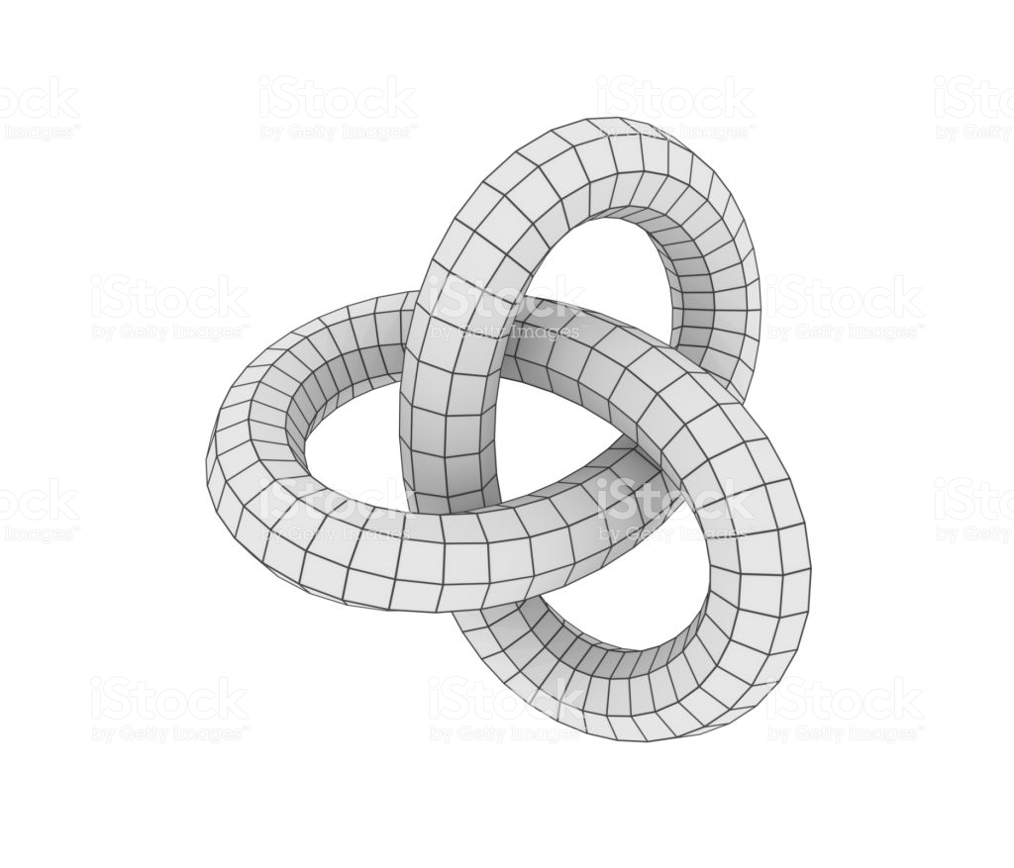
Trefoil Knot
Notes:
Trefoil knot

Slide 10
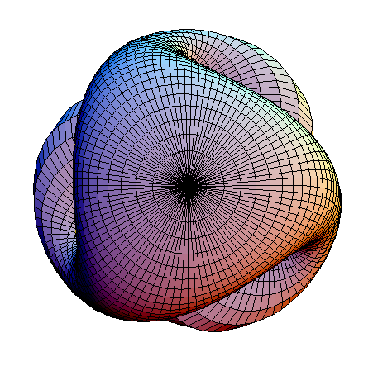
What’s Next?
Boy’s Surface…. A bit tricky. Can you help?
If you make something cool with Curvahedra this weekend, please either find and show me or tweet me a picture! - @theclairodactyl

