Slide 1
Chinese TakeAway
Subtraction

Slide 2

Subtraction distractions

Slide 3
Borrow & pay-back ‘Milk bottle’ method
 | 5 | 0 | 0 | 0
- | 1 | 2 | 5 | 8
Notes:
Borrowing & pay-back (aka milk bottle method) was the prevalent method taught in 1950s and 60s.

Slide 4
Borrowing ‘Milk bottle’ method
 | 5 | 0 | 0 | 0
- | 1 | 2 | 5 | 8
1
Notes:
Cannot subtract 8 from 0 so need to ‘borrow’ 1 ten (from tens column)

Slide 5
Borrowing method
 | 5 | 0 | 0 | 0
- | 1 | 2 | 5 | 8
 |  |  |  | 2
1
Notes:
Subtract 8 from 10 gives 2

Slide 6
Borrowing method
 | 5 | 0 | 0 | 0
- | 1 | 2 | 5 | 8
 |  |  |  | 2
1
1
Notes:
Need to ‘payback’ the borrowed ten (on the lower line next to 5)
The ‘paid-back’ 1 (ten) looks like the milk bottles left on the door-step every morning, hence the alternative name!
So now need to subtract 6 (5 + 1) from zero!

Slide 7
Borrowing method
 | 5 | 0 | 0 | 0
- | 1 | 2 | 5 | 8
 |  |  |  | 2
1
1
1
Notes:
Cannot subtract 6 from zero so need to ‘borrow’ 1 (hundred)
So calculation becomes subtract 6 from 10 (i.e. 60 from 100) = 4

Slide 8
Borrowing method
 | 5 | 0 | 0 | 0
- | 1 | 2 | 5 | 8
 |  |  | 4 | 2
1
1
1
Notes:
Subtracting 6 from 10 = 4

Slide 9
Borrowing method
 | 5 | 0 | 0 | 0
- | 1 | 2 | 5 | 8
 |  |  | 4 | 2
1
1
1
1
Notes:
Need to ‘pay back’ the borrowed 1 (hundred)
Bur cannot subtract 3 from zero

Slide 10
Borrowing method
 | 5 | 0 | 0 | 0
- | 1 | 2 | 5 | 8
 |  |  | 4 | 2
1
1
1
1
1
Notes:
Need to ‘borrow’ 1 (i.e. 1 thousand)
So we can subtract 3 from 10 (subtract 300 from ten hundred (1000))

Slide 11
Borrowing method
 | 5 | 0 | 0 | 0
- | 1 | 2 | 5 | 8
 |  | 7 | 4 | 2
1
1
1
1
1
Notes:
3 subtracted from 10 = 7 (hundreds)

Slide 12
Borrowing method
 | 5 | 0 | 0 | 0
- | 1 | 2 | 5 | 8
 |  | 7 | 4 | 2
1
1
1
1
1
1

Slide 13
Borrowing method
 | 5 | 0 | 0 | 0
- | 1 | 2 | 5 | 8
 | 3 | 7 | 4 | 2
1
1
1
1
1
1
Notes:
Need to pay-back the 10 borrowed (in hundreds column)
So now subtracting 2 from 5 in thousands column

Slide 14
Borrow & pay-back ‘Milk bottle’ method
 | 5 | 0 | 0 | 0
- | 1 | 2 | 5 | 8
 | 3 | 7 | 4 | 2
1
1
1
1
1
1

Slide 15
Decomposition Method
 | 5 | 0 | 0 | 0
- | 1 | 2 | 5 | 8
Notes:
Alternative method which my daughters were all taught (they are in their 30s-40s now!)

Slide 16
Decomposition Method
 | 5 | 0 | 0 | 0
- | 1 | 2 | 5 | 8
?
Notes:
Need to subtract 8 from zero units, can we ‘borrow from tens?

Slide 17
Decomposition Method
 | 5 | 0 | 0 | 0
- | 1 | 2 | 5 | 8
?
?
Notes:
Cannot borrow from zero tens! – Can we borrow from hundreds?

Slide 18
Decomposition Method
 | 5 | 0 | 0 | 0
- | 1 | 2 | 5 | 8
?
?
?
Notes:
No hundreds from which to borrow!! Let’s try thousands?!

Slide 19
Decomposition Method
 | 5 | 0 | 0 | 0
- | 1 | 2 | 5 | 8
4
1
Notes:
Yes - we can – by decomposing 5000 to 4000 + ten hundred!

Slide 20
Decomposition Method
9
 | 5 | 0 | 0 | 0
- | 1 | 2 | 5 | 8
4
1
1
Notes:
Then decompose Ten hundred as ten hundred = 1000 = 900 + ten tens (100)

Slide 21
Decomposition Method
9
9
 | 5 | 0 | 0 | 0
- | 1 | 2 | 5 | 8
4
1
1
1
Notes:
Ten tens = 100, need to decompose to 90 + ten units

Slide 22
Decomposition Method
9
9
 | 5 | 0 | 0 | 0
- | 1 | 2 | 5 | 8
 |  |  |  | 2
4
1
1
1
Notes:
At last – we can subtract!! 10 – 8 = 2; so units sorted!!

Slide 23
Decomposition Method
9
9
 | 5 | 0 | 0 | 0
- | 1 | 2 | 5 | 8
 |  |  | 4 | 2
4
1
1
1
Notes:
9 – 5 = 4 tens

Slide 24
Decomposition Method
9
9
 | 5 | 0 | 0 | 0
- | 1 | 2 | 5 | 8
 |  | 7 | 4 | 2
4
1
1
1
Notes:
9 – 2 = 7 hundreds

Slide 25
Decomposition Method
9
9
 | 5 | 0 | 0 | 0
- | 1 | 2 | 5 | 8
 | 3 | 7 | 4 | 2
4
1
1
1
Notes:
4 – 1 = 3 thousands

Slide 26
Decomposition updated?
9
9
4 9 9 1
 | 5 | 0 | 0 | 0
- | 1 | 2 | 5 | 8
 | 3 | 7 | 4 | 2
 | 5 | 0 | 0 | 0
- | 1 | 2 | 5 | 8
 | 3 | 7 | 4 | 2
4
1
1
1
Notes:
I believe the ‘decomposition’ method was introduced in late1960-70s as it enabled students to utilise & apply the underlying Mathematical principles.
However my 10 year old granddaughter informed me recently that her teacher has given them a shorthand which makes it easier!!
Ironically I suspect the ‘pay-back’ method was a shorthand which went out of favour?!

Slide 27
Decomposition Borrowing
9
9
 | 5 | 0 | 0 | 0
- | 1 | 2 | 5 | 8
 | 3 | 7 | 4 | 2
 | 5 | 0 | 0 | 0
- | 1 | 2 | 5 | 8
 | 3 | 7 | 4 | 2
1
1
1
4
1
1
1
1
1
1
Notes:
Both methods gain the same solution! (Fortunately!)
We’ve been wondering which technique is the most ‘common’ in the UK?
So we would like to do a quick show of hands! About which technique did you learn in school! (or if you cannot recall – which are you most familiar with!)

Slide 28
Invisible number line
 | 5 | 0 | 0 | 0
- | 1 | 2 | 5 | 8
Effectively changing subtraction
into addition
1258

Slide 29
Invisible number line
 | 5 | 0 | 0 | 0
- | 1 | 2 | 5 | 8
Effectively changing subtraction
into addition
1258
1260
+2

Slide 30
Invisible number line
 | 5 | 0 | 0 | 0
- | 1 | 2 | 5 | 8
Effectively changing subtraction
into addition
1258
1260
1300
+2
+40

Slide 31
Invisible number line
 | 5 | 0 | 0 | 0
- | 1 | 2 | 5 | 8
Effectively changing subtraction
into addition
1258
1260
1300
2000
+2
+40
+700

Slide 32
Invisible number line
 | 5 | 0 | 0 | 0
- | 1 | 2 | 5 | 8
Effectively changing subtraction
into addition
1258
1260
1300
2000
5000
+2
+40
+700
+3000

Slide 33
Invisible number line
 | 5 | 0 | 0 | 0
- | 1 | 2 | 5 | 8
Effectively changing subtraction
into addition
1258
1260
1300
2000
5000
+2
+40
+700
+3000
Answer: 3742

Slide 34
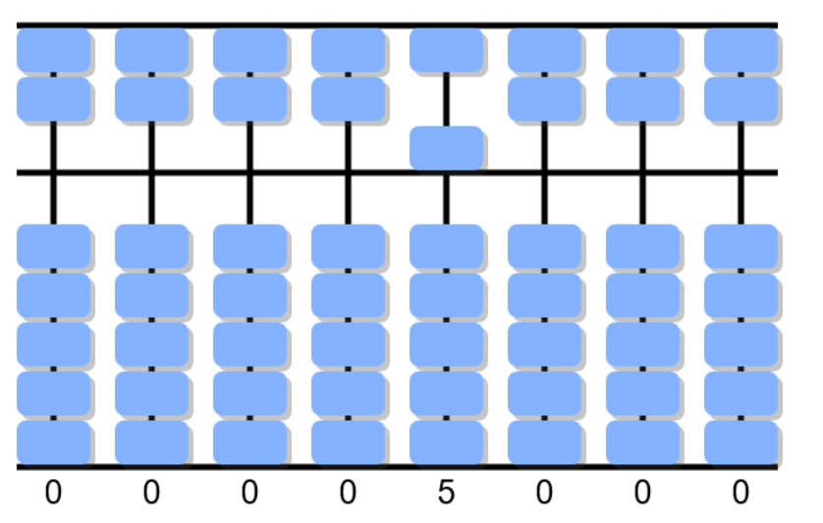
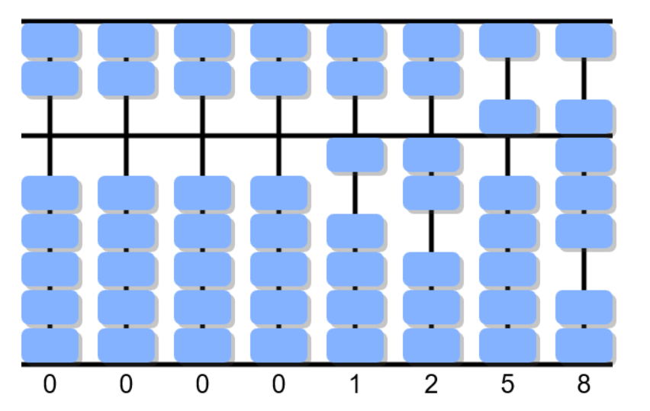
Chinese Takeaways
 | 5 | 0 | 0 | 0
- | 1 | 2 | 5 | 8

Slide 35
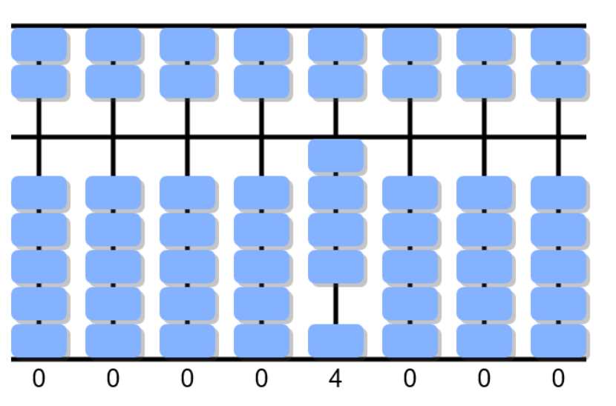
Chinese Takeaways
 | 5 | 0 | 0 | 0
- | 1 | 2 | 5 | 8
 | 4

Slide 36
Chinese Takeaways
 | 5 | 0 | 0 | 0
- | 1 | 2 | 5 | 8
 | 4

Slide 37
Chinese Takeaways
 | 5 | 0 | 0 | 0
- | 1 | 2 | 5 | 8
 | 4
3

Slide 38
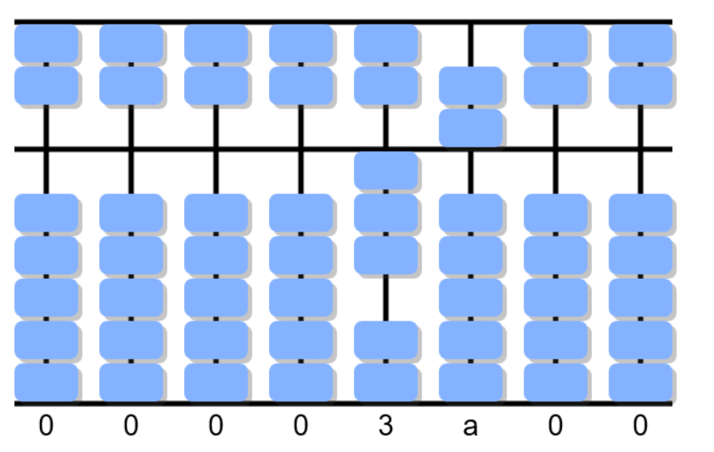
Chinese Takeaways
1
 | 5 | 0 | 0 | 0
- | 1 | 2 | 5 | 8
 | 4
3

Slide 39
Chinese Takeaways
1
 | 5 | 0 | 0 | 0
- | 1 | 2 | 5 | 8
 | 4
3

Slide 40
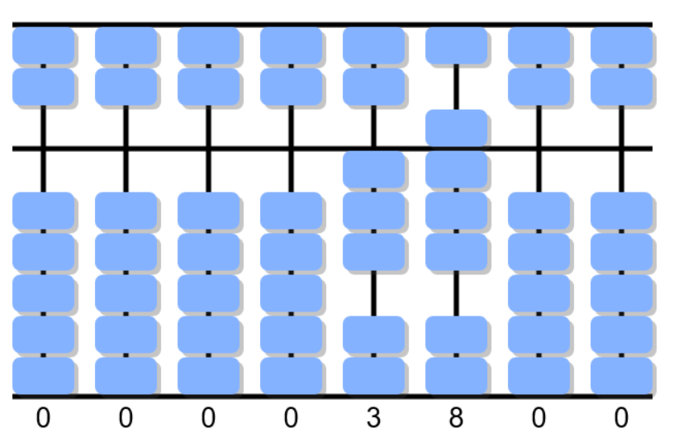
Chinese Takeaways
1
 | 5 | 0 | 0 | 0
- | 1 | 2 | 5 | 8
 | 4 | 8
3

Slide 41
Chinese Takeaways
1
1
 | 5 | 0 | 0 | 0
- | 1 | 2 | 5 | 8
 | 4 | 8
3
7

Slide 42
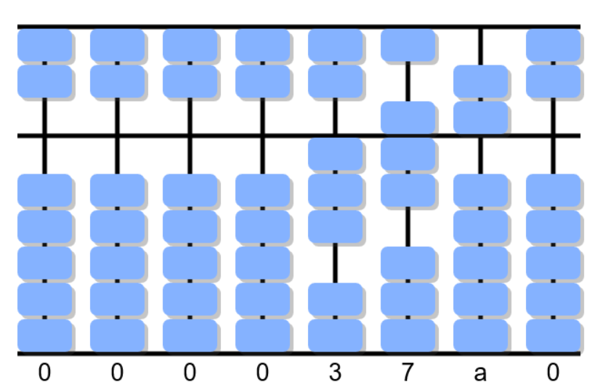
Chinese Takeaways
1
1
 | 5 | 0 | 0 | 0
- | 1 | 2 | 5 | 8
 | 4 | 8
3
7

Slide 43
Chinese Takeaways
1
1
 | 5 | 0 | 0 | 0
- | 1 | 2 | 5 | 8
 | 4 | 8
3
7

Slide 44

Chinese Takeaways
1
1
 | 5 | 0 | 0 | 0
- | 1 | 2 | 5 | 8
 | 4 | 8 | 5
3
7

Slide 45
Chinese Takeaways
1
1
 | 5 | 0 | 0 | 0
- | 1 | 2 | 5 | 8
 | 4 | 8 | 5
3
7

Slide 46
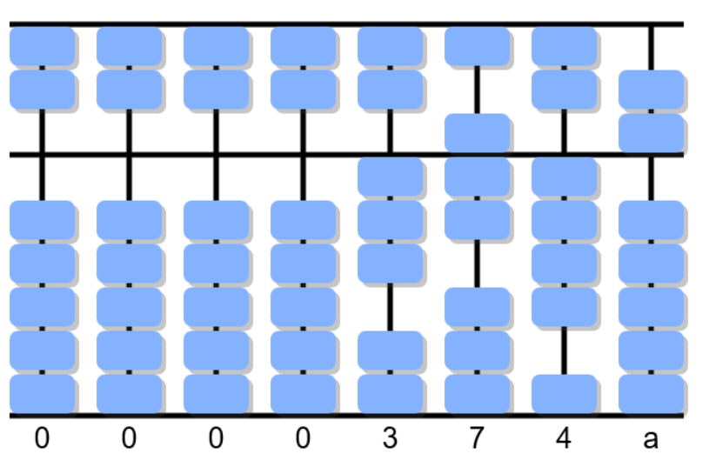
Chinese Takeaways
1
1
1
 | 5 | 0 | 0 | 0
- | 1 | 2 | 5 | 8
 | 4 | 8 | 5
3
7
4

Slide 47
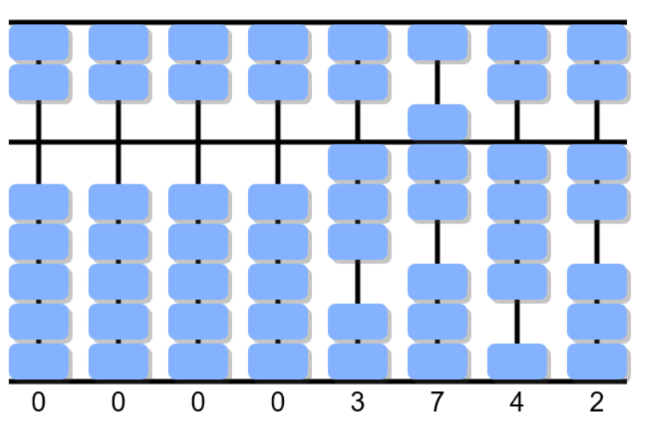
Chinese Takeaways
1
1
1
 | 5 | 0 | 0 | 0
- | 1 | 2 | 5 | 8
 | 4 | 8 | 5 | 2
3
7
4

Slide 48
Chinese Takeaways
1
1
1
 | 5 | 0 | 0 | 0
- | 1 | 2 | 5 | 8
 | 4 | 8 | 5 | 2
3
7
4
Some of the ‘ease’ in Chinese Takeaways is lost in translation
-8 = -10 + 2

Slide 49
Borrow and pay-back
Decomposition
Invisible Number line
Chinese Abacus
Please let me know of any other ‘pupil-proof’ subtraction methods?

Slide 50
Subtractions
Elaine.ep.Smith@gmail.com

