Slide 1
How many are in a few?
Eva Lesny
Annual Mathsjam Conference 2019

Slide 2
How I found out how many are in a few – and other expressions
Google Survey with 31 expressions like „a few“, „about half“ or „many“
69 answers – hopefully from different people
Using Tableau public to plot results
 | Female | Male | Other / non binary / - | Sum
<29 | 13 | 10 | 3 | 25
30-39 | 6 | 7 | 1 | 14
40-49 | 8 | 5 | 1 | 14
50+ | 8 | 6 |  | 14
- |  |  | 1 | 1
Sum | 35 | 27 | 6 | 69

Slide 3
What I learned

Slide 4
A few people would have prefered ranges*
The whole point of “a few” is that it’s vague, so it was really tough for me to pick a single number! (…) It almost hurt to have to choose.
I think I’d have liked a ‘what is the maximum that this could be?’ and ‘what’s the minimum it could be?’
I can't do this. These vague terms exist because they do a different job to numbers, so just to equate them to one number is not true to how they're used.
For me, several doesn’t really have a specific number, it’s just ‘several’…
My friend and me say we need ranges to answer this**
* Quotes from replies to my twitter post regarding the poll
** Except this one

Slide 5
People love their 0s and 5s

Slide 6
The results

Slide 7
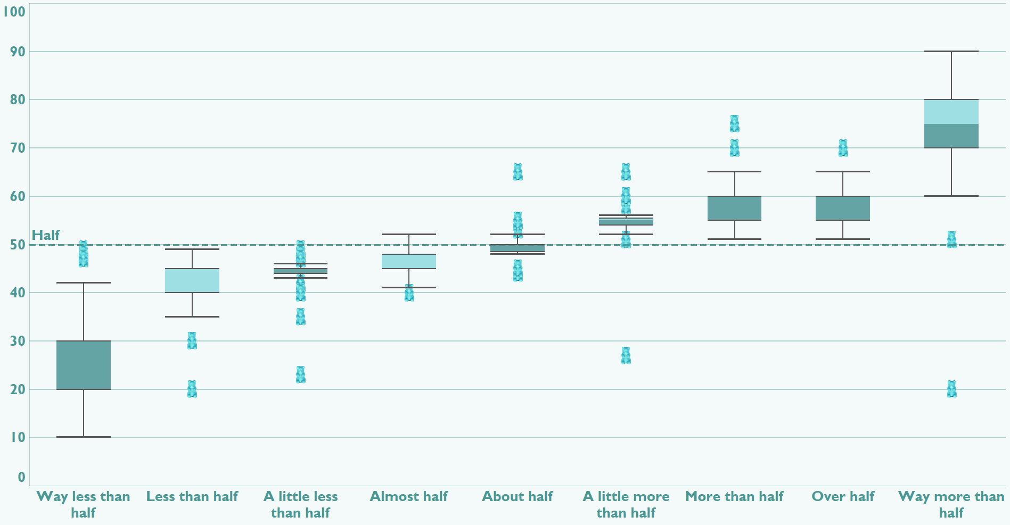
All the gummy bears – or well, half of them

Slide 8
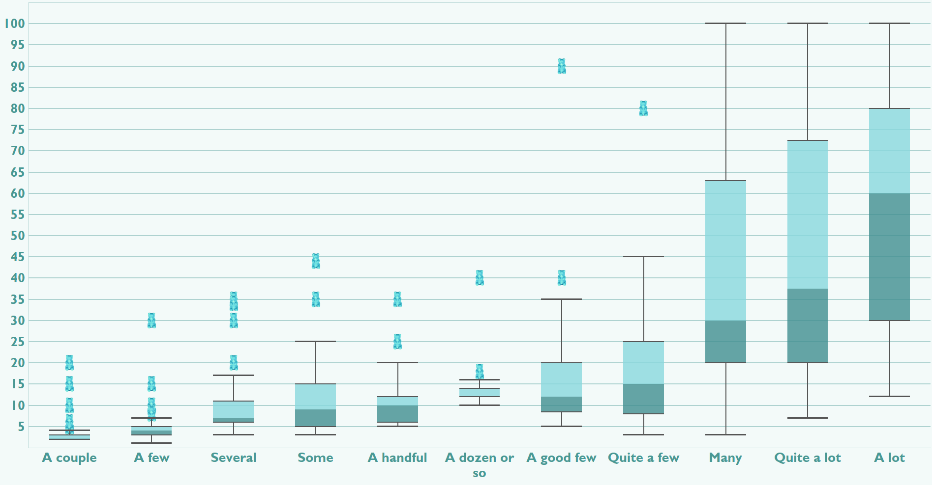
Some more expressions

Slide 9
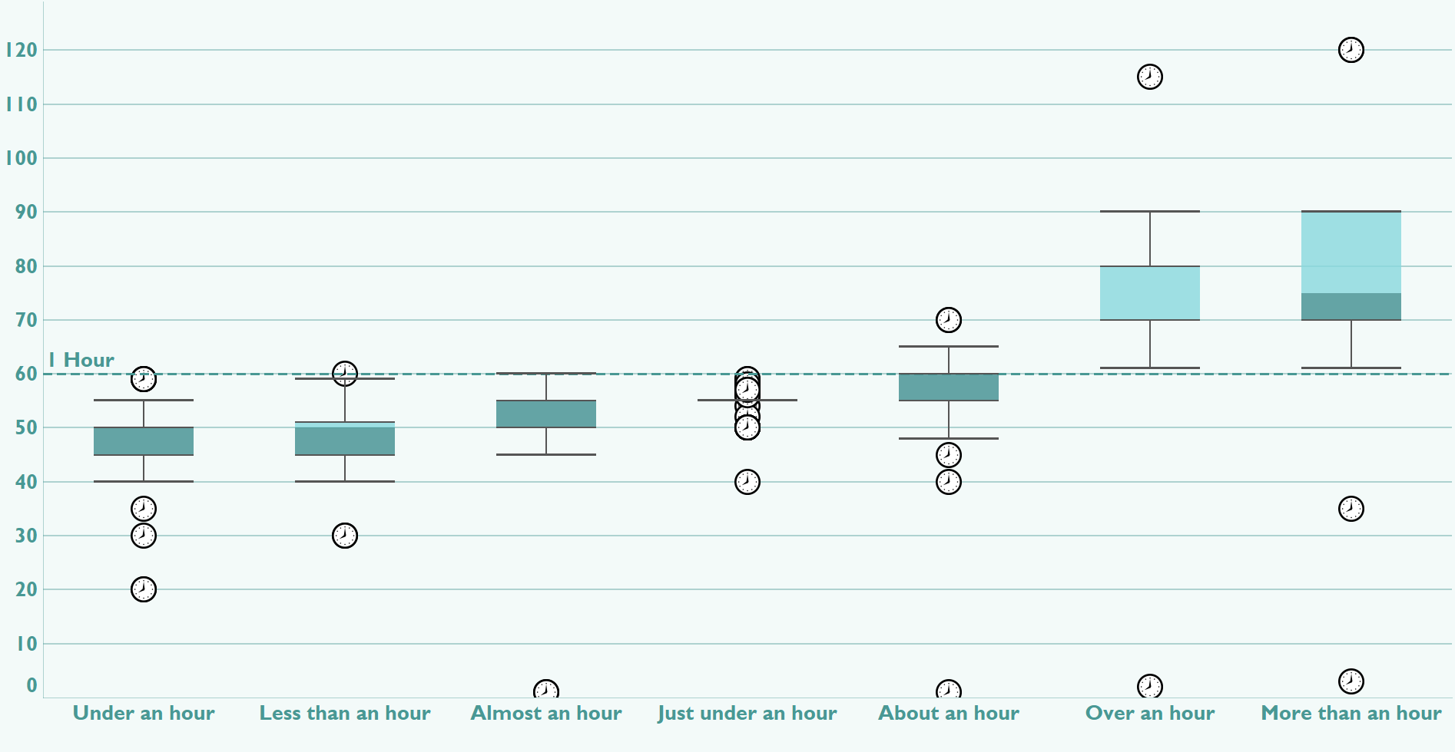
Just under an hour is 55 min

Slide 10
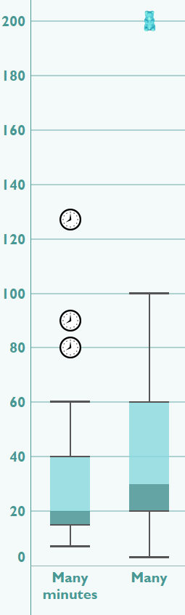
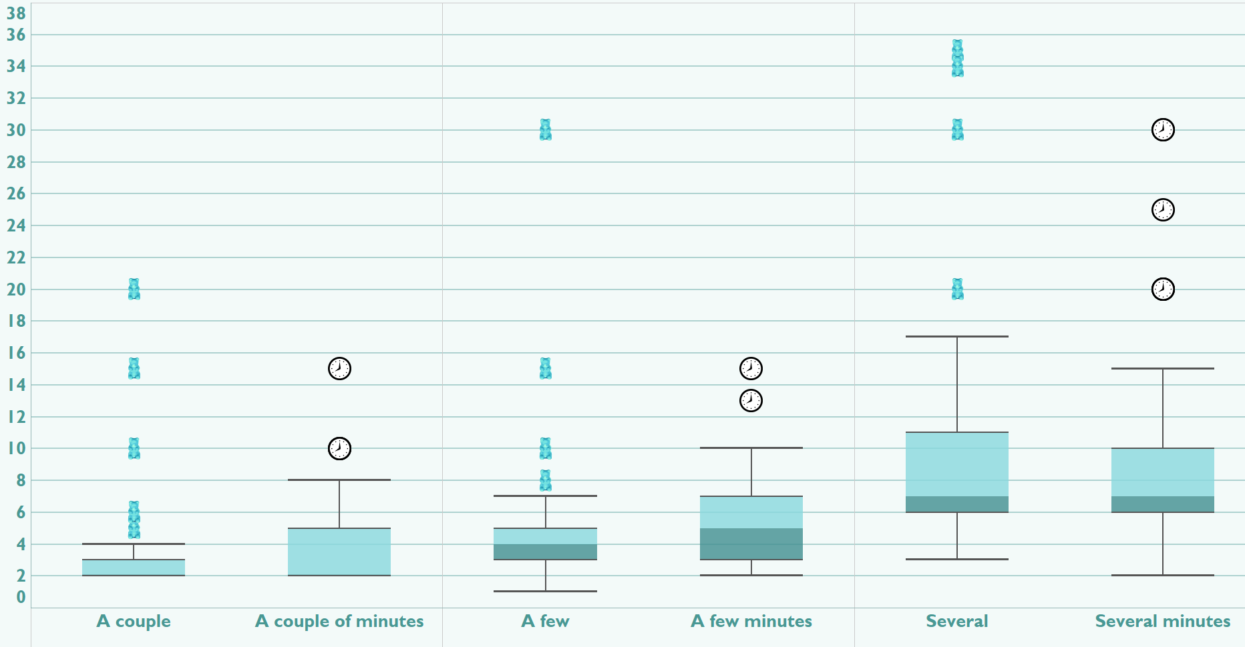
How many “x gummy bears" can you eat in “x minutes"? All of them of course

Slide 11
So how many are in a few?
 | A few Gummy bears | A few minutes
Min. Value | 1 | 2
Median Value | 4 | 5
Avg. Value | 5.07 | 5.33
Max. Value | 30 | 15

Slide 12
Thanks!
Respond to the survey: https://forms.gle/fCSwjDoczJtVryVP9
Check out the results from the slides yourself: https://public.tableau.com/profile/fenneklyra#!/vizhome/Howmanyareinafew/Thecrowd

