Slide 1
As far as I can remember no-one has talked about them before.
Firstly, although I do come back to the title, I should declare it’s just a little intrigue to draw you in.
I just wanted to talk about Prüfer sequences.
HOW TO AVOID A HANGOVER USING MATHS
This is because Graph Theory was one on my favourite subjects in maths at university.
They seemed like a neat little thing for a MathsJam talk.

Slide 2
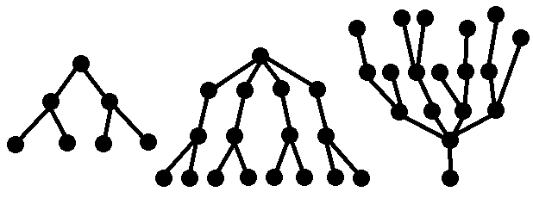
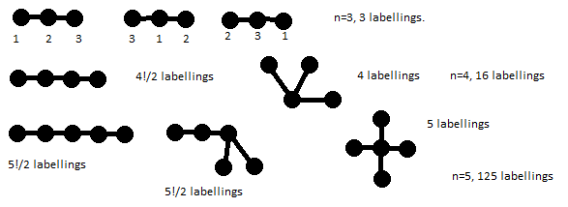
Definitions:
A tree is a simple connected graph with no circuits.
A labelled tree is a tree with a label attached to each vertex.
Notes:
Two labelled trees are the same if there is a bijection between the vertices, preserving the edges and the labelling.
Many more labelled trees than there are trees – for n vertices (top row), #trees, and #labelled trees grow as:
1,2,3,4,5,6,7,8
1,1,1,2,3,6,11,23,47,106
1,1,3,16,125,1296,16807,262144….

Slide 3
Theorem (Cayley, 1889):
There are n^{n-2} labelled trees with n vertices.
There are several proofs of this, but we’re going to look at a nice easy one due to
Heinz Prüfer, (1896-1934).

Slide 4
Prüfer assigned a sequence to a labelled tree using the following rule:
Look at the ‘ends’ and choose the one with the smallest label.
Put the label of the adjacent vertex as the first/next, number in the sequence.
Remove the end already used and repeat the process until there are two vertices left.

Slide 5
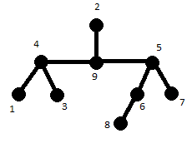
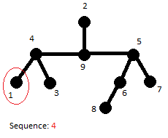
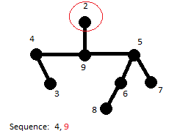
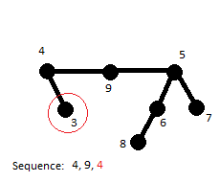
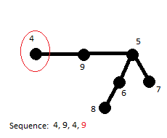
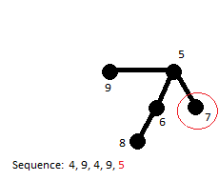
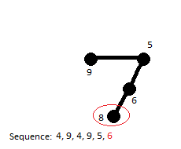
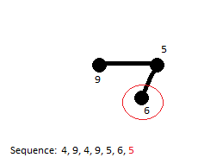
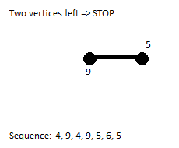
1) Look at the ‘ends’ and choose the one with the smallest label.
2) Put the label of the adjacent vertex as the first/(next) number in the sequence.
3) Remove the end already used and repeat the process until there are two vertices left.

Slide 6
In general, a labelled tree gives a unique sequence, (of length n-2 on the labels 1-n).
Since there are n^{n-2} such sequences, then provided we can show there is a 1-1 correspondence between Prüfer sequences and labelled trees, we will have proven Cayley’s theorem.
Notes:
A labelled tree gives a unique sequence: Every tree has at least two nodes of index 1 (leaf nodes). The node v which is adjacent to the lowest labelled leaf is uniquely determined. When this is taken as the first element of the sequence and deleted, the same may be said of the remaining tree.

Slide 7
Draw the n vertices and label them 1,2…,n.
Write down a list of the labels 1,2…,n. Write down the sequence.
Find the smallest number, k, not in the Prüfer sequence. Join this vertex to the first element in the sequence.
Remove k from the list and delete the first element of the sequence.
Repeat from 3. until the list has just two elements. Join them.

Slide 8
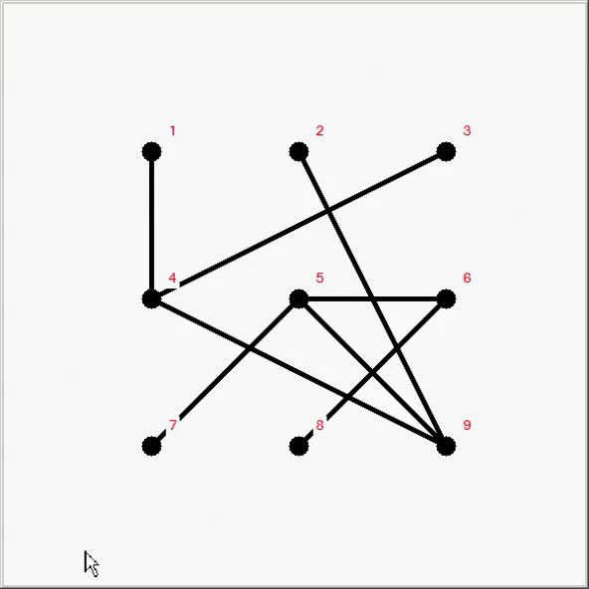
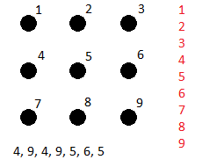
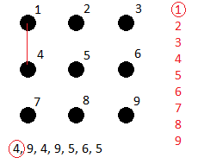
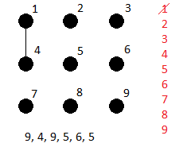
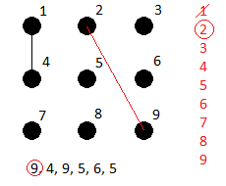
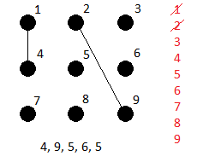
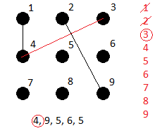
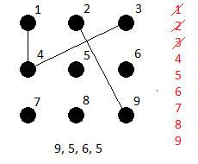
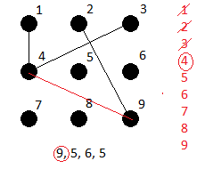
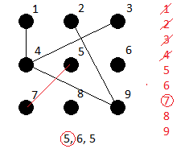
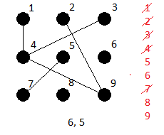
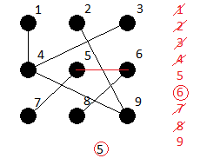
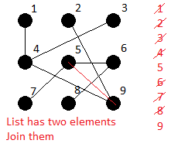
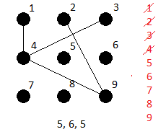
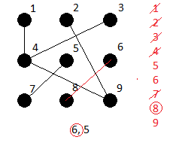
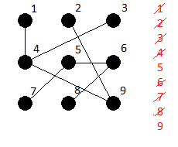
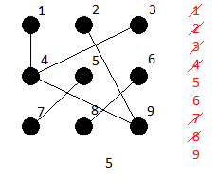
1)Draw the n vertices and label them 1,2…,n.
2)Write down a list of the labels 1,2…,n.
3)Find the smallest number, k, not in the Prüfer sequence. Join this vertex to the first element in the sequence.
4)Remove k from the list and delete the first element of the sequence.
5)Repeat from 3) until the list has just two elements. Join them.

Slide 9

About Hangovers
Some drinks seem to cause worse hangovers than others. E.g. Brandy and red wine, worse than vodka.
Impurities in the alcohol, called “congeners” are thought to be a contributory factor.
(Ethyl) Alcohol is CH₃CH₂OH
It’s a saturated hydrocarbon. One of things Cayley was interested in was counting the number of saturated hydrocarbons.
Leave it as an “exercise to the reader” to continue his good work, focussing on the binding sites of the congeners.
Notes:
I’m not a chemist!
H for Hydrogen replaced by dots.
Saturated means no double Carbon bonds
Think the congeners hang onto the oxygen, but not sure.

