Slide 1
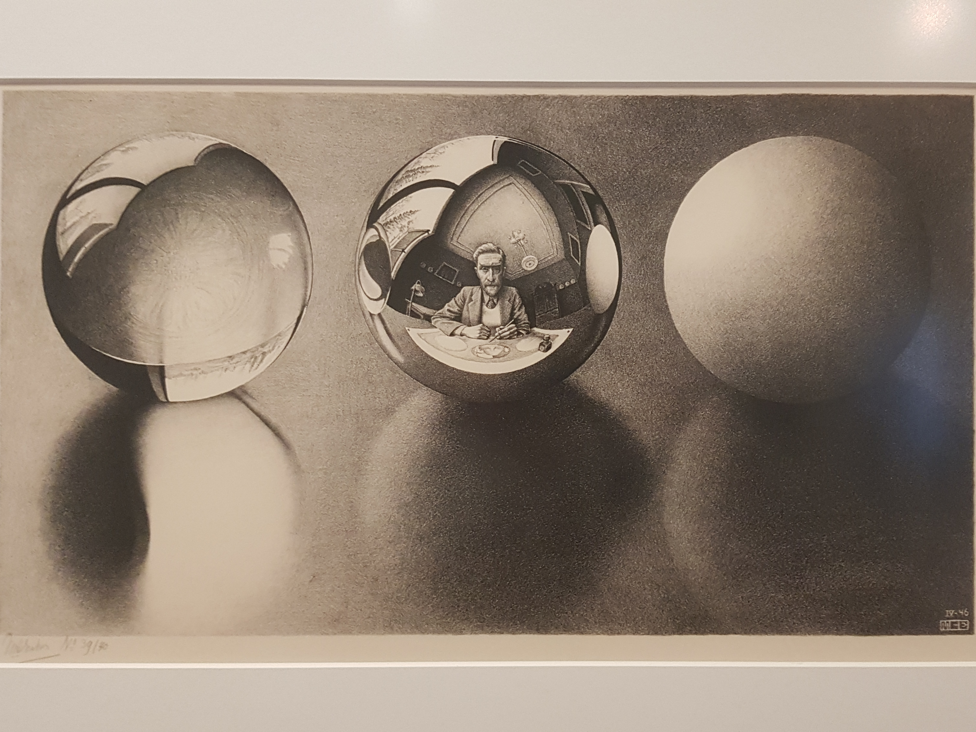
Escher in the Palace
(Escher in Het Paleis)
Notes:
Historic palace which houses Permanent exhibition of work of M.C. Escher in The Hague

Slide 2
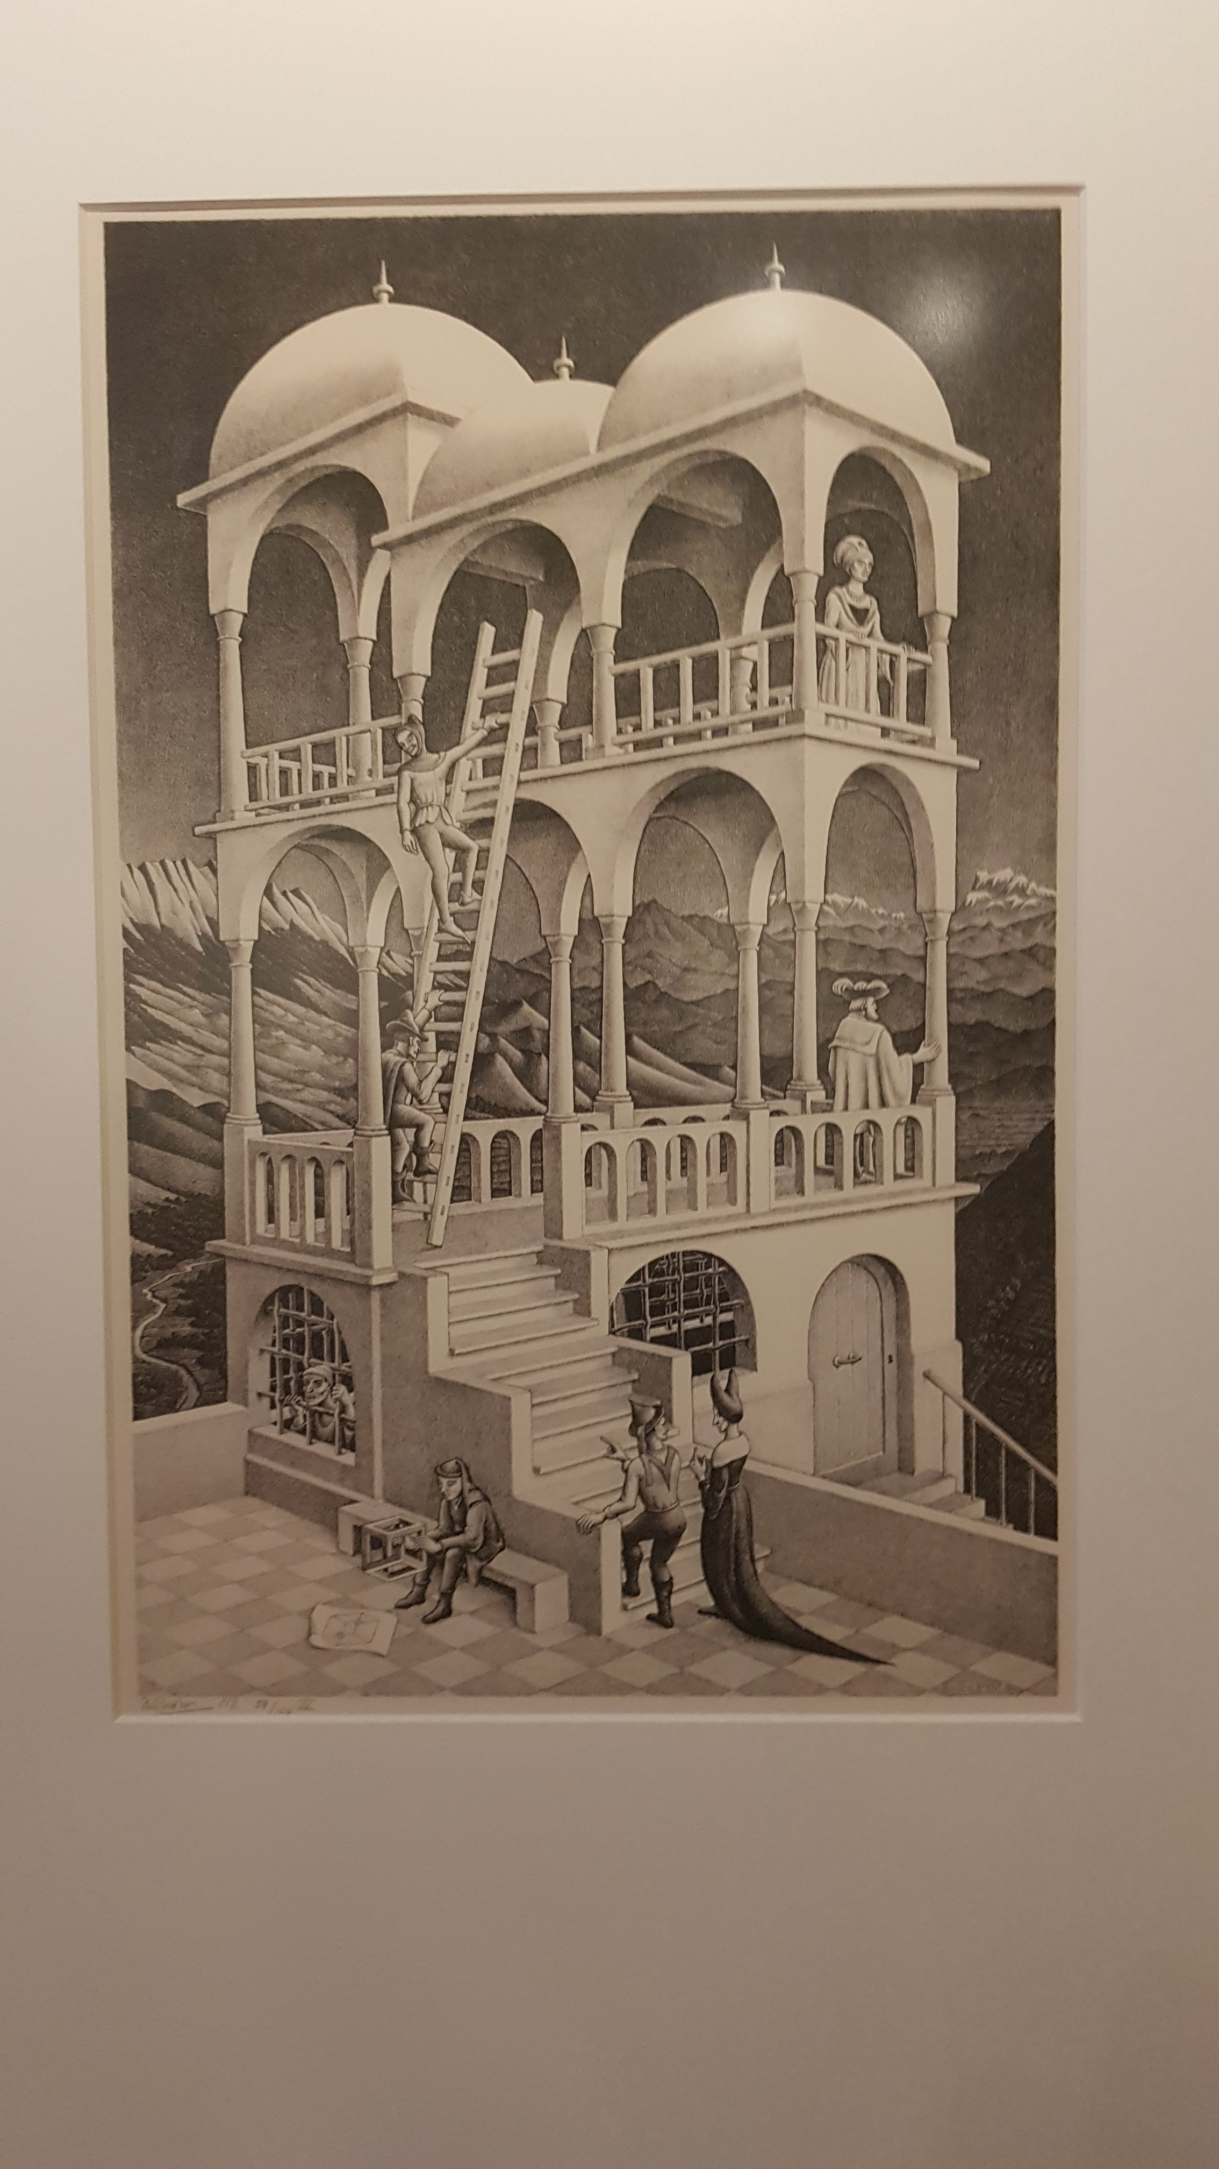
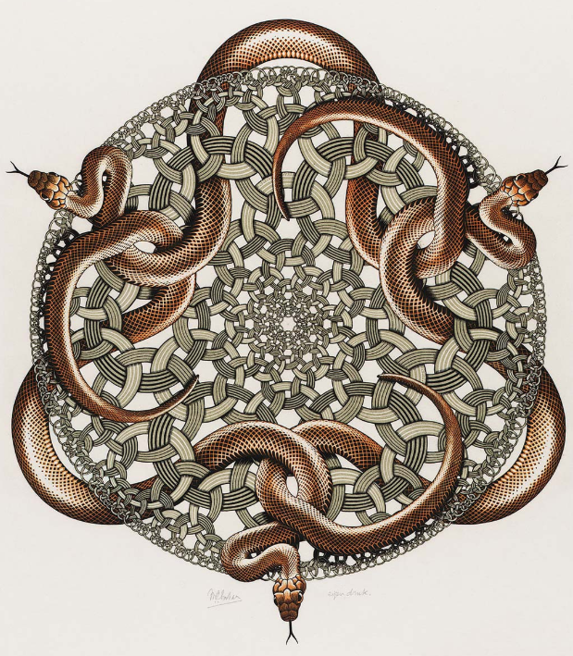
Maurits Cornelis Escher
Born 17 June 1898
Died 27 March 1972
Notes:
You might now Escher for his mathematically based works, inc tessalations & impossible objects

Slide 3



Did you know? Education
Secondary School
Maths
Art
Played in a String Quartet
Failed final exams
Higher Education
Started on Architecture
Failed first year…
New Uni
Started on Architecture
Graphic Art skills noticed…switches!
Notes:
“Instinctive mathematician” later in life. Loved playing with maths
Escher studies architecture (Dad’s advice) at the ‘Hogere Technische School’ in Delft. He doesn’t like it there and he doesn’t pass his exams, partly due to illness.
Escher attends the School for Architecture and Decorative Arts in Haarlem. He starts by studying architecture, but switches to graphic art, encouraged by his teacher, Samuel Jessurun de Mesquita.

Slide 4
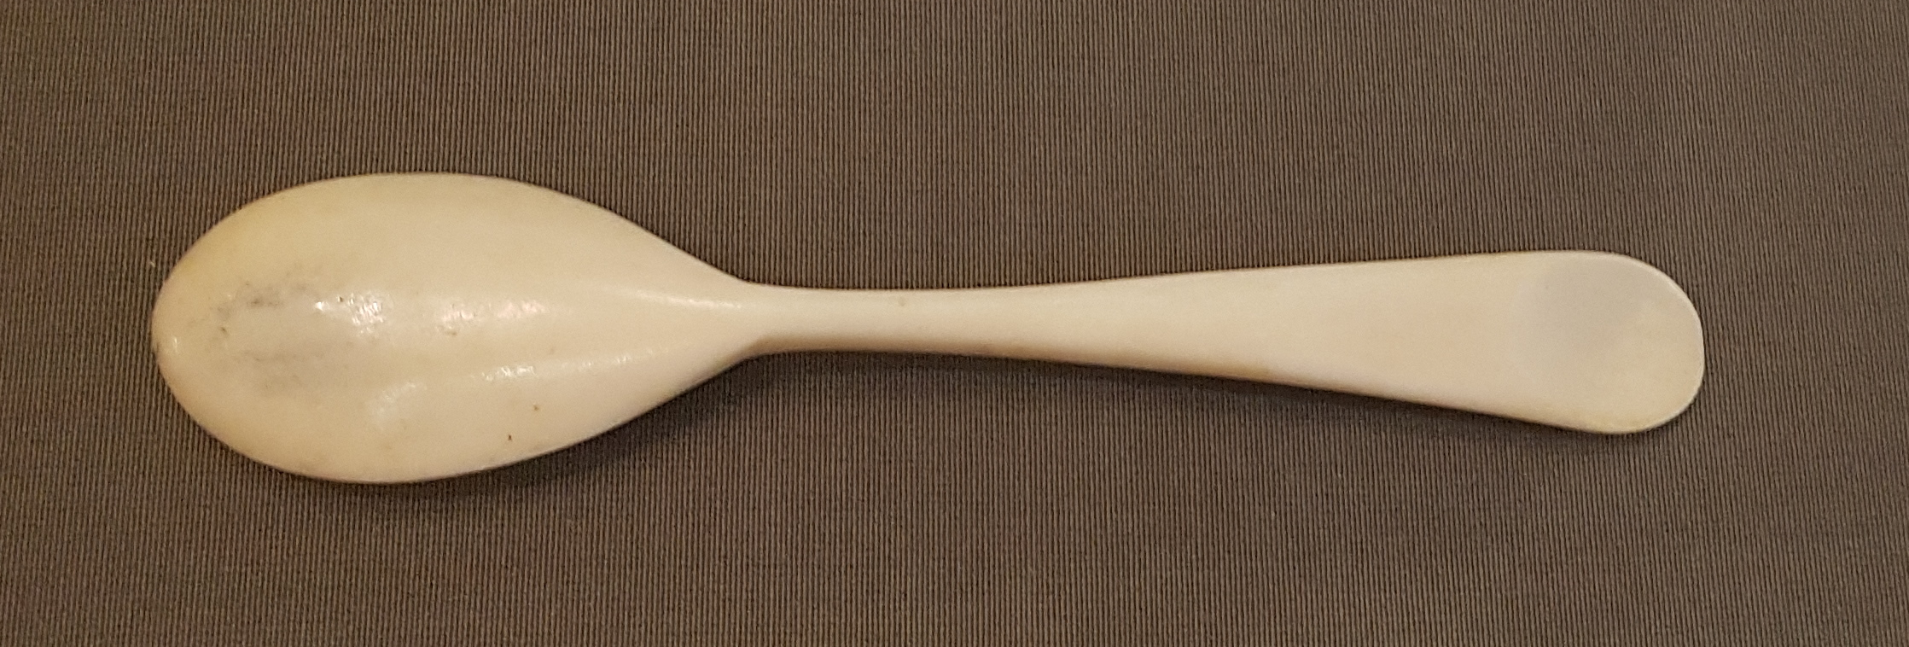
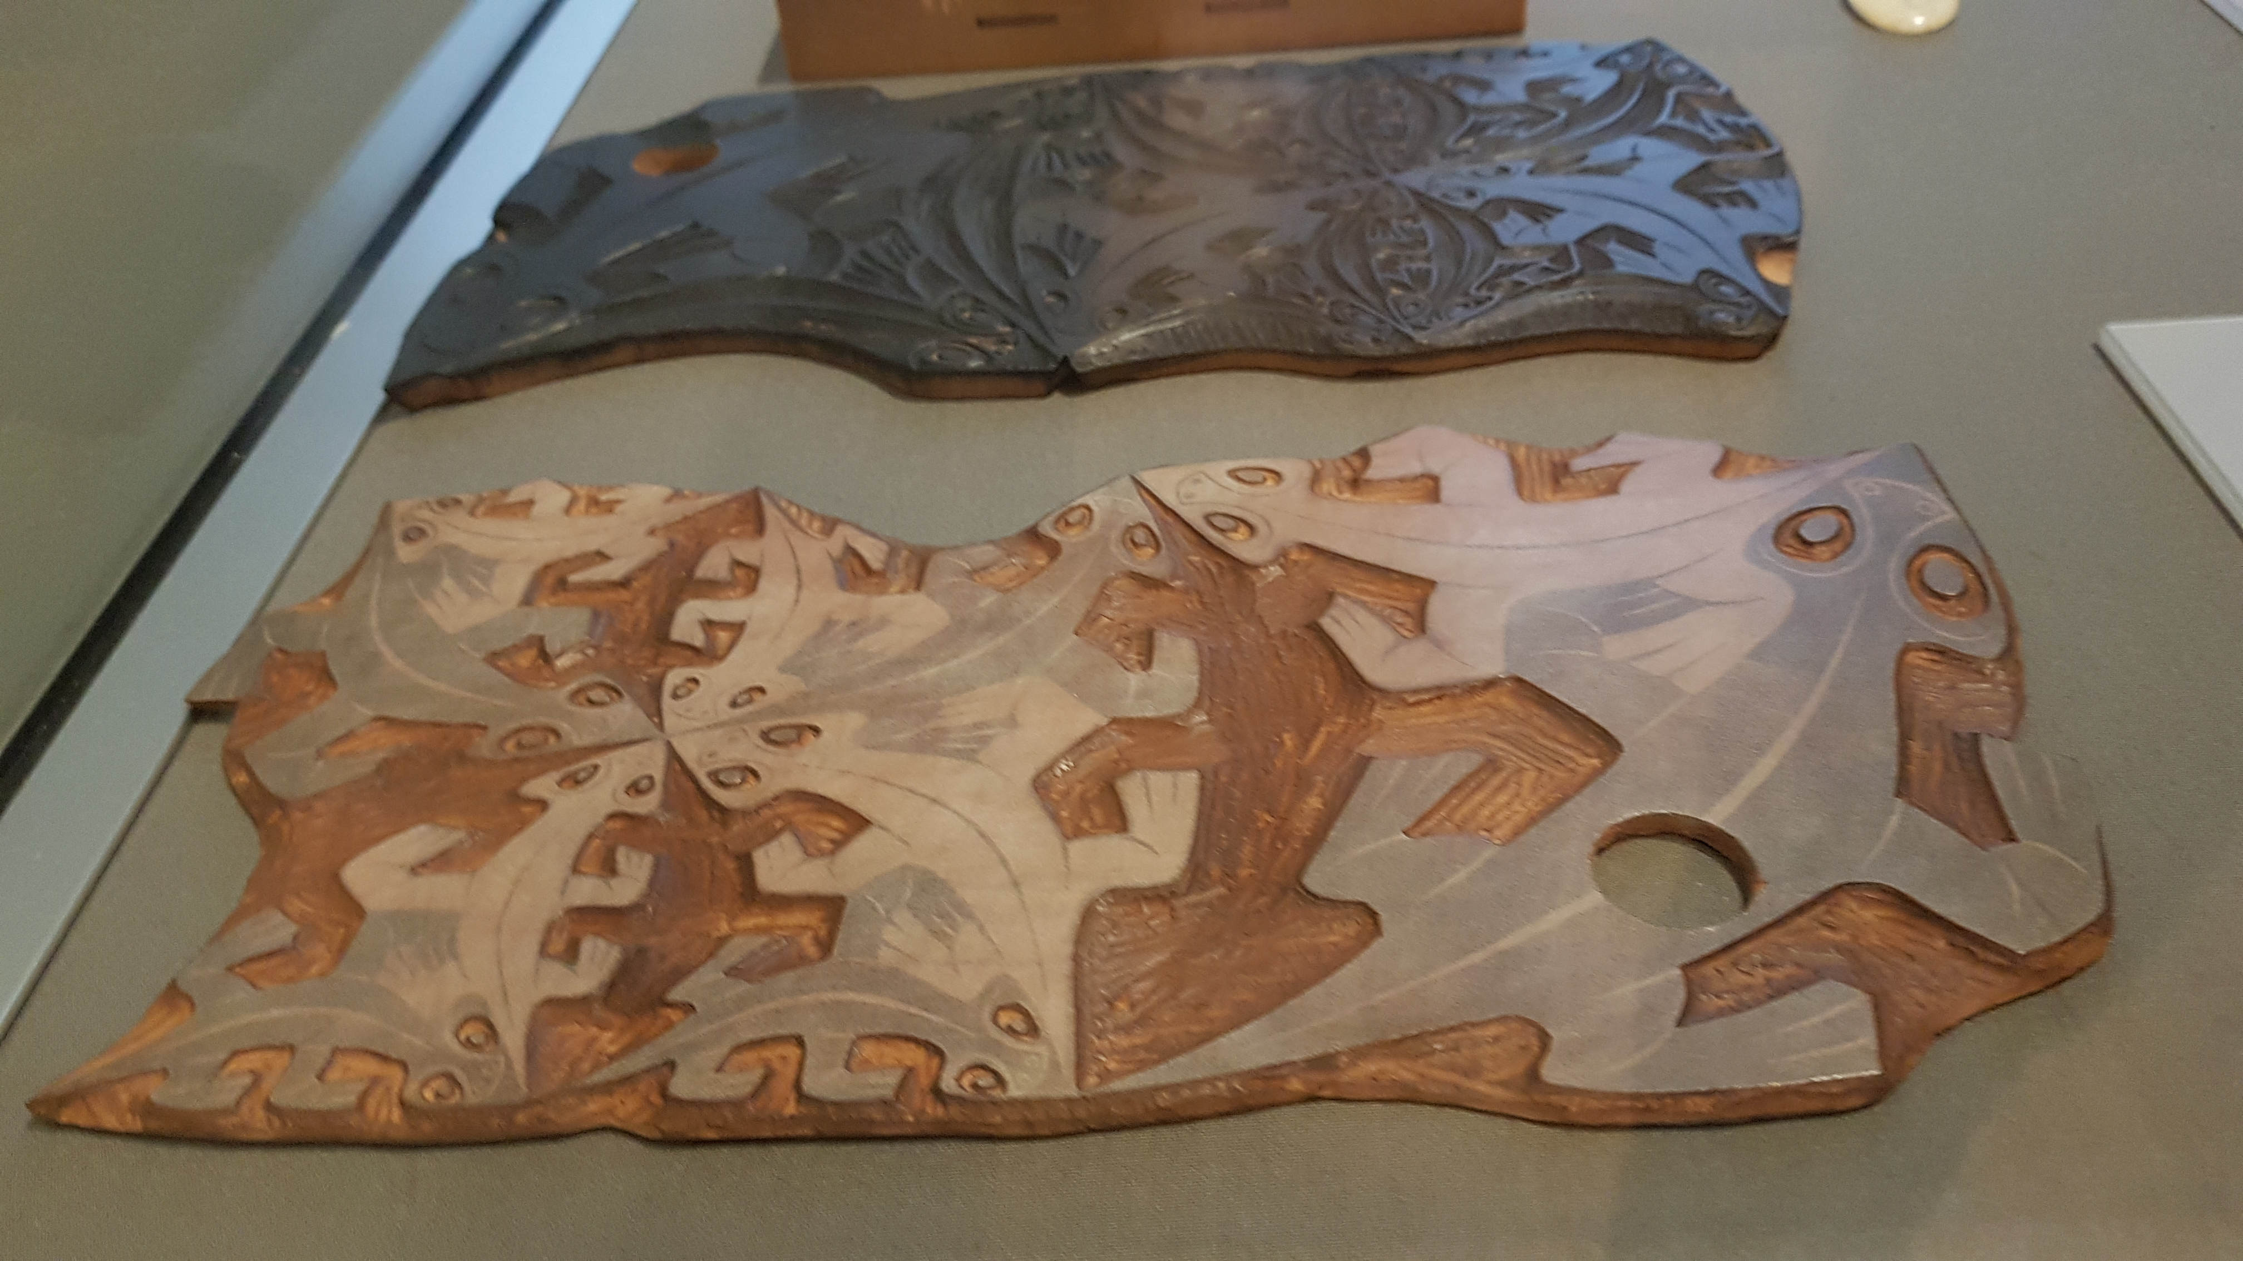
Did you know?
Escher choose to be a graphic artist to share his work
Escher produced woodcuts himself and supervised the lithographs
Bone egg spoon
Notes:
Choose to be a graphic artist to share his work – an artist prodcues one painting but graphic artists produce a series of copies of their prints (Escher = 30 – 650 copies per print run)
Mostly worked with wood engravings and lithographs (local printer)

Slide 5
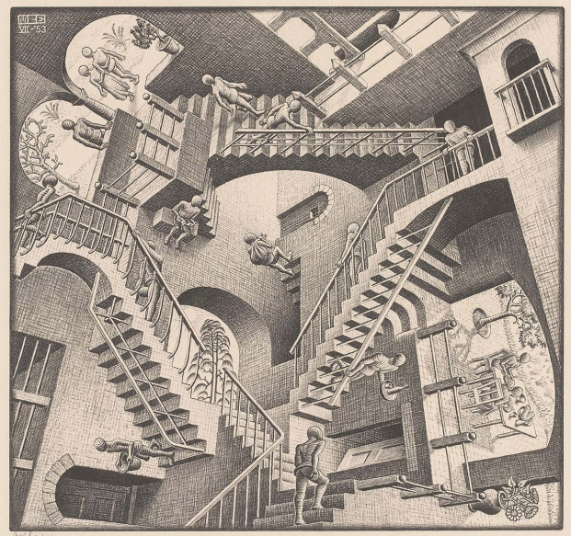
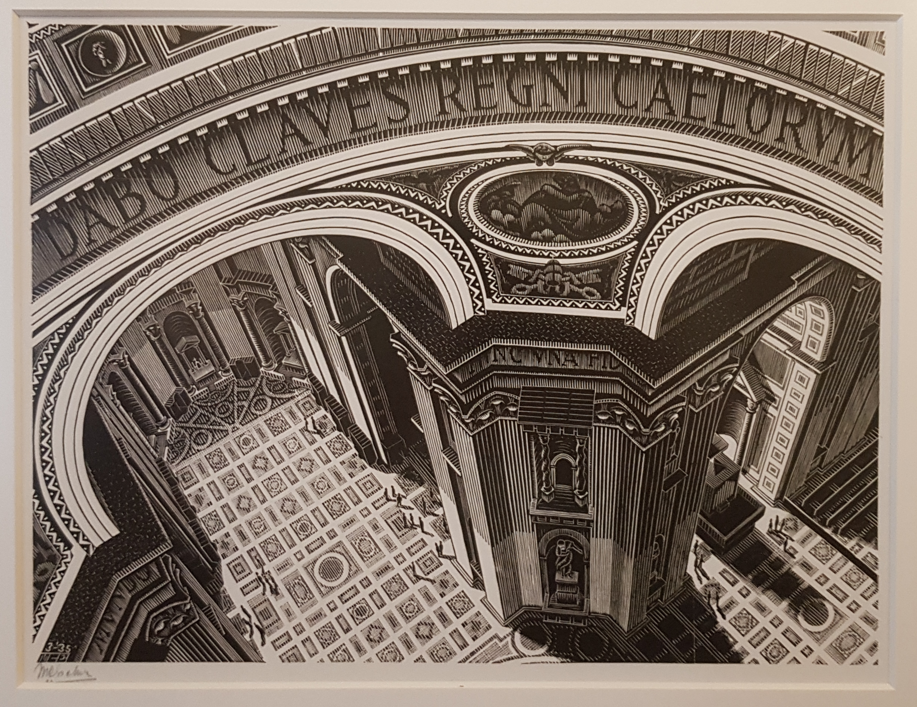
Inspiration
Travels, particularly Italy
Playing with reality and perspective
Nature
Reflections
Secondary school building (staircases)
Imagination
Tessalations
“Generate amazement”

Slide 6
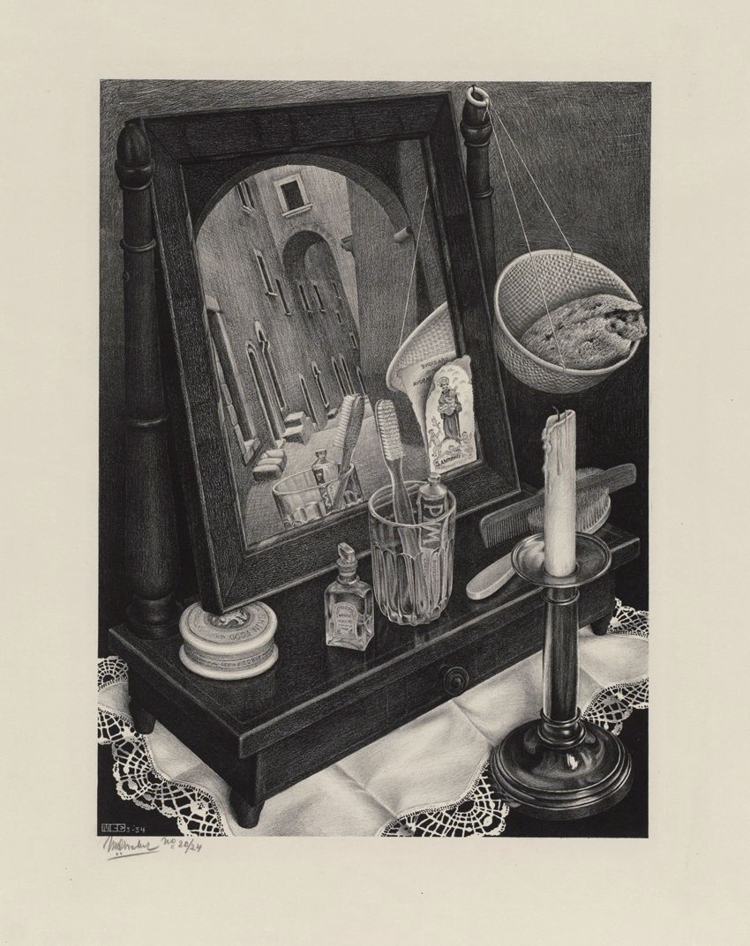
Still Life with Mirror
Notes:
1934

Slide 7
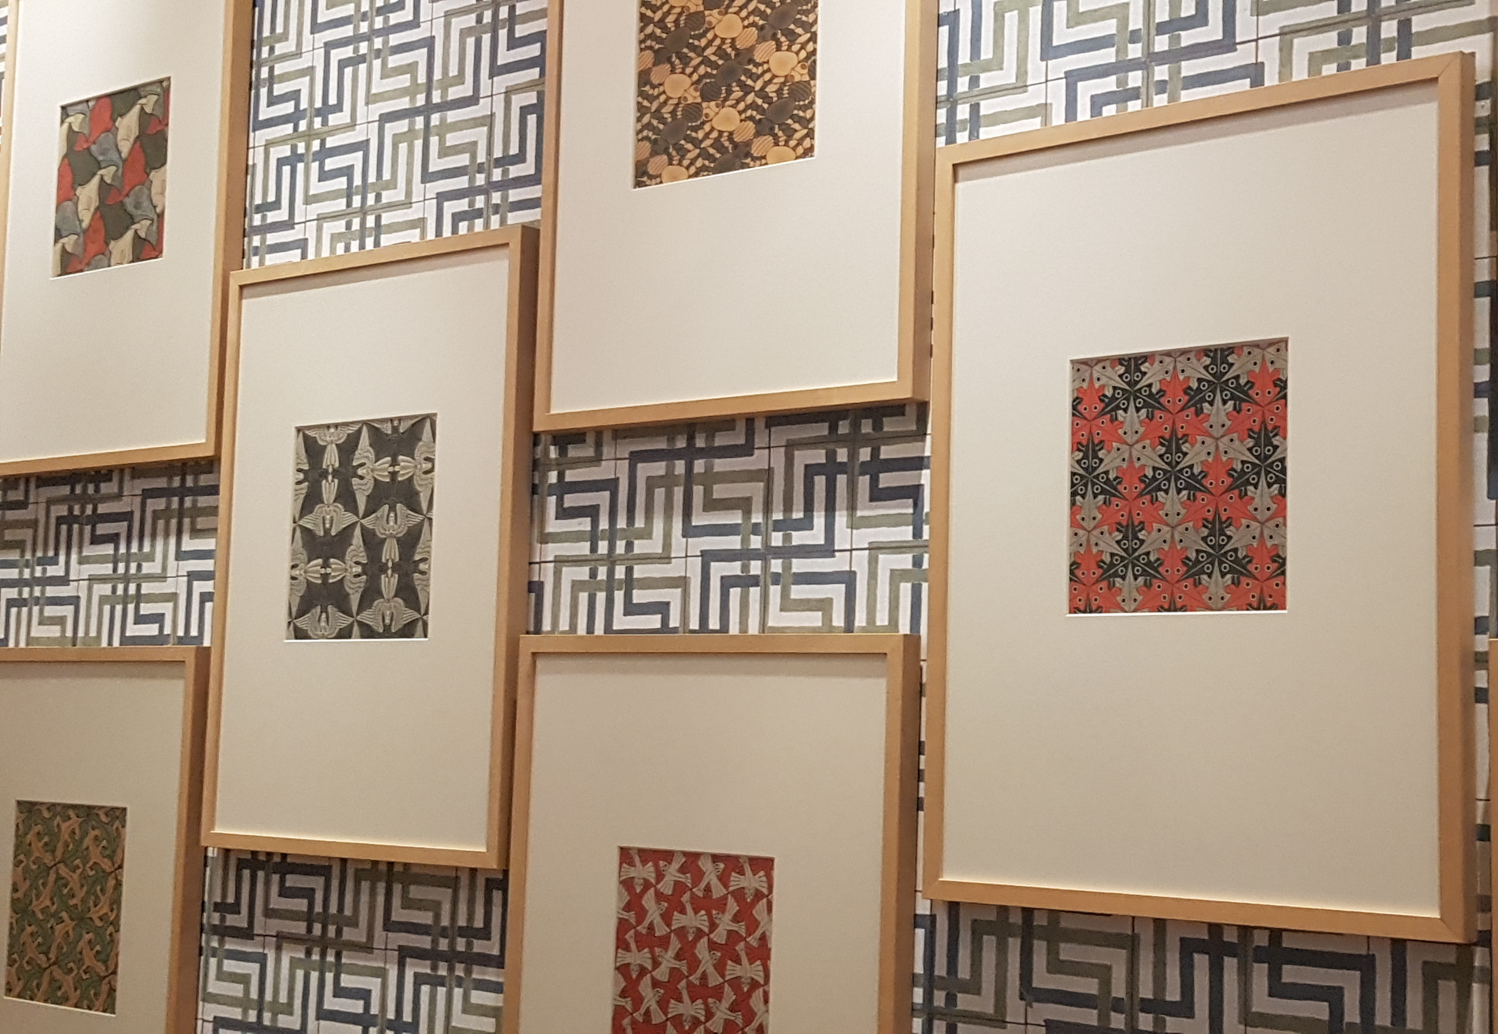
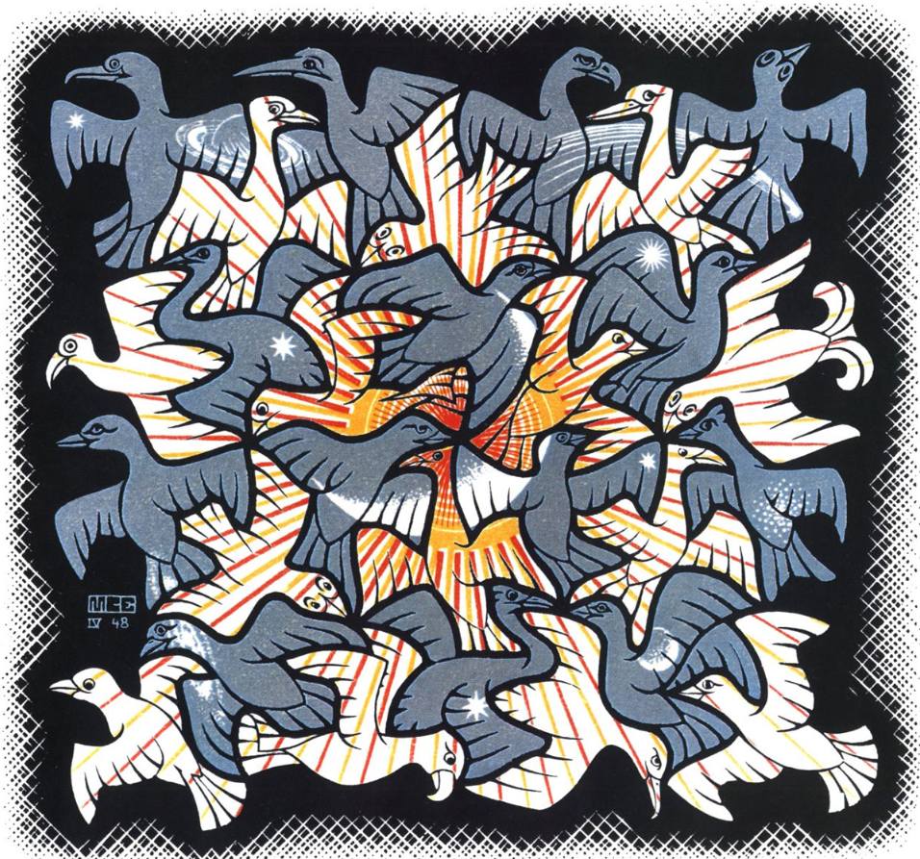
Tessalations
Sun and Moon
“It remains an extremely absorbing activity, a real mania to which I have become addicted…”
Notes:
First o“It remains an extremely absorbing activity, a real mania to which I have become addicted, and from which I sometimes find it hard to tear myself away.”
ne 1922 then left these till travels… (spain)
“It remains an extremely absorbing activity, a real mania to which I have become addicted, and from which I sometimes find it hard to tear myself away.”
Half-brother (prof geology & crystalography) gave him scientific literature from crystallography which included the 17 symmetry groups on plane – Escher had been discovering these himself through experimentation and took this further and played with tessellations. Creates own systems.
This one 1948.

Slide 8
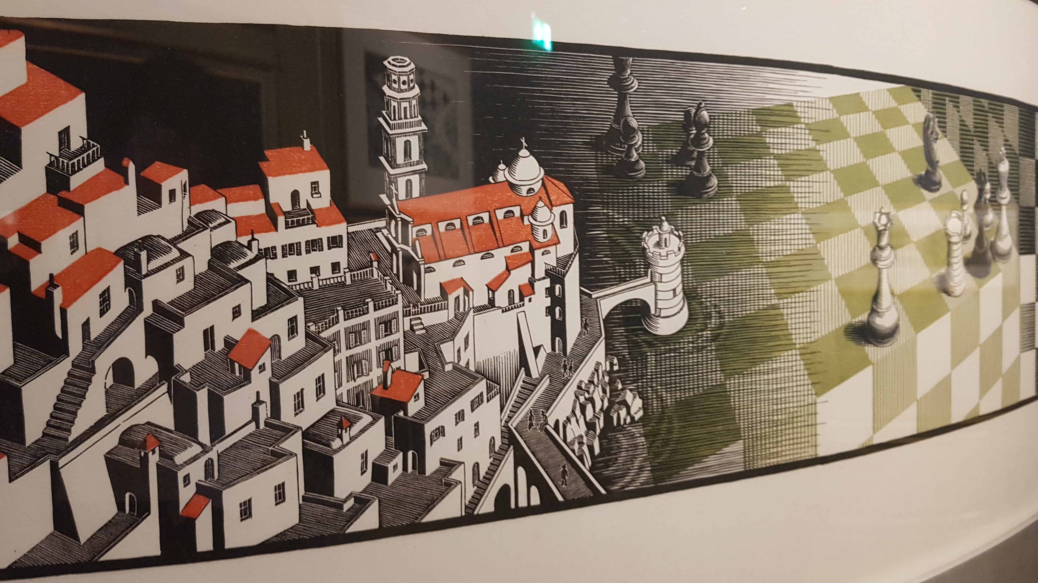
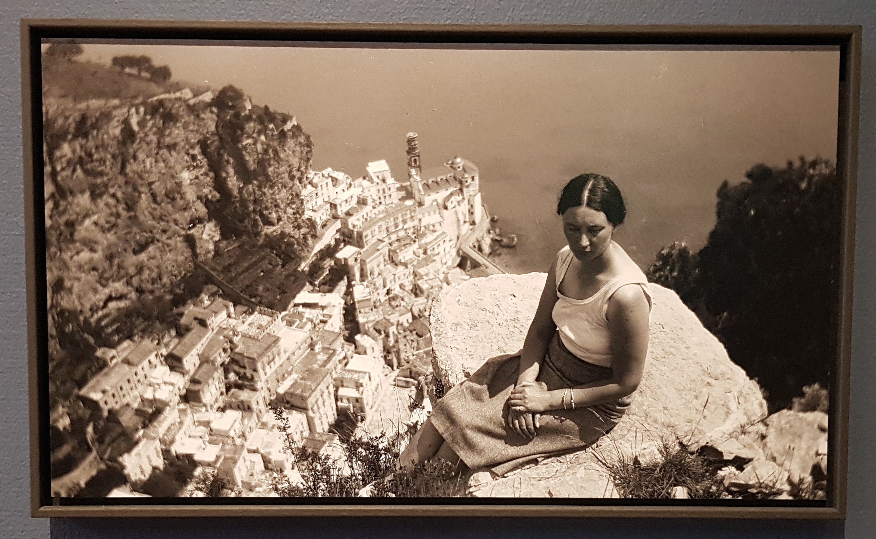
Metamorphosis (x 3)
Notes:
Atrani on Amalfi coast.
Jetta (wife) –artist

Slide 9

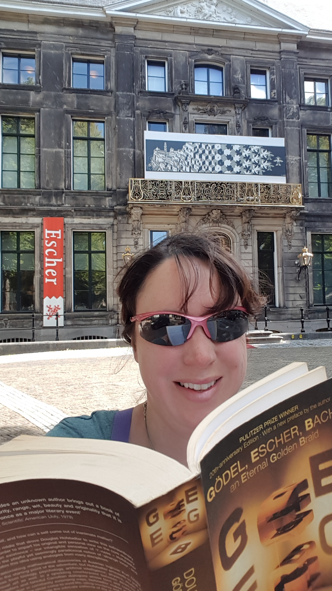



Contact
hmgray321@gmail.com
@snowpinga
www.escherinhetpaleis.nl

