Slide 1
S.O.X
James Grime

Slide 2
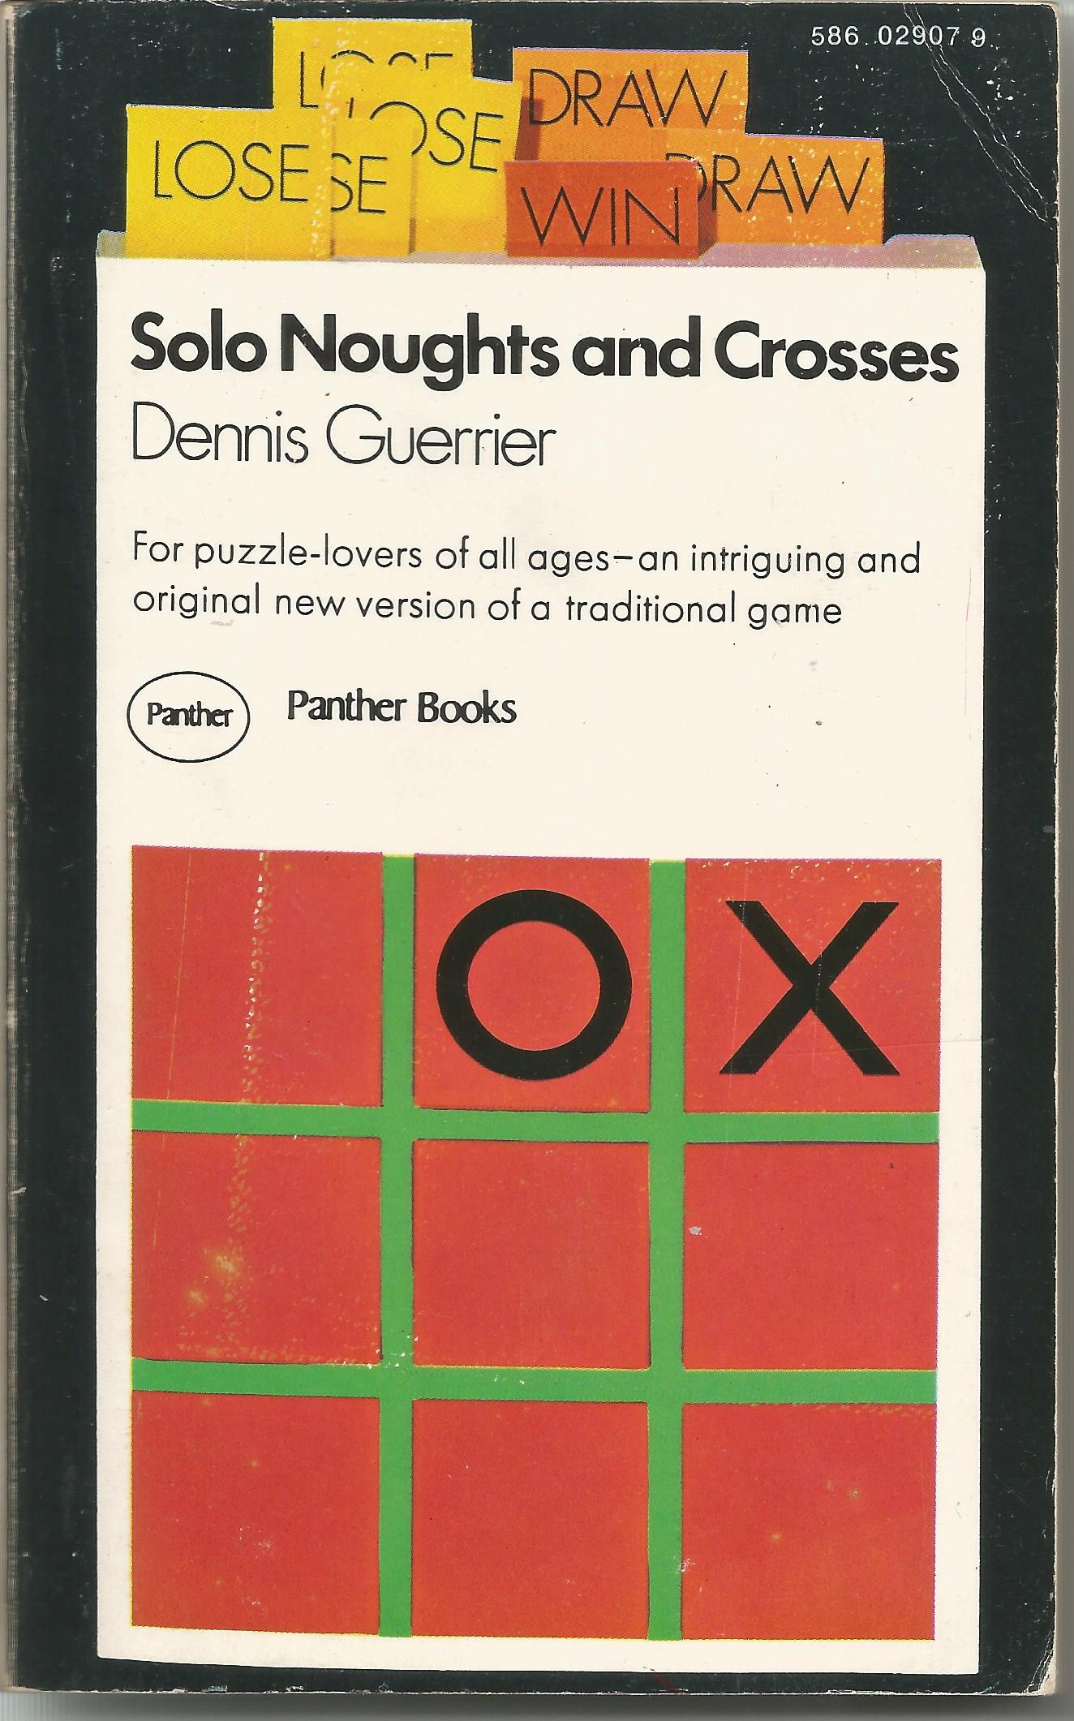

Slide 3
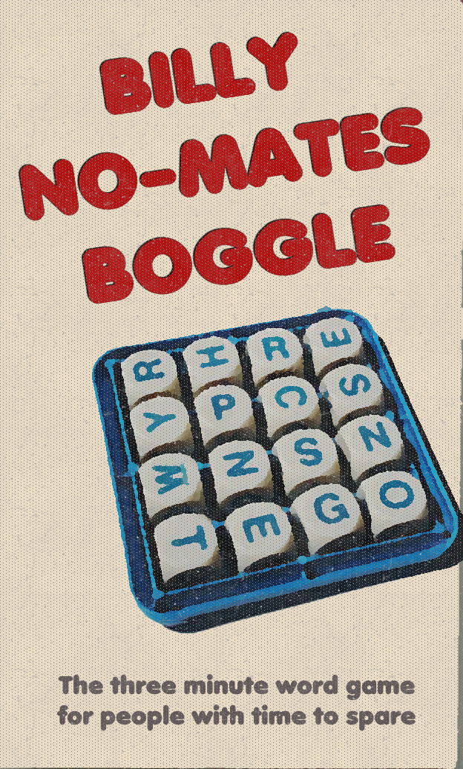
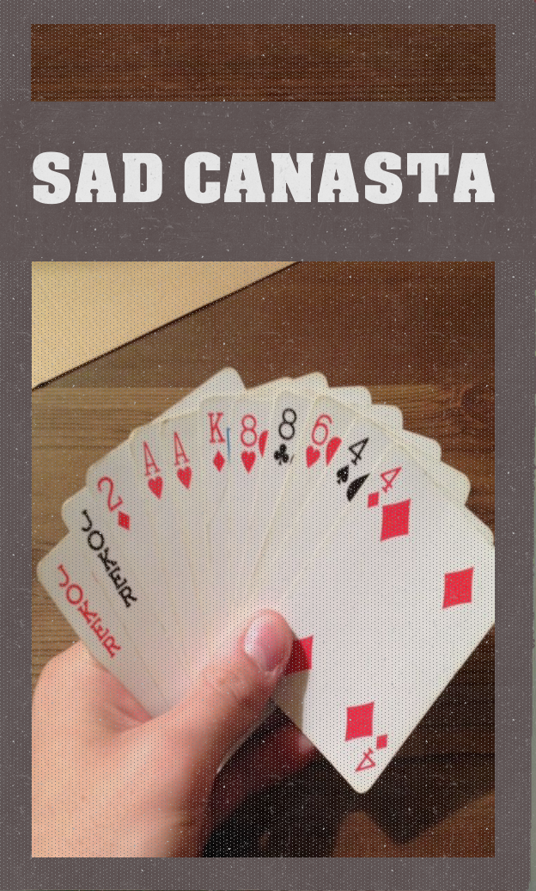

Slide 5
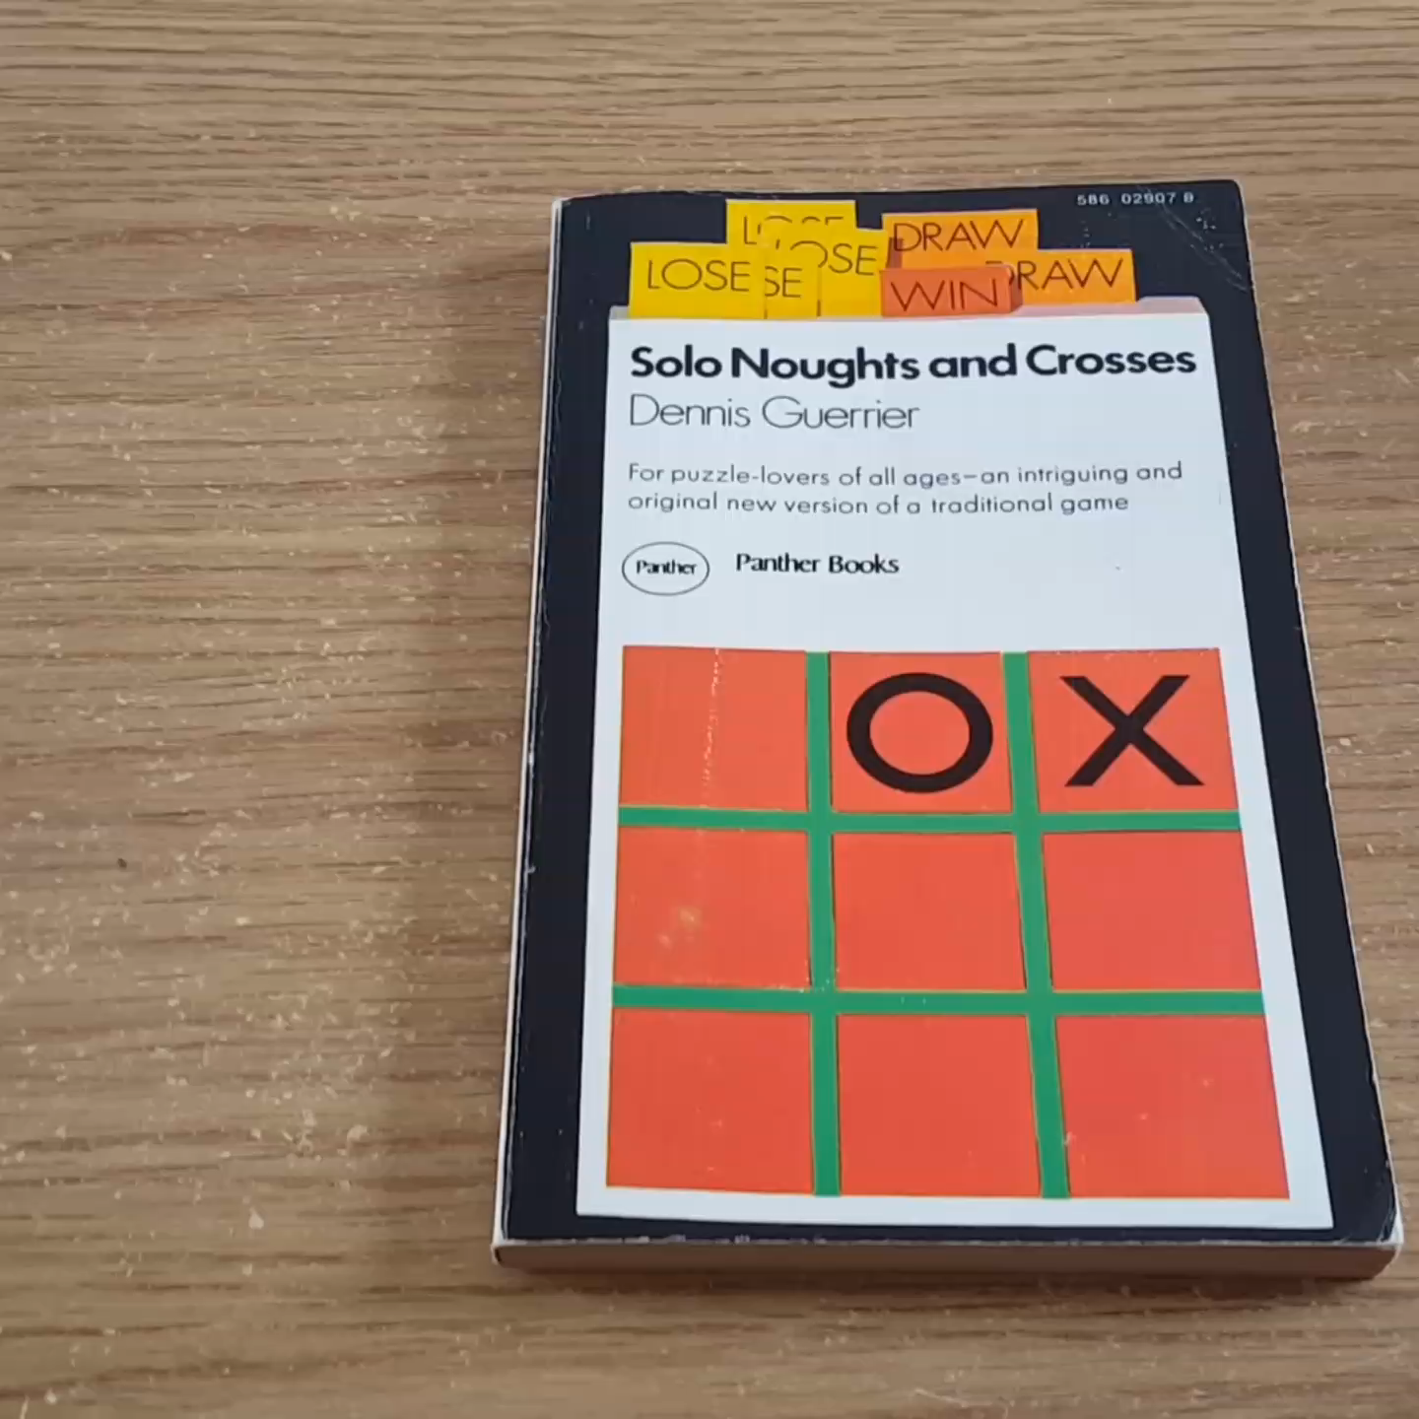
“Hours of enjoyment.”

Slide 6
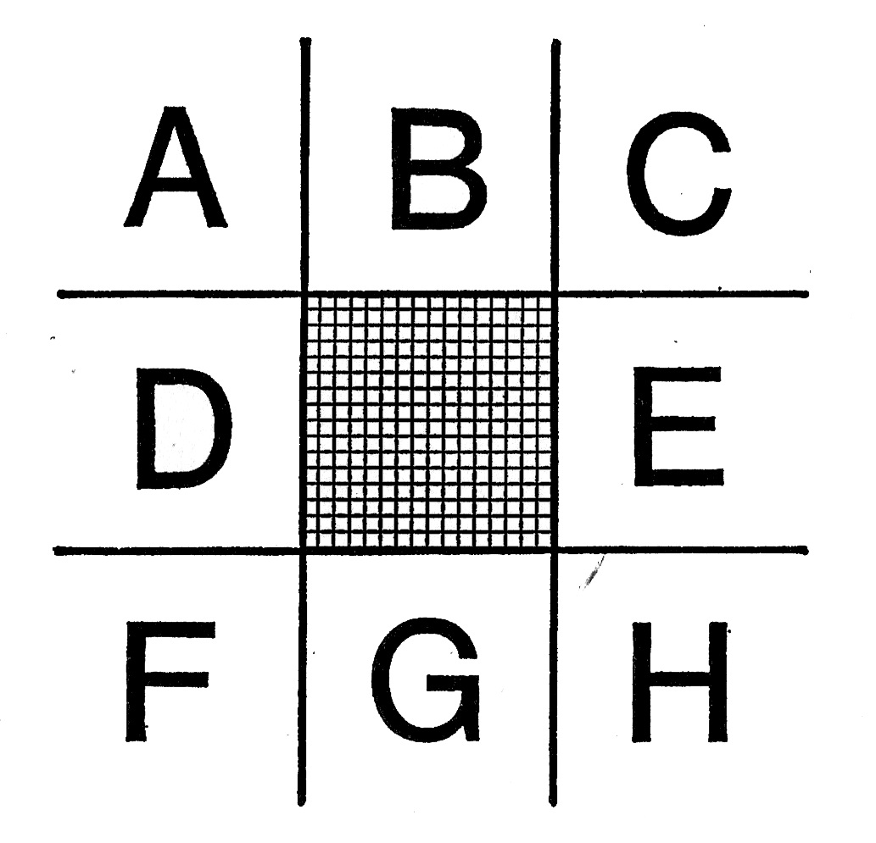
bit.do/soxbook

Slide 7
Analysis

Slide 8
492
Possible Games

Slide 9
22
Wins (4.5%)
Starting Square: | A | B | C | D | E | F | G | H
Wins: | 3 | 1 | 3 | 3 | 1 | 5 | 2 | 4

Slide 10
371
Losses (75%)
Starting Square: | A | B | C | D | E | F | G | H
Losses: | 45 | 42 | 45 | 45 | 49 | 52 | 45 | 48

Slide 11
99
Draws (20%)
Starting Square: | A | B | C | D | E | F | G | H
Draws: | 23 | 2 | 17 | 5 | 2 | 27 | 2 | 21

Slide 12
22
Wins (4.5%)
Starting Square: | A | B | C | D | E | F | G | H
Wins: | 3 | 1 | 3 | 3 | 1 | 5 | 2 | 4

Slide 13
Reader Plays Optimally

Slide 14
bit.do/soxbook

Slide 15
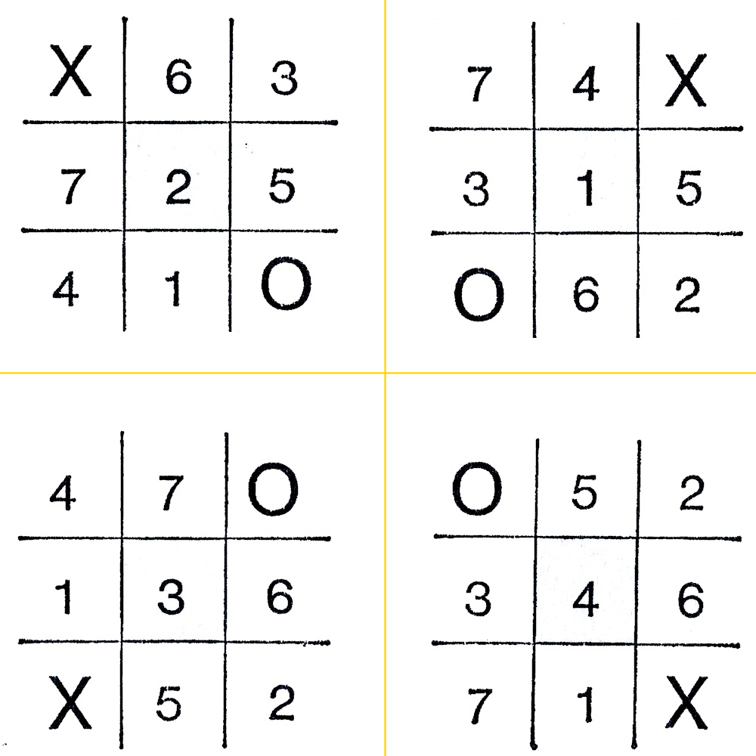

Slide 16
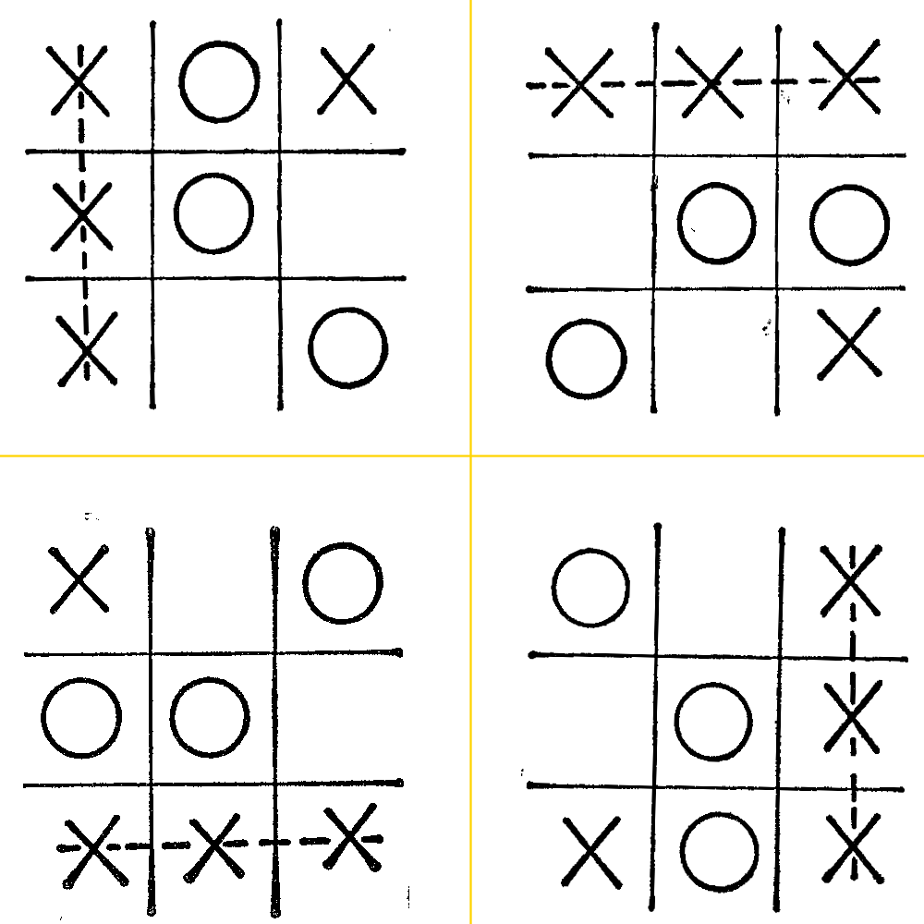

Slide 17
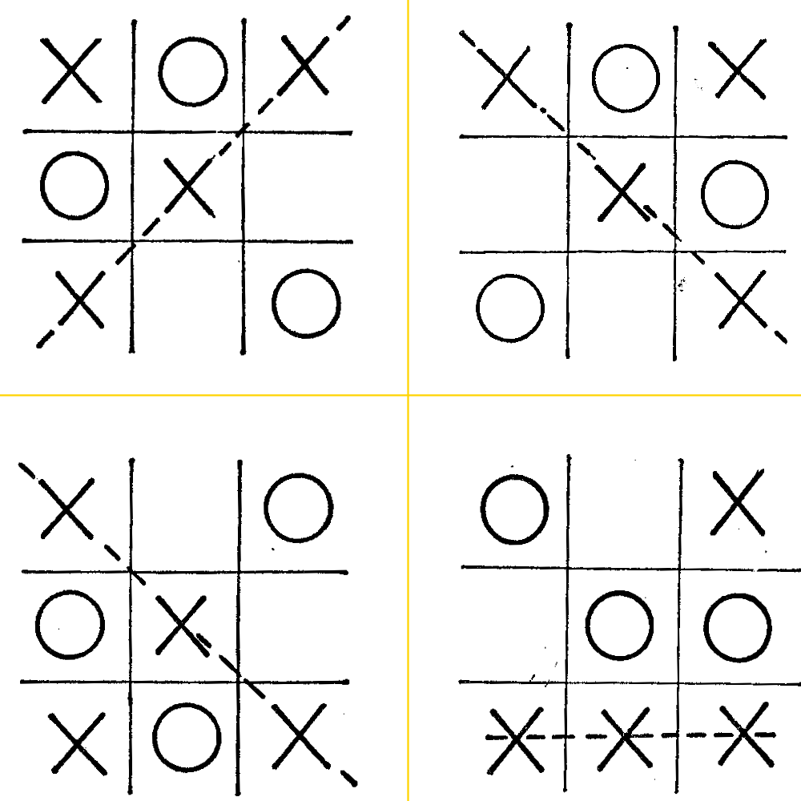

Slide 18
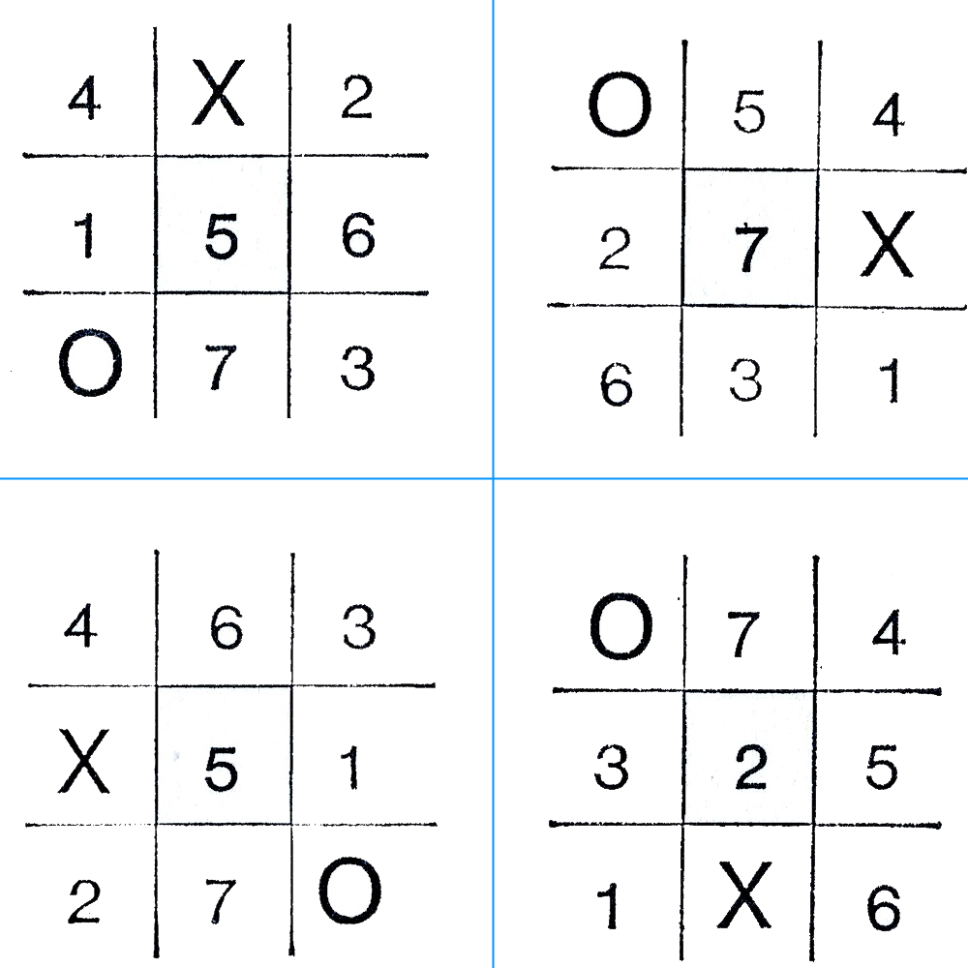

Slide 19
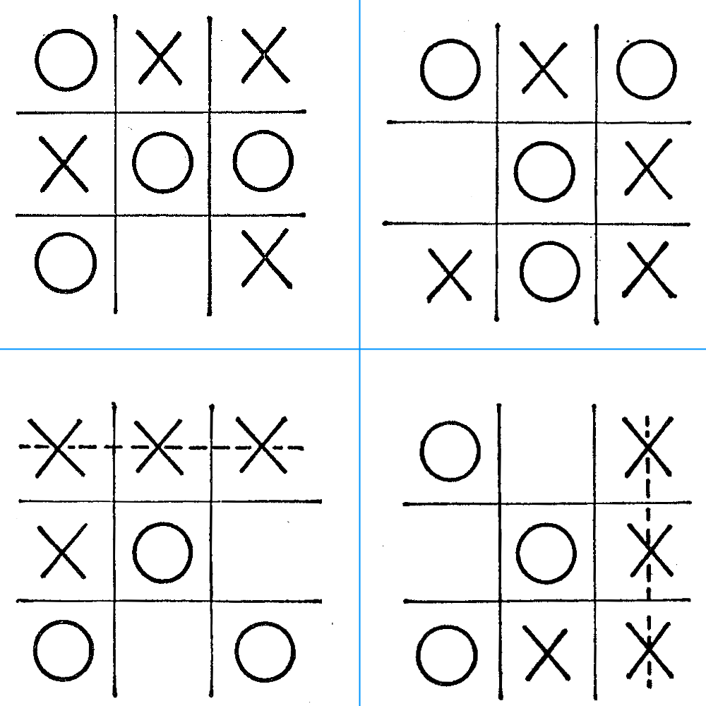

Slide 20
Reader Plays Optimally
12
Possible Games

Slide 21
10
Wins (83%)
Starting Square: | A | B | C | D | E | F | G | H
Wins: | 2 | 0 | 2 | 1 | 0 | 2 | 1 | 2

Slide 22
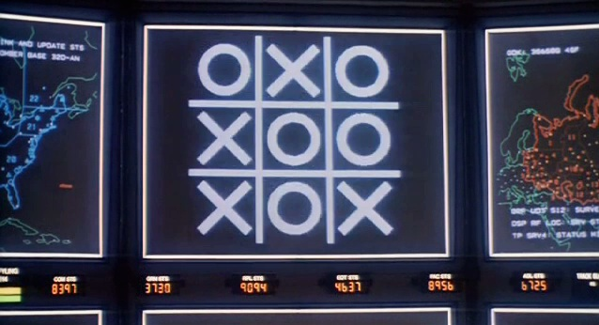
Reader and Book Play Optimally:
Every game would end in a draw.

Slide 23
Dennis Guerrier

Slide 24

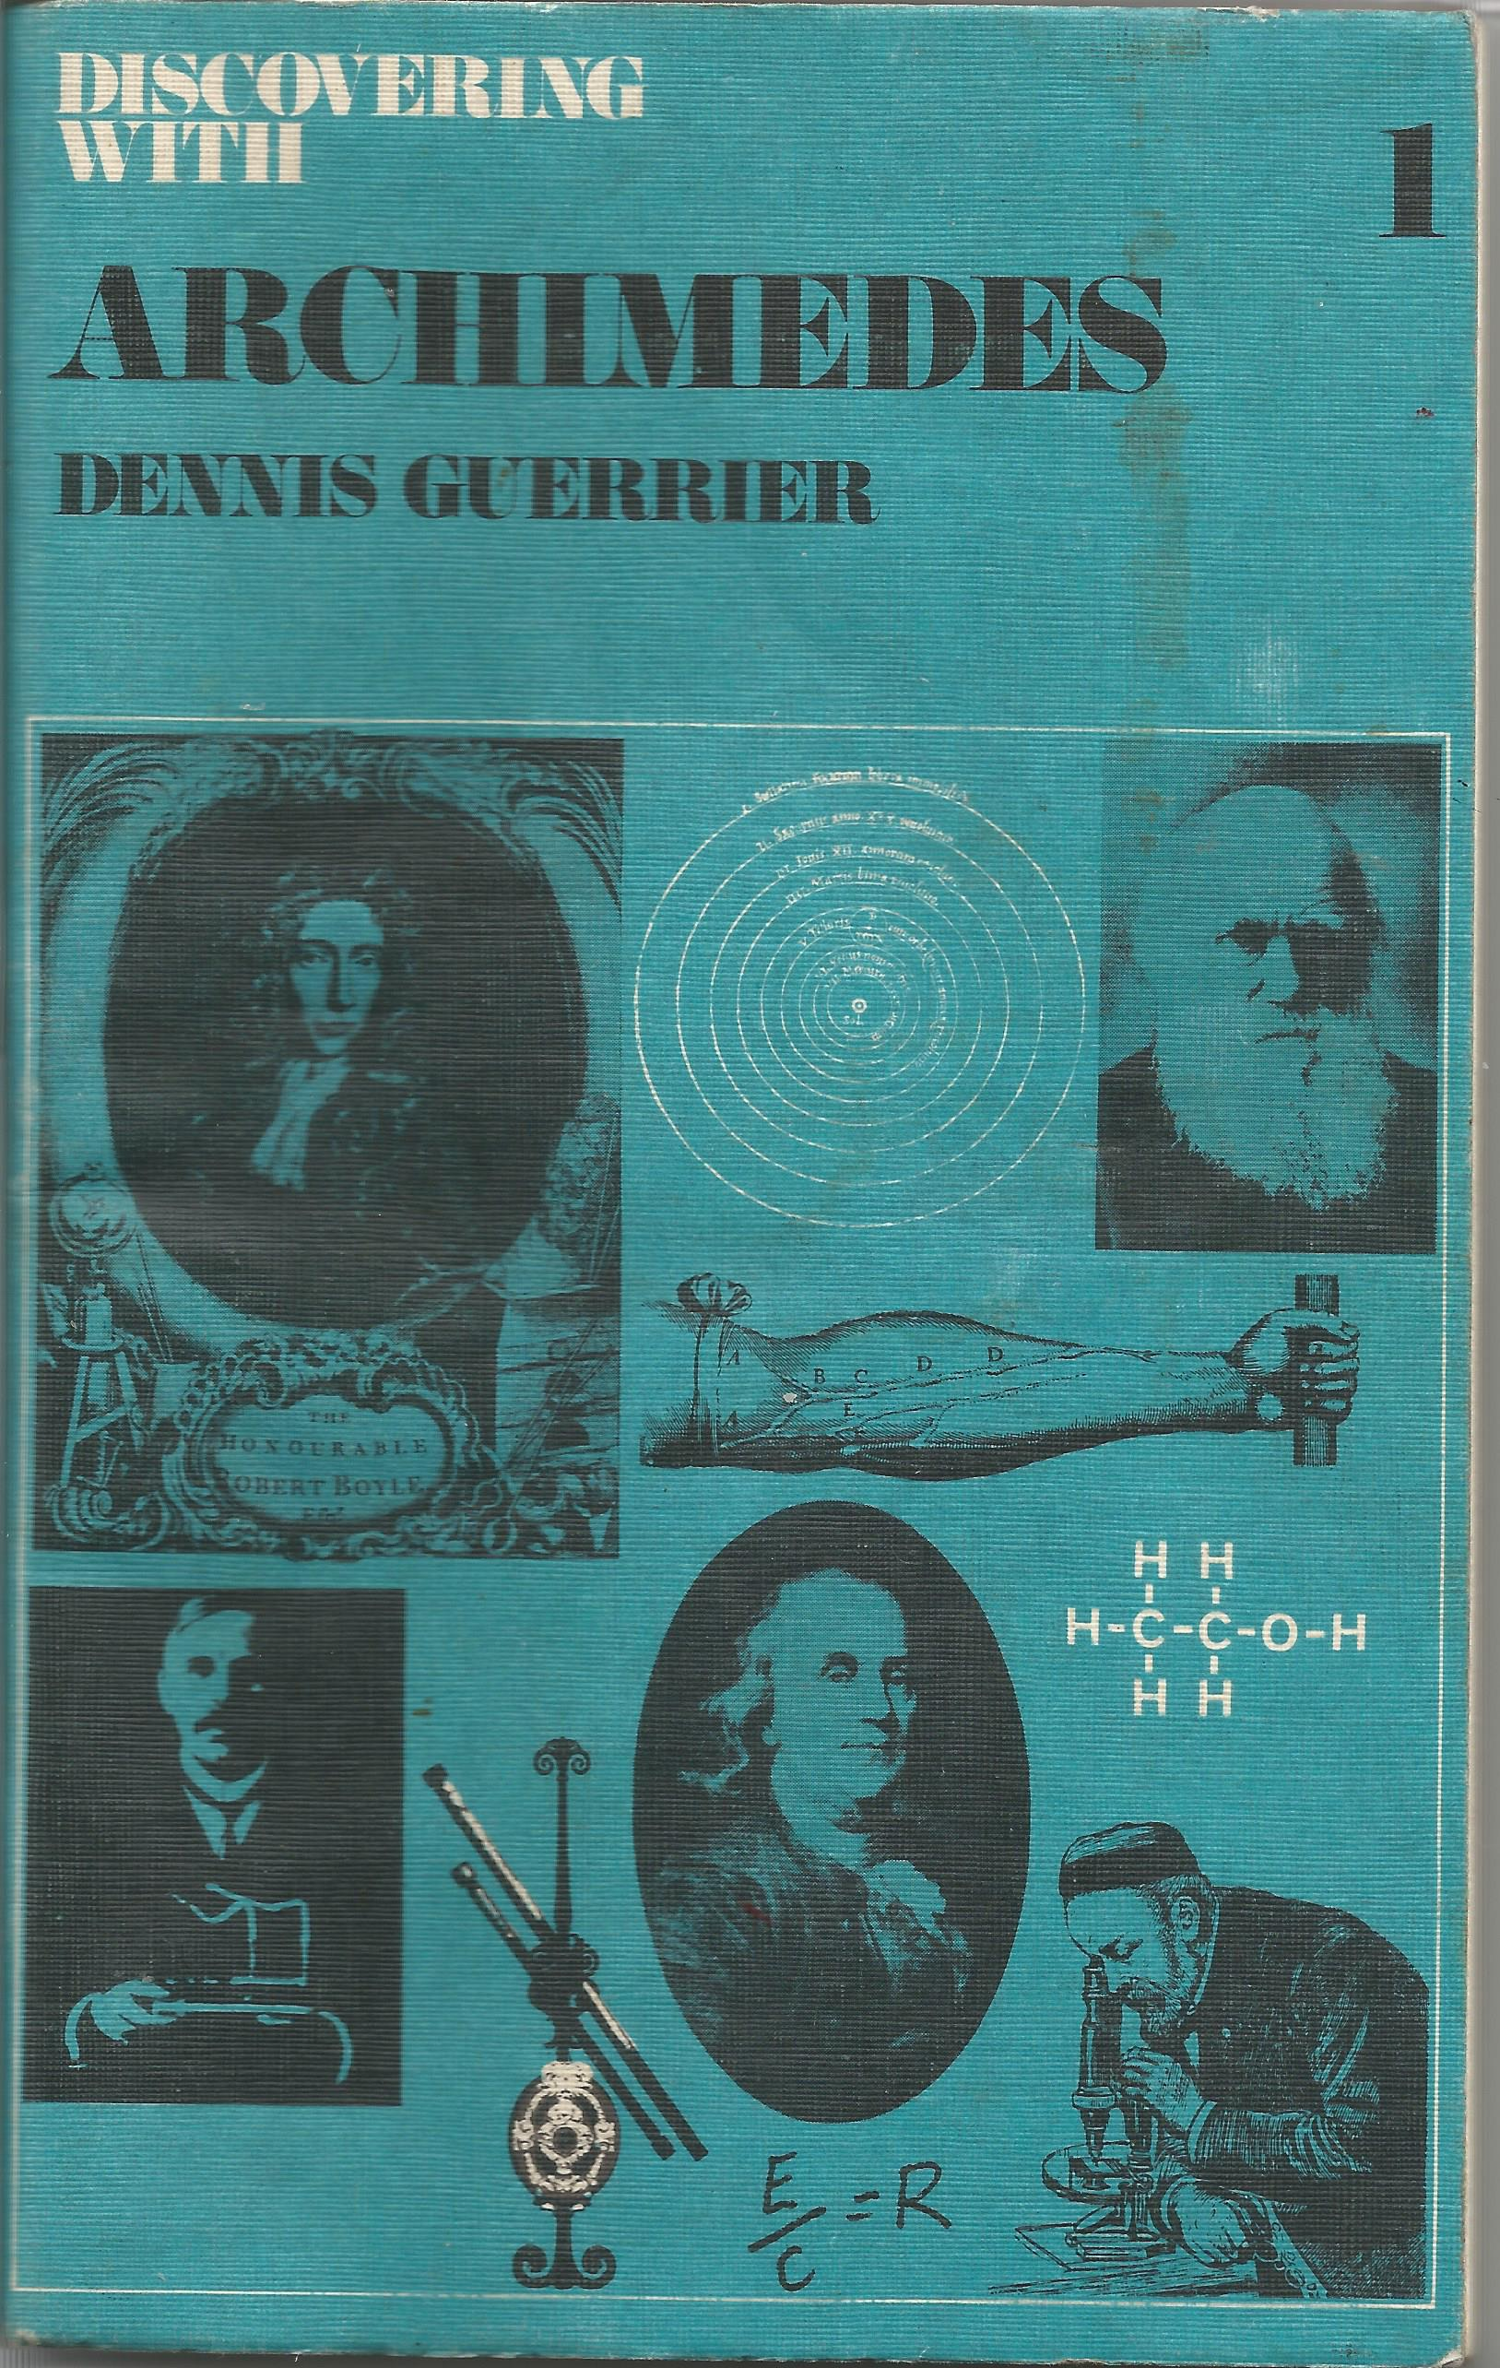


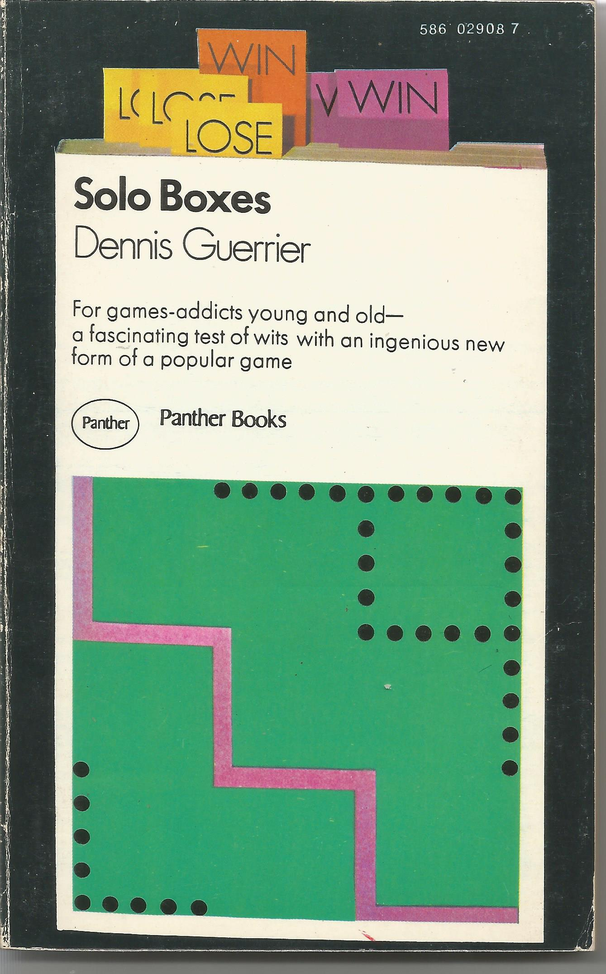
Guerrier’s Miracle Year

Slide 25
Guerrier’s Miracle Year
"A Programmed Entertainment.
The first do-it-yourself novel in which the reader directs the course of action"

Slide 26
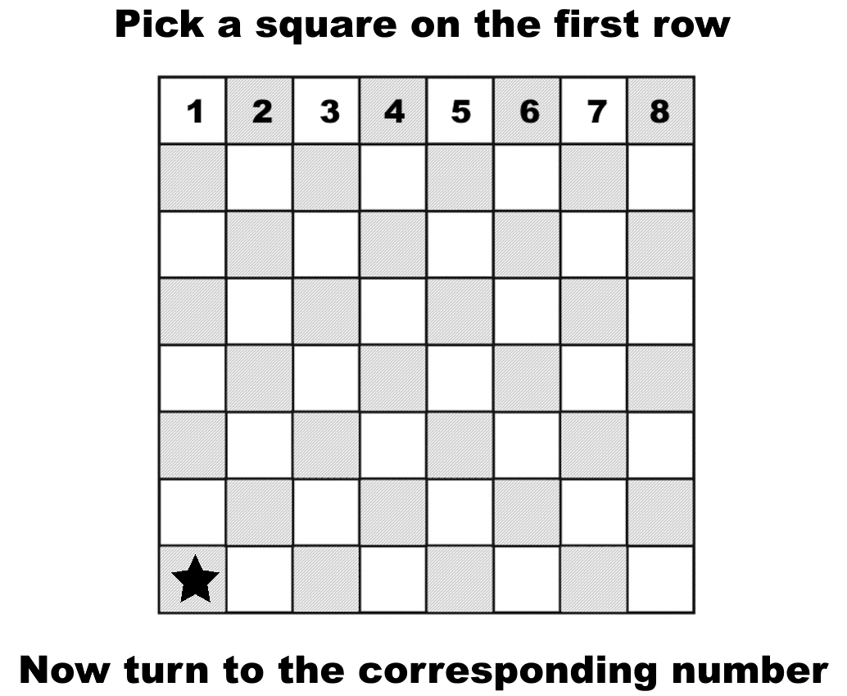
Catch The Star

Slide 27
Catch The Star

Slide 29
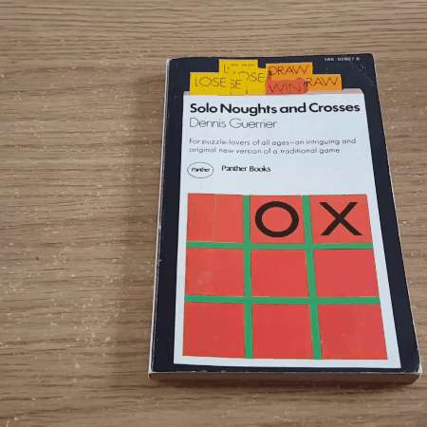
“Hours of enjoyment.”
Notes:
GIF

