Slide 1
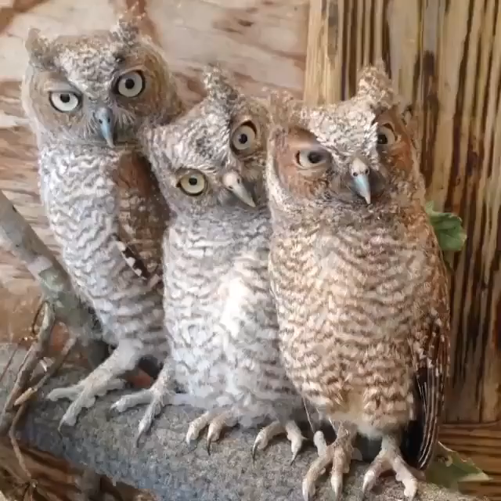
Ten New Maths Jokes
Lucy Rycroft-Smith
@honeypisquared

Slide 2
1. The classic setup-punchline
Lucy Rycroft-Smith
@honeypisquared

Slide 3
2. The broken assumption (also known as ‘pull back and reveal’)
Lucy Rycroft-Smith
@honeypisquared

Slide 4
3. The pun/double meaning
Lucy Rycroft-Smith
@honeypisquared

Slide 5
4. The missing punchline/dead stop
Lucy Rycroft-Smith
@honeypisquared

Slide 6
5. I wrote the punchline first
Lucy Rycroft-Smith
@honeypisquared

Slide 7
6. The tag on the end (also known as the gift that keeps on giving)
Lucy Rycroft-Smith
@honeypisquared

Slide 8
7. The list
Lucy Rycroft-Smith
@honeypisquared

Slide 9
8. One setup, three punchlines
Lucy Rycroft-Smith
@honeypisquared

Slide 10
9. One punchline, three setups
Lucy Rycroft-Smith
@honeypisquared

Slide 11
10. The callback
Lucy Rycroft-Smith
@honeypisquared

Slide 12
Thank you!
Lucy Rycroft-Smith
@honeypisquared

