Slide 1
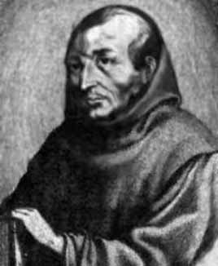
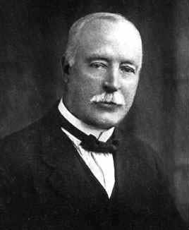
Mersenne and Cole
By Mark Fisher Mathsjam 2019
Pictures from mactutor history of mathematics archive
Notes:
Hello, I’m Mark Fisher, and I’ll be talking about two mathematicians Mersenne and Cole. Who were they, what connected them, and why should we care today?

Slide 2
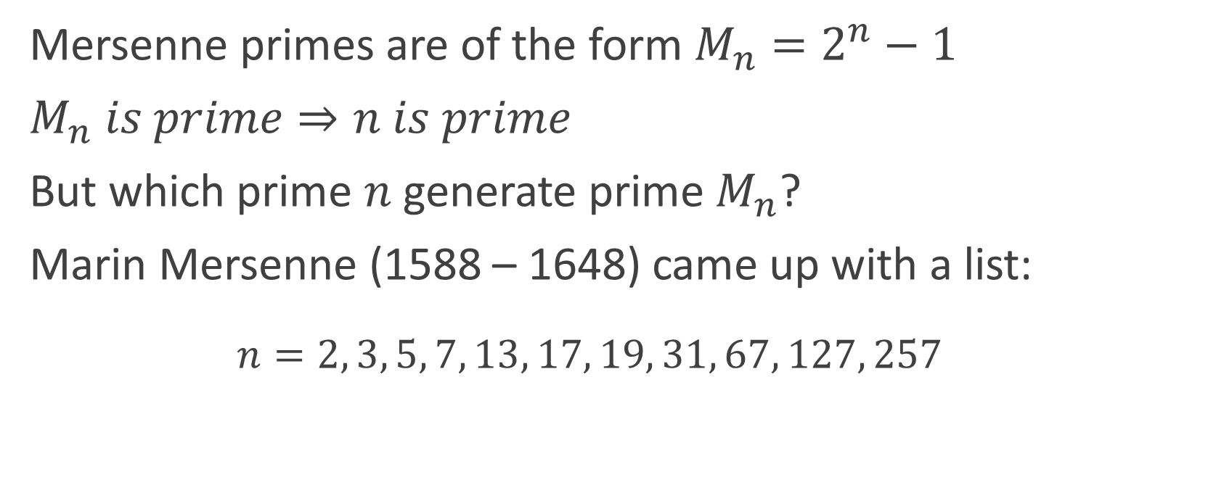
Prime Numbers and Mersenne
Mersenne primes are of the form $M_{n}=2^{n}−1$
$M_{n} is prime⇒n is prime$
But which prime $n$ generate prime $M_{n}$?
Marin Mersenne (1588 – 1648) came up with a list:
  $$n=2, 3, 5, 7, 13, 17, 19, 31, 67, 127, 257$$
Notes:
Let’s start with one of my favourite sets in maths, the prime numbers. I think the prime numbers are endlessly fascinating, and perhaps the most famous type of prime number is the Mersenne prime. Mersenne primes are of the form Mn= 2^n -1. It can easily be shown that for Mn to be prime then n has to be prime, however not all prime n generate a Mersenne Prime. In fact, the ones that do are named for Marin Mersenne, a French monk who worked in the first half of the 17th century. He came to prominence through several different scientific fields of study, including harmonics and music theory, and he corresponded with many other luminaries of the day including Descartes and Galileo. And most importantly for us, he came up with a list of n that give primes (up to 257):
n = 2, 3, 5, 7, 13, 17, 19, 31, 67, 127, 257
So did Mersenne have a formula for working out which Mersenne numbers were prime?

Slide 3
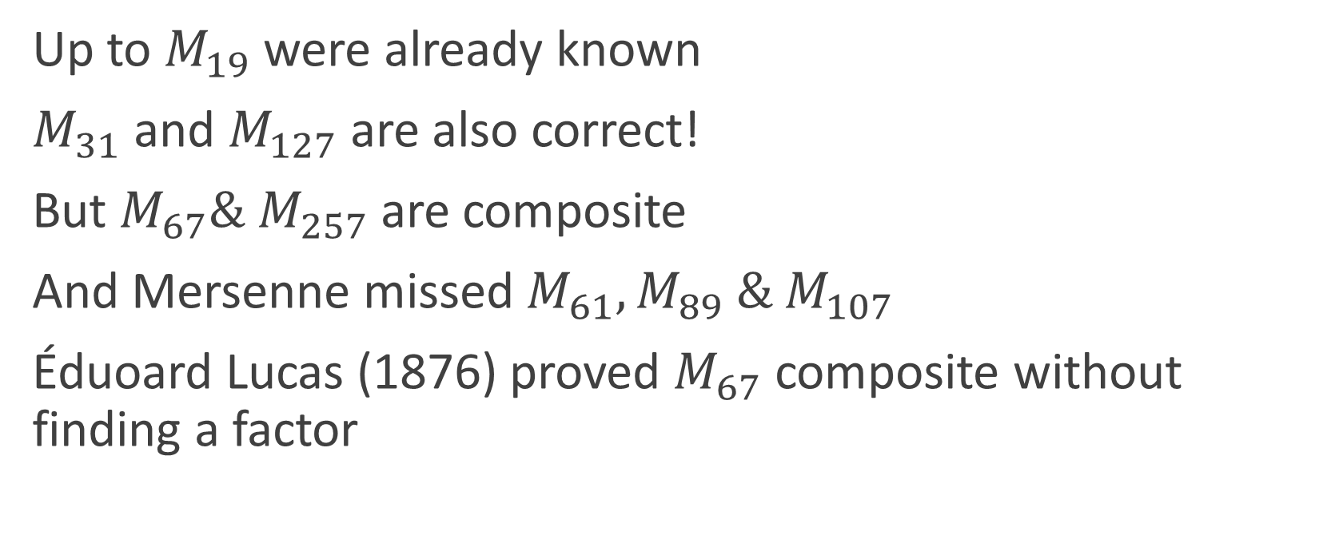
Correcting Mersenne!
Up to $M_{19}$ were already known
$M_{31}$ and $M_{127}$ are also correct!
But $M_{67}\& M_{257}$ are composite
And Mersenne missed $M_{61}, M_{89} \& M_{107}$
Éduoard Lucas (1876) proved $M_{67}$ composite without finding a factor
Notes:
Unfortunately for us, and for Mersenne, his list was wrong! He was correct up to n=31, and also about M127, but M67 and M257 are composite, and he missed out 3 correct primes (M61, M89, M107).
During the latter half of the 19th century French mathematician Édouard Lucas came up with some primality tests, which enabled him and others to prove whether a number is prime or composite without finding out the exact factors. Descendants of those primality tests, such as the Lucas-Lehmer test, are still used today in searching for new, bigger prime numbers, including in the Great Internet Mersenne Prime Search. However, this does leave a gap in our knowledge: what are the factors of the numbers that Mersenne thought were prime? What are the factors of M67?

Slide 4
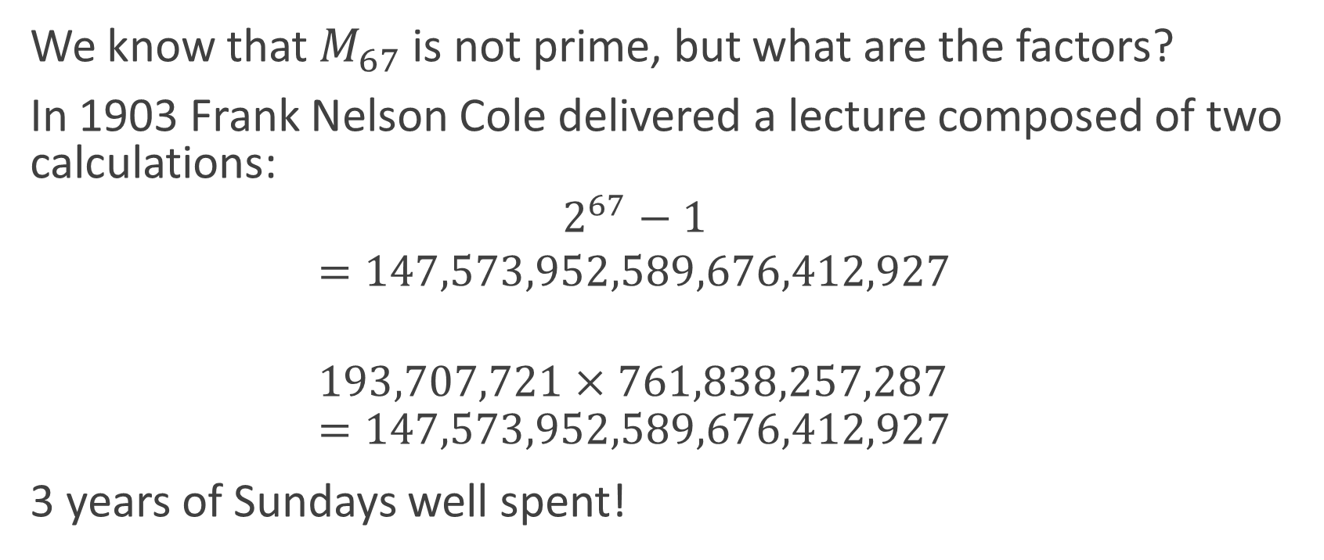
Enter Frank Nelson Cole
We know that $M_{67}$ is not prime, but what are the factors?
In 1903 Frank Nelson Cole delivered a lecture composed of two calculations:
  $$2^{67}−1$$
  $$=147,573,952,589,676,412,927‬$$
  $$193,707,721×761,838,257,287=147,573,952,589,676,412,927$$
3 years of Sundays well spent!
Notes:
Enter our hero, Frank Nelson Cole! Cole was a respected American mathematician, who taught at Harvard and Michigan before becoming a professor at Columbia University. He was also the secretary of the American Mathematical Society, and one of his key contributions to maths was his translation into English of an early work on Group Theory by Eugen Netto. So, to recap, at this point we know that 2^67 -1 is not a prime number, but we don’t know what the factors are. In 1903 Cole delivered a lecture, in which he simply got up, and worked through the tedious calculation of 2^67 - 1 on one side of the blackboard, then on the other side wrote out the even more tedious multiplication of 193,707,721 * 761,838,257,287, demonstrating that they were equal – to rapturous applause. He showed incredible dedication, as it had taken him 3 years of Sundays to calculate the factors!
It’s always a story that has appealed to me, of someone making sure that we filled in all the gaps we could about how the primes, and the closely related composite numbers, fit together. You never know when getting a few extra data points like those factors could change the understanding of a sequence, and maybe lead someone to prove whether or not there are an infinite number of Mersenne primes, a conjecture which is still unproven today, nearly 400 years after Mersenne published his list.

