Slide 1
The Travelling Salesman Problem: A Couple of Whimsical Applications by Martin Chlond
Notes:
1

Slide 2
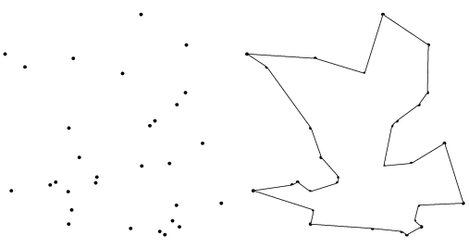

Slide 3
TSP Art

Slide 4
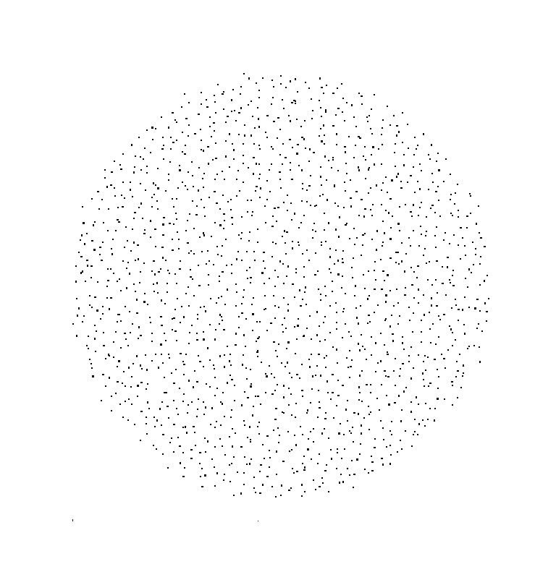

Slide 5

Single Line Drawing - Animation

Slide 6
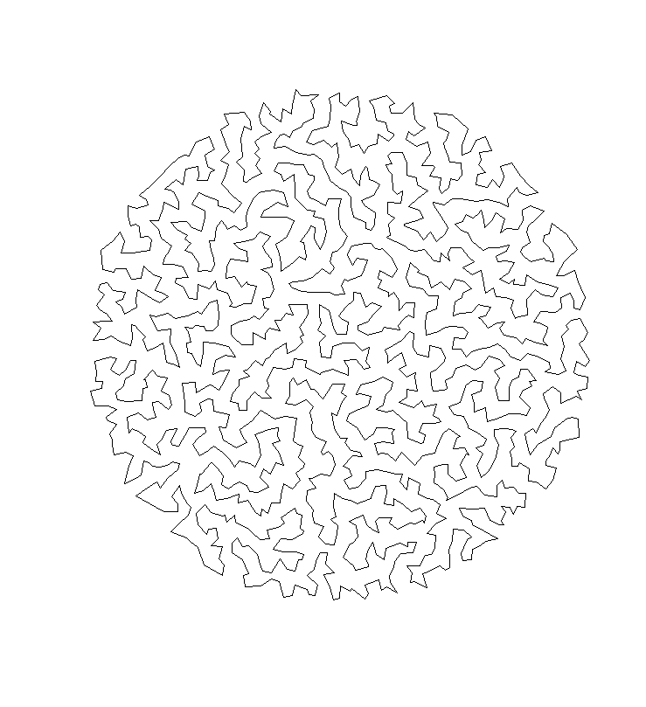

Slide 7
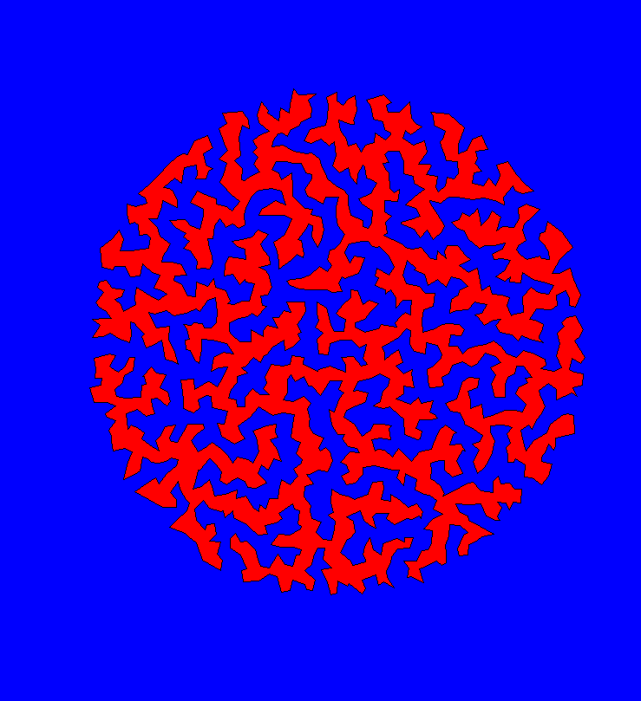

Slide 8


Slide 9
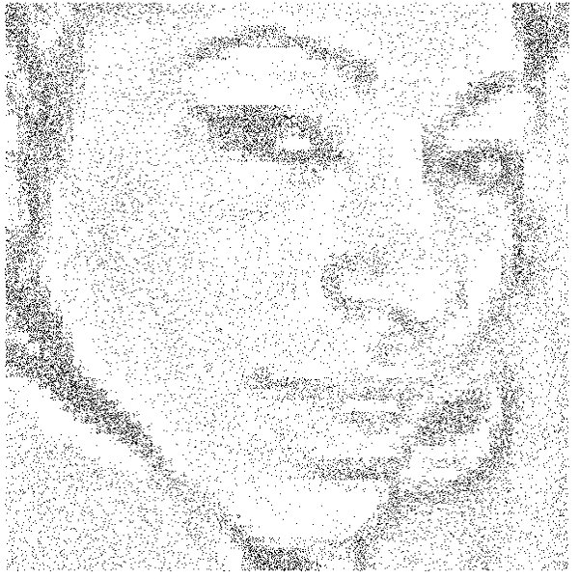

Slide 10
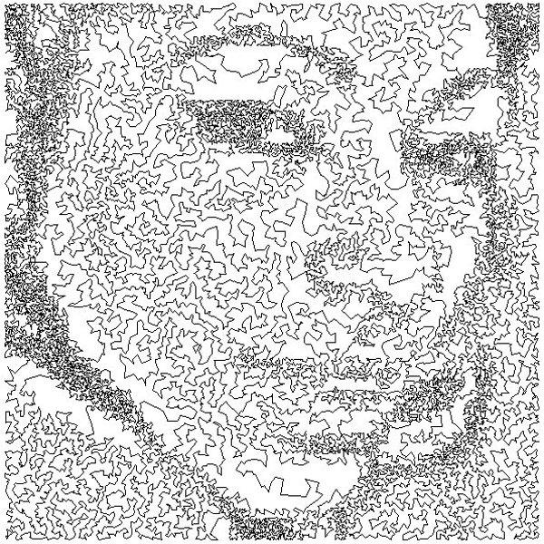

Slide 11
Selected Works
of
Bob Bosch

Slide 13
The following three pieces are based on the work of Andy Warhol. Each loop is exactly the same length (45.5 feet when printed on 8.5" by 11" paper).

Slide 14


Slide 15


Slide 16


Slide 17
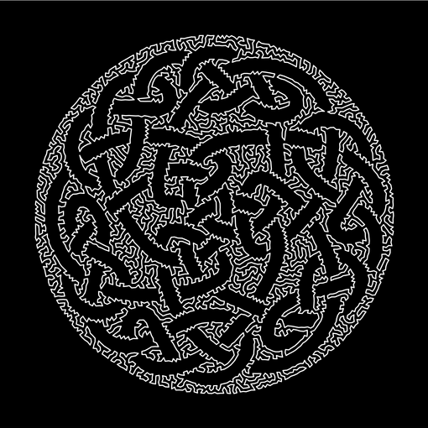

Slide 18
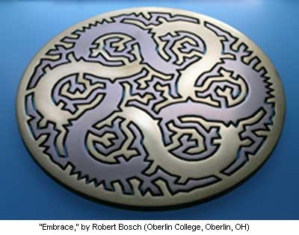
2010 Mathematical Art Exhibition, First Prize
American Mathematical Society

Slide 19
Yondu’s Dart Problem
Notes:
19

Slide 20


Slide 21


Slide 22
https://www.youtube.com/watch?v=rTQkO1-Of3I

Slide 23
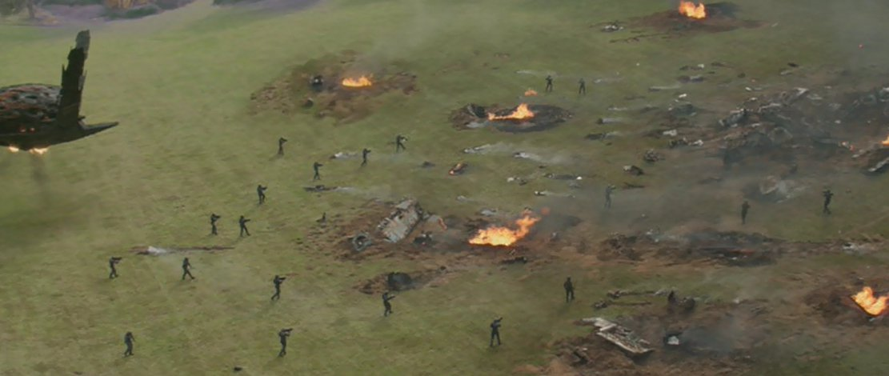

Slide 24
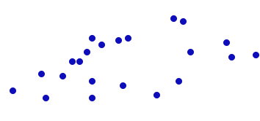

Slide 25
NAME: yondu.tsp
TYPE: TSP
COMMENT: Yondu's travelling dart problem
COMMENT: Guardians of the Galaxy (1:26:0)
DIMENSION: 22
EDGE_WEIGHT_TYPE: EUC_2D
NODE_COORD_SECTION
1 200 910
2 250 1030
3 260 930
4 240 760
5 360 710
6 420 620
.
.

Slide 26
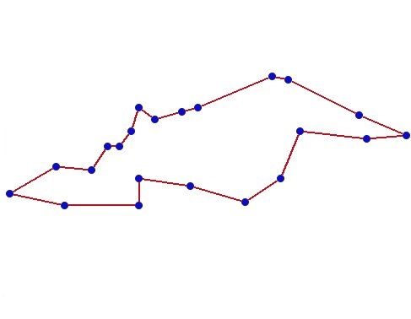

Slide 28
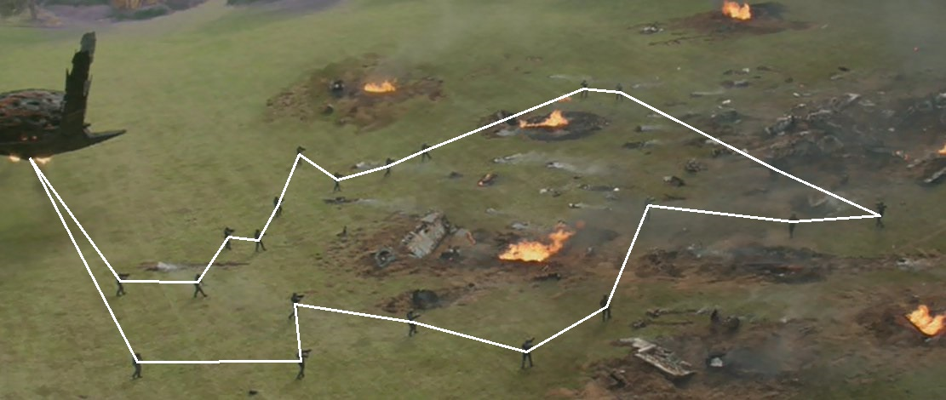

Slide 29


Slide 30
