Slide 1
Sums of powers
Martin Whitworth
@MB_Whitworth

Slide 2
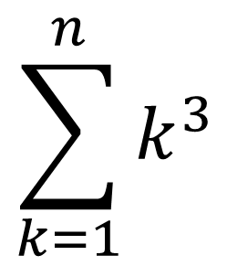
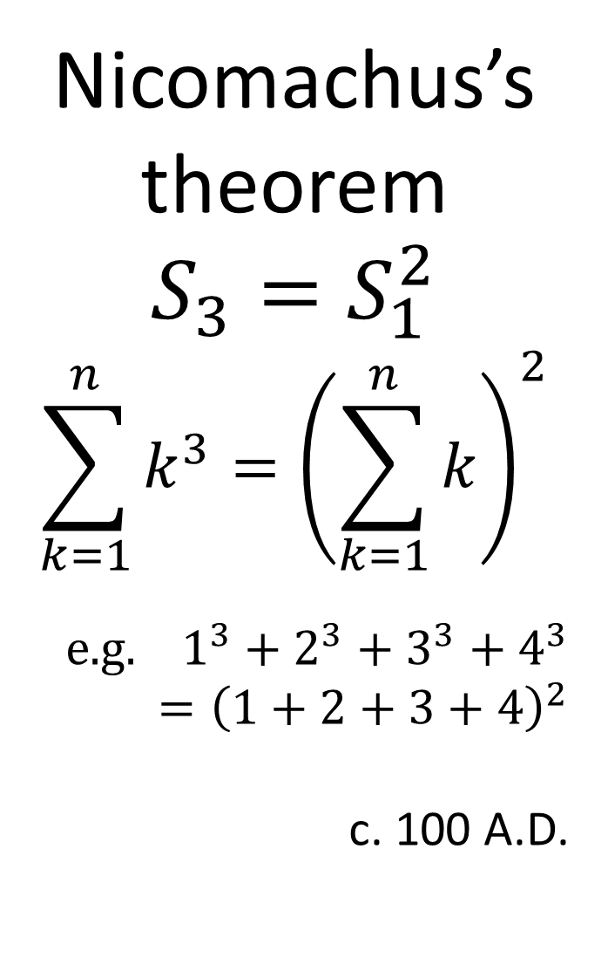
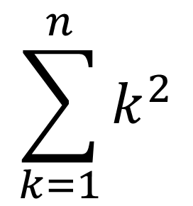
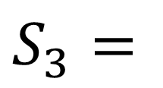
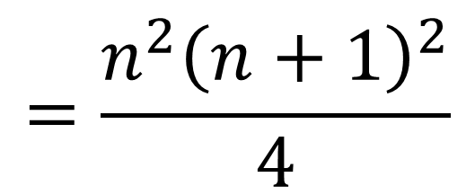
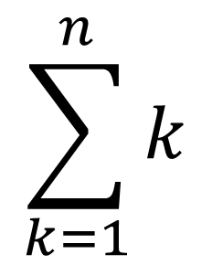
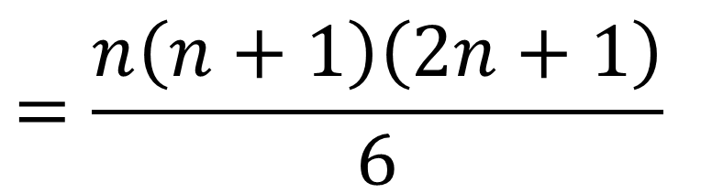
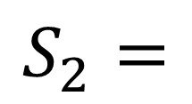
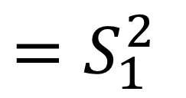
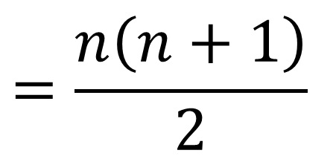
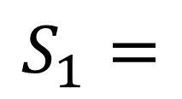
$$\sum_{k=1}^{n}{k}$$
$$=\frac{n\left(n+1\right)}{2}$$
Sum of natural numbers: triangular numbers
$$S_{1}=$$
Nicomachus’s theorem
$$S_{3}=S_{1}^{2}$$
$$\sum_{k=1}^{n}{k^{3}}={\left(\sum_{k=1}^{n}{k}\right)}^{2}$$
$$\text{e}\text{.}\text{g}\text{. }1^{3}+2^{3}+3^{3}+4^{3}={\left(1+2+3+4\right)}^{2}$$
c. 100 A.D.
$$\sum_{k=1}^{n}{k^{2}}$$
$$=\frac{n\left(n+1\right)\left(2n+1\right)}{6}$$
Sum of squares: square pyramidal numbers
$$S_{2}=$$
$$\sum_{k=1}^{n}{k^{3}}$$
$$=\frac{n^{2}{\left(n+1\right)}^{2}}{4}$$
$$S_{3}=$$
$$=S_{1}^{2}$$
Sum of cubes
Cannonball problem: Are any of S₂ square?
Notes:
Most of you probably know the formula for the sums of the natural numbers.
And many of you may also know the formula for the sums of squares – and maybe the one for cubes.
I’ll introduce some notation here.
Incidentally, the latest Mathsjam Shout (October 2019) asked if any triangular numbers are square. What about square pyramidal ones?
Well clearly all the sums of cubes are square – and this is a famous result, known as Nicomachus’s theorem.

Slide 3
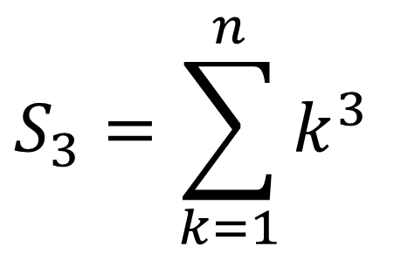
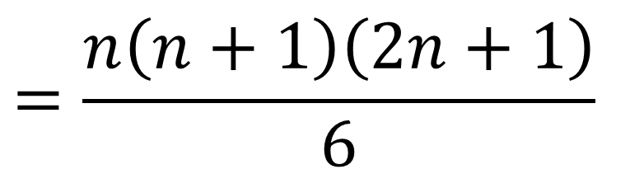
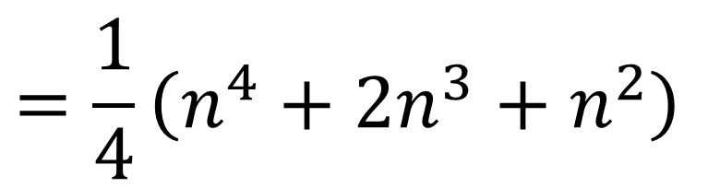
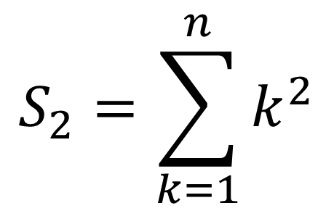
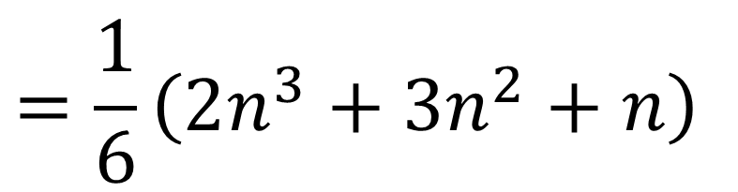
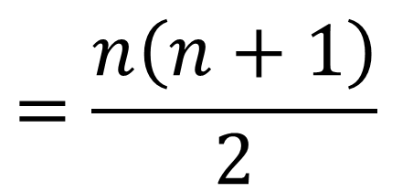
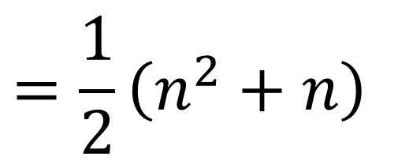
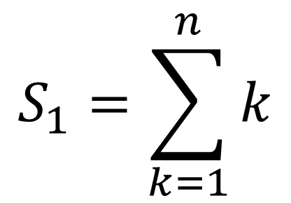
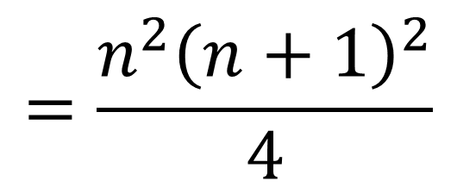
$$S_{1}=\sum_{k=1}^{n}{k}$$
$$=\frac{n\left(n+1\right)}{2}$$
$$=\frac{1}{2}\left(n^{2}+n\right)$$
$$S_{2}=\sum_{k=1}^{n}{k^{2}}$$
$$=\frac{n\left(n+1\right)\left(2n+1\right)}{6}$$
$$=\frac{1}{6}\left(2n^{3}+3n^{2}+n\right)$$
$$S_{3}=\sum_{k=1}^{n}{k^{3}}$$
$$=\frac{n^{2}{\left(n+1\right)}^{2}}{4}$$
$$=\frac{1}{4}\left(n^{4}+2n^{3}+n^{2}\right)$$
How to work out the next one?
Notes:
These are the expansions as polynomials.
The formulae are easy to prove by induction, but how to derive them?

Slide 4
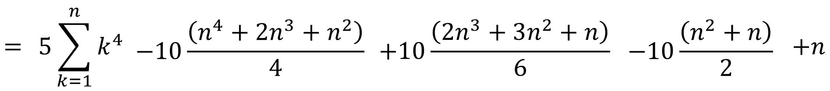
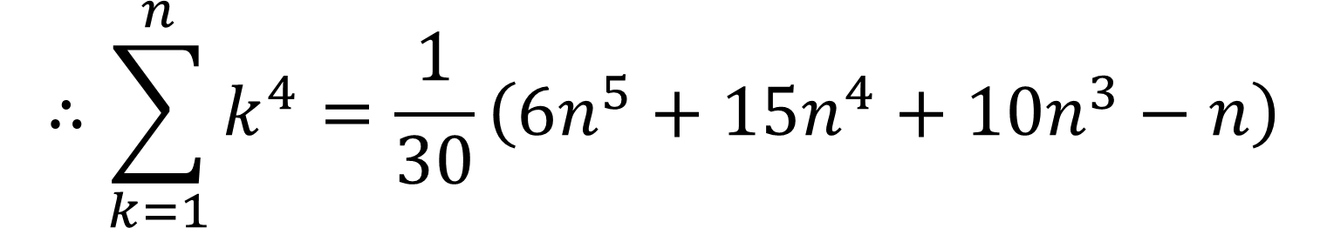
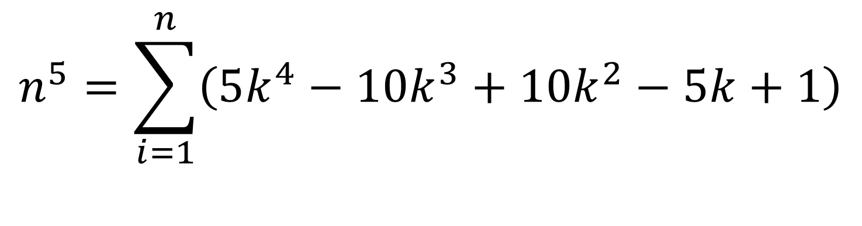
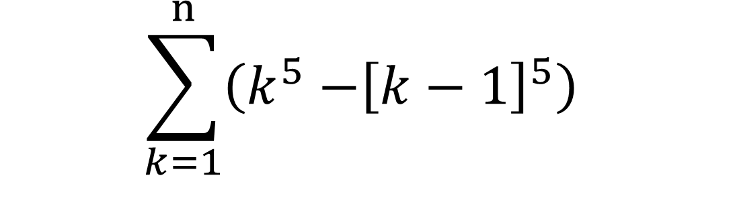
$$\sum_{k=1}^{n}{\left(k^{5}{−\left[k−1\right]}^{5}\right)}$$
Consider
$$\begin{aligned}n^{5}&=\sum_{i=1}^{n}{\left(5k^{4}−10k^{3}+10k^{2}−5k+1\right)} \\ &\end{aligned}$$
$$=$$ | $$5\sum_{k=1}^{n}{k^{4}}$$ | $$−10\frac{\left(n^{4}+2n^{3}+n^{2}\right)}{4}$$ | $$+10\frac{\left(2n^{3}+3n^{2}+n\right)}{6}$$ | $$−10\frac{\left(n^{2}+n\right)}{2}$$ | $$+n$$
$$∴\sum_{k=1}^{n}{k^{4}}=\frac{1}{30}\left(6n^{5}+15n^{4}+10n^{3}−n\right)$$

Slide 5
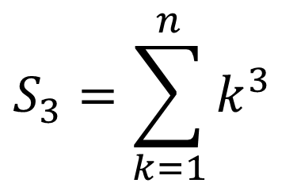
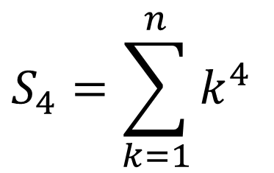
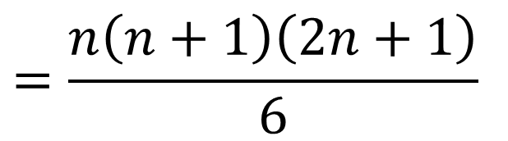
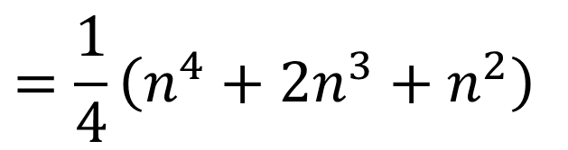
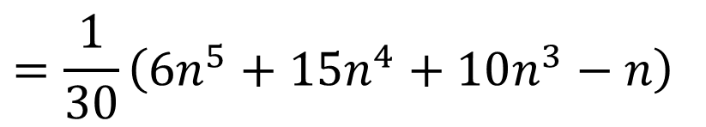
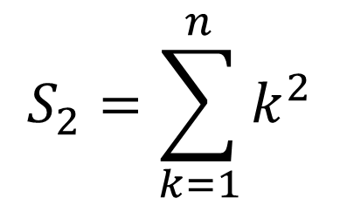
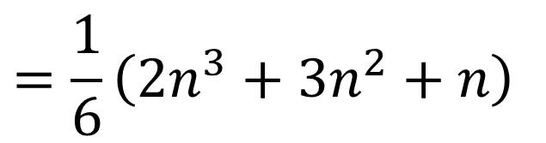
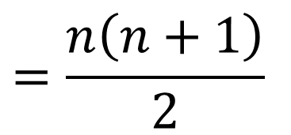
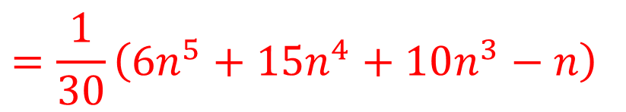
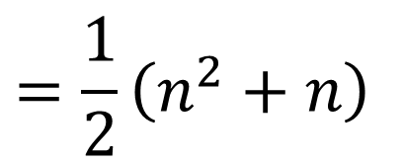
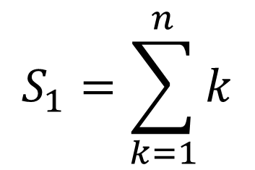
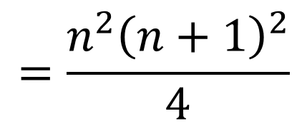
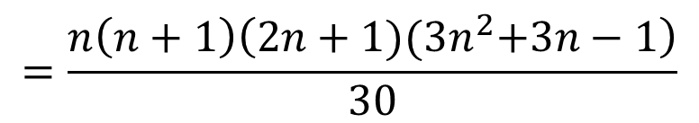
$$S_{1}=\sum_{k=1}^{n}{k}$$
$$=\frac{n\left(n+1\right)}{2}$$
$$=\frac{1}{2}\left(n^{2}+n\right)$$
$$S_{2}=\sum_{k=1}^{n}{k^{2}}$$
$$=\frac{n\left(n+1\right)\left(2n+1\right)}{6}$$
$$=\frac{1}{6}\left(2n^{3}+3n^{2}+n\right)$$
$$S_{3}=\sum_{k=1}^{n}{k^{3}}$$
$$=\frac{n^{2}{\left(n+1\right)}^{2}}{4}$$
$$=\frac{1}{4}\left(n^{4}+2n^{3}+n^{2}\right)$$
$$S_{4}=\sum_{k=1}^{n}{k^{4}}$$
$$=\frac{1}{30}\left({6n}^{5}+15n^{4}+10n^{3}−n\right)$$
$$=\frac{n\left(n+1\right)\left(2n+1){(3n}^{2}+3n−1\right)}{30}$$
$$=\frac{1}{30}\left({6n}^{5}+15n^{4}+10n^{3}−n\right)$$
We can iterate to get subsequent ones.
Notes:
We can iterate, but it’s tedious.

Slide 6
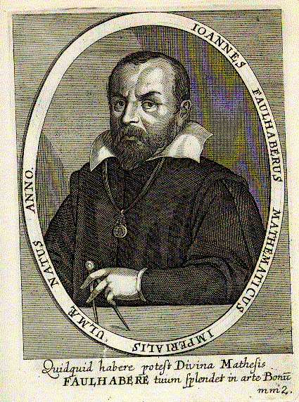
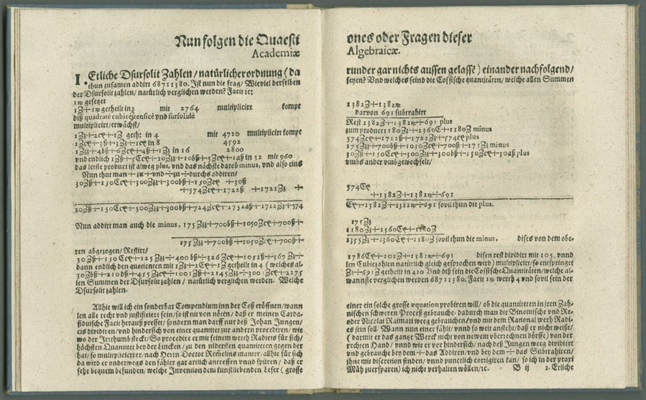
Johann Faulhaber - The Great Arithmetician of Ulm
Academia Algebrae, 1631
$$\sum_{k=1}^{n}{k^{13}}=\frac{1}{420}\left(30n^{14}+210n^{13}+455n^{12}−1001n^{10}+2145n^{8}−3003n^{6}+2275n^{4}−691n^{2}\right)$$
Notes:
Faulhaber diligently worked through this process to get formulae for sums of higher powers – 13th power and in fact beyond.

Slide 7
1
1
1
1
2
1
1
3
3
1
1
4
6
4
1
1
5
10
10
5
1
1
6
15
20
15
6
1
1
7
21
35
35
21
7
1
1
8
28
56
70
56
28
8
1
1
9
36
84
126
126
84
36
9
1
1
10
45
120
210
252
210
120
45
10
1
1
11
55
165
330
462
462
330
165
55
11
1
Notes:
With modern notation, we can write this in a more systematic way.
Start with Pascal’s triangle

Slide 8
1
1
1
1
1
0
0
0
0
0
0
0
0
0
0
0
0
0
0
0
0
0
0
0
0
1
2
1
1
0
0
0
0
0
0
0
0
0
0
0
0
0
0
0
0
0
0
1
3
3
1
1
0
0
0
0
0
0
0
0
0
0
0
0
0
0
0
0
1
4
6
4
1
1
0
0
0
0
0
0
0
0
0
0
0
0
0
0
1
5
10
10
5
1
1
0
0
0
0
0
0
0
0
0
0
0
0
1
6
15
20
15
6
1
1
0
0
0
0
0
0
0
0
0
0
1
7
21
35
35
21
7
1
1
0
0
0
0
0
0
0
0
1
8
28
56
70
56
28
8
1
1
0
0
0
0
0
0
1
9
36
84
126
126
84
36
9
1
1
0
0
0
0
1
10
45
120
210
252
210
120
45
10
1
1
0
0
1
1
11
55
165
330
462
462
330
165
55
11
1
Notes:
Remove the 1’s on the right hand edge.
Fill in zeros to make a lower triangular square matrix.

Slide 9
1
0
0
0
0
0
0
0
0
0
0
1
-1
-1
2
0
0
0
0
0
0
0
0
0
1
3
-3
-3
3
0
0
0
0
0
0
0
0
1
-1
-1
4
6
-6
-6
4
0
0
0
0
0
0
0
1
5
-5
-5
10
10
-10
-10
5
0
0
0
0
0
0
1
-1
-1
6
15
-15
-15
20
15
-15
-15
6
0
0
0
0
0
1
7
-7
-7
21
35
-35
-35
35
21
-21
-21
7
0
0
0
0
1
-1
-1
8
28
-28
-28
56
56
56
70
56
28
-28
-28
8
0
0
0
1
9
-9
-9
36
84
-84
-84
126
126
-126
-126
84
36
-36
-36
9
0
0
1
-1
-1
10
45
-45
-45
120
210
-210
-210
252
210
-210
-210
120
45
-45
-45
10
0
1
11
-11
-11
55
165
-165
-165
330
462
-462
-462
462
330
-330
-330
165
55
-55
-55
11
Notes:
Negate alternate elements.

Slide 10
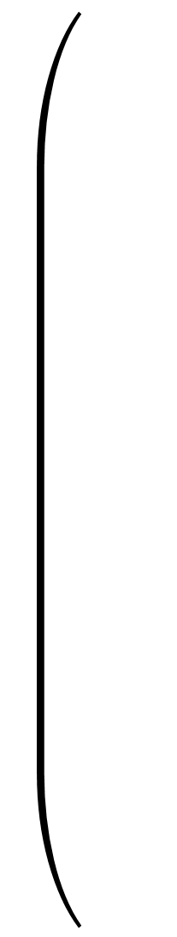
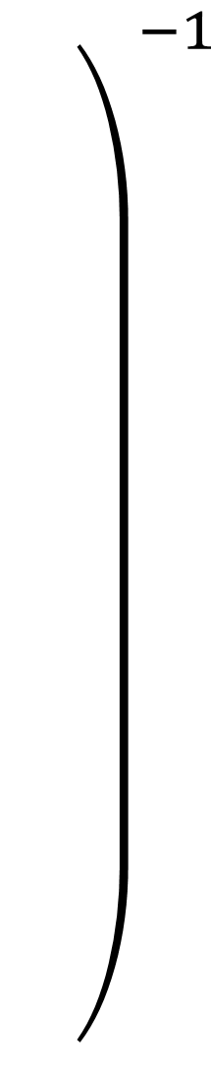
$${\left.\begin{matrix} \\ \\ \\ \\ \\ \\ \\ \\ \\ \\ \end{matrix}\right)}^{−1}$$
1
0
0
0
0
0
0
0
0
0
0
-1
2
0
0
0
0
0
0
0
0
0
1
-3
3
0
0
0
0
0
0
0
0
-1
4
-6
4
0
0
0
0
0
0
0
1
-5
10
-10
5
0
0
0
0
0
0
-1
6
-15
20
-15
6
0
0
0
0
0
1
-7
21
-35
35
-21
7
0
0
0
0
-1
8
-28
56
-70
56
-28
8
0
0
0
1
-9
36
-84
126
-126
84
-36
9
0
0
-1
10
-45
120
-210
252
-210
120
-45
10
0
1
-11
55
-165
330
-462
462
-330
165
-55
11
Notes:
Invert the matrix.
It’s a lower triangular matrix, so fairly easy to do, although nowadays of course we get a computer to do the work.

Slide 11
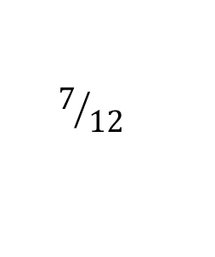
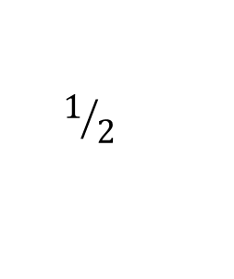
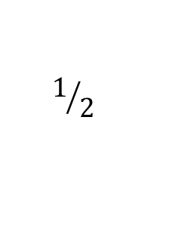
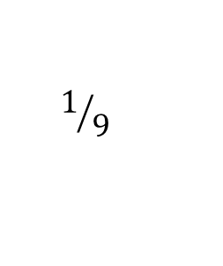
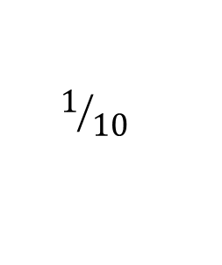
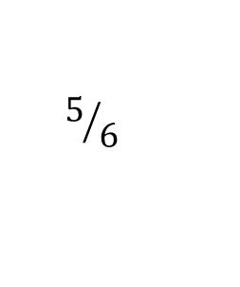
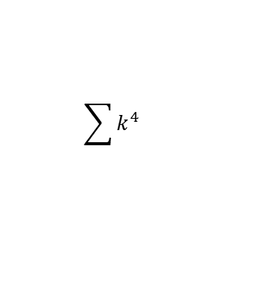
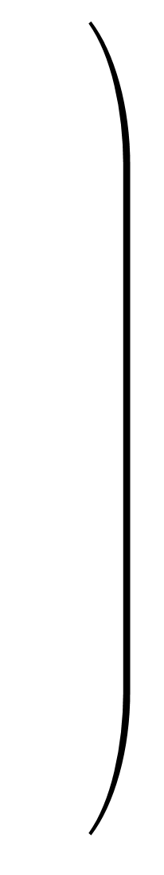

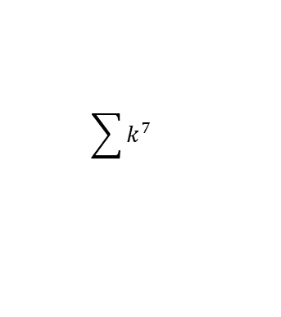





















































$$\left(\begin{matrix} \\ \\ \\ \\ \\ \\ \\ \\ \\ \\ \end{matrix}\right)=$$
$$\sum{1}$$
1
0
0
0
0
0
0
0
0
0
0
n
$$\sum{k}$$
$$1/2$$
$$1/2$$
0
0
0
0
0
0
0
0
0
n²
$$\sum{k^{2}}$$
$$1/6$$
$$1/2$$
$$1/3$$
0
0
0
0
0
0
0
0
n³
$$\sum{k^{3}}$$
$$0$$
$$1/4$$
$$1/2$$
$$1/4$$
0
0
0
0
0
0
0
n⁴
$$\sum{k^{4}}$$
$${−1}/{30}$$
0
$$1/3$$
$$1/2$$
$$1/5$$
0
0
0
0
0
0
n⁵
$$\sum{k^{5}}$$
0
$${−1}/{12}$$
0
$$5/{12}$$
$$1/2$$
$$1/6$$
0
0
0
0
0
n⁶
$$\sum{k^{6}}$$
$$1/{42}$$
0
$${−1}/6$$
0
$$1/2$$
$$1/2$$
$$1/7$$
0
0
0
0
n⁷
$$\sum{k^{7}}$$
0
$$1/{12}$$
0
$${−7}/{24}$$
0
$$7/{12}$$
$$1/2$$
$$1/8$$
0
0
0
n⁸
$$\sum{k^{8}}$$
$${−1}/{30}$$
0
$$2/9$$
0
$${−7}/{15}$$
0
$$2/3$$
$$1/2$$
$$1/9$$
0
0
n⁹
$$\sum{k^{9}}$$
0
$${−3}/{20}$$
0
$$1/2$$
$$0$$
$${−7}/{10}$$
$$0$$
$$3/4$$
$$1/2$$
$$1/{10}$$
0
n¹⁰
$$\sum{k^{10}}$$
$$5/{66}$$
0
$${−1}/2$$
0
$$1$$
0
$$−1$$
0
$$5/6$$
$$1/2$$
$$1/{11}$$
n¹¹
Notes:
…and that gives you the formulae for sums of powers.
Each row gives the formula for sums of a given power.

Slide 12




Jakob Bernoulli
Ars Conjectandi, 1713
${−3}/{20}$nn
Bernoulli numbers
Notes:
But what’s the pattern behind the coefficients?
Jakob Bernoulli knew of Faulhaber’s work (he made a mistake, but we’ll forgive him). 82 years later, he found a pattern.
Factoring out binomial coefficients, you get the Bernoulli numbers.

Slide 13


$$\sum_{i=1}^{n}{i}$$ | $$=\frac{n\left(n+1\right)}{2}$$ | $$=\frac{1}{2}\left(n^{2}+n\right)$$
$$\sum_{i=1}^{n}{i^{2}}$$ | $$=\frac{n\left(n+1\right)\left(2n+1\right)}{6}$$ | $$=\frac{1}{6}\left(2n^{3}+3n^{2}+n\right)$$
$$\sum_{i=1}^{n}{i^{3}}$$ | $$=\frac{n^{2}{\left(n+1\right)}^{2}}{4}$$ | $$=\frac{1}{4}\left(n^{4}+2n^{3}+n^{2}\right)$$
$$\sum_{i=1}^{n}{i^{4}}$$ | $$=\frac{n(n+1)(n^{2}+n+1)}{30}$$ | $$=\frac{1}{30}\left(6n^{5}+15n^{4}+10n^{3}−n\right)$$
 | …
$$=\frac{1}{2}\left(n^{2}+\frac{1}{2}\left(\begin{matrix}2 \\ 1\end{matrix}\right)n\right)$$
$$=\frac{1}{3}\left(n^{3}+\frac{1}{2}\left(\begin{matrix}3 \\ 1\end{matrix}\right)n^{2}+\frac{1}{6}\left(\begin{matrix}3 \\ 2\end{matrix}\right)n\right)$$
$$=\frac{1}{4}\left(n^{4}+\frac{1}{2}\left(\begin{matrix}4 \\ 1\end{matrix}\right)n^{3}+\frac{1}{6}\left(\begin{matrix}4 \\ 2\end{matrix}\right)n^{2}+0\left(\begin{matrix}4 \\ 3\end{matrix}\right)n\right)$$
$$=\frac{1}{5}\left(n^{5}+\frac{1}{2}\left(\begin{matrix}5 \\ 1\end{matrix}\right)n^{3}+\frac{1}{6}\left(\begin{matrix}5 \\ 2\end{matrix}\right)n^{3}+0\left(\begin{matrix}5 \\ 3\end{matrix}\right)n^{2}−\frac{1}{30}\left(\begin{matrix}5 \\ 4\end{matrix}\right)n\right)$$
$$\sum_{i=1}^{n}{i^{k}}$$ | $$=\frac{1}{k}\left(n^{k}+\frac{1}{2}\left(\begin{matrix}k \\ 1\end{matrix}\right)n^{k−1}+\frac{1}{6}\left(\begin{matrix}k \\ 2\end{matrix}\right)n^{k−2}+0\left(\begin{matrix}k \\ 3\end{matrix}\right)n^{k−3}−\frac{1}{30}\left(\begin{matrix}k \\ 4\end{matrix}\right)n^{k−4}+0\left(\begin{matrix}k \\ 5\end{matrix}\right)n^{k−5}+…\right)$$
Bernoulli numbers: $1, \frac{1}{2},\frac{1}{6},0,\frac{−1}{30},0,\frac{1}{42},0,\frac{−1}{30},0,\frac{5}{66},0,\frac{−691}{2730},0,\frac{7}{6},0,\frac{−3617}{510},…$
Notes:
These are the Bernoulli numbers. Learn these and you can work out sums of powers.
But that still seems arbitrary, so where do these coefficients come from?

Slide 14

How can we calculate the Bernoulli numbers?
“I am doggedly attacking and sifting to the very bottom, all the ways of deducing the Bernoulli Numbers.”
Ada Lovelace,
5 July 1843
$$B_{8}=\frac{\left|\begin{matrix}1 & 2 & 0 & 0 & 0 & 0 & 0 & 0 \\ 1 & 3 & 3 & 0 & 0 & 0 & 0 & 0 \\ 1 & 4 & 6 & 4 & 0 & 0 & 0 & 0 \\ 1 & 5 & 10 & 10 & 5 & 0 & 0 & 0 \\ 1 & 6 & 15 & 20 & 15 & 6 & 0 & 0 \\ 1 & 7 & 21 & 35 & 35 & 21 & 7 & 0 \\ 1 & 8 & 28 & 56 & 70 & 56 & 28 & 8 \\ 1 & 9 & 36 & 84 & 126 & 126 & 84 & 36\end{matrix}\right|}{9!}=\frac{−1}{30}$$
Pascal’s triangle again
Notes:
Ada Lovelace wrestled with this problem.
You can work them out from determinants of matrices containing Pascal’s triangle. This is the one Ada’s first programme was intended to calculate, although this isn’t explicitly the method she was using. She was deriving it from earlier ones.
Either way, an Analytical Engine is handy.

Slide 15













Factorised
$$S_{1}=\frac{1}{2}n\left(n+1\right)$$
$$S_{2}=\frac{1}{6}n\left(n+1\right)\left(2n+1\right)$$
$$S_{2}=\frac{1}{6}n\left(n+1\right)\left(2n+1\right)$$
Faulhaber’s theorem:
Sums of odd powers are polynomials in S₁.
$$S_{3}=\frac{1}{4}n^{2}{\left(n+1\right)}^{2}$$
$$=S_{1}^{2}$$
$$S_{4}=\frac{1}{30}n\left(n+1\right)(2n+1)\left(3n^{2}+3n−1\right)$$
$$S_{4}=\frac{1}{30}n\left(n+1\right)(2n+1)\left(3n^{2}+3n−1\right)$$
$$S_{5}=\frac{1}{12}n^{2}{\left(n+1\right)}^{2}\left(2n^{2}+2n−1\right)$$
$$=\frac{1}{3}\left(4S_{1}^{3}−S_{1}^{2}\right)$$
$$S_{6}=\frac{1}{42}n\left(n+1\right)(2n+1)\left(3n^{4}+6n^{3}−3n+1\right)$$
$$S_{6}=\frac{1}{42}n\left(n+1\right)(2n+1)\left(3n^{4}+6n^{3}−3n+1\right)$$
$$S_{7}=\frac{1}{24}n^{2}{\left(n+1\right)}^{2}\left(3n^{4}+6n^{3}−n^{2}−4n+2\right)$$
$$=\frac{1}{3}\left(6S_{1}^{4}−4S_{1}^{3}+S_{1}^{2}\right)$$
$$S_{8}=\frac{1}{90}n\left(n+1\right)\left(2n+1\right)\left(5n^{6}+15n^{5}+5n^{4}−15n^{3}−n^{2}+9n−3\right)$$
$$S_{8}=\frac{1}{90}n\left(n+1\right)\left(2n+1\right)\left(5n^{6}+15n^{5}+5n^{4}−15n^{3}−n^{2}+9n−3\right)$$
Notes:
These are the factorisations (thanks to Mathematica). Not sure of the pattern.
Faulhaber identified that the sums of odd powers are polynomials in the triangular numbers.
…and it looks to me as if the sums of even powers have a factor of S₂, but I haven’t proved it.

Slide 16


Some nice relationships
$$S_{3}=S_{1}^{2}$$
Nicomachus’s theorem
$$S_{5}+S_{7}=2S_{1}^{4}$$
Notes:
So we’ve seen the first one before. It’s hard to beat that, but there are a few others.
I like this one.

Slide 17
References
Mathologer, Youtube, Power sum masterclass: How to sum quadrillions of powers…by hand! (Euler Maclaurin formula) https://www.youtube.com/watch?v=fw1kRz83Fj0
Faulhaber’s formula, Wikipedia https://en.wikipedia.org/wiki/Faulhaber%27s_formula
Bernd Kellner and Jonathan Sondow (2017), Power-sum denominators https://arxiv.org/pdf/1705.03857.pdf
Nigel Derby (2015) A search for sums of powers, Mathematical Gazette 99(546), 416-421 https://www.researchgate.net/publication/304207815_A_search_for_sums_of_powers
A.F. Beardon (1996) Sums of powers of integers, The American Mathematical Monthly, March, 201-213 https://www.maa.org/sites/default/files/images/images/upload_library/22/2975368.pdf.bannered.pdf
Generalising the sum of consecutive cubes to other odd powers, Stack Exchange https://math.stackexchange.com/questions/549823/generalizing-the-sum-of-consecutive-cubes-sum-k-1n-k3-big-sum-k-1n
Notes:
The Mathologer one, annoyingly, was posted just 3 days after I submitted this topic for my talk – but it’s really good, and goes into more detail than I can do in 5 minutes.

