Slide 1
A problem of proportion
Rachel Wright
MathsJam 2019

Slide 2
Twisted Yarn Structure
Fasciated Yarn Structure
Continuous effect
Intermittent effect

Slide 3
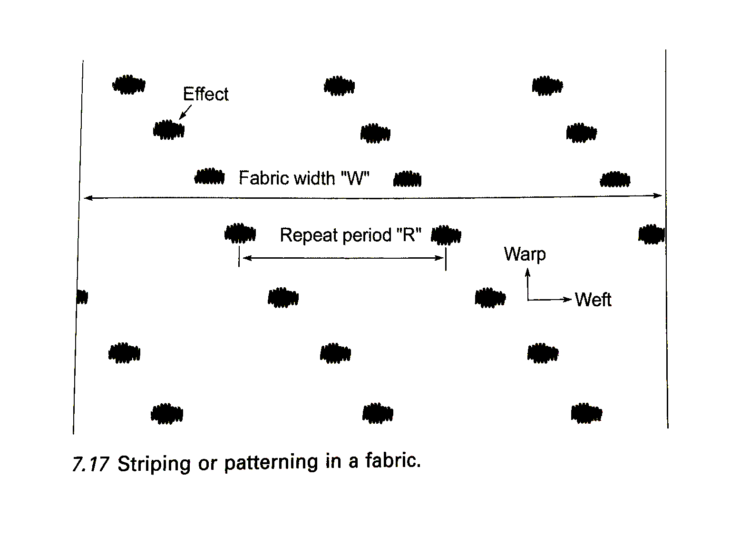

Slide 4
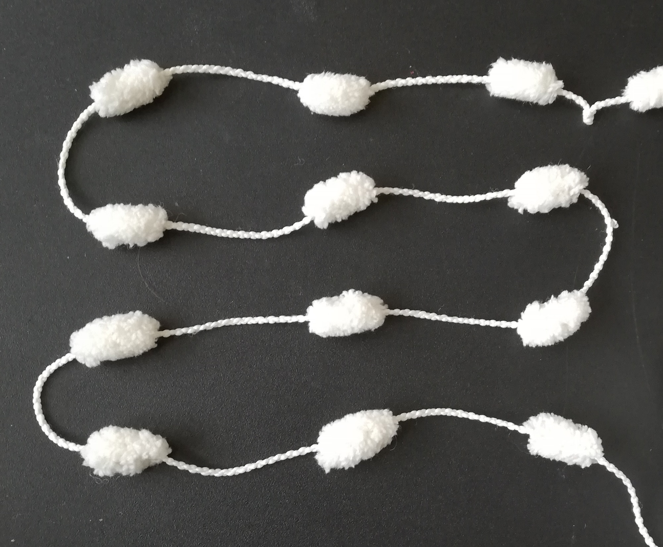

Slide 5
